Slide 1

Metropolitan Washington
Air Quality Status
Greenhouse Gas - Multi-sector Working Group
Metropolitan Washington Council of Governments
September 19, 2016

Slide 2

Outline
About COG
Clean Air Act Amendments
Washington Region Status
MWAQC
Organizational Structure
Metro Region and MWAQC’s Role
Ozone
Fine Particles
Transportation Conformity
Progress, Challenges, Outlook
Forecast & Data Sources

Slide 3
COG, MWAQC & Air Quality Planning Area
Metropolitan Washington Council of Governments (COG), an independent, nonprofit association, brings area leaders together to address major regional issues in the District of Columbia, suburban Maryland, and Northern Virginia
COG, through the Metropolitan Washington Air Quality Committee (MWAQC), coordinates regional air quality planning activities, reviews policies, resolves policy differences, and adopts air quality plans for transmittal to the District of Columbia, Maryland, and Virginia for submittal to EPA
MWAQC members include area elected officials, environmental directors, and state air management and transportation officials.

Slide 4
Clean Air Act Amendments 1990
Regulates emission of air pollutants from human sources into the atmosphere
Classifies areas that do not meet the federal health standard as nonattainment areas
Nonattainment areas are further classified as Marginal, Moderate, Serious, Severe, and Extreme depending on the level of air pollution
Establishes process for reducing pollution to meet standards

Slide 5
Federal Health-Based Air Quality Standards
SO₂
Sulfur Dioxide
NO₂
Nitrogen Dioxide
Pb
Lead
PM₁₀
Particulate
Matter
PM_{2.5}
Fine Particulate
Matter
CO
Carbon Monoxide
O₃
Ozone
Authority: Clean Air Act Amendments of 1990

Slide 6
Washington Region Status
Ozone
  1991 Designated a “serious” ozone nonattainment area
  2003 Reclassified as “severe” for 1-hr standard
  2004 Reclassified as “moderate” for 1997 8-hr standard (84 ppb)
  2012 Reclassified as “marginal” for current 2008 8-hr standard (75 ppb)
  2015 Data shows that the region is meeting the 2008 8-hr ozone standard
  2015 New 8-hour ozone standard (70 ppb) : 2014-16 design value (draft) at 71 ppb
  2017 Maintenance plan and redesignation request to be submitted to EPA
PM_{2.5}
  2004 Designated as nonattainment area for 1997 annual standard 15 µg/m³
  2005 Data shows meeting the 1997 standard
  2014 Reclassified as “attainment”, Maintenance Plan approved
  2016 EPA revokes 1997 annual standard 15 µg/m³
CO
  1996 Classified as a “maintenance area”

Slide 7
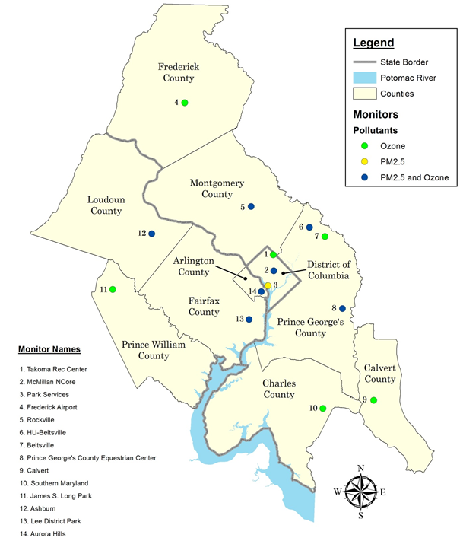
Air Quality (Ozone & PM_{2.5}) Monitors
Ashburn
River Terrace
Haines Point
Arlington

Slide 8
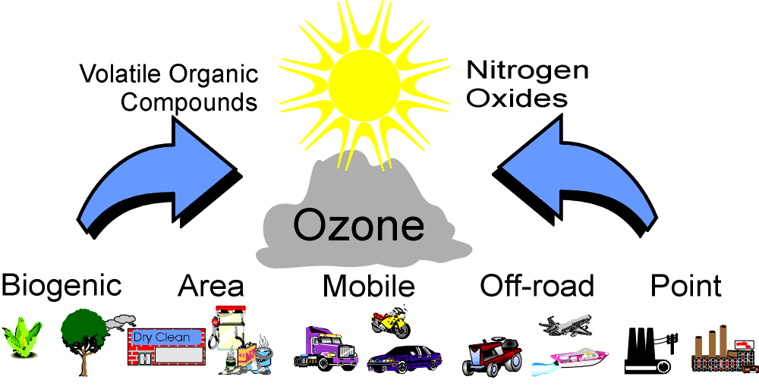
How is Ground-Level Ozone Formed?

Slide 9
Ozone Pollution Health Effects
Repertory System Effects
  Asthma attacks
  Respiratory symptoms (cough, wheezing, etc.)
  Decreased lung function
  Airway inflammation

Slide 10
Washington Region’s Ozone Plans
1997 Ozone Standard: 84 ppb
Washington region (Moderate NAA) submitted State Implementation Plan (SIP) to EPA in 2007, approved in 2015
Contained Federal, State and local control measures to reduce ozone pollution
Demonstrated region will attain health standard in 2009
EPA issued Clean Data Determination in 2011
2008 Ozone Standard: 75 ppb
Washington region (Marginal NAA), did not need to submit a SIP, but a base year inventory (2011) required by July 2014
Data shows compliance with the standard in 2015

Slide 11
Ozone Standards - Timelines
Wash DC-MD-VA Marginal Nonattainment Area
Attainment date extended for 75 ppb Standard/Washington region attains
Final Ozone Standard Designation (EPA)
New Ozone Standard: 75 PPB
Deadline to attain 75 ppb Standard/New Ozone Standard (70 ppb)
2008 Ozone Standard Designation Recommendations (States)
Ozone Standard: 84 PPB
Attainment Dates (2020 –Marginal NAA)
Ozone SIP Submitted
1997
2007
2008
2012
2015
2016
2017
2018
2020-37
Region draft “design value” for 2014-2016 is 71 ppb, (Marginal nonattainment level)

Slide 12
2015 Ozone Standard : 70 ppb
Milestone | Dates
Final Rule Announced | October 1, 2015
State Designation Recommendations to EPA | October 1, 2016
EPA Response to State Designation Recommendations | June 1, 2017
Final Designations | October 1, 2017 (Likely based on 2014-16 data)
Attainment Demonstration SIPs Due | 2020/2021 (for Moderate and above)
Attainment Dates | 2020-2037 (depends on level of nonattainment designation) Marginal = October 1, 2020
Notes:
Clean Data started 2008 (2008-2010).

Slide 13
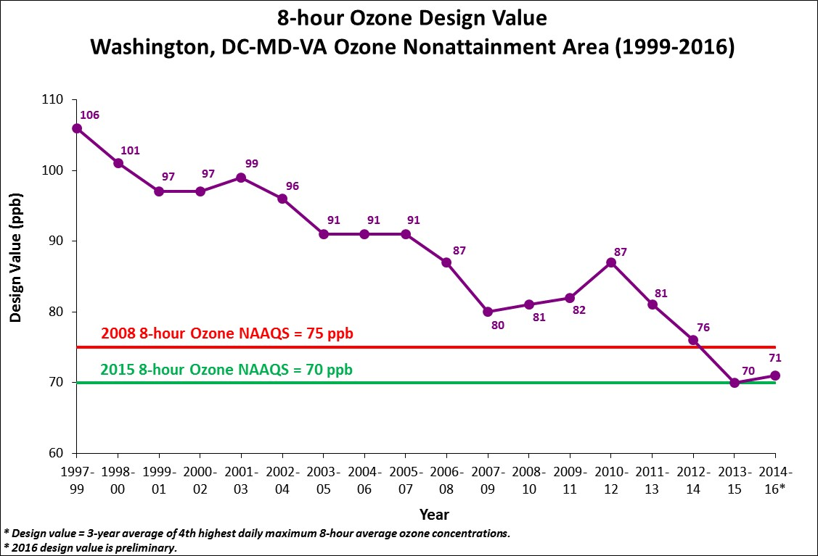
Washington Region’s Ozone Data & Standards
Notes:
Clean Data started 2008 (2008-2010).

Slide 14
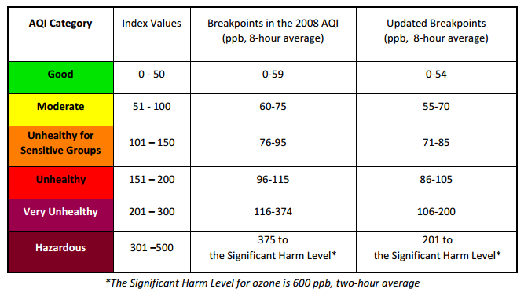
Air Quality Index (AQI) – 2008 & 2015 Ozone Standards

Slide 15
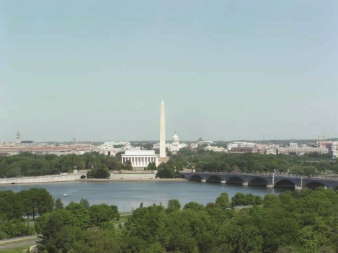
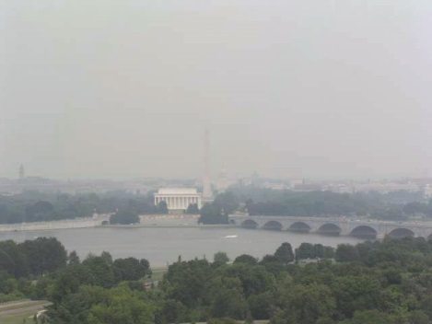
Air Pollution: Fine Particles
Chemical, particulate matter or aerosol that modifies the natural characteristics of the atmosphere
Created locally by emissions from coal combustion, cars & trucks, road construction
Causes respiratory problems
Impairs visibility

Slide 16
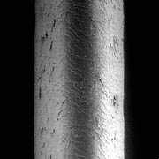
How Fine is Fine?
Particles are only a fraction of the size of a human hair
PM₁₀
(10µm)
PM_{2.5}
(2.5 µm)
Hair cross section (70 mm)
Human Hair (70 µm diameter)

Slide 17
Fine Particulate Pollution Health Effects
Respiratory System Effects
Cardiovascular System Effects
Chronic bronchitis
Asthma attacks
Respiratory symptoms (cough, wheezing, etc.)
Decreased lung function
Airway inflammation
Heart attack
Cardiac arrhythmia
Changes in heart rate and heart rate variability
Premature death

Slide 18
Plans to Reduce Fine Particles
Point Source
  NO_{X} SIP Call
  Clean Air Interstate Rule (CAIR) - VA & DC
  Maryland Healthy Air Act - MD
  Utility Reductions (Possum Point Fuel Conversion) -VA
Area Source
  National Locomotives Rule
Nonroad Source
  2004 Nonroad Heavy Duty Diesel Rule
Onroad Source
  Heavy-Duty Diesel Engine Rule
  Tier 2 Motor Vehicle Emission Standards
  Vehicle Inspection Program
Supplemental Measures:
  Telecommuting Initiative
  Tree Canopy Programs
  Wind Energy Purchases
  Energy Efficiency in buildings
  LED Traffic Signal Retrofits
  Renewable Portfolio Standards

Slide 19
Status of PM_{2.5} Planning
EPA releases daily (65 ug/m3) & annual standard (15 ug/m3) in 1997
Washington region designated as Nonattainment for annual standard in April 2005, submits SIP in 2008
Data shows compliance starting 2005, region submits request (and a maintenance plan) to redesignate the region to attainment in 2013, EPA approves request and MP in 2014
EPA revokes the standard in 2016, no transportation conformity required, states still need to keep implementing control measures in MP and regulating any new or upcoming major industries
EPA releases new daily standard in 2006 – 35 ug/m3
EPA releases new annual standard in 2012 – 12 ug/m3
Monitoring shows the region is in compliance for both standards, no planning requirements are needed for either standard

Slide 20
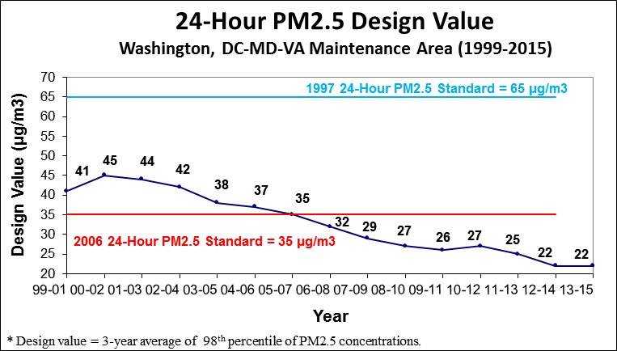
Metropolitan Washington PM2.5 Design Values

Slide 21
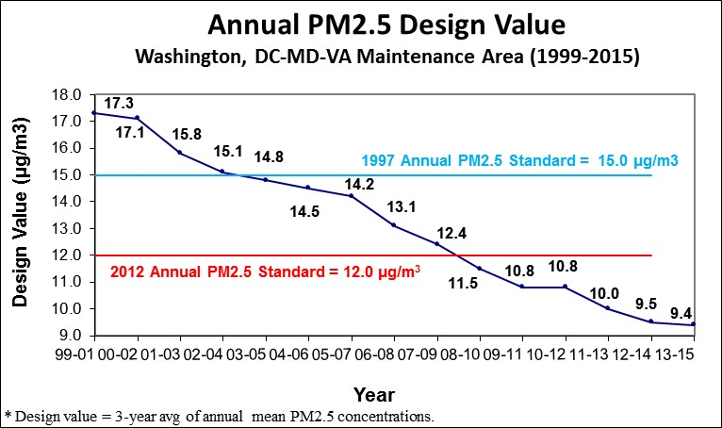
Metropolitan Washington PM2.5 Design Values

Slide 22
Transportation Conformity
Clean Air Act Amendments of 1977 included a provision requiring transportation investments to be consistent with (conform to) regional air quality plans

Slide 23
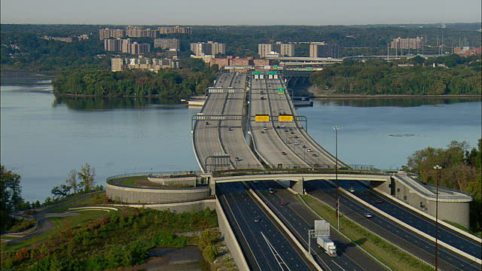
What is Transportation Conformity?
Conformity ensures that Federal funding and approval are given to transportation activities that are consistent with air quality goals
Ensures that these transportation activities do not worsen air quality or interfere with the "purpose" of the SIP

Slide 24
Summary of Recent Progress
2014 – The region designated as attainment for 1997 annual PM2.5 standard; also complies with 2006 daily & 2012 annual PM2.5 standards
2015 – The region met CO NAAQS for 20 years; Transportation conformity no longer required
2015 – Achieved compliance with 2008 ozone NAAQS, region working on developing a request to EPA to redesignate it as an attainment area, will also propose motor vehicle emissions limits (mobile budgets) for transportation conformity purposes
2016 - EPA revoked 1997 Annual PM2.5 standard; Transportation conformity no longer required
2016 - The region did not record any Code Red day yet
  One code red day in 2015 (assuming current ozone standard was in place); 24 code red days & 5 code purple days in 1997
  Draft data shows the region is yet to meet the new ozone standard (70 ppb)

Slide 25
Regional Air Quality Challenges
Attainment of 2015 Ozone NAAQS will require continued emission reductions
Near-road monitoring for NO_{2,} PM_{2.5}
Clean Power Plan (Greenhouse gas reduction goals for existing power plants)

Slide 26
2017 Outlook
2015 Ozone Standard Compliance
2008 Ozone Standard Maintenance Plan
Climate, Energy and Air Survey Results
Transportation Conformity
Multi-Sector greenhouse gas emission reduction effort – What We Can Do study & report

Slide 27
Sources for Air Quality Forecasts and Data & Other Resources
  COG: https://www.mwcog.org/environment/planning-areas/air-quality/
  Virginia Dept. of Environmental Quality: www.deq.virginia.gov/Programs/Air.aspx
  Maryland Dept. of the Environment: www.mde.state.md.us/Air
  EPA Air Quality data maps and forecasts: www.epa.gov/airnow
  Clean Air Partners: www.cleanairpartners.net
  Ozone Transport Commission: www.otcair.org/
  EPA (Home page): www.epa.gov
  EPA Region 3: www.epa.gov/aboutepa/epa-region-3-mid-atlantic
  EPA AQ Planning & Standards: www3.epa.gov/airquality/
  EPA Office of Transportation & Air Quality: www.epa.gov/otaq

Slide 28
Sources for Air Quality Forecasts and Data
  Organizations
    Clean Air Partners: www.cleanairpartners.net
    Ozone Transport Commission: www.otcair.org/
    EPA (Home page): www.epa.gov
    EPA Region 3: www.epa.gov/aboutepa/epa-region-3-mid-atlantic
    EPA AQ Planning & Standards: www3.epa.gov/airquality/
    EPA Office of Transportation & Air Quality: www.epa.gov/otaq

Slide 29

www.mwcog.org

