Slide 1
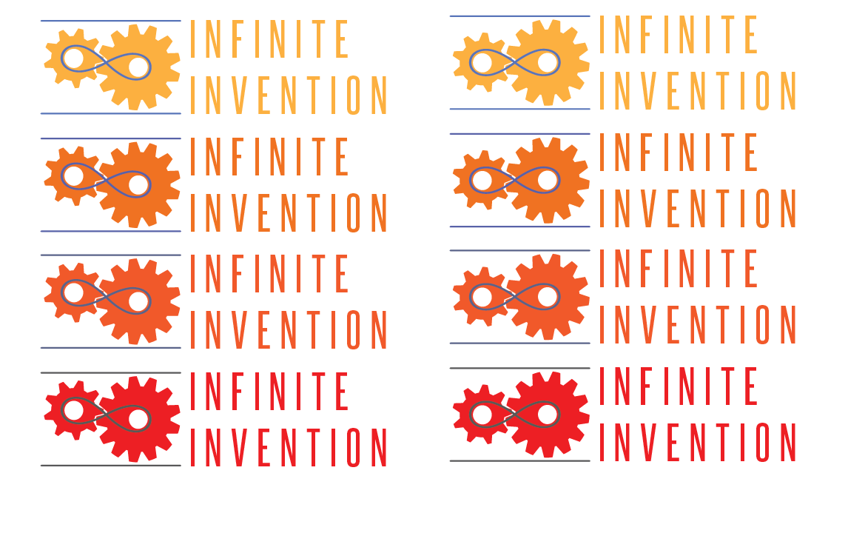
ConnectDER Product Overview
MWCOG – BEEAC Meeting
7/17/14

Slide 2
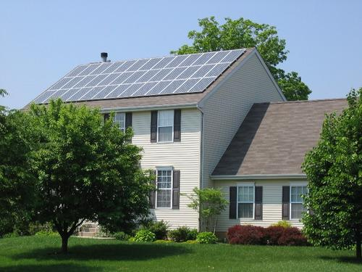
A Home Goes Solar Every 4 Minutes
Notes:
And that rate is projected to increase to every 83 seconds by 2016. But there are some fundamental problems the solar industry is facing – today I’m going to tell you about our technology is going to solve those problems and unlock huge new value for the industry.

Slide 3
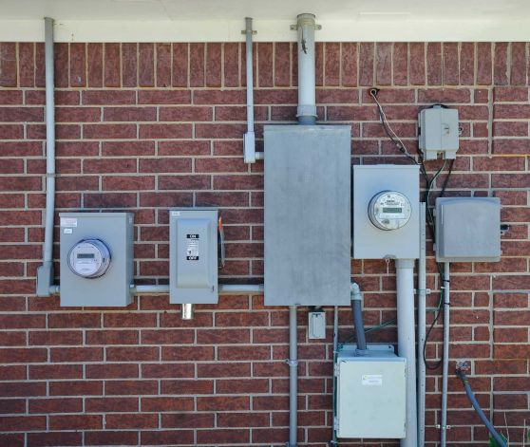
Wiring Can Be Complicated
Equipment + Labor = $800 5% of cost
Notes:
According to the Rocky Mountain Institute, one of the biggest opportunities for cost reductions is wiring connections into the home.
Now there may seem like unrelated problems, but push those two problems together in a solution and you get a killer app.
Electrician 5 hours @ $80/hour (inc travel) * 1.25 for 1 in 4 rewiring issues = $500
Equipment and materials = $300

Slide 4
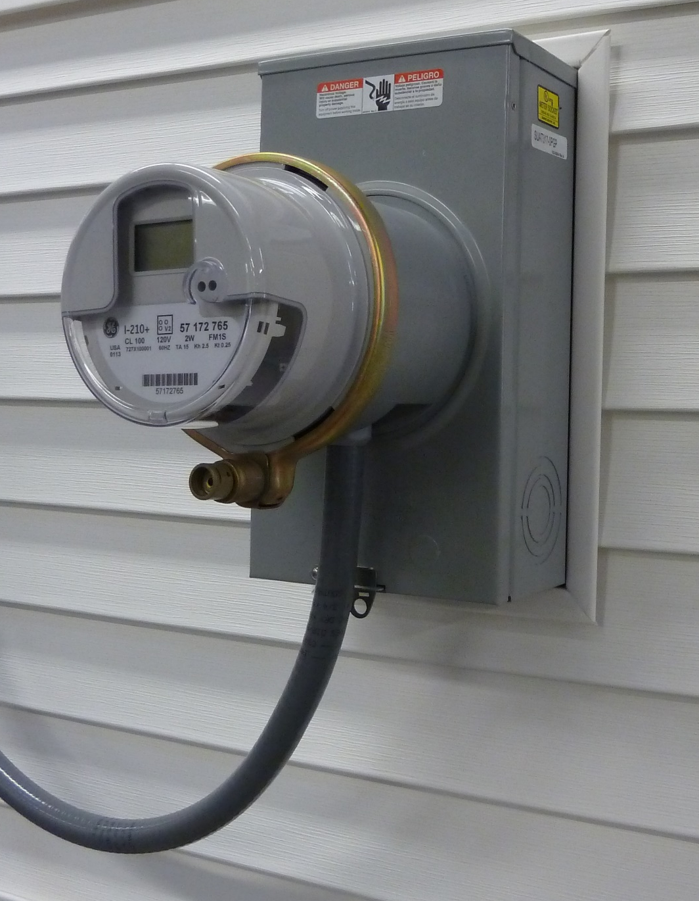
The ConnectDER
(xDER)
“Plug-and-play” solar via meter case
Integration and revenue models for utilities
Key installation costs eliminated
Notes:
Meet the Connect-DER or “connector” for short – DER stands for Distributed Energy Resources like solar power and electric vehicles.
Our patent pending product allows quick installation of DERs by creating a grid connection point behind an standard electric power meter.
Utilities buy it to create a universal point of connection and metering for solar that they control.
Better yet, they can build new business offerings around it while saving customers money to go solar.

Slide 5
Power grid
Solar panels
cellular
wifi
zigbee
AMI
Cloud
Reporting
& controls
Inverter
ConnectDER
API
Home

Slide 6
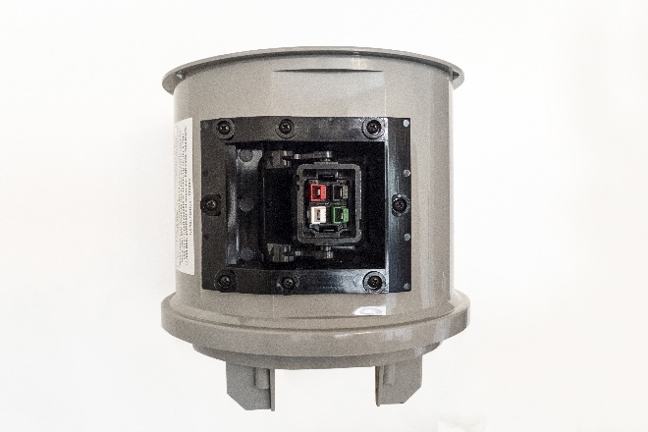
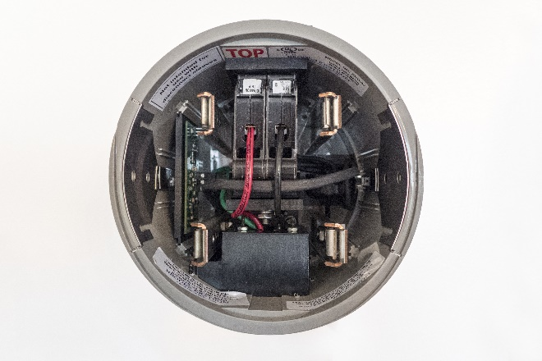
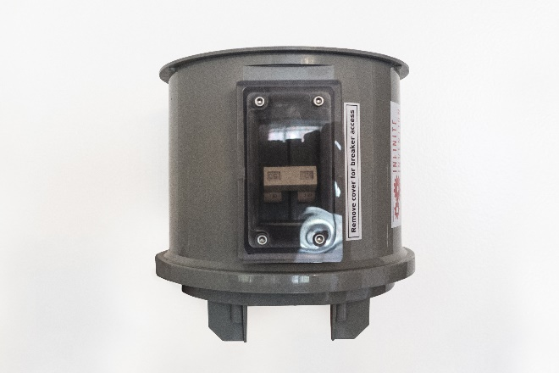
Hardware
Connector
Metering
Circuit Breaker
Notes:
Here’s a closer look at the technology… it may not look like much, but there’s a lot of magic in this little box.
It’s got a point to plug-in on the base, a circuit breaker for protection on the top, and a meter and communications system inside.
That’s metering with the same certified accuracy as your standard house meter, only for the solar energy.

Slide 7
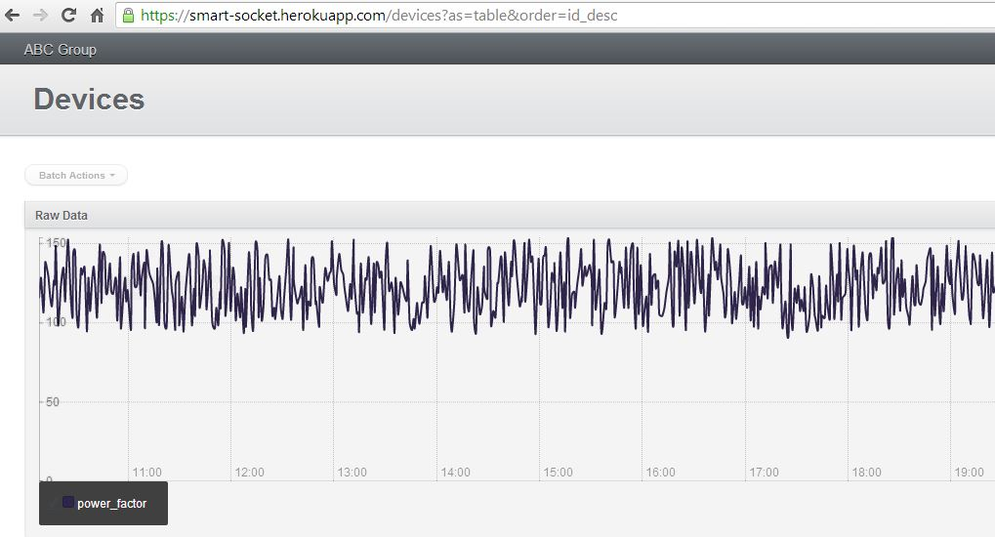
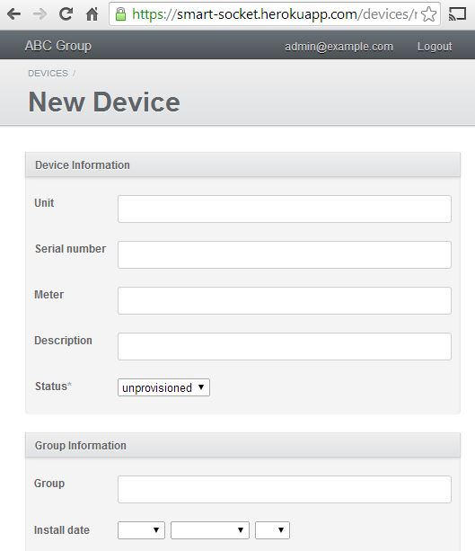
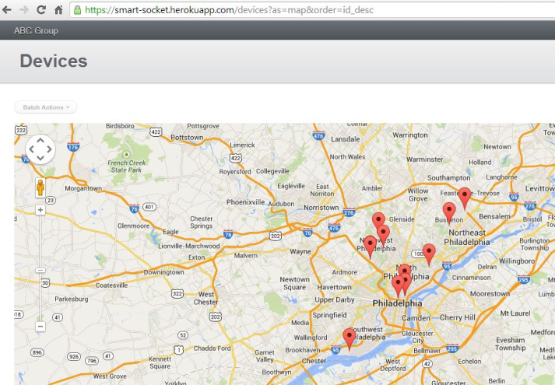
Software
Metering
Connection
Status
Notes:
Our cloud based software system provides the core communications, metering, and control functions.
Utilities use it for system maintenance, grid management, reporting, and presenting information to their customers.

Slide 8
MEA Game Changer 2.0 Project
Install xDER on 10 MD homes; Demonstrate positive user experience and cost savings from technology
Team of Infinite, Standard Solar, Bill Brooks (Solar and NEC code expert), PEPCO
Schedule
  May-July: Prep, training, scheduling
  August-September: installation, reporting
  Oct 2014 – Sep 2015: performance tracking and reporting

Slide 9
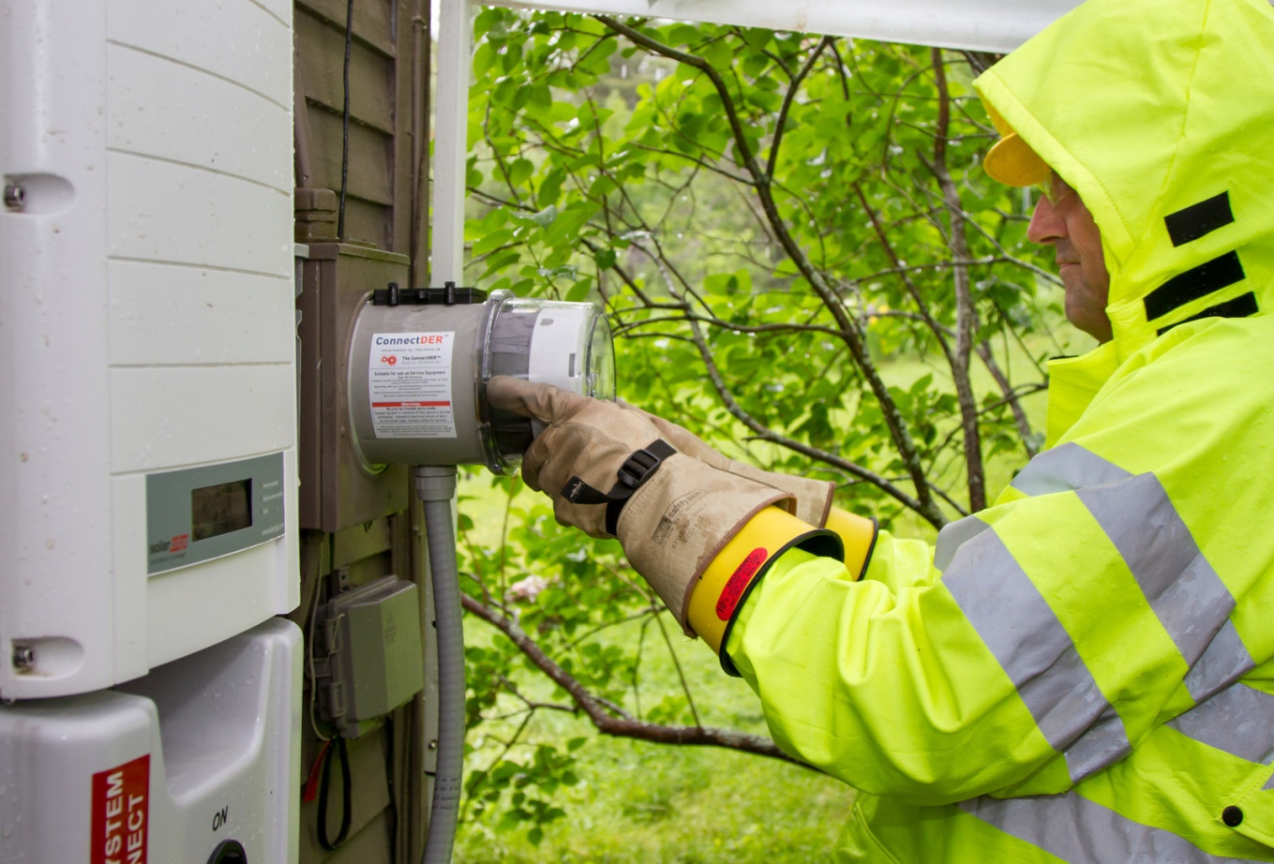
Contact
Whitman Fulton
CEO
202-207-6882
wfulton@infiniteinvention.com

