Slide 1
Ozone Season Summary 2025
Sunil Kumar Principal Environmental Engineer MWAQC-TAC May 6, 2025
Agenda Item 2

Slide 2
Peak 8-Hour Average Ozone Levels (ppb)
* 2025 Data is preliminary.

Slide 3
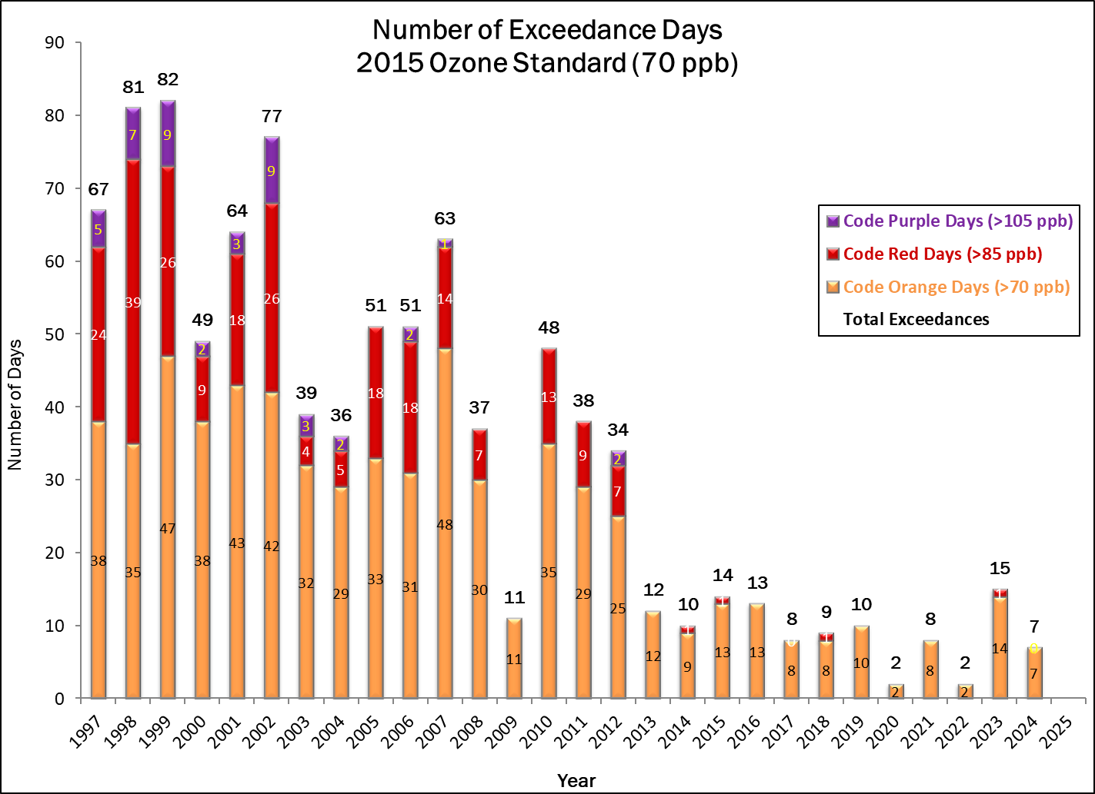
Ozone Exceedance Trend
* 2025 Data is preliminary.

Slide 4
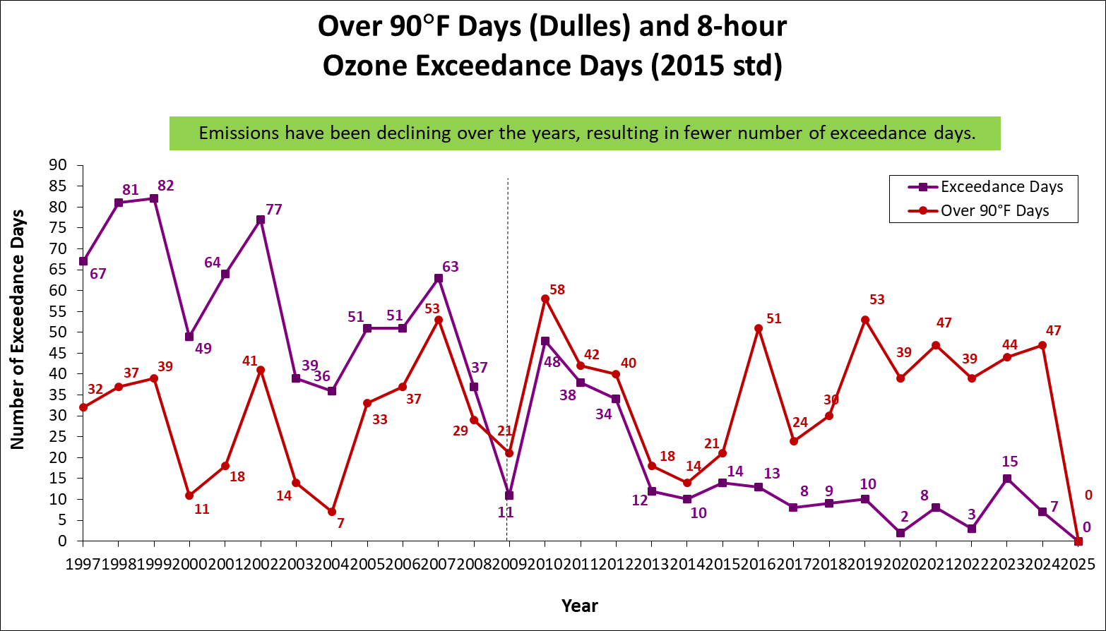
Ozone & Temperature Trend
* 2025 Data is preliminary.

Slide 5
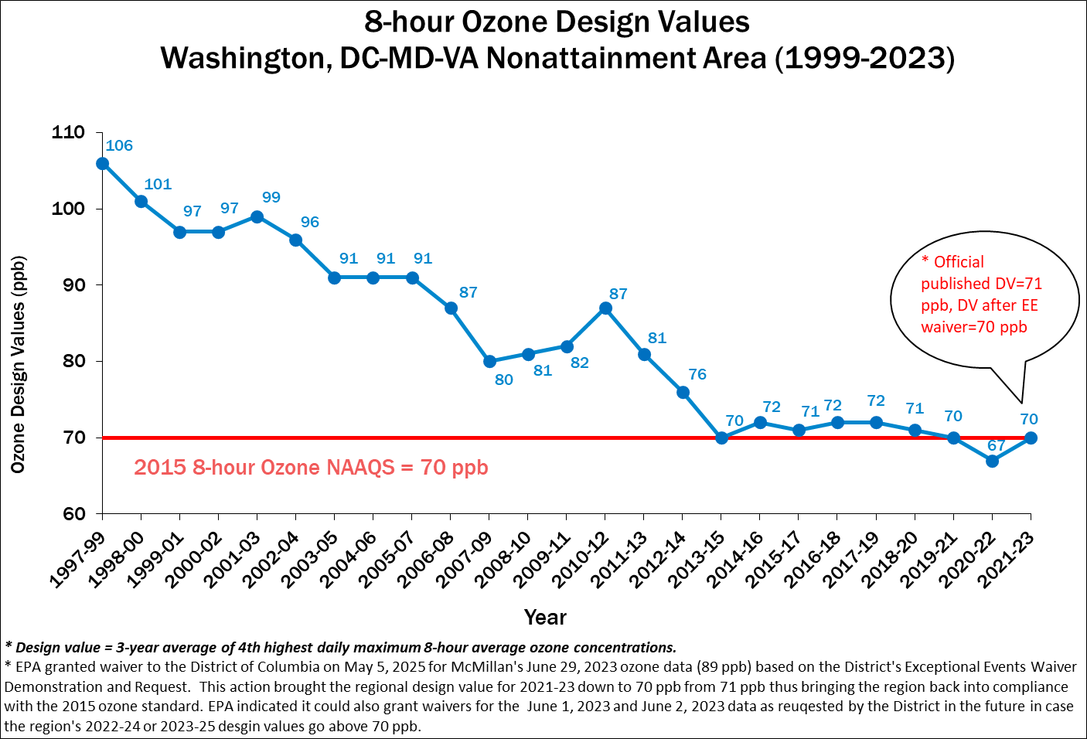
Ozone Design Value Trends

Slide 6
Why Fewer Exceedance Days Now ?
Emission Control Programs
Federal | State | Local
Acid Rain Program (1996/2000) | Vehicle Inspection & Maintenance Programs | Renewable Energy Programs Regional Wind Power Purchase Program Clean Energy Rewards Program Renewable Portfolio Standards
Tier 2 (LD Vehicle) Rule (2004) | Maryland Healthy Air Act (2009/2012) | Energy Efficiency Programs LED Traffic Signal Retrofit program Building Energy Efficiency Programs
HD Diesel vehicle Rule (2004/2007) | Virginia CSAPR Rule | VRE Idling Reduction
NOX SIP Call (2004) | Ozone Transport Commission Rules | LOW VOC Paint
CAIR/CSAPR/CSAPR Update/Revised CSAPR Update (2009/2015/2017/2021) |  | Gas Can Replacement

Slide 7
24-Hour Average PM2.5 Levels (µg/m³)
* 2025 Data is preliminary,

Slide 8
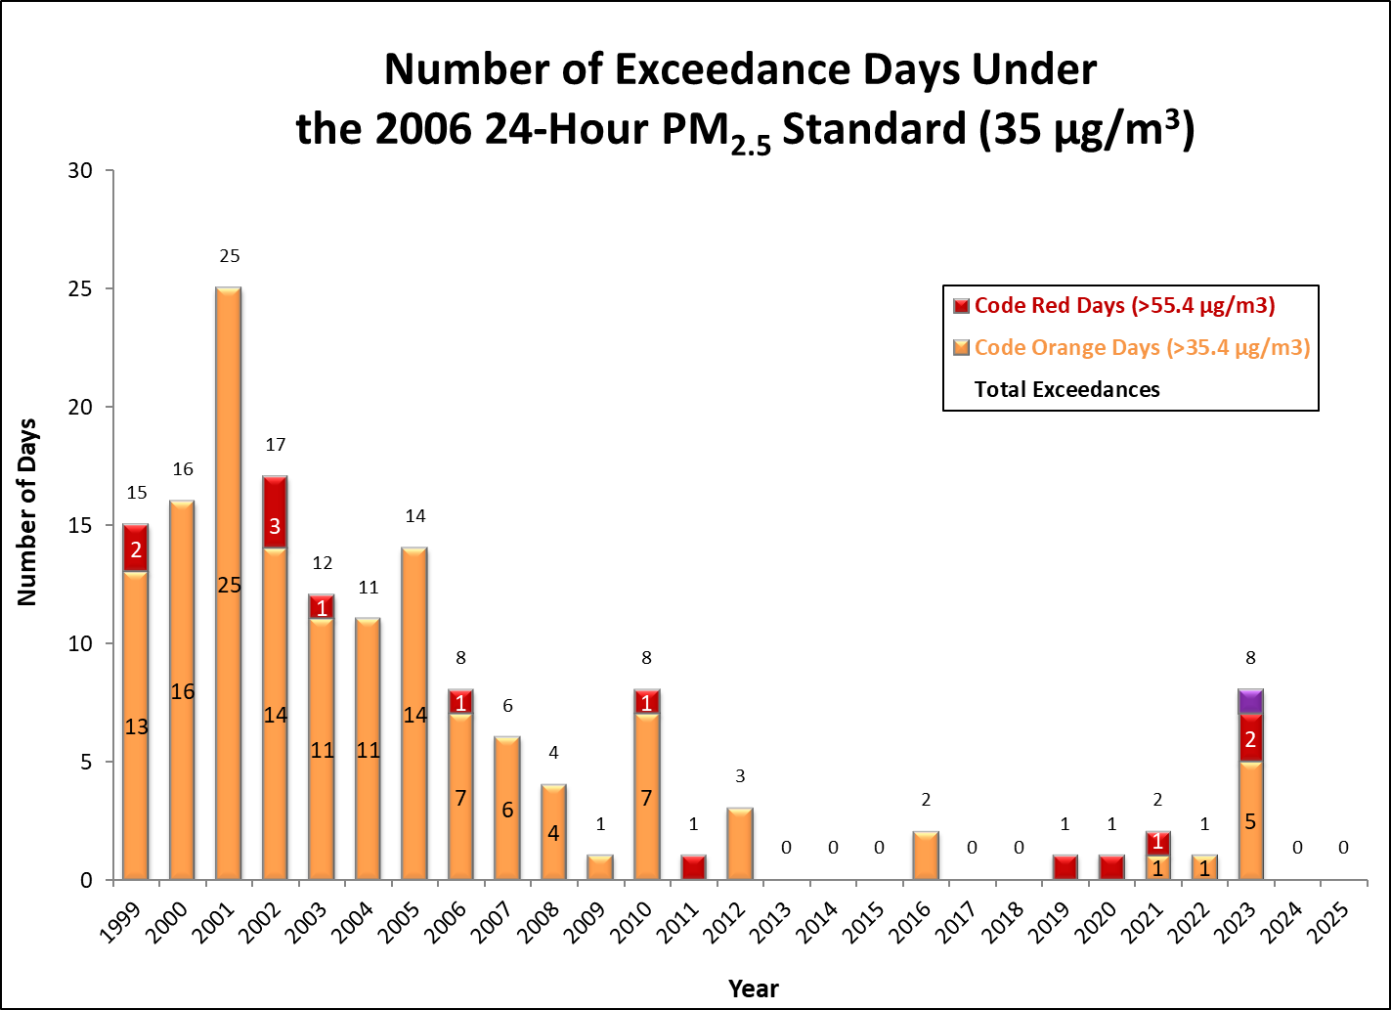
PM2.5 Exceedance Trend
* 2025 Data is preliminary.

Slide 9
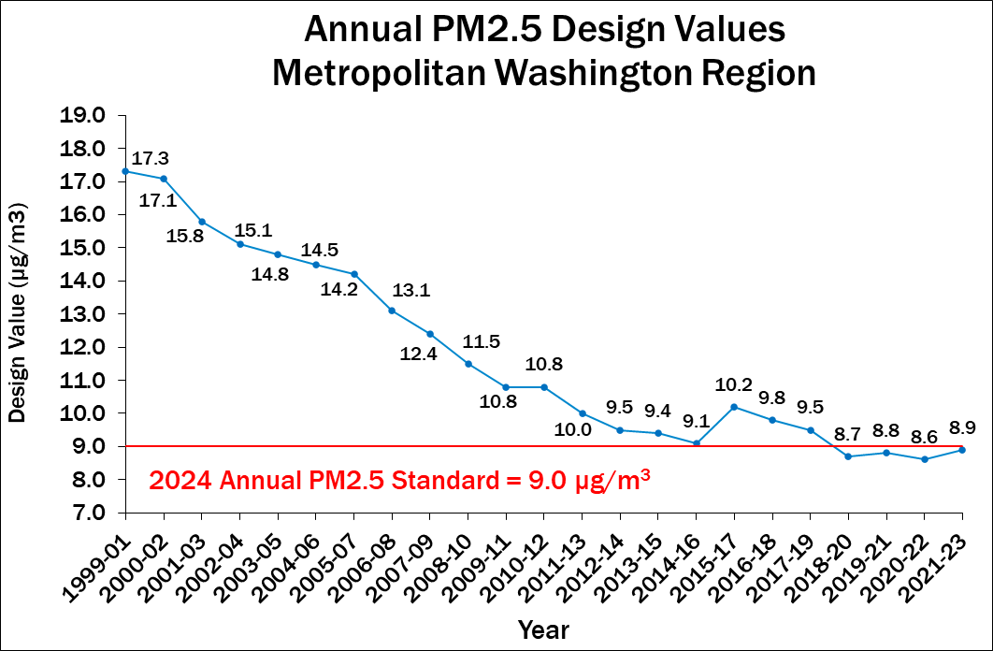
Annual PM2.5 Design Value Trend
* 2025 Data is preliminary.

Slide 10
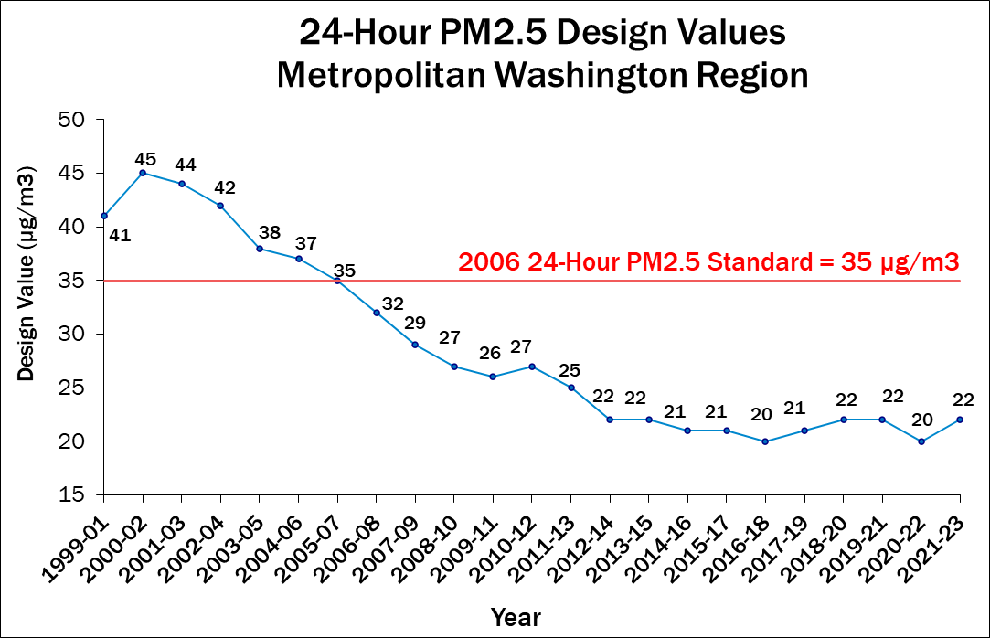
24-Hour PM2.5 Design Value Trend
* 2025 Data is preliminary.

Slide 11
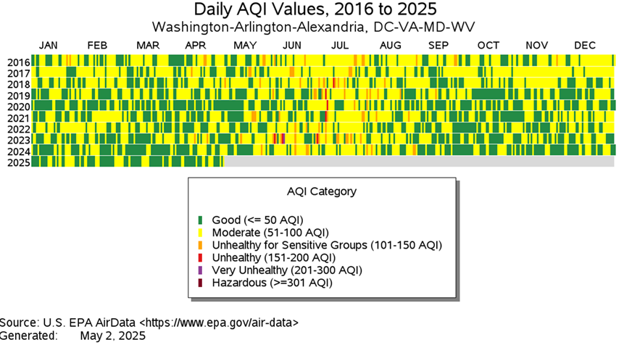
AQI Value Trends
Note: Data shown above is for combined AQI values for ozone, PM2.5, PM10, CO, NO2, and SO2 for the Washington-Arlington-Alexandria CBSA.

Slide 12
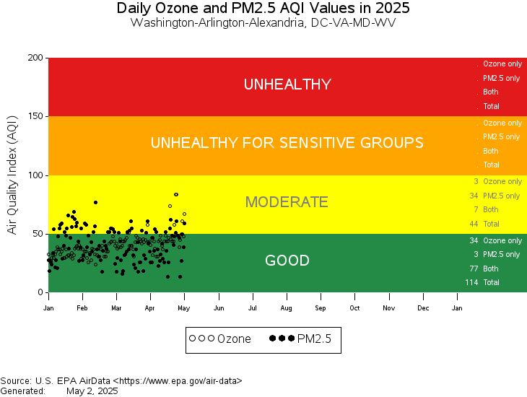
AQI Values - 2025

Slide 13
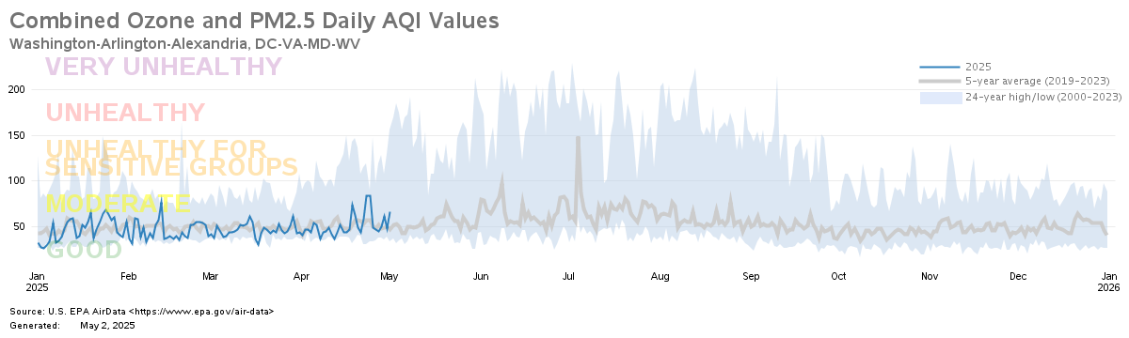
AQI Value Trends
Note: Data shown above is for the Washington-Arlington-Alexandria CBSA.

Slide 14
Minimum 4th High Ozone in 2025 Needed to Exceed 2015 Ozone NAAQS
Monitor | Draft 2022-24 Design Value (ppb)* | 4Th High Ozone (ppb)
McMillan (DC) | 69 (Excludes 6.29.23 EE data) | 72
Prince George’s Equestrian Center (MD) | 68 | 72
Beltsville (MD) | 68 | 73
Arlington (VA) | 67 | 71
* Based on draft data as of May 2, 2025.

Slide 15
Sunil Kumar Principal Environmental Engineer (202) 962-3244 / skumar@mwcog.org | mwcog.org
777 North Capitol Street NE, Suite 300 Washington, DC 20002

