Slide 1






NCR Emergency Preparedness Council
September 10, 2014

Slide 2
National Capital Region
Interoperable Communications
Infrastructure
September 10, 2014

Slide 3


NCR ICI
Agenda & Perspectives
National Capital Region Public Safety Communications
Wanda Gibson, Fairfax County CIO
Chair of COG Chief Information Officers (CIO) Committee
9-1-1 Operations
Steve Souder, Fairfax County 9-1-1 Director
Chair of COG 9-1-1 Directors Committee
FCC and 9-1-1 Governance
David Simpson, FCC Chief, Public Safety and Homeland Safety Bureau
NG9-1-1 Implementer
Christy Williams, 9-1-1 Program Manager
North Central Texas Council Of Governments (NCTCOG) (Dallas/Ft. Worth metroplex) President of National Emergency Number Association (NENA)
Regional Infrastructure
mwcog.org

Slide 4
NCR ICI
Public Safety Communications
Building on a decade of regional collaboration to advance interoperability and communications infrastructure, the NCR Interoperable Communications Infrastructure (NCR ICI) was implemented with funding from UASI grants and affirms the region’s commitment to a common vision of working together towards a safe and secure National Capital Region.
NCR ICI is a shared jurisdiction-managed private IP based network transport infrastructure, data exchange engine, shared applications and tools, and IT (cyber) security that can be leveraged of:
  (NCRnet) to include monitoring and security risk mitigation technologies
  Identity and Access Management System (IAMS)
  Data Exchange Hub (DEH) Services (technology standards and guidelines) to support cross-jurisdictional data sharing between disparate systems
  Geospatial Data Exchange (GDX): links regional maps and updated data on emergency response
Regional Infrastructure
mwcog.org

Slide 5
NCR ICI
Public Safety Communications
National Capital Region
Interoperable Communications Infrastructure (NCR ICI)
  Nearly a dozen public safety applications
  Capabilities support all aspects of law enforcement and emergency response
Governance and Support
  Direct oversight by COG Chief Information Officers Committee
  Supporting governance by multiple COG technical committees
  Policy guidance from Homeland Security Executive Committee
Regional Infrastructure
mwcog.org

Slide 6
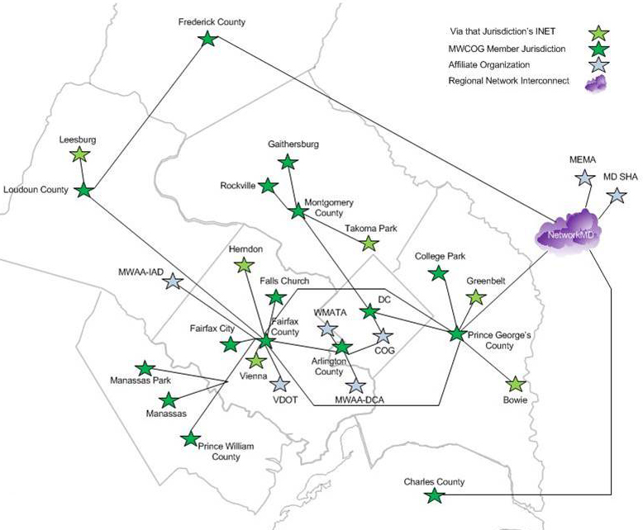
NCR ICI
Public Safety Communications – NCRnet Connectivity Map
Region-wide, physical interoperable network infrastructure
Scalable
Does not share bandwidth with any other users
Controlled Access
24x7 monitoring
Regional Infrastructure
mwcog.org

Slide 7
NCR ICI
Public Safety Communications
  Pre-FirstNet: Public Safety Broadband
In 2005, Wireless Broadband was initially the final planed component for the NCR Interoperable Infrastructure (NCR ICI).
Goal was to provide the secure communication infrastructure for communications for data and video between the 9-1-1 Center and the responding mobile field units.
Post-FirstNet
FirstNet goal is to provide a nation-wide broadband network primarily for public safety use that can be focused based on on-demand capacity need.
  Individual State decision required to Opt-in or Opt-out
  Uses similar technical architecture previously developed as a part of the NCR ICI
  On July 29,2014 MD became the first state to begin the FirstNet Consultation process and stakeholder Education and Outreach and Data Collection that will continue into 2015.
Regional Infrastructure
mwcog.org

Slide 8

NCR ICI
9-1-1 Technology Support
Local 9-1-1 Center Technologies
  Secure locality controlled environments
  Voice platform and Common Carrier 9-1-1 distribution
  Computer Aided Dispatch (CAD) software solution
  Geospatial Information Systems (GIS)
  Automated Vehicle Locater (AVL)
  800 or 700 MHz narrowband voice radio systems
  Commercial carrier wireless services to the mobile computers
Regional Infrastructure
mwcog.org

Slide 9
NCR ICI
9-1-1 Technology Support
Next Gen 9-1-1 Opportunities
  Opportunity for a more local/ regional collaboration and approach to 9-1-1 operations that could optimize costs and investments
  Promote shared systems, data and response; eliminate duplicate system
  Provide regional views and information across jurisdictional boundaries
  Enhance 9-1-1 Center staff to stay informed with voice, data, Texting, Web, and visual information at fingertips supporting response and coordination
  Shared Back-up Center
  Better use of Social Media
  Enhance Mobile experience
  Improve overall response
Regional Infrastructure
mwcog.org

Slide 10
NCR ICI
9-1-1 Operations
Locality Challenges
  Rapid use of wireless by public with less accurate location information
  Penetration of in-building wireless not optimal Required investment and funding options
  Adoption into new business culture
  Equal or better response times
  Limited market availability currently of next gen platform providers
Regional Challenges
  Overcoming discrete independent jurisdictional and state legal boundaries
    Uniform response protocols
    Different Public Service Commission regulatory authorities
  Giving up local control over system preferences
  Individual states’ planning (MD, VA, DC)
Regional Infrastructure
mwcog.org

Slide 11
NCR ICI
9-1-1 Operations
What is NG9-1-1?
  Providing ability for 9-1-1 PSAP to keep pace with today’s wireless and broadband technologies and public’s expectations – voice, text, pictures, video
  Replacement of Verizon 911 Call Routing Network with a New digital Network (ESInet) and implement a new way to “Direct” calls to proper PSAP using GIS data, not tabular data as is done today.
Why is it Necessary?
  Wire line phone networks are rapidly decreasing and wireless and IP networks are rapidly increasing
  9-1-1 network designed 40+ years ago and is a low capacity voice only network. It is inflexible and doesn’t fully support the ways people communicate today
  NG9-1-1 network is a high capacity network. It is a more resilient voice and data network.
What Did We Learn from Previous Technology Crossroads?
  Example: COG wide Interoperability Radio system upgrade (system of systems) – Led to cost and operational inefficiencies due to stovepipe, incremental approach
  Maximize GIS (Geographical Information System) efficiencies in NG9-1-1 Call Routing
  NG9-1-1 Management and Contract Structures could be Regional, not parochial, in order to maximize benefits and minimize costs
Regional Infrastructure
mwcog.org

Slide 12
NCR ICI
9-1-1 Operations
When and How Do We Start?
  Implement Regional Text-to-9-1-1 Capability – Contract to be awarded soon
  By use of a UASI recently awarded grant, Identify NG9-1-1 Implementation Strategy for COG with Industry Input
    Implementation Strategy Study begins in October under COG 9-1-1 Director’s Committee
    Study will identify Timelines and Cost Estimates for NG9-1-1 Regional Call Routing and ESInet
  Report back to COG Board of Directors
What’s Most Important?
  Do it right and cost effectively and learn from other COG regions what has worked (NCTCOG)
  Funding: Most funding formulas for 9-1-1 services are as old as 9-1-1
  Technology aside, the most important aspect of NG9-1-1, will be as it is today, the Public Safety Communicator. In the future they will operate with evermore complex systems and responsibilities. Personnel investments are critical.
What Legal Changes Might be Necessary?
  Current laws, regulations, and funding mechanisms are geared to traditional telephone networks and dated telephone terminology
  FCC has identified primary areas for consideration.
Regional Infrastructure
mwcog.org

Slide 13
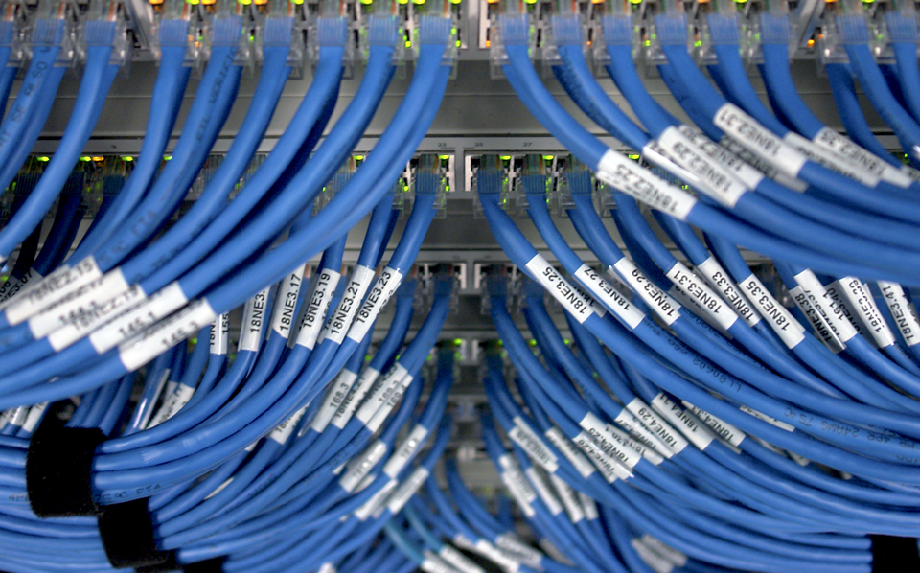
NCR ICI
FCC & 9-1-1
Text-to-911 Rules
  On August 8, 2014, the Commission adopted a Second Report and Order which requires that all CMRS providers and providers of interconnected text messaging must:
        Be capable of supporting text-to-911 by December 31, 2014.
        Commence delivery of 911 text messages to requesting PSAPs by June 30, 2015, or within 6 months of the date of a PSAP’s request (whichever is later).
        Route 911 text messages to the appropriate PSAP, using coarse location or other equivalent means.
  The Commission also adopted a Third Further Notice, which sought comment on:
    Enhanced location for text-to-911,
    Roaming support for text-to-911
Text-to-911 Deployment
  As of August 8, 2014, 121 PSAPS support text-to-911, and at least 48 others plan to go live this year or in early 2015:
    Available statewide in Iowa, Maine, Vermont, and in a number of jurisdictions in Colorado, Maryland, New York, North Carolina, Ohio, Pennsylvania, Texas, South Carolina, and Virginia.
  Early adopters have had positive experiences with text-to-911 so far.
  The Commission will establish a centralized database in which PSAPs can declare their text-readiness to covered text providers.
Regional Infrastructure
mwcog.org

Slide 14
NCR ICI
FCC & 9-1-1
E911 Location Accuracy
  There have been major changes in consumer habits since the Commission first adopted E911 rules.
  The Commission adopted a Third Further Notice in February 2014, which:
    Proposed to require CMRS providers to locate callers indoors
Wireless Alerting and 911
  There is a logical nexus between 911 and wireless alerting for emergencies.
  We want to encourage the full exploitation of wireless alerting protocols and systems that are already in place, or soon will be:
    Wireless Emergency Alerts (WEA)
    Emergency Alert System (EAS)
    Integrated Public Alert and Warning System (IPAWS)
  PSAPs are uniquely positioned to make the best use of wireless alerts, and we encourage them to do so.
  What are the impediments to PSAPs making greater use of WEA/EAS? How can we overcome them?
Regional Infrastructure
mwcog.org

Slide 15
NCR ICI
FCC & 9-1-1 Governance
The Commission is working to protect 911 service both
before and during the approaching Technology Transition.
Recent 911 Outages
    The April multi-state outage has provided insight into the challenges for 911 service in an all-IP environment:
        NG911 transition architectures pose greater risk to 911 reliability than legacy 911 or full NG911.
        System providers and state/local authorities need to coordinate on respective responsibilities in the event of an outage.
    There is a growing imperative for clarity in 911 governance, situational awareness, and coordination of service restoration.
    Subsequent Vermont and nationwide T-Mobile outages further validate this imperative.
Regional Infrastructure
mwcog.org

Slide 16
NCR ICI
FCC & 9-1-1 Governance
The Commission and MWCOG can and should work together towards secure and efficient deployment of NG911.
Cybersecurity
    The Commission’s core mission is to protect the safety of life and property, and in the modern context, that necessarily includes the security of IP networks.
    The National Institute for Standards and Technology (NIST) has developed a Cyber Security Framework (CSF) that PSAPs can use to evaluate and develop plans for addressing risk, and we encourage them to do so.
    Cyber threats are real, and it takes only one hacker to create a major public safety hazard.
  FirstNet
    FirstNet and the ESInets that will support NG911 may be able to use some of the same infrastructure.
    As the two services are built out, federal, state, and local governments have an opportunity to leverage the limited resources that are available for both.
Task Force for Optimal PSAP Architecture
    PSHSB has been tasked with conducting a study on optimal PSAP architecture.
    As we move forward with this study, we want to work with state and local 911 authorities, along with CSRIC, in studying the makeup of an ideal 21st Century PSAP.
Regional Infrastructure
mwcog.org

Slide 17
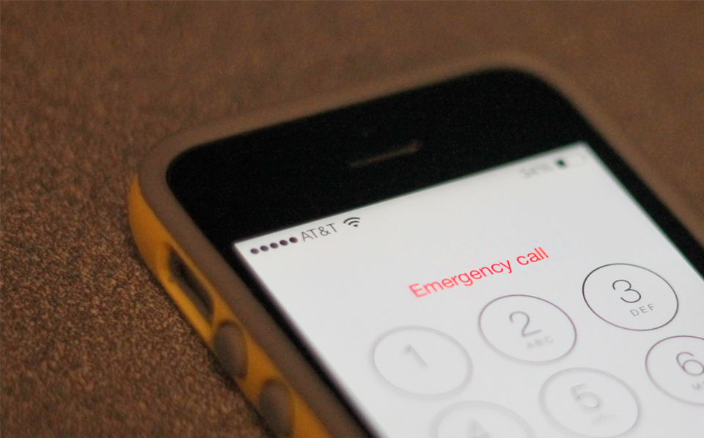
NCR ICI
NG 9-1-1 Implementer
North Central Texas
Council of Governments 9-1-1
SIZE and AREA COVERED:
14 counties (include 134 cities) surrounding Dallas/Fort Worth Metroplex
44 Public Safety Answering Points
Geographically dispersed with 12, 800 square miles (rural and urban)
9-1-1 Program covers 1.7 million population
GOVERNANCE:
9-1-1 Program – in house staff – set up based on legislation 1989
Regional Advisory Committee – Executive Board – CSEC (state 9-1-1 agency)
Local Control and autonomy – some standardization of technology
Regional 9-1-1 System – one network (shared and disparate technology)
  Not consolidation of centers or people
Regional Infrastructure
mwcog.org

Slide 18
NCR ICI
NG 9-1-1 Implementer
Drivers for NG9-1-1
Limitations of current system – 1968 Infrastructure
  Didn’t have connectivity – transfer problems
  Lack of contingency options in a disaster or outages
  Lack of equal access for Deaf, hard of hearing and & speech impaired community
  Need a consistent level of 9-1-1 service throughout the Metroplex
Provide improved 9-1-1 service to our citizens
  Not meeting public expectations
Shared costs and services
  provide efficiencies to each participant
Regional Infrastructure
mwcog.org

Slide 19
NCR ICI
NG 9-1-1 Implementer
Process
Started by developing a plan
Conducted studies and analysis (third party)
Multi-year, phased plan based on our diversity/complexity and funding model
Design, testing and implementation
  ROADBLOCKS: Regulatory and Legislative /funding issues (mitigation in plan)
NG9-1-1 is not a project, it is a journey.
Regional Infrastructure
mwcog.org

Slide 20
NCR ICI
NG 9-1-1 Implementer
The New 9-1-1 Network
RFI – network analysis to find options – looking for existing networks
  Network must be public safety grade with uptime requirements
  Other states have utilized existing networks
  Standards based solution - strong requirements for RFP
Digital network is the foundation for: features, applications, functionality
  Text, videos, intelligent medical devices, sensors, telematics, etc.
Added redundancy and diversity
Regional Infrastructure
mwcog.org

Slide 21
NCR ICI
NG 9-1-1 Implementer
Geospatial Information Systems
GIS went from a “nice to have” to a “must have” with NG9-1-1
Regional maps
  Leveraging the existing geographic data from our counties
Using 3rd party vendors to supplement staff/resources
  Analyze current GIS, Compare, Gap Analysis, clean data project
Regional Infrastructure
mwcog.org

Slide 22
NCR ICI
NG 9-1-1 Implementer
Text to 9-1-1
Drivers
  Equal level of service for the Deaf/hard of hearing/speech impaired
  Increase in school and public active shooters/domestic violence – not safe to speak
  Citizen expectations
Fear of the Unknown (Less than 2% of PSAPs have implemented
text to 9-1-1)
  Facts – low volume of texts, not seeing language barrier, technology has limitations, but is working for interim solution
Need a Plan – technology, training, public education and SOPs
  National Emergency Number Association has resource materials
It’s the RIGHT thing to do!
Regional Infrastructure
mwcog.org

Slide 23
Questions?
Photos From Flickr
Regional Infrastructure
mwcog.org

