Slide 1
ONECOMMUTE FAQS AND POLICIES
Frequently Asked Questions, Report Building, and Licenses
Rachel Coppe Senior Outreach and Communications Specialist Employer Outreach Committee September 15, 2026
Agenda Item 4

Slide 2
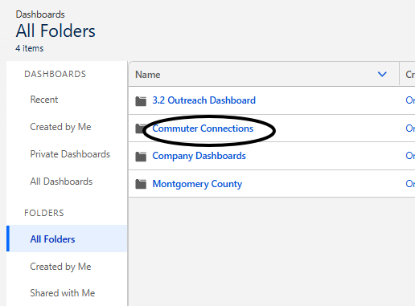
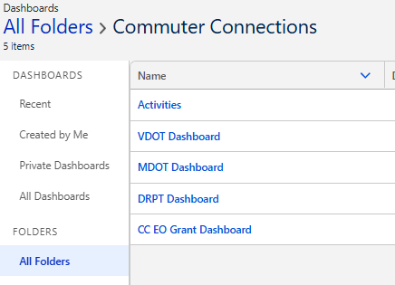
Dashboards and Reports
Report folders for each jurisdiction are currently a work in progress
Dashboards will allow you to view and open the reports you need and provide a visual snapshot

Slide 3
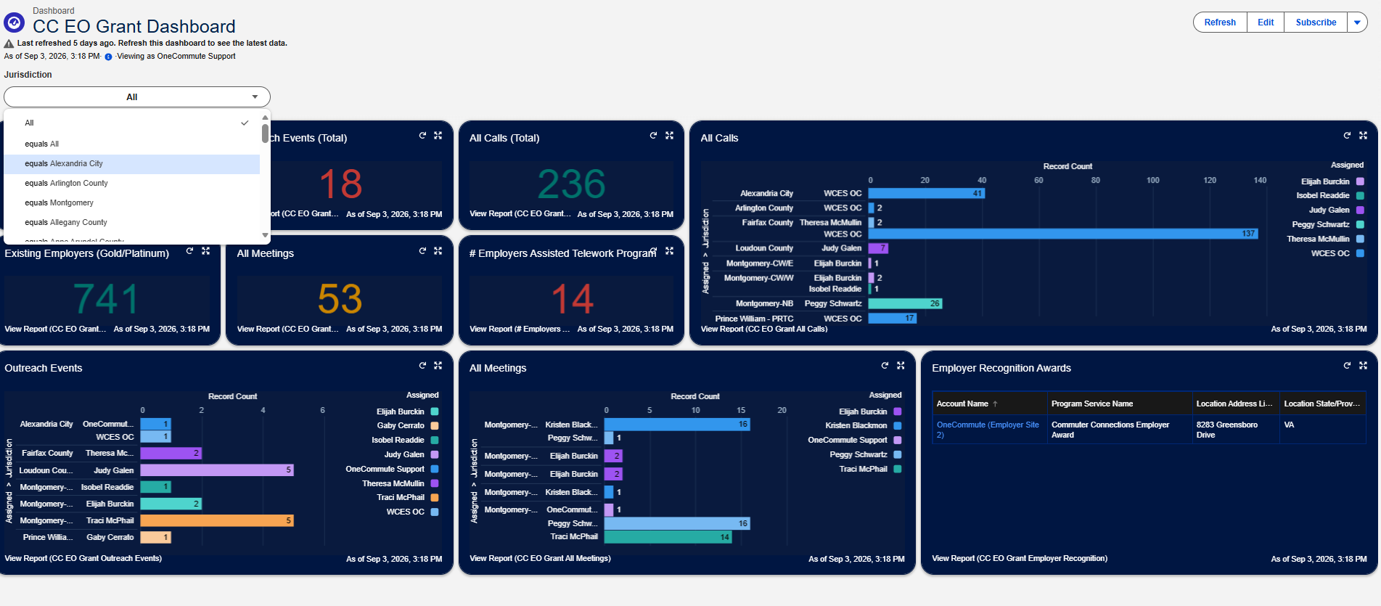
Dashboards and Reports

Slide 4
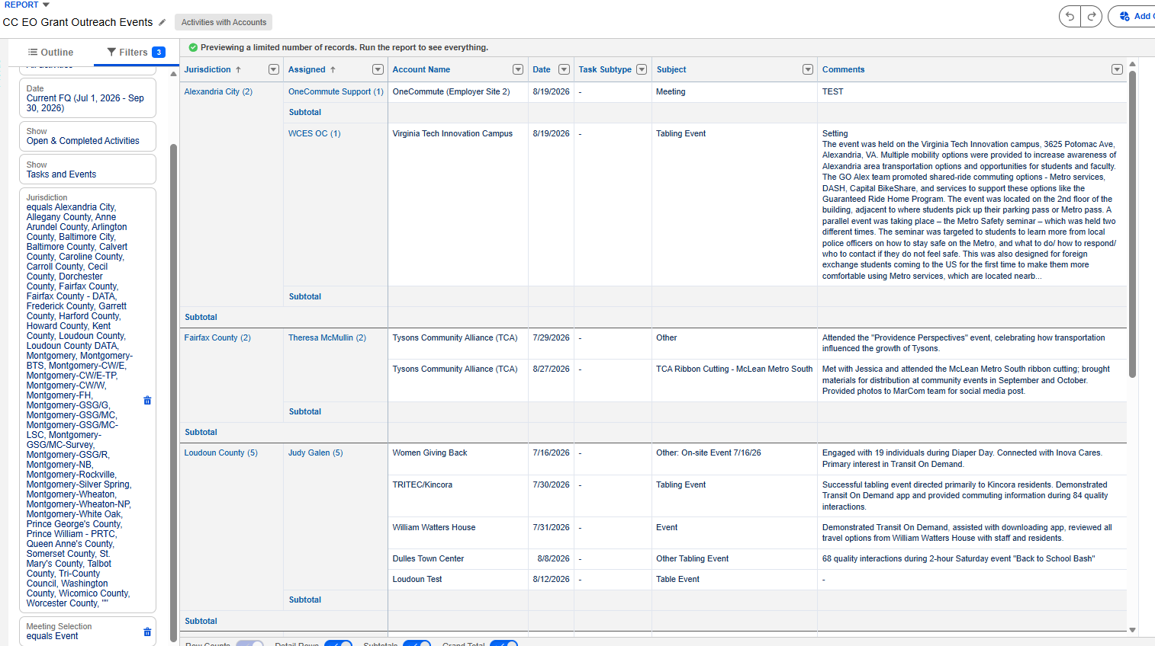
Dashboards and Reports

Slide 5
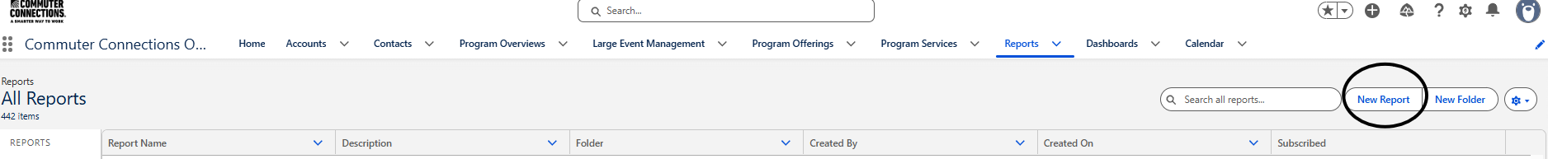
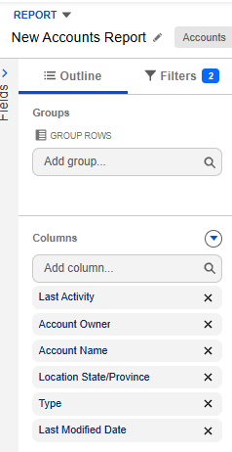
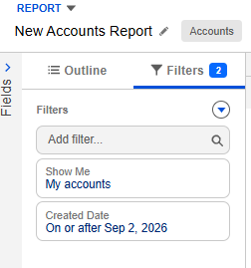
Building a Report
Common Report Types: Accounts, Contacts & Accounts, Activities with Accounts
Far left: editing capabilities and filters
Preset filters are always set to "my accounts" and a "create date" of one week
Accounts will always be part of any report

Slide 6
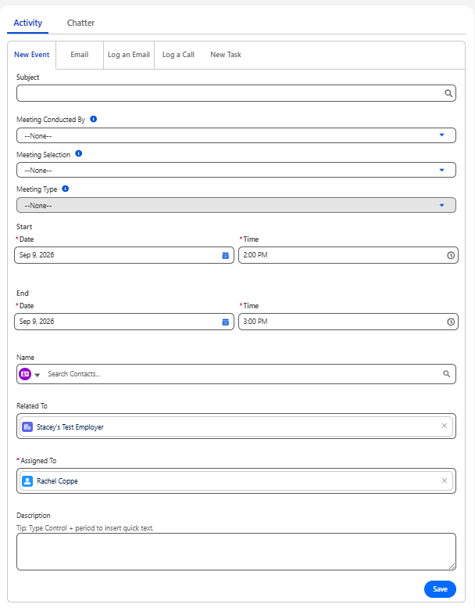
Logging an Event
New Event:
  Meeting selection includes event, meeting type includes event types
Email:
  This allows emails to be send from OneCommute
Log an Email/Log a Call:
  Record an email/call that has already occurred
  Date will automatically log as date recorded, but can be edited for calls
New Task:
  Log a planned event, call, or email with a due date
  Requires you to mark "Status" of the task

Slide 7
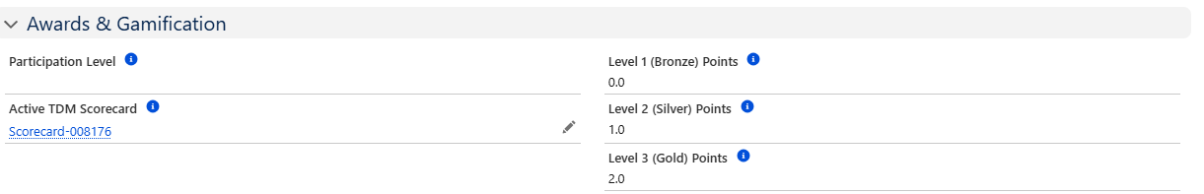
Levels and Scorecards
Employer levels are determined by information in the Program Overview
Points = credit for Level 1, 2, or 3 items that create a score
Bronze (Level 1), Silver (Level 2), Gold (Level 3), Platinum (Level 4)

Slide 8
Other Frequently Asked Questions
In Act! It was easy for me to toggle between employers, can I do that in OneCommute?
  There is no way to toggle between Accounts or Contacts on a list, we recommend opening the account or contact record in a new tab.
My report doesn't list the employee count, can we add this so we can see employers with more than 100 employees?
  You can create a report that has employee counts, but it is no longer a reporting requirement to show that an employer has more than 100 employees.
I had an event and want to add a lot of records at once, is there a way to do this?
  Yes, an import button is featured on both the Accounts and Contacts home pages.

Slide 9
Other Frequently Asked Questions
Can my team have another license?
  We do not have anymore licenses to distribute, but we can facilitate a purchase from OneCommute on your behalf.
Can I change the owner of an employer account?
  Account owners can only be changed by an admin or the current owner. A user cannot transfer an account from another owner to themselves. Please send us any account owner change requests.
I don't work with an employer anymore, can I delete them?
  Only admins can delete records, but you can change their status to "Archived/Closed" on their account page.

Slide 10
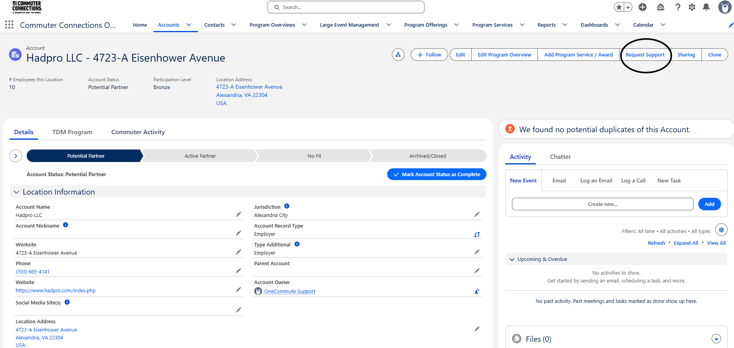
I Have a Problem You Didn't Answer
Reach out to me directly or Request Support directly from the OneCommute website

Slide 11
FY2028 License Distribution
Beginning July 2027, DC-region licenses will be allocated based on employer counts:
TPB staff will notify local jurisdictions of their allocated quantities in the coming weeks
  If additional licenses are needed, consider including requests in state grant applications
    “Standard” and “Read & Report” licenses are available
Jurisdictions who may not need their full allocation can defer unused licenses to a pool for others to claim (first come, first served, with a waitlist)
# Employers | # Licenses
0 – 10,000 | 2
10,001 – 17,999 | 3
18,000 – 25,999 | 4
26,000+ | 5
Notes:
Also note:
Unused licenses will be reclaimed and re-assigned if logins amount to less than three times a quarter
State agencies will be provided a “Read and Report” license

Slide 12
Rachel Coppe Senior Outreach and Communications Specialist (202) 962-3387 rcoppe@mwcog.org | commuterconnections.org
Metropolitan Washington Council of Governments 777 North Capitol Street NE, Suite 300 Washington, DC 20002

