Slide 1



WATER QUALITY LOADS AND TRENDS IN THE POTOMAC WATERSHED
07 JUNE 2016
Saurav Kumar
sk1@vt.edu
Adil Godrej
agodrej@vt.edu
Harold Post
hpost@vt.edu

Slide 2
Objectives of the study
Estimate loads and trends using data from the COG/OWML Chain Bridge station, and the following methods:
  Direct load calculation based on intensive sampling
  USGS's WRTDS method applied to the COG/OWML data

Slide 3


Outline
Loads 101
Load computation
Interpretation

Slide 4

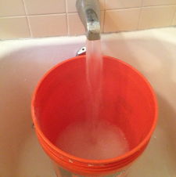
What are loads?
The cumulative mass of a constituent delivered to some location within a specified time.

Slide 5
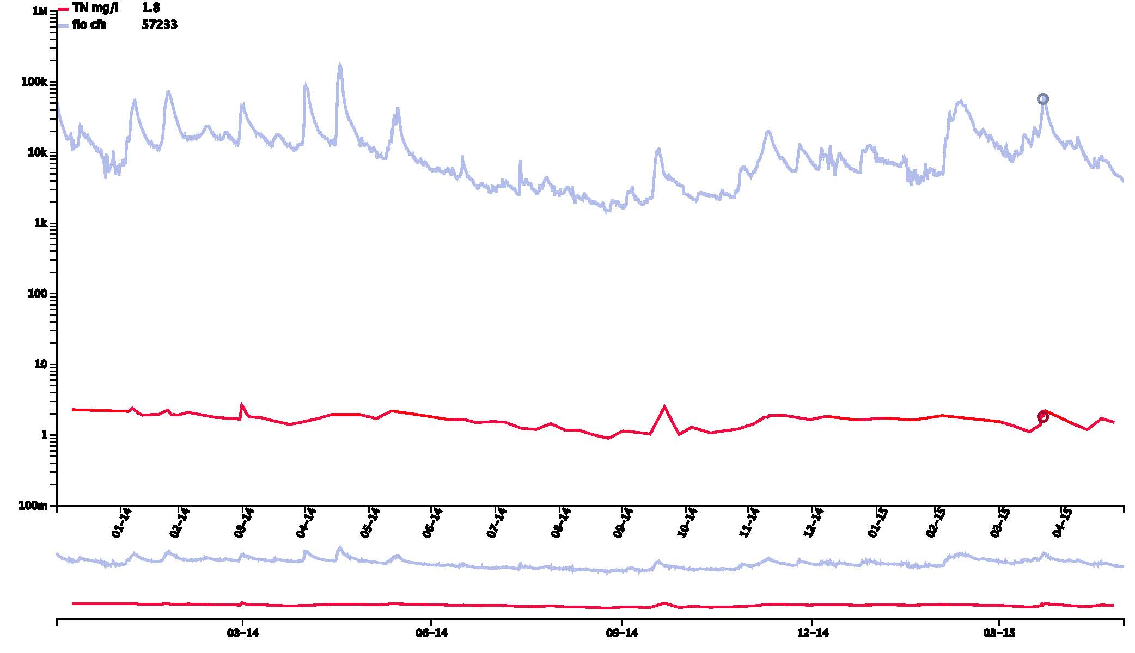
True load: Computation
Loads are dependent on :
Flow “Q”
  Volume transported per unit time
  $\left[\frac{L^{3}}{T}\right],\frac{m^{3}}{s},\frac{{ft}^{3}}{s}$
Concentration “c”
  Mass of constituent relative to the volume of the water
  $\left[\frac{M}{L^{3}}\right],\frac{mg}{l},\frac{µg}{l}$
$$L=\int_{0}^{t}{Qc dt} ≈\sum_{i=0}^{n}{Q_{i}c_{i}{∆t}_{i}}$$
Flow fluctuates more than concentration
Large and sudden fluctuations in concentration are during storm events
Notes:
The delta T is a bucket

Slide 6
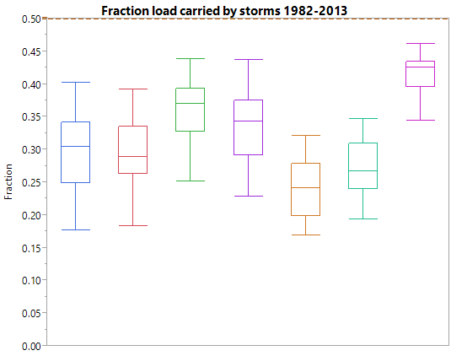
Why is Storm Flow Important?
Variability in Q and C
Large storm loads
Notes:
Explain why we care about storm flow
Q and C relation
Surface sub-surface storage conditions
Antecedent conditions
Time of the year
Significant load is transported in storm flow.

Slide 7
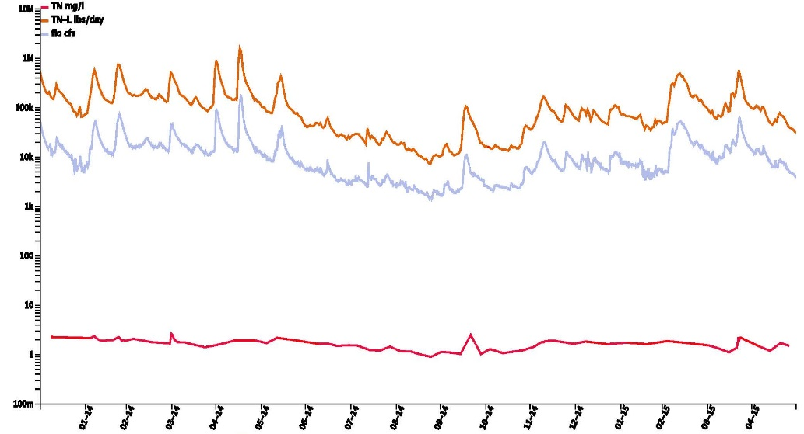
Flows drive the load
Flow-independent load trends
  Remove the effect of flow (largely uncontrollable) and isolate interventions
Loads closely follow flow

Slide 8
WRTDS Flow Normalization
All flows observed on any day are equally likely
Flow normalization: mean of concentration or flux computed with all flows observed on any day.
  Example for period 1981-2013 (32 years)
  Flow normalized concentration for April 14, 2013
    32 flows on April 14→32 concentrations (computed using WRTDS model)
    Mean of 32 concentrations

Slide 9
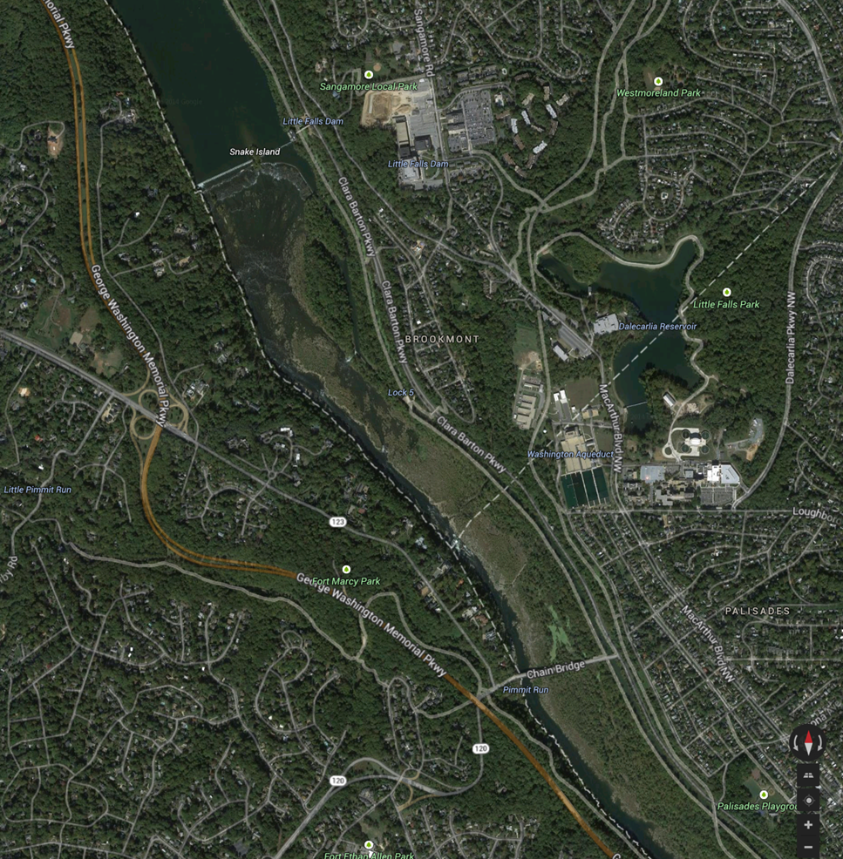
The two stations
Stage
WQ
Notes:
Flow is estimated every minute at the little falls dam using the pressure transducer to measure stage, and then using the predefined stage discharge relationship to compute discharge from stage value.
Recording is done 15 minutes to an hour based on how frequently is the stage changing. If changes are frequent or the onsite microcontroller estimates that Potomac is in storm mode stage and flow are recorded every 15 minutes otherwise they are recorded hourly.
Talk about communication between Little Falls Dam and chain bridge
Automatically triggered flow-composite sampling based on the stage rise and automatically stopped too.

Slide 10
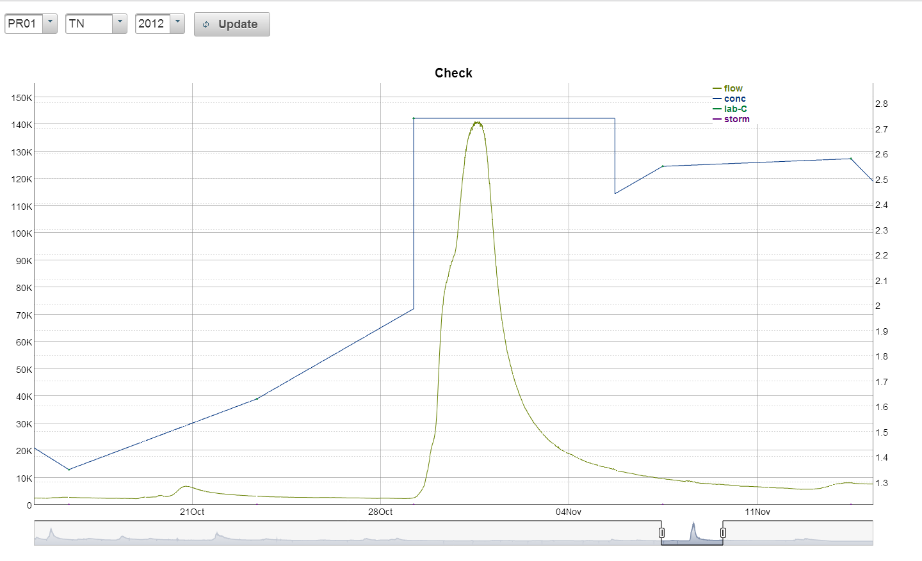

Flow composite sampling and load computations
manual-sample
EMC
Flow (cfs)
TN (mg/l)
Notes:
I talked about we measure EMC when I was talking about the true load this explains how we compute the EMC.
Explain the Graph
EMC or event mean concentration is computed by analyzing one flow composite sample. During the storm event after a pre-specified volume has passed a sample is taken in a carboy. This scheme repeats till whole storm is sampled; in the process creating a composite sample for the event on-site. Now we have to analyze one sample per storm.
Once a set volume (typically 400×10⁶ ft³)is exceeded, a signal is sent to the Chain Bridge station to collect a sample

Slide 11
How to get trends with DL
Look at loads independent of flow
  Moving average
    MA-285 days
    MA-2 years
  LOWESS
    Residuals not explained by flow
    DL-Residual, WL-O Residual

Slide 13
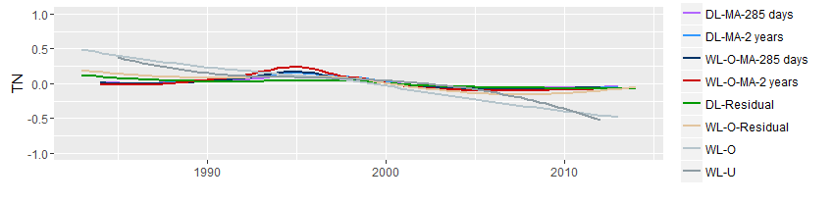
What do trends look like
Centered and normalized by band width

Slide 14
Good news?
All declines, majority significant
Large decline
Not much significant decline
Better than last decade
All units are in [kg/day]/year
 | DL-MA-285 days | DL-MA-2 years | DL-Residual | WL-O | WL-U
TP
<1990 | -693 | -846* | -280 | -279* | -542*
1990-1999 | 28 | 183 | -118 | -33 | 73
>1999 | -52 | -143 | -143* | -215* | -132*
All | -100* | -95* | -87* | -92* | -37
TN
<1990 | -4926 | -4432* | -1503 | -427* | -1368*
1990-1999 | 2414 | 3323 | -532 | -192* | -81*
>1999 | 1292 | 839 | -140 | -359* | -597*
All | -372 | -294 | -315* | -344* | -320*
TSS
<1990 | -565128 | -554958 | -171928 | -128085*
1990-1999 | 26433 | 155010 | -32662 | -3568
>1999 | -6436 | -115 | -32652 | -75854*
All | -49921* | -49493 | -34213* | -30191*
 |  |  |  | * significant at 95%

Slide 15
Meeting Bay program targets
Time to meet the target (back of envelop calculations)
  Based on 2025 targets and 2009 baseline data for all sectors except WW
Can we sustain the decline?
  Pre—1990: impact of point source
  Expect >1999 rate of decline to slows?
 | rate average | rate most optimistic | time (years) average | time (years) most optimistic
 | TP
>1999 | -137 | -215 | 11 | 7
All | -82 | -100 | 18 | 15
 | TN
>1999 | 207 | -597 | ∞ | 14
All | -329 | -372 | 27 | 23
 | TSS
>1999 | -28764 | -75854 | 25 | 9
All | -40955 | -49921 | 17 | 14
Some data from https://stat.chesapeakebay.net/?q=node/130&quicktabs_10=1
Notes:
http://www.bayjournal.com/documents/reprints/allocate%20.pdf
Update this based on https://stat.chesapeakebay.net/?q=node/130&quicktabs_10=1

Slide 16
Trends to Magnitude

Slide 17
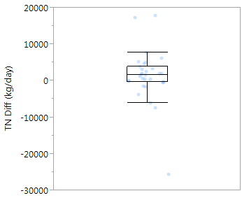
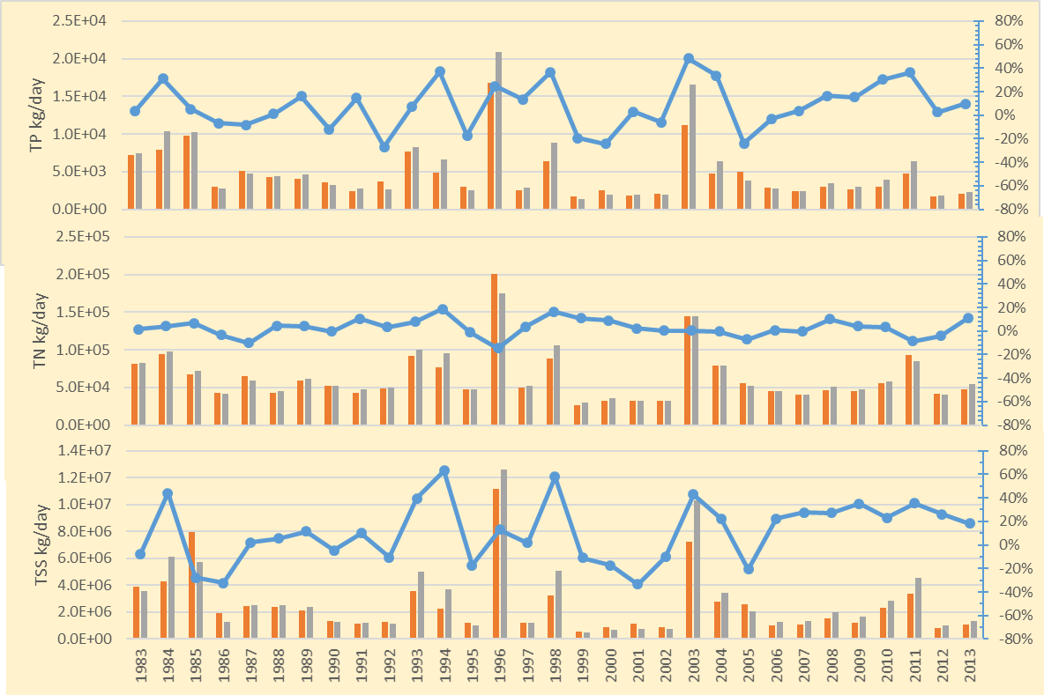
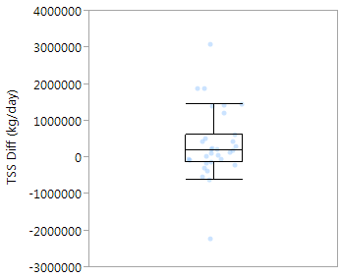
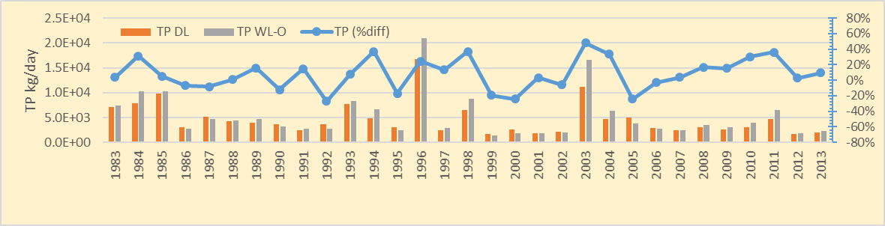
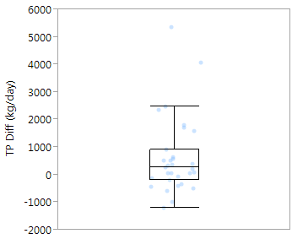
Load magnitudes
 | Range of difference
TP | -27%—48%
TN | -13%—23%
TSS | -33%—63%

Slide 18
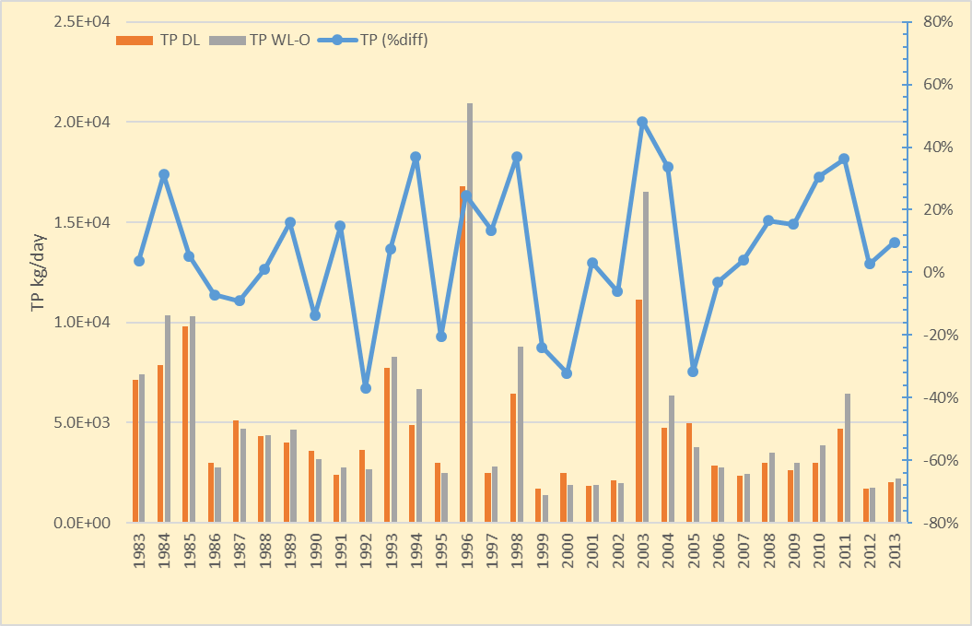
Magnitude matters: TP Loads

Slide 19
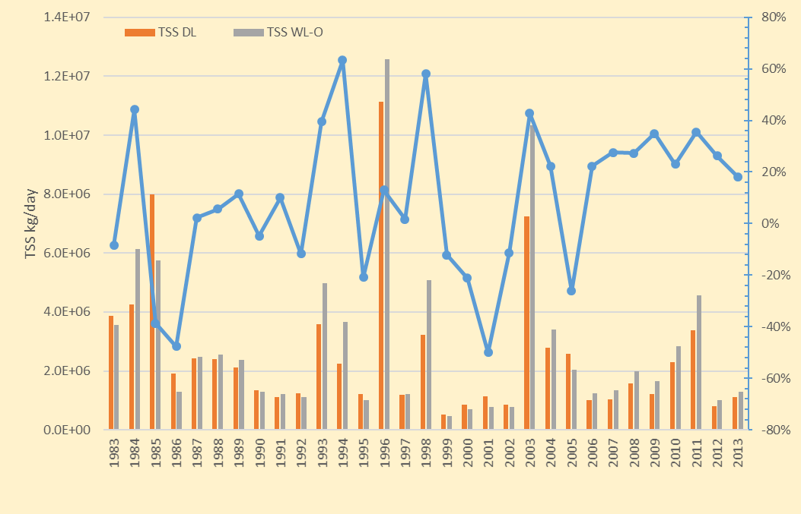
Magnitude matters: TSS Loads

Slide 20
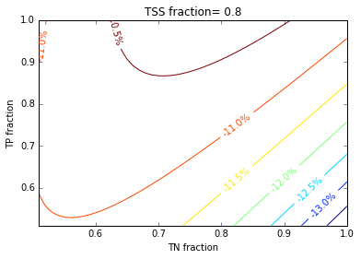
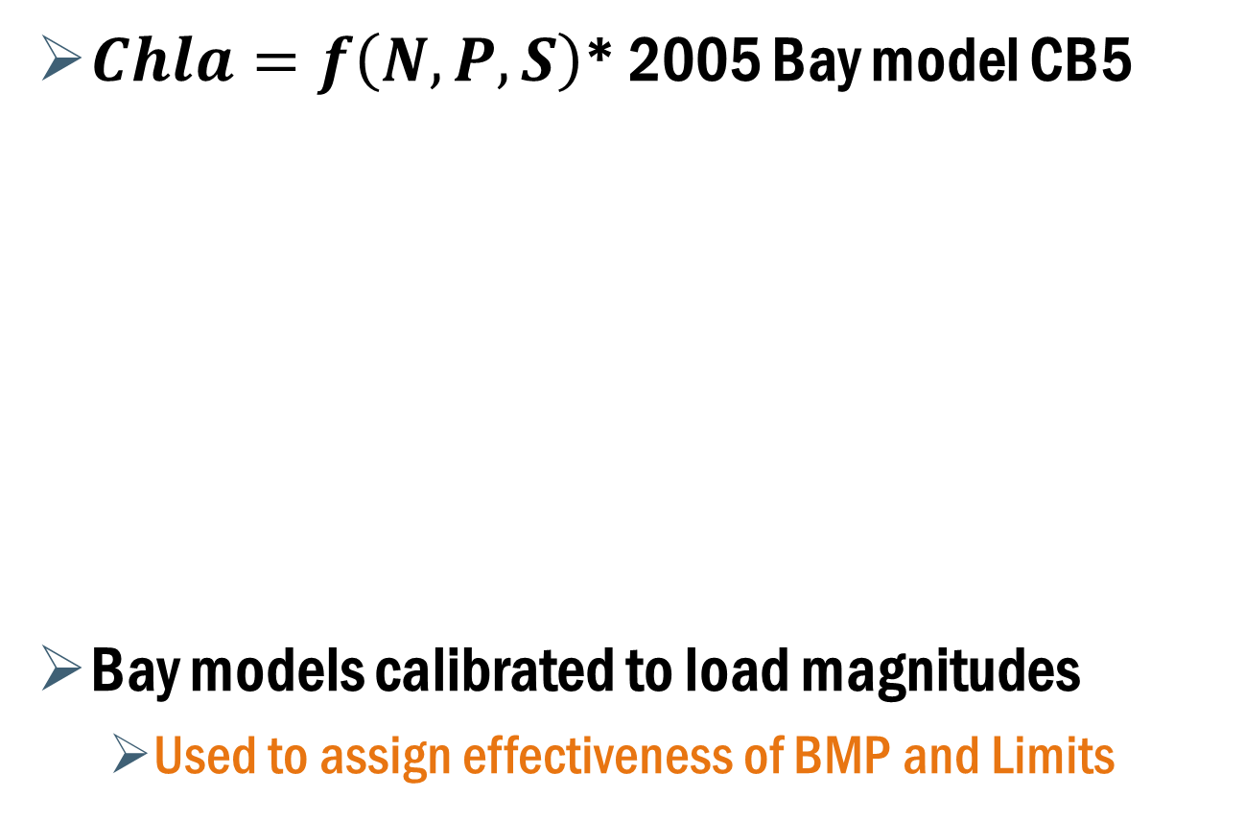
Magnitude matters: Impact to the Bay
$Chla=f\left(N, P, S\right)$* 2005 Bay model CB5
Bay models calibrated to load magnitudes
  Used to assign effectiveness of BMP and Limits
* Wang, P., Linker, L., Batiuk, R., and Cerco, C. (2006). "Surface Analysis of Chesapeake Bay Water Quality Response to Different Nutrient and Sediment Loads." J. Environ. Eng., 10.1061/(ASCE)0733-9372(2006)132:3(377), 377-383

Slide 21
Magnitude matters: Cost of remediating the difference - TN
Costing data from CWP 2013* (2013 $)
* Center for Watershed Protection (CWP). 2013. Cost-Effectiveness Study of Urban Stormwater BMPs in the James River

Slide 22
Magnitude matters: Cost of remediating the difference - TP
Data from CWP 2013* (2013 $)
* Center for Watershed Protection (CWP). 2013. Cost-Effectiveness Study of Urban Stormwater BMPs in the James River

Slide 23
Going forward
Look at NPS loads, trends, and costs below and above fall line
Translate trends and targets to jurisdictions and/or sectors
  Integrate Bay modeling efforts
  System dynamics/other model?

