Slide 1

Item #2
Ozone Season Summary
2014
Sunil Kumar
MWAQC-TAC Meeting, COG
September 9, 2014

Slide 2
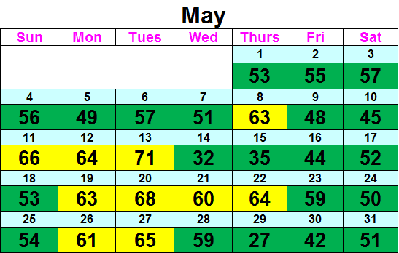
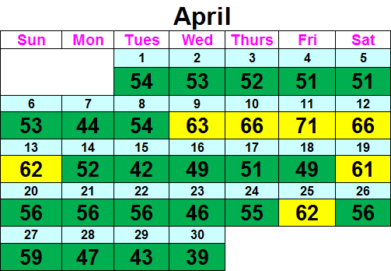
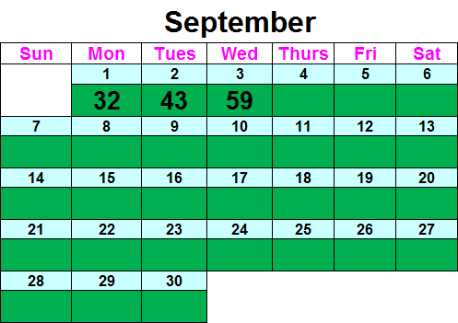
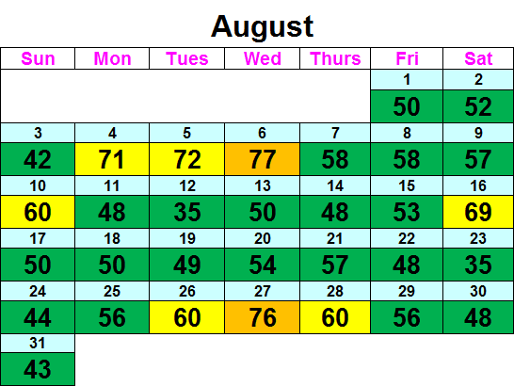
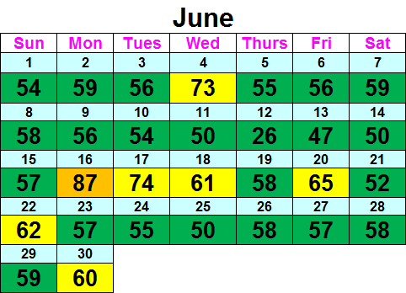
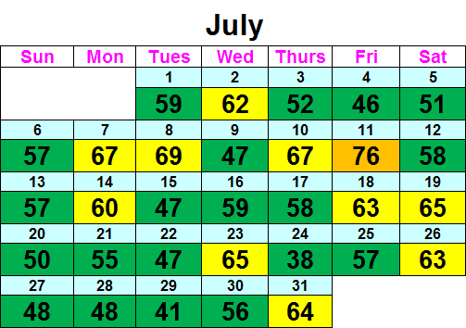
Ozone Season Summary
[As of September 3, 2014]
Peak 8-Hour Ozone Concentrations (ppb)
Data based on the 8-hour standard set at 75 ppb. Since April 1, 2014, there have been:
4 Code Orange Days, 39 Code Yellow Days, 112 Code Green Days

Slide 3
Meteorology Factors on Exceedance Days
August 6, 2014
  High Temperature: 90°F
  Light winds
  Northwesterly winds brought NOx and ozone from the Ohio River Valley
  Clear Skies due to a high pressure system
  Similar conditions during the two days prior caused ozone to build up
August 27, 2014
  High Temperature: 90°F
  Northwesterly winds brought NOx and ozone from Western PA and OH
  High ozone values in Western PA on August 26
  Clear and sunny skies

Slide 4
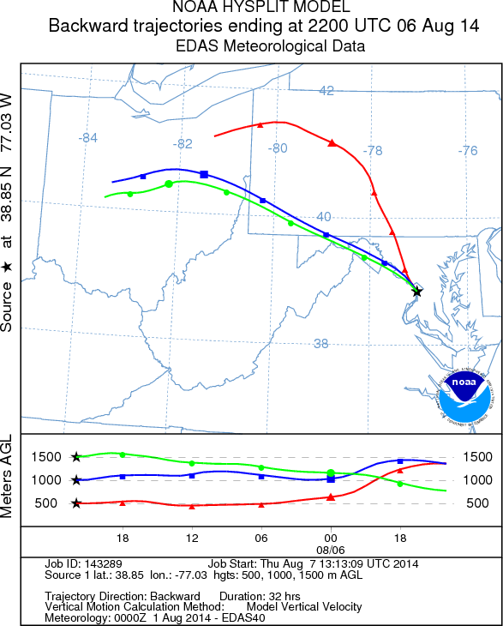
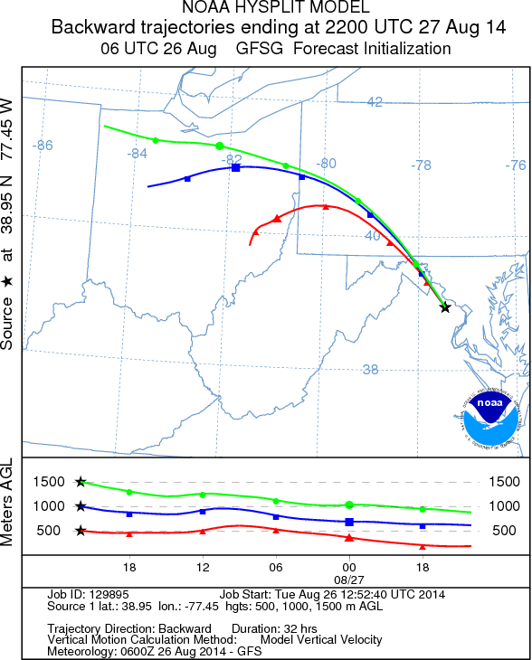
Wind Trajectories for 8/6 and 8/27

Slide 5
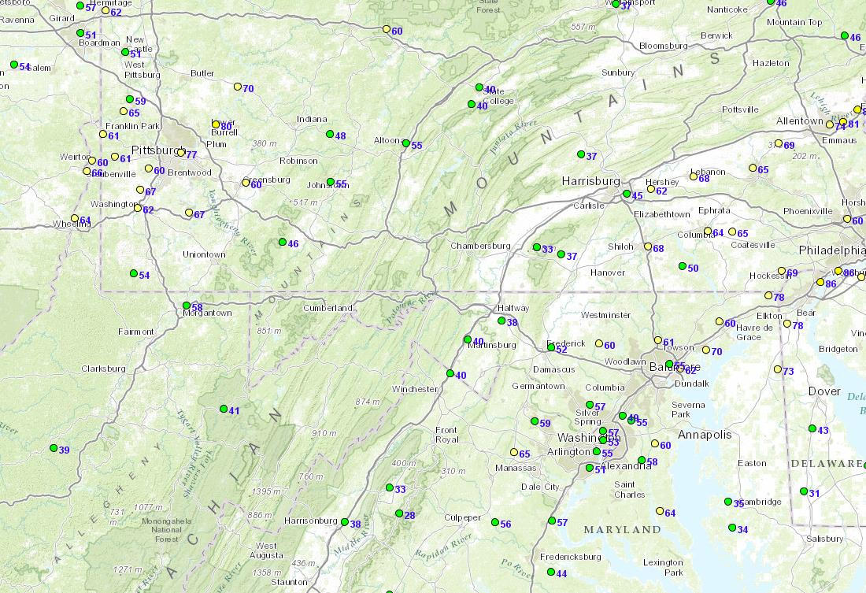
Ozone Concentration at 3 PM
August 26
Ozone concentrations = 70-80 ppb
24 – 32 hours

Slide 6
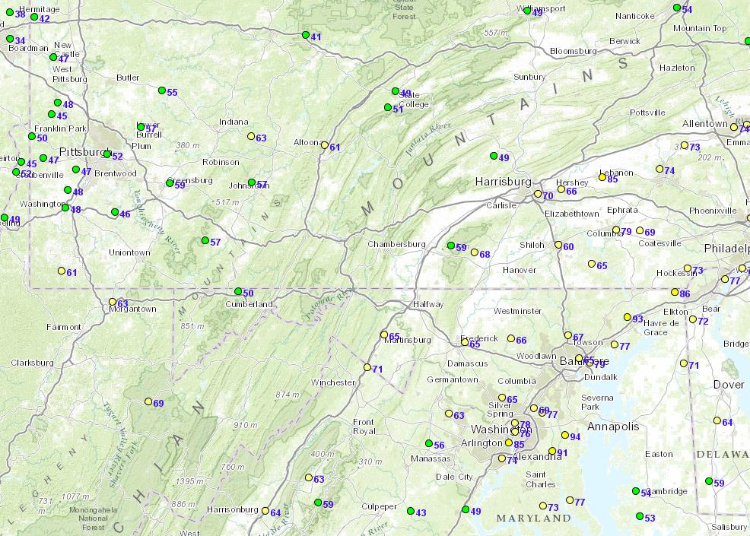
Ozone Concentration at 3 PM
August 27
Ozone concentrations = 70-90 ppb

Slide 7
2014 Ozone Exceedances
Date | Monitors Exceeding | Highest Monitor | 8-Hr Max (ppb)
6/16/2014 | 4 | Arlington | 87
7/11/2014 | 1 | Prince William | 76
8/6/2014 | 1 | Charles County | 77
8/27/2014 | 2 | Arlington/Prince George County (tie) | 76
Analysis is based on draft data until September 3, 2014. Data is subject to change.

Slide 8
Ozone Exceedance Trend
2014 analysis is based on draft data as of September 4, 2014 and is subject to change.

Slide 9
90 Degree Days and Exceedance Days
2014 analysis is based on draft data as of September 3, 2014 and is subject to change.

Slide 10
Why Fewer Exceedance Days Now ?
Emission Control Programs
Federal | State | Local
Acid Rain Program (1996/2000) | Vehicle Inspection and Maintenance Programs | Renewable Energy Programs Regional Wind Power Purchase Program Clean Energy Rewards Program Renewable Portfolio Standards
Tier 2 (LD Vehicle) Rule (2004) | MD Healthy Air Act (2009/2012) | Energy Efficiency Programs LED Traffic Signal Retrofit Program Building Energy Efficiency Programs
HD Diesel Vehicle Rule (2004/2007) | VA CAIR Rule | VRE Idling Reduction
NOx SIP Call (2004) | DC CAIR Rule | Low VOC Paint
Clean Air Interstate Rule (2009) | Ozone Transport Commission Rules | Gas Can Replacement

Slide 11
Ozone Design Value Trend

Slide 12
4th Highest Ozone Value

Slide 13
These 4th highest 8-hour ozone values in 2015 would lead to non-attainment in 2015
Site | 4th Highest 8-Hour Max Ozone Concentration (ppm)
Beltsville | 0.087
PG Equestrian | 0.090
Arlington | 0.090
Calvert | 0.091
Franconia | 0.092
Southern Maryland | 0.094
Rockville | 0.095
HU- Beltsville | 0.095
McMillian NCore | 0.096
Frederick | 0.096
Ashburn | 0.099
Long Park | 0.100
Analysis is based on draft data until September 3, 2014. Data is subject to change.

Slide 14
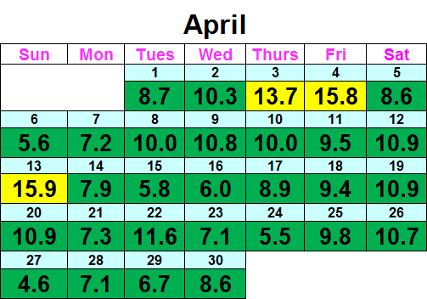
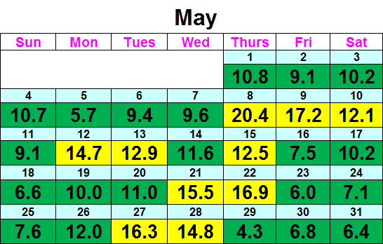
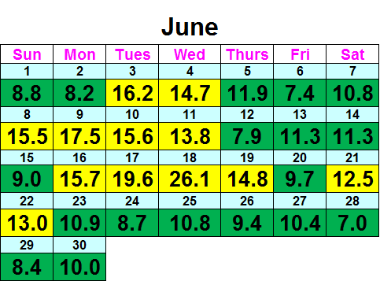
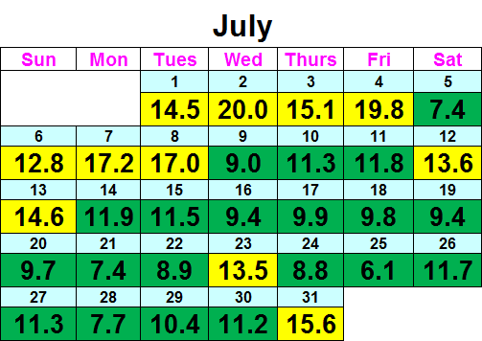
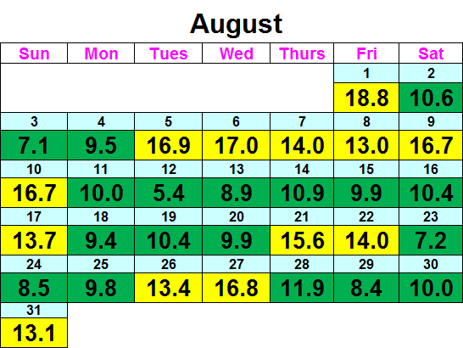

Fine Particle Summary
[As of September 3, 2014]
24-hour PM_{2.5} Average (µg/m³)
Data based on the 24-hour standard set at 35 µg/m³. Since April 1, 2014, there have been:
49 Code Yellow Days, 106 Code Green Days

Slide 15
PM_{2.5} Exceedance Trend

Slide 16
24-Hour PM_{2.5} Design Value Trend

Slide 17
Annual PM_{2.5} Design Value Trend

