Slide 1


American Solar Transformation Initiative
Program Overview
Tyler Espinoza, Senior Project Manager, Optony Inc.
Tyler.Espinoza@optony.com
Ben Foster, Senior Vice-President, Optony Inc.
Ben.Foster@optony.com

Slide 2
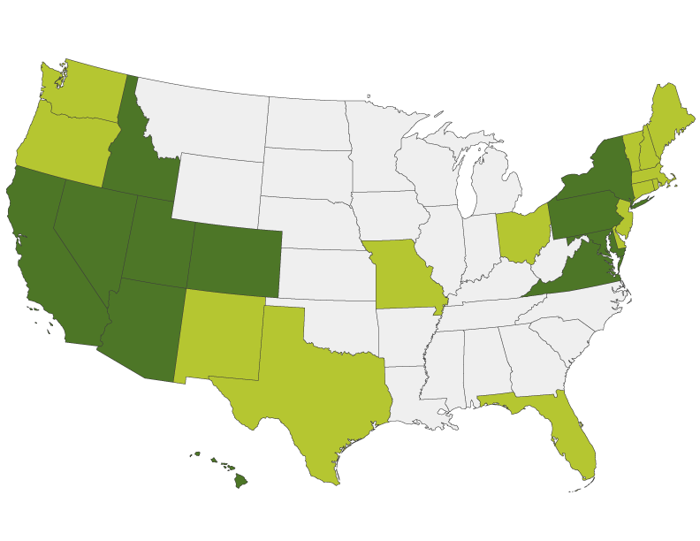
American Solar Transformation Initiative (ASTI)
Initiative to reduce the total installed costs of solar systems
And increase deployment of solar power across the USA
Focus Areas:
Local Permitting Process
Planning & Zoning Regulations
Utility Interconnection
Education and Outreach
Financing Tools and Resources
Innovative Deployment Programs
2

Slide 3












ASTI – Supporters and Partners
The ASTI program has broad support and is coordinating with regional organizations to ensure the maximum impact to each participating agency and relevancy to national goals.
3

Slide 4

About Optony
Optony develops and deploys solar best practices across the entire solar project lifecycle for government agencies, schools and commercial organizations.
Working with clients across all phases of solar projects creates deep insight into true performance drivers which is used to reduce costs and improve performance at any stage in the process.
www.optony.com
“Optony's consulting service is a must-have for any organization considering an investment in solar. Based on Optony’s comprehensive analysis and recommendations, we now have a low-risk, high-return solar strategy.”
4

Slide 5
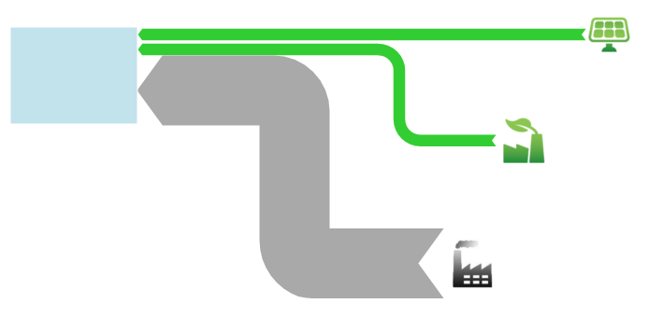
Targeting Distributed Generation Potential
Renewable Portfolio Standard: 20% by 2020
Distributed Generation Creates:
New Jobs
Economic Activity
Environmental Benefits
Community Engagement
Statewide
Total Electricity
Consumption
Utility Provided Clean Power
Central Station Energy Production
5

Slide 6
How the ASTI Program Works
Provide curated resources from around the country and expert support, coordinated regionally to enable solar market transformation and growth via the Solar Roadmap™.
Process Outline
Assess current market conditions and potential
Benchmark to national and regional goals and best practices
Tailor interactive roadmap for individual situation and needs
Convene working groups and training with experts and peers
Take action with support from ASTI team and partners
Be recognized locally, regionally and nationally
Increase solar market activity and improve the local economy and environment
6

Slide 7
Solar Market Potential Example – Central Valley CA
 | Solar Viable Residences | Size Potential (MW) |  | Solar Viable Residences | Size Potential (MW)
Arvin | 1,781 | 9.1 | Madera | 7,092 | 36.2
Atwater | 3,378 | 17.2 | Mendota | 910 | 4.6
Clovis | 14,051 | 71.7 | Merced | 9,157 | 46.7
Delano | 4,308 | 22.0 | Modesto | 29,002 | 147.9
Fresno | 57,251 | 292.0 | San Joaquin | 362 | 1.8
Hanford | 7,382 | 37.7 | Turlock | 10,616 | 54.1
Livingston | 1,593 | 8.1 | Visalia | 18,256 | 93.1
 |  |  | TOTAL | 165,138 | 842.2
Regional Economic Impact: $1.56B
Annual Clean Energy Production: ~1 Billion kWh
Additional opportunities in the commercial, government, and utility sectors
7

Slide 8
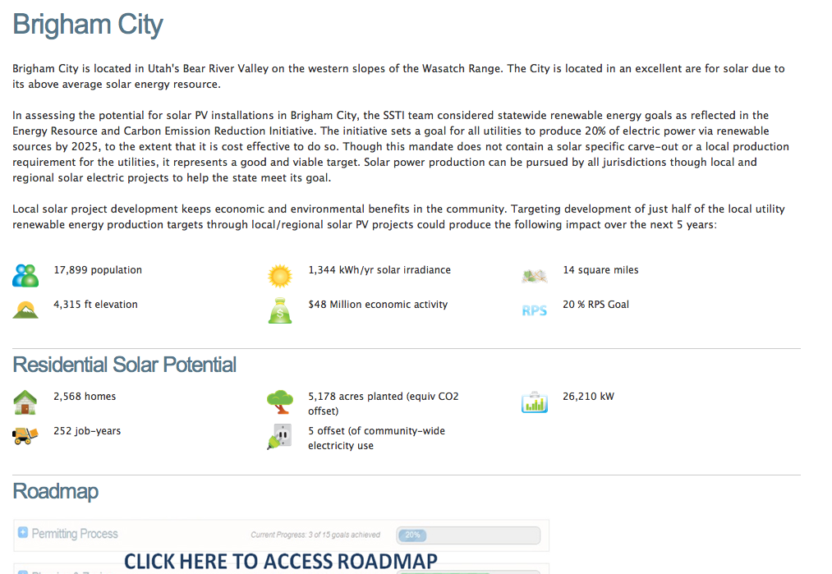
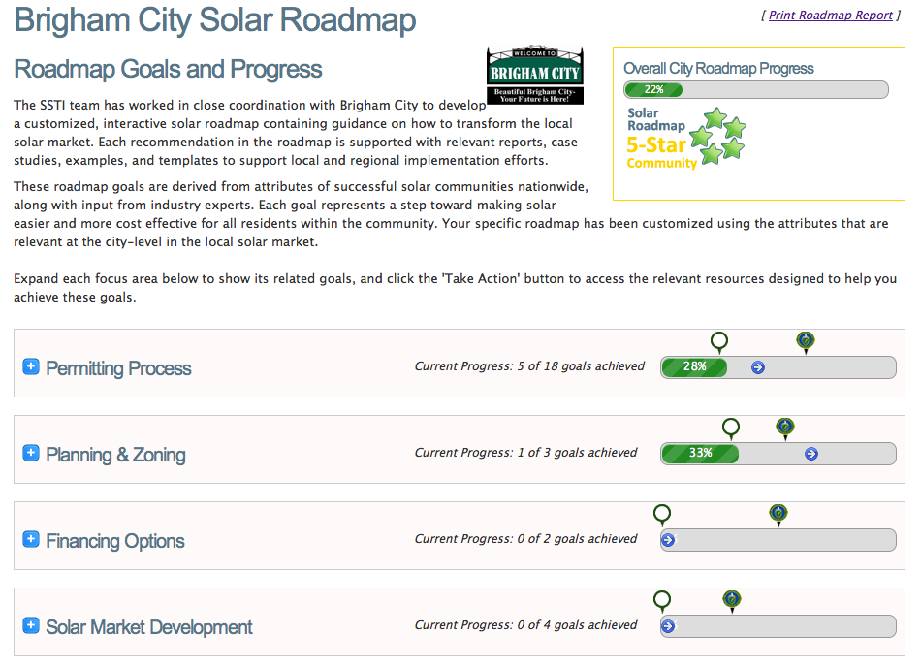
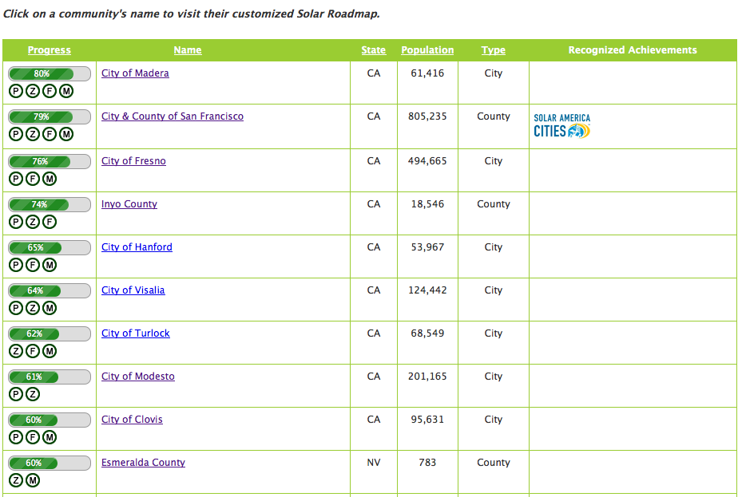
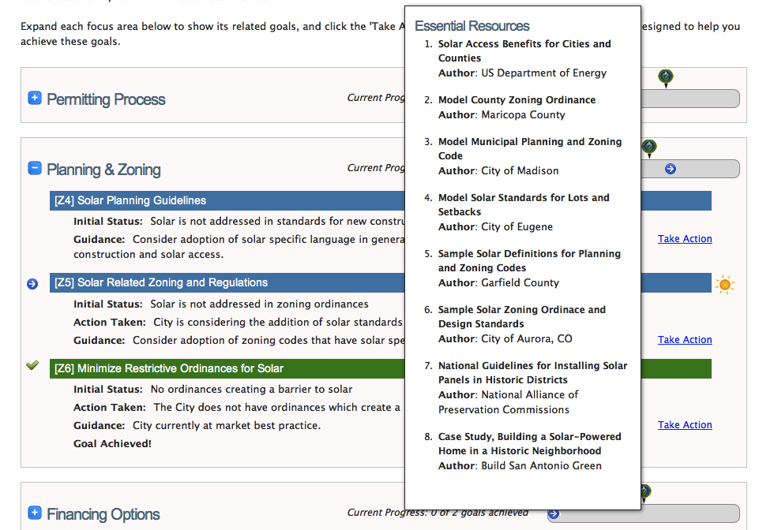
Participant View & Tools
City/County Landing Page
Community Stats & Resources
Customized Roadmap
Interactive & Updated Real-time
Solar Roadmap Leaderboard
View by Region, Pop., Type, Progress
Resources for Taking Action
Organized by Goal & Available for Download
8

Slide 9
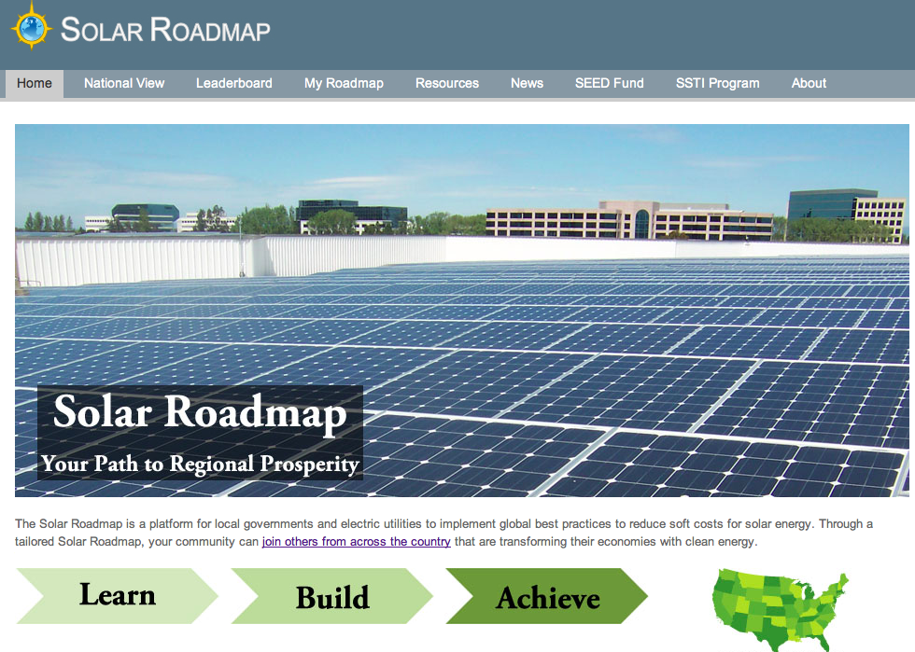









www.SolarRoadmap.com
Hundreds of resources from all major organizations
Consumers
Government
Industry
9

Slide 10
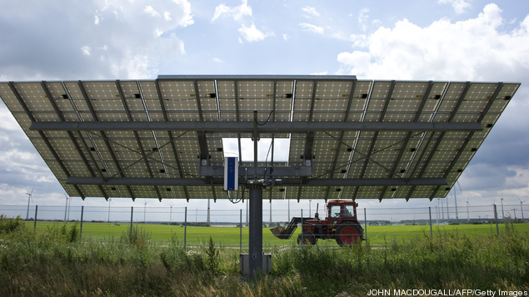

Benefits from Participation
Coordinated technical assistance and resources provided to individual participating jurisdictions and regionally.
Benefits
Provide resources to installers and consumers
Drive engagement through educational resources
Reduce project complexity and transaction costs
Coordinate efforts regionally for maximum impact
Convene solar market transformation work-groups
Residential/commercial/municipal aggregation
10

Slide 11
Next Steps
Review website and materials
Sign and return the ASTI participation agreement
Work with the team to complete “SM3” survey
Schedule interview to start building roadmap
Begin planning for training and information sessions
To Learn More Contact:
Tyler.Espinoza@optony.com
Or Visit:
www.solarroadmap.com
11

