Slide 1
MWAQC Action Plan and Stakeholder Engagement
Project Kick-Off
May 2, 2024

Slide 2
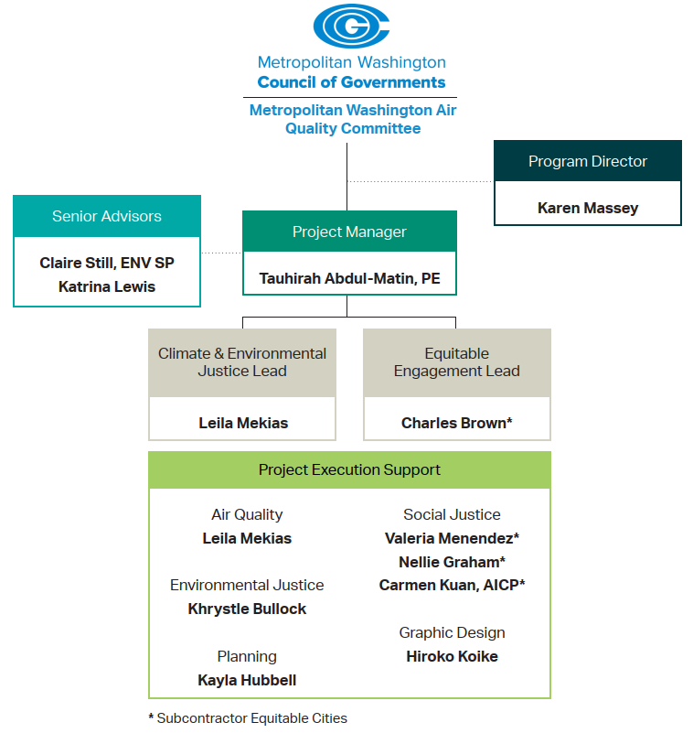
AECOM Introductions
Tauhirah Abdul-Matin, Project Manager, AECOM
Karen Massey, Program Director, AECOM
Claire Still, Senior Advisor, AECOM
Leila Mekias, Climate & Environmental Justice Lead, AECOM
Charles Brown, Equitable Engagement Lead, Equitable Cities
Khrystle Bullock-Sam, Environmental Justice Support, AECOM
Kayla Hubbell, Planning Support, AECOM

Slide 3
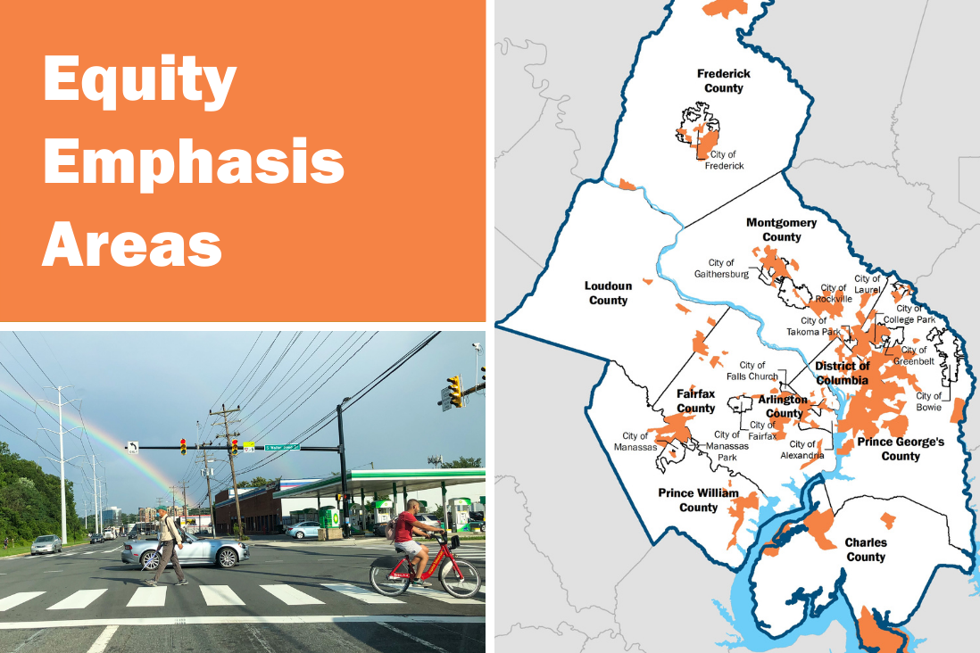
MWCOG Introductions
Robert Christopher, MWCOG Environmental Planner
Anita Bonds, EJ Subcommittee Co-Chair, District of Columbia
David Snyder, EJ Subcommittee Co-Chair, City of Falls Church
Kristin Mink, EJ Subcommittee Co-Chair, Montgomery County

Slide 4
Agenda
Project Overview & Alignment
Project Execution Approach
Next Steps
Input from the EJ Subcommittee

Slide 5

Project Overview & Alignment

Slide 6
Project Overview and Goals
Develop an Action Plan to assist members on how to consider equity when implementing air quality polices, projects, and programs.
Stakeholder Engagement Goals
Action Plan Goals
Form partnerships, solicit feedback, and gather input
Understand stakeholder groups' priorities, goals, potential concerns, and recommendations for integration of feedback into the Action Plan.
Develop tiered priorities and action steps for achieving the goals, recommended performance metrics, and guidance for effectively tackling EJ-related issues in alignment with the MWAQC and EJ subcommittee.

Slide 7

Project Execution Approach

Slide 8
Team Structure

Slide 9
Scope of Work and Deliverables
1
2
3
Project Administration
Project Kick-off
Monthly check-in calls
Stakeholder meetings
Deliverables
Kick-off Slide Deck (D/F)
Action Plan Technical Memo (D/F)
Stakeholder and Sub-Committee meeting materials
Invoices and progress reports
Stakeholder Engagement
Engagement Planning - Mapping
Preliminary outreach and engagement strategy
Implementation of engagement activities
Engagement report
Deliverables
Up to 10 preliminary outreach calls
1 Digital information flyer
1 Engagement Report
Action Plan Development
Include stakeholder feedback
Desktop research on best practices from peer examples
Input from subject matter experts.
Deliverables
Action Plan outline
Draft Action Plan
Final Action Plan
Action Plan summary presentation

Slide 10
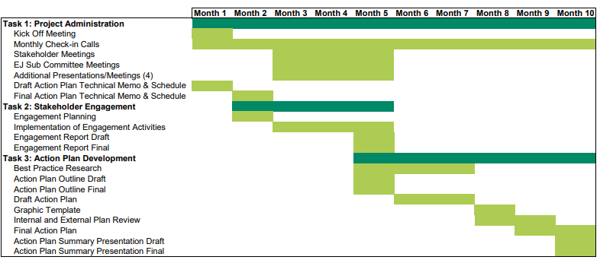
Timeline and Milestones

Slide 11
Technical Approach
Desktop Review
  Existing air monitoring data and any health studies specific to the area
  Identifying any gaps in our understanding of air quality
  Point and mobile sources
  Air quality policies
  Environmental justice analysis & best practices
  Planned developments and impacts
  Climate change impacts to air quality
Stakeholder Engagement
  Develop and document stakeholder outreach strategy
  Identify and prioritize impacted/interested stakeholders
  Outreach and Engage. Solicit recommendations and feedback for the Action Plan
  Ground truth our understanding of regional air quality, pollution sources, and air monitoring efforts

Slide 12

Input from the EJ Subcommittee

Slide 13
Stakeholders and Communication Plan
Stakeholder | Membership | Objective of involvement | Method of outreach | AECOM Scope
Metropolitan Washington Air Quality Committee (MWAQC) | 44 Elected/appointed officials of COG jurisdictions Air management directors State Env. Agencies Transportation directors State General Assemblies Transportation Planning Board Chair Chair: Kenny Boddye (PWC Supervisor) | Air quality and maintenance planning Develop and maintain public participation and education Provides project oversight and final approval of the action plan. | Outreach to occur during a regularly scheduled MWAQC meeting | One (1-hr) meeting with MWAQC May 22
EJ Sub-Committee | 5 Local Jurisdictions 3 State Agencies 2 Public Agencies (ACPAC) | Lead the plan development and seek input from MWQAC, ACPAC, and external Stakeholders Provides updates to MWAQC | To be determined | 4 (1-hr) meetings
Air and Climate Public Advisory (ACPAC) | 18 Members from MWCOG communities, industries, businesses, education, civic Chair: Julie Kimmel | Advise MWAQC and Climate, Energy, and Environment Policy Committee (CEEPC) on air quality, climate and energy issues | Outreach to occur during a regularly scheduled ACPAC meeting | One (1-hr) meeting with ACPAC
External Stakeholder | To be identified during stakeholder mapping/planning | Provide recommendations and feedback on air quality equity actions to include in the plan | To be determined | One (1-hr) meeting 4 (1-hr) optional mtgs

Slide 14
Input from the Environmental Justice Sub Committee
At what milestones in the Action Plan development process would you prefer to be engaged?
Are there community stakeholders you’d recommend engaging?
2. Do you have recommendations on how to equitably engage partners impacted or interested in the MWAQC Action Plan?
    What has worked?
    What hasn’t work?
Live Workshop Notes:

Slide 15

Next Steps

Slide 16
Next Steps
Confirm Project Schedule
Technical Memo Development
Draft Stakeholder Engagement/Outreach Plan

Slide 17
Thank you.
Tauhirah Abdul-Matin
tauhirah.abdul-matin@aecom.com

