Slide 1

Water Resources
Technical Committee
January 9, 2026
VA and MD
Legislative Session Preview
Lisa M. Ochsenhirt

Slide 2

2026 MD
Legislative Session

Slide 3


MD Legislative Session
2026 Session Dates
  Jan. 14: General Assembly convenes
  Jan. 21: Deadline for Budget Introduction
  Feb. 9: Senate Bill Introduction Date
  Feb. 13: House Bill Introduction Date
  Mar. 23: Crossover
  Apr. 6: Budget to Be Passed By Both Chambers
  Apr. 13: Adjournment Sine Die
  June 2: Governor to Sign Bills by This Date
Dems in Control of Both Houses
  34-13 in Senate, 100-39 in House (2 empty seats)
  With a Democratic Governor
Notes:
3

Slide 4
State Budget
Budget, Budget, Budget
  Will loom large over the 2026 Session
  Maryland faces a $1.5 B budget gap for coming fiscal year
  In 2025 GA increased certain fees (EX: 6% tax on vending machine sales)
  What will 2026 GA do? Increase revenues, start cutting expenditures, or a combination of both?
Bills with High Fiscal Impacts Will Be Scrutinized
  Opportunity to push back on bills that shift costs to localities
  If you are asked to provide information for Fiscal & Policy Note, please try to do so
Notes:
4

Slide 5
State Budget (cont.)
Agency Cost Shifting
  Some agencies may be looking for other ways to financially support programs
  EX: Administrative penalties, increased fees for permit applications
  Or pass along tasks (and costs associated with those tasks) to counties and municipalities
Next Year is Election Year
  GA Members looking to reinforce records with constituents before elections
  Could see some creative/unusual bills
Notes:
5

Slide 6
Potential 2026 GA Bills
PFAS
  Phase-outs, biosolids land application (see slides below for more details)
Environmental Justice (EJ) and MDE Permitting
  Frequently see bills to strengthen oversight of environmental permits that have potential impacts in EJ communities
Flooding
  MDE flooding bill (to update studies from 1970s and 1980s)
  Some $ to assist with updating studies
  MDE wants to look at 500-year and 1000-year events at 1 sq. mi. scope
Notes:
6

Slide 7
Potential Topics (cont.)
MDE Penalties
  Would like to add administrative penalties option to wastewater construction and water appropriation sections of Code
Legionnaires’ Disease
  2 bills introduced in 2022 and 1 in 2023
  Supported by the Alliance to Prevent Legionnaires’ Disease
  Bill is coming for 2026 GA Session
  Will require public water systems to take certain steps to reduce disease
  EX: Maintain a minimum detectable disinfectant residual of free chlorine of at least 0.5 mg/l in all active parts of the system at all times if the system uses chlorine as disinfectant
Notes:
7

Slide 8
Potential Topics (cont.)
Open Drainage Inlets
  “Mason’s Law”; Mason Kearns’ family is advocating for passage
  Municipality must incorporate an approved grating system to any new open drainage inlet
  Municipality must install approved grating system on all existing open drainage inlets by June 1, 2027
  Approved grating system would need to be secured so it cannot be removed without appropriate tools or by force of flood water
  Approved grating system includes: (i) standard yard inlet; (ii) raised grate yard inlet; (iii) trash rack grating if it has at least 4 sides each as large as opening; (iv) for new inlets, a precast concrete box incorporated in drainage inlet construction
Others?
  Water cut-off bills
  Boil water advisories
  Stream restoration (seems unlikely, but see below)
Notes:
8

Slide 10
PFAS Bills
Senator Love Will Introduce 2 Bills
  Likely to also see cross-filed bills from Delegate Stein
Bill #1: Product Phase Out Bill
  Meant to reduce level of PFAS chemicals in State from consumer products
  CA Governor Newsome vetoed similar bill
    Would have banned cleaning products, dental floss, juvenile products, food packaging, ski wax, cookware with intentionally added PFAS
    From Newsome’s veto: “while this bill is well-intentioned, I am deeply concerned about the impact this bill would have on the availability of affordable options in cooking products”
Notes:
10

Slide 11
Expected PFAS Bills (cont.)
Bill #2: Biosolids Bill
  Would apply to all biosolids land applied in State
Basic Concepts
  Ban on land app. if biosolids have PFOS + PFOA levels > 50 ppb
  Additional management requirements for land app. if biosolids have PFOS + PFOA levels between 25 and 50 ppb
  No restrictions for biosolids with PFOS + PFOA levels < 25 ppb
  NB: Discussions are still underway, no legislative text shared yet, so concepts are subject to change
Notes:
11

Slide 12
Expected PFAS Bills (cont.)
Discussions
  Have taken different path than in 2025
  Senator Love has been meeting regularly with MDE and stakeholders
MAMWA and MACO Jointly Submitted “Asks”
  EX: Allow POTWs to use a running annual average
  Do not impose additional management measures using a single sample
  Consistent with drinking water SDWA NPDWR MCL compliance
Ongoing Discussions
  How localities will pay to address new requirements (funding)
  Shoring up local authority over industrial users in bill
  House E&T and Senate EEE have expressed interest in briefing early in Session
Notes:
12

Slide 13
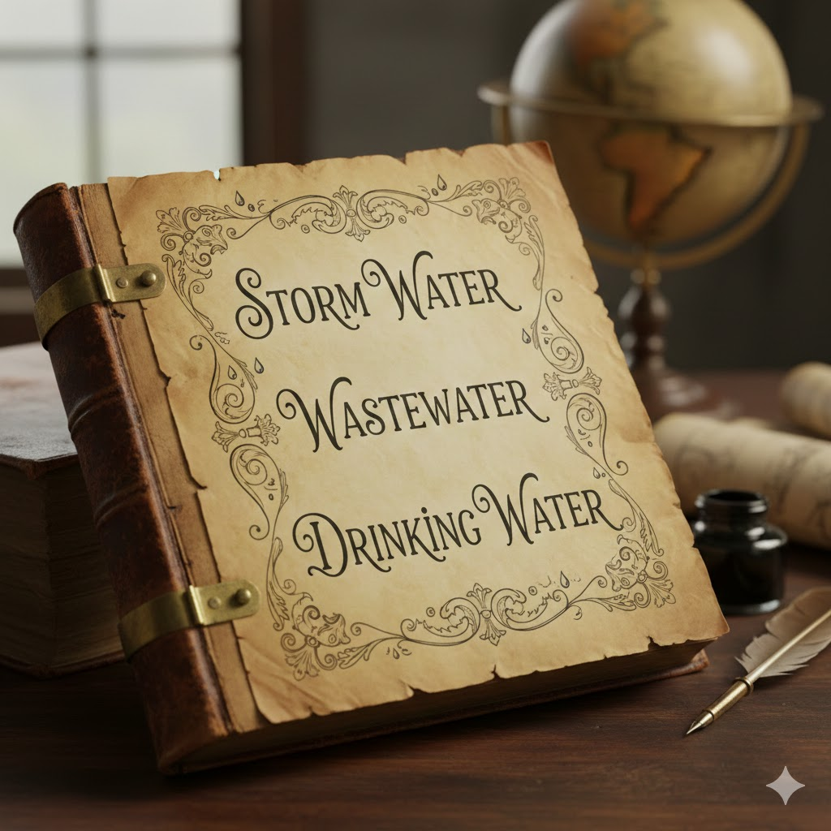
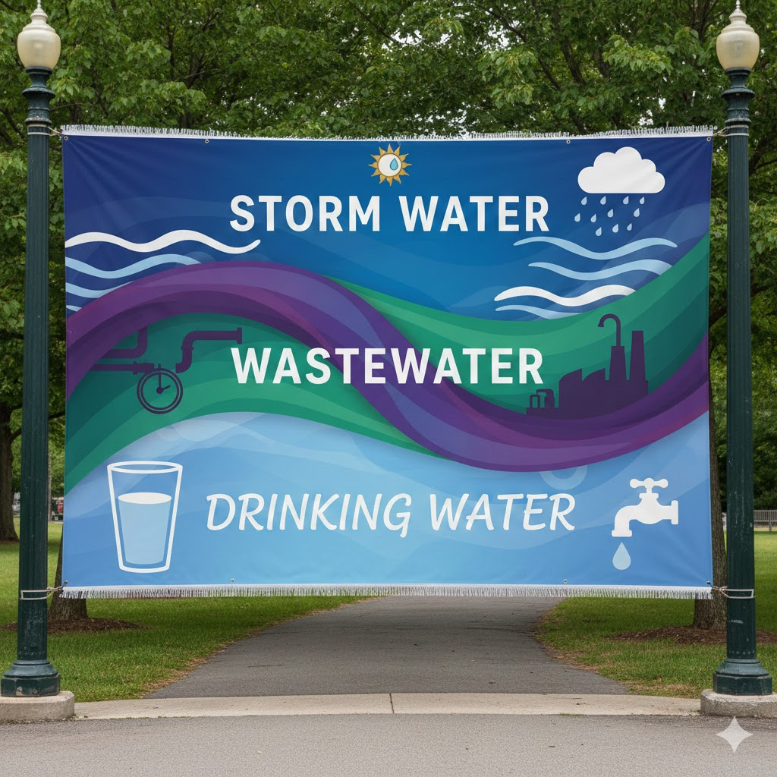
Notable Stormwater, Wastewater, Drinking Water Issues

Slide 14
Stormwater Issues
Post Development Stormwater Regulations
  MDE issued Advanced Notice of Proposed Rulemaking (ANPRM) in Sept. 2025
  Shared draft regulations and draft SW Design Manual sections
    Introduction (Ch. 1), SW Management Criteria and ESD (Ch. 2), SW BMP Design (Ch. 3), Selecting the Best BMP at a Development Site (Ch. 4)
  Added listening session for Jan. 20, 2026 (6-8 PM) and extended public comment period through Jan. 30, 2026
  More information here: https://mde.maryland.gov/programs/Water/StormwaterManagementProgram/Pages/index.aspx
Mitigation Banking Regulations
  MDE issued ANPRM in Sept. 2025
  Goal is to “Strengthen MDE’s regulatory authority to implement in-lieu fee and mitigation banking programs” for non-tidal wetlands
  More information here: https://mde.maryland.gov/programs/water/WetlandsandWaterways/AboutWetlands/Pages/ANPRM-Nontidal-Wetland-Mitigation.aspx
Notes:
14

Slide 15
Stormwater Issues (cont.)
Flooding
  MDE is receiving more complaints than normal about flooding issues
  Wants to partner with localities to understand/address this challenging topic
MS4 Permitting
  MDE states that restoration target for next permits will be 10%
  Phase II MS4s currently waiting for MDE draft of General Permit
  Phase I large MS4 permits will expire in late 2026; medium permits in 2027; SHA in 2030
E&S Manual
  MDE has hired a contractor, but work is likely still a few years out
MS4 Regulations
  State does not have MS4 regulations in COMAR (unlike in VA)
  MDE is considering convening a workgroup to discuss
Notes:
15

Slide 16
Wastewater Issues
Cybersecurity Planning
  As a result of passage of HB 1062/SB 871 in 2025
  Requires that Community Water and Sewerage Systems take certain steps to reduce risk
  EX: Attend annual trainings to improve awareness
  Additional requirements for systems serving more than 3,300 customers
  EX: Adopt and implement standards equal to or better than MDE standards
  MDE is working on regulations and guidance
Pretreatment Regulations
  MDE circulated draft regulations on March 2, 2025
  Currently regulations are sparse (only a few sections)
  Draft regulations are extensive
  MAMWA shared comments on Apr. 14, 2025; met with MDE on July 28, 2025
  Waiting for MDE response to MAMWA’s comments
Notes:
16

Slide 17
Wastewater Issues (cont.)
Significant Industrial User (SIU) PFAS Action Levels
  MDE required to set action levels by 2024 GA Law: Protecting State Waters from PFAS Contamination
  Released Determination of PFAS Action Levels for Significant Industrial Users (Dec. 2025)
  MDE set levels at 12 ppt for PFOS and 10 ppt for PFOA for influent to plant
  “As a next step, MDE will coordinate with pretreatment programs and facilities to develop mitigation plans for SIUs that have a reasonable potential to exceed the action levels.”
MDE-MAMWA Meeting
  Scheduled for Mon., Jan. 12 from 1-2
  MDE believes document is fairly self-explanatory but will answer questions
  Please reach out to me (lisa@aqualaw.com) if you would like to participate
Notes:
17

Slide 18
Drinking Water Issues
Boil Water Advisory Regulations
  Will be published in Maryland Register on Jan. 23, 2026
  MDE’s goal is to establish a regulatory procedure for managing outages
  Currently, COMAR has no BWA language in the drinking water regulations
  Comment period closes Feb. 23, 2026
PFAS MCL Rule
  In active litigation in federal courts
  MDE wants to adopt MCLs and submit primacy application in 2026
  Versus asking for 2-year extension (as we expect VA to do)
Notes:
18

Slide 19
Drinking Water Issues (cont.)
EPA’s Revised CCR Rule
  CWS that serves more than 10,000 people must circulate CCR 2X/yr.
  As compared to current July 1 annual requirement
  CWS that serves more than 50,000 people post CCR on website
  Compliance date is 2027
Lead and Copper Rule (LCCR/LCRI)
  Still in litigation in federal courts
  MDE will likely propose regulations in 2026
  Will reach out to MAMWA first to review proposed text
Notes:
19

Slide 20

2026 VA
Legislative Session

Slide 21

VA Legislative Session:
Long 60-Day Session
2026 Session Dates
  Jan. 14: General Assembly Convenes
  Jan. 16: Budget Amendment Request Deadline
  Jan. 23: Last Day to Introduce Legislation
  Feb. 18: Crossover
  Feb. 22: Money Committees Act on Budget Bills
  Mar. 14: Adjournment Sine Die
  Apr. 13: Governor’s Action Deadline
  Apr. 22: Veto Session
Notes:
21

Slide 22
2025 Virginia Elections
Generally
  Almost every locality got “bluer” vs. 2021 election
  Inauguration for Governor (D), Lt. Governor (D), and Attorney General (D) on Jan. 17, 2026
  New Governor-Elect Spanberger had biggest D win % since 1962
General Assembly
  17 newly elected House members (13 D, 4 R)
  53 of the 100 House members will have served no more than 4 years
  64 House Ds is most since early 1980s
  From 51 D/49 R in 2025 to 64 D/36 R in 2026 (13 seat swing)
  Senate remains 21 D/19 R in 2026 (no 2025 election)
Notes:
22

Slide 23
Issues for New Administration
Affordability
  High priority; implications for housing and energy policy? Water/Wastewater utilities?
Economy Slowing?
  Unemployment at 3.0% as of Jan. 2026, 3.6% as of Oct. 2025, Weldon Copper projects 4.8% in 2026
Notes:
23

Slide 24
Issues for New Administration (cont.)
Spending Issues/Estimates
  Federal cuts will impact VA Medicaid and SNAP
  Federal Tax Policy conformance could cost VA $2.3 B over biennium
  SLAF has nearly $236 M in needed State funding over next 5 years
  WQIF is also in significant need (see slide below)
Other/Miscellaneous
  Participation in RGGI
  Labor Policy
  Data centers (energy, water, rates)
Notes:
24

Slide 25
Notes:
25

Slide 26
Key Appointments
Secretary of Natural and Historic Resources
  David Bulova
Natural and Historic Resource Agency Heads
  Still waiting for announcements on DEQ, DCR, VMRC, DHR
Notes:
26

Slide 27
Budget Proposal
(From Outgoing Administration)
DCR Budget
  $2.5 M for Dam Safety, Flood Prevention and Protection Assistance Fund
  $750,00 for harmful algal blooms in Lake Anna
Environmental Financial Assistance
  $43.5 M for SLAF
  $140.5 M for WQIF but earmarked for HRSD Boat Harbor Plant subject to grant agreement
New Governor Will Submit Amendments
  To reflect Administrative priorities
Notes:
27

Slide 28
HB 52 (Bloxom)
Marine Resources Commission; Beneficial Use of Dredged Material
New State Policy
  Supports use of beneficial dredged material “whenever feasible”
  Requires use for permits involving dredged materials unless unsuitable
Expanded Use (Currently Limited to Beaches)
  Includes projects that are consistent with use of dredged materials
New Definition of Beneficial Use of Dredged Material
  “…any of the following uses of dredged material from the Chesapeake Bay and its tributary waters placed into water or onto bottomlands of the Chesapeake Bay or its tidal tributaries: (i) the restoration of underwater grasses; (ii) the restoration of islands; (iii) the stabilization of eroding shorelines; (iv) the creation, restoration, or enhancement of wetlands; or (b) the creation, restoration, or enhancement of fish or shellfish habitats.”
Notes:
28

Slide 29
HB 70 (Feggans)
Resilient VA Revolving Fund; Projects in Low-Income Geographic Areas, Nature Based Solutions
Interagency Resilience Management Team
  Will be responsible for reviewing, making recommendations on RVRF applications
Use of Funds
  No less than 25% used for projects in low-income areas as defined in §10.1-603.24
  Priorities given to projects in low-income areas and that incorporate nature-based solutions
VRA Authority
  VRA may contract with any person to serve as program administrator (must be approved by DCR) to assist with the distribution of funds to local governments with up to 5% administrative payment
Notes:
29

Slide 30
HB 135 (Simon)
Virginia Code Commission; Extends Subdivision Plats Work Group; Report
Amends 2025 Law
  Directed VA Code Commission to convene a workgroup to study and make recommendations on submittal, review, and approval of subdivision plats and site plans
VA Code Commission Report
  Under 2025 Law, report was due to Chairs of House Committee on Counties, Cities and Towns and Senate Committee on Local Government by Nov. 1, 2025
  HB 135 would extend to Nov. 1, 2026
Notes:
30

Slide 31
HB 214 (Feggans)
Localities; Home Flood Protection Assistance Program
Locality Option
  May by ordinance establish Program to provide $ to homes to install temporary home flood exclusion tools at vulnerable entry points
  Cannot provide more than $3,000 per home
  Locality may use funds from Resilient VA Revolving Fund to administer program
  Locality with a program may partner with a nonprofit on program
Limitations on Recipients
  Household can only receive funds after it has taken several steps
  EX: Completed “all required or recommended passive or structural flood mitigation measures, including drainage improvements, minor property regrading, cleaning of ditches, installation of French drains, and downspout reconfiguration
Notes:
31

Slide 32
HB 214 (Feggans) (cont.)
DCR’s Role
  DCR shall “establish and maintain uniform product performance verification standards for home exclusion tools”
Limitations on Uses
  May only be used for temporary home flood exclusion tools including modular door barriers, temporary flood dams, water-inflated or self-activating barriers, garage-entry flood shields, portable sump pump systems with barriers and “similar protective tools
  Cannot be used for permanent structural flood proofing tools that need FEMA flood proofing certification requirements
Notes:
32

Slide 33
SB 11 (DeSteph and Craig)
Expanded Polystyrene Food Service Containers; Repeal of Prohibition
Repeals Ban
  Currently in VA Code §10.1-1424.3
Tiered Prohibition
  As of July 1, 2023, larger food vendors (w/20+ locations) are prohibited from dispensing food in expanded polystyrene food container
  As of July 1, 2025, all food vendors are prohibited
Definition of Expanded Polystyrene Food Container
  “…means a rigid single-use container made primarily of expanded polystyrene and used in the restaurant and food service industry for serving or transporting prepared, ready-to-consume food or beverages…includes plates, cups, bowls, trays, and hinged containers but does not include packaging for unprepared foods or packaging, including a cooler, used in the shipment of foods.”
Notes:
33

Slide 34
Other Potential Topics for 2026 GA
Likely
  Construction: Mandatory Apprentice Labor Participate Rate
    Would require at least 8% of total labor hours for any capital outlay project be performed by apprentices (with some limited opportunities for waiver)
    Last year’s bill was vetoed, but will likely be reintroduced in 2026
  Right of Entry for Water Service Line Inspections
    To allow water utility to determine lead-status for EPA-required inventories
Also, Likely
  Biosolids and PFAS
  VA and MD GAs will be watching each other
  Need for VA and MD POTWs to keep each other apprised
Notes:
34

Slide 35

Notable Stormwater, Wastewater, Drinking Water Issues

Slide 36
Stormwater Issues
Fee Regulations
  DEQ presented final regulations at Nov. 18, 2025 State Water Control Board meeting
  Significant fee increases for MS4 maintenance fees, CGP coverage fees
  Made some changes to initial proposal
  Final regulations will be published in Jan. 26, 2026 Virginia Register
Dam Safety Regulations
  Legislation passed in 2025 GA Session, effective July 1, 2025
  DCR proposed regulations in May 5, 2025 Virginia Register
  Regulations are effective as of Jan. 14, 2026
Notes:
36

Slide 37
Stormwater Issues (cont.)
MS4 Permitting
  Most Phase I MS4 permits will expire in early 2029; Arlington Co. permit expires on June 30, 2026
  Phase II MS4 GP expires on Oct. 31, 2028
  Open question whether/what DEQ will incorporate for Bay Restoration requirements
EPA Inspections
  EPA is sending contractor back into VA for MS4 inspections
  DEQ taking the position EPA inspection is not sufficient for DEQ purposes
SW Handbook Ver. 1.2 (Dec. 18, 2025)
  DEQ will continue to accept applications, plans, etc. that use Ver. 1.1 until June 30, 2026
  As of July 1, 2026, must use Ver. 1.2
  Ver. 1.2 is focused on construction BMPs for E&S control
  Ver. 1.3 will be focused on post-construction BMPs
Notes:
37

Slide 38
Wastewater Issues
Biosolids Storage Regulations
  2024 GA passed HB 870
  Directs State Water Control Board to adopt regulations
  “11. Procedures for addressing administrative, staging, signage, and additional on-site and alternative storage site requirements when routine and on-site storage facility capacity and holding times are anticipated to be exceeded for the purpose of protecting against the release of sewage sludge into state waters, and to account for increased intensity, frequency, and duration of storm events”
  Proposed regulations published on Dec. 1, 2025 in Virginia Register
  Comment period ends Jan. 30, 2026
Triennial Review Topics
  Chesapeake Bay WQS segmentation, DO criteria, copper biotic ligand model permit-process option, PFOS and PFOA aquatic life criteria
Notes:
38

Slide 39
Drinking Water Issues
EPA PFAS MCLs
Lead and Copper Rule (LCCR/LCRI)
State PFAS Work
Water Withdrawal Permitting (Grandfathered Withdrawals)
Cybersecurity
Notes:
39

Slide 40


Lisa Ochsenhirt
Lisa@AquaLaw.com
804.716.9021
www.AquaLaw.com

