Slide 1
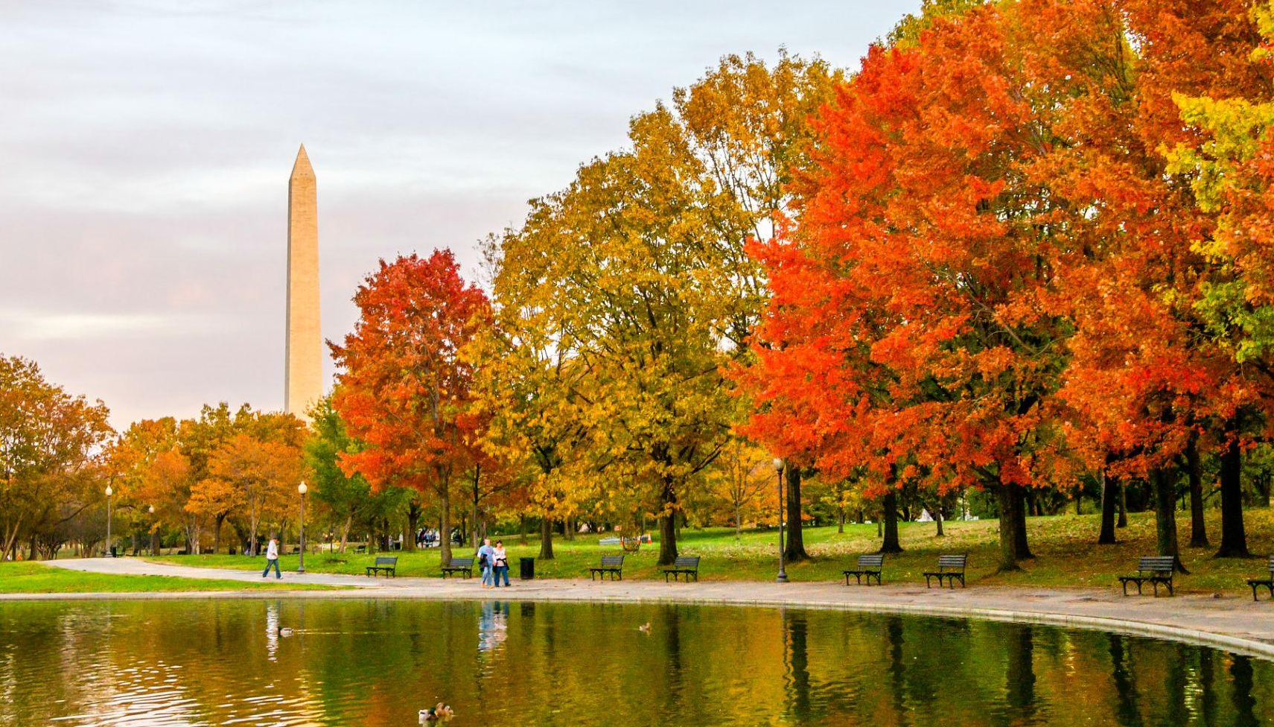
Item #3
COMMUTER CONNECTIONS
REGIONAL TDM MARKETING GROUP
FY 2027 MARKETING ACTIVITY
SEPTEMBER 15, 2026

Slide 2
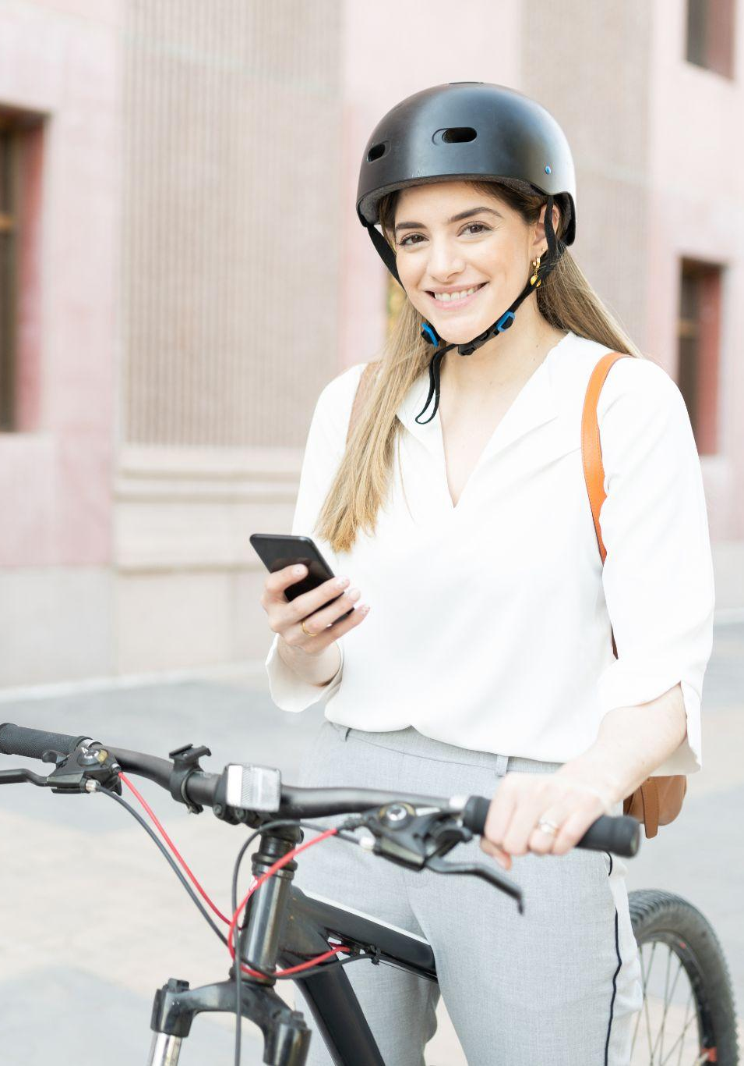

COMMUTER CONNECTIONS PROGRAM OBJECTIVES
Encourage alternatives to SOV commuting
Reduce vehicle trips and miles traveled
Reduce traffic congestion and improve
air quality

Slide 3
FY27 MARKETING ACTIVITIES
FALL SCHEDULE
CommuterCash (DC Regional & MDOT)
Carpool & GRH Fall Campaign
Employer Awards Call For Nominations Creative Development
Bike To Work Day Sponsor Drive
Bike To Work Day Creative Development
goDMV Marketing Campaign Development
Spring Carpool & GRH Campaign Creative Development

Slide 4
FY27 MEASUREMENT & TARGETING APPROACH
Building on last year’s measurement and tracking foundation, we’re increasingly prioritizing measurable strategies while reaching audiences when and where behavior change is most relevant.
Measure meaningful actions.
Prioritize actionable metrics—i.e. link clicks and landing page views—to gauge audience intent.
Track registration intent.
Connect the dots from communications to active site engagement.
Prioritize trackable digital channels.
Maximize program impact by increasing investment in measurable digital tactics.

Slide 5

COMMUTERCASH

Slide 6
CommuterCash
OBJECTIVES & STRATEGY
Media Budget:
  Regional - $142,500
  MDOT - $47,500
Encourage commuters to download and use the new CommuterCash app

Slide 7
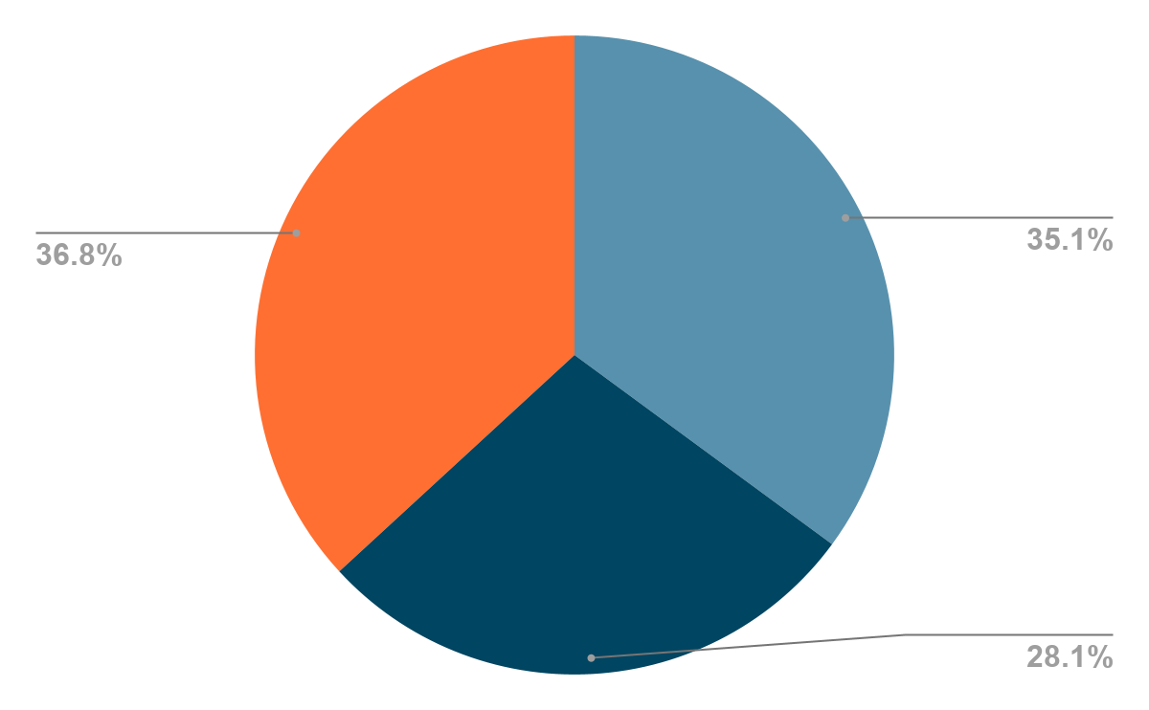
CommuterCash
REGIONAL MEDIA BUDGET (NET)
Digital Display
Streaming Radio/Podcasting
Social Media
Total
$52,500
$40,000
$50,000
$142,500

Slide 8
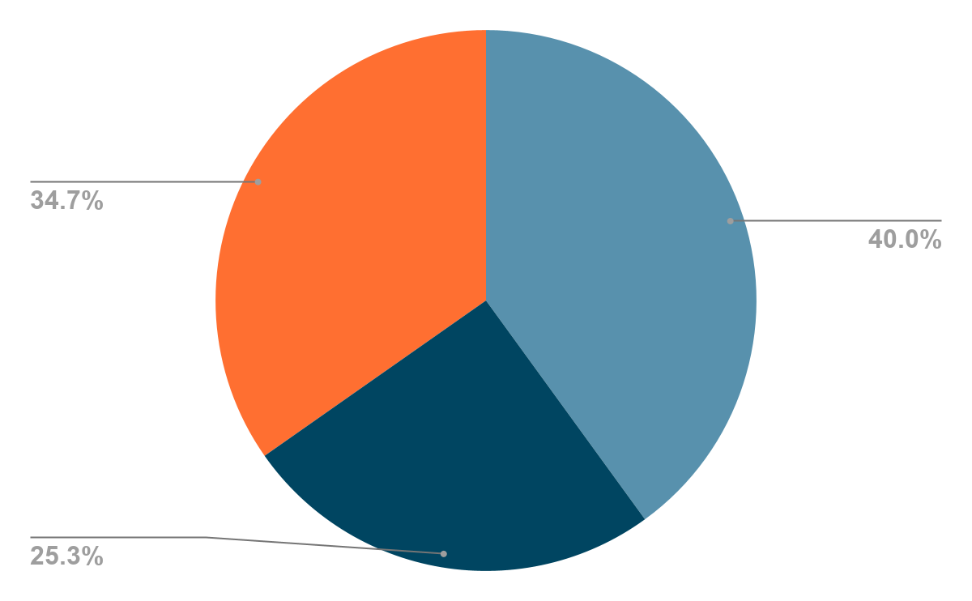
CommuterCash
MDOT MEDIA BUDGET (NET)
Digital Display
Streaming Radio/Podcasting
Social Media
Total
$19,000
$12,000
$16,500
$47,500

Slide 9
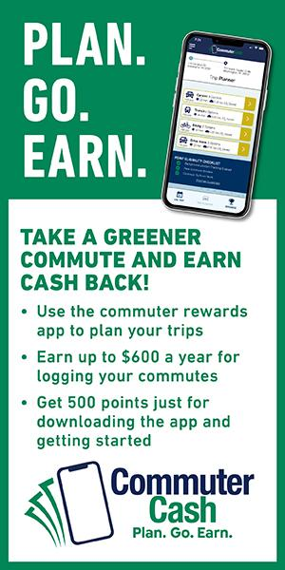
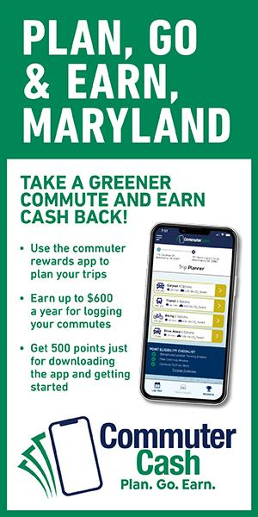
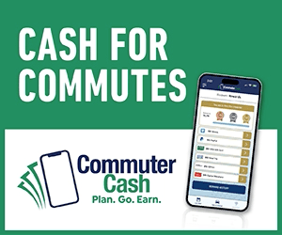

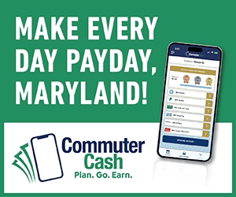

CommuterCash
CREATIVE EXAMPLES

Slide 10
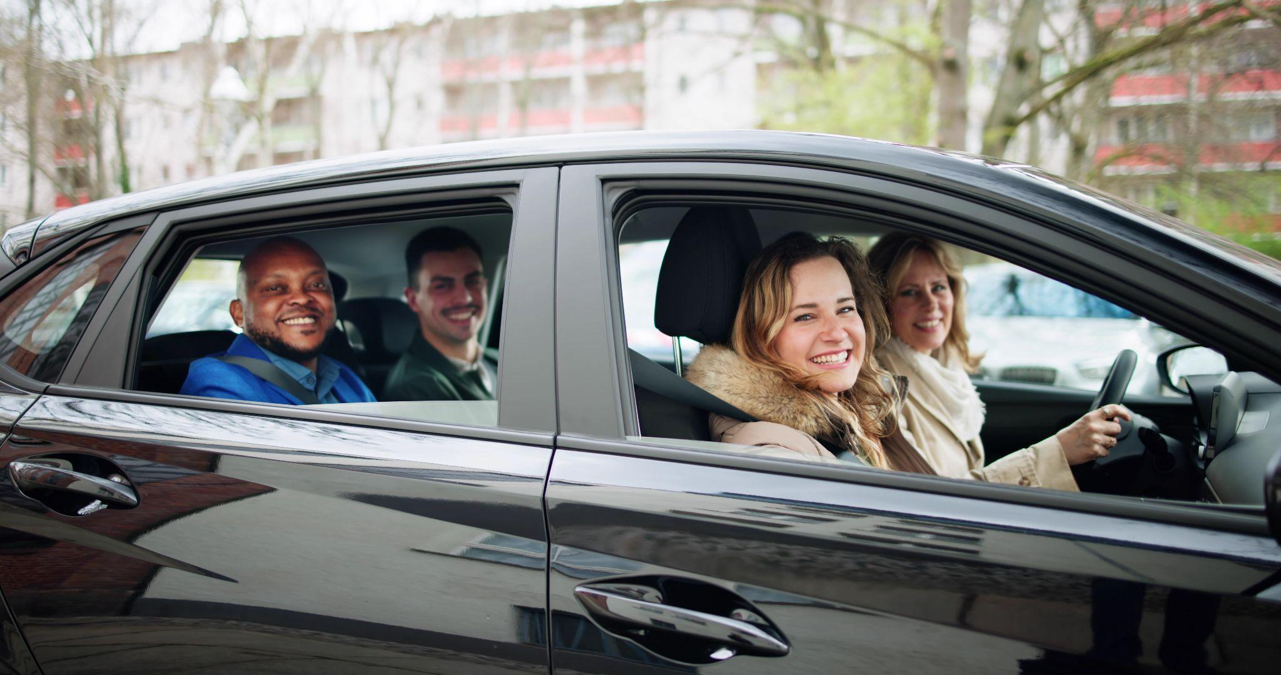
FALL UMBRELLA CAMPAIGN

Slide 11
OBJECTIVES & STRATEGY
Fall Umbrella Campaign
Media budgets:
  $ (Total)
    $180,500 for Ridematch
    $180,500 for Guaranteed Ride Home - DC region
    $26,125 for Guaranteed Ride Home - Baltimore region
Objectives
  Encourage and increase alternative modes of travel, primarily carpool, on the days workers travel to their worksite(s)
  Encourage Guaranteed Ride Home registrations for those using alternatives to SOV commuting

Slide 12
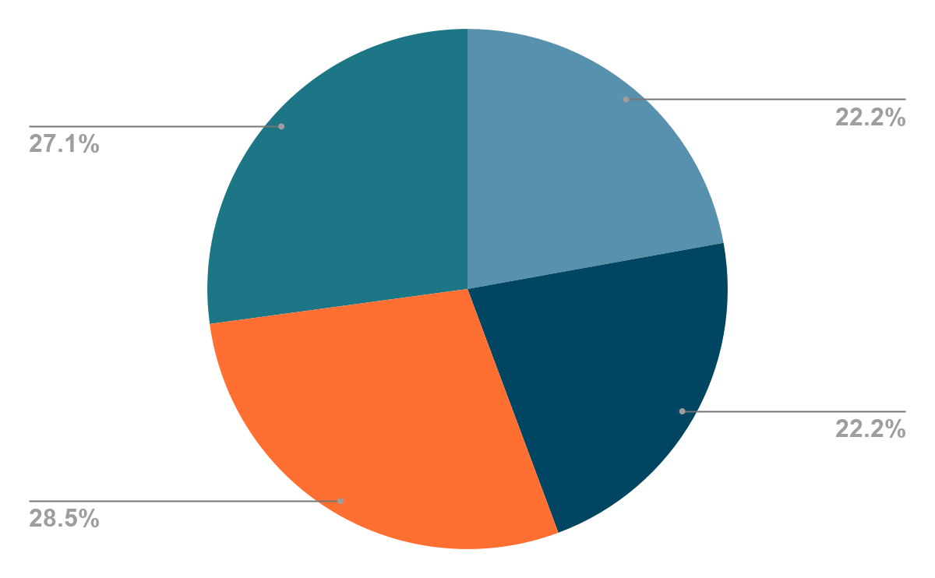
MEDIA BUDGET (NET)
Ridematch
Fall Umbrella Campaign
Traditional Radio
Streaming Radio/Podcasting
Digital Display
Social Media/Google
Total
$40,000
$40,000
$51,500
$49,000
$180,500

Slide 13
MEDIA BUDGET (NET)
Guaranteed Ride Home
Fall Umbrella Campaign
Traditional Radio
Streaming Radio/Podcasting
Digital Display
Social Media/Google
Total
$40,000
$40,000
$51,500
$49,000
$180,500

Slide 14
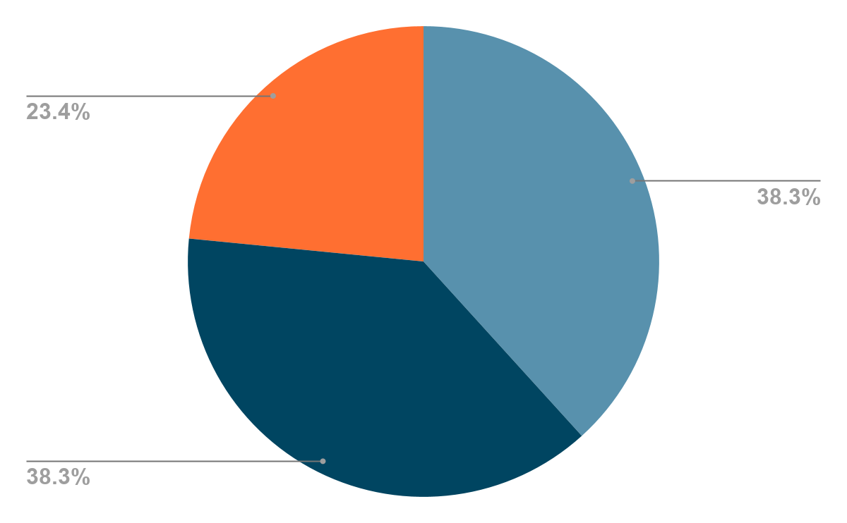
MEDIA BUDGET (NET)
Guaranteed Ride Home - Baltimore
Fall Umbrella Campaign
Digital Display
Streaming Radio/Podcasting
Social Media/Google
Total
$10,000
$10,000
$6,125
$26,125

Slide 15




RIDEMATCH CREATIVE EXAMPLES
Fall Umbrella Campaign

Slide 16


GRH CREATIVE EXAMPLES
Fall Umbrella Campaign

Slide 17
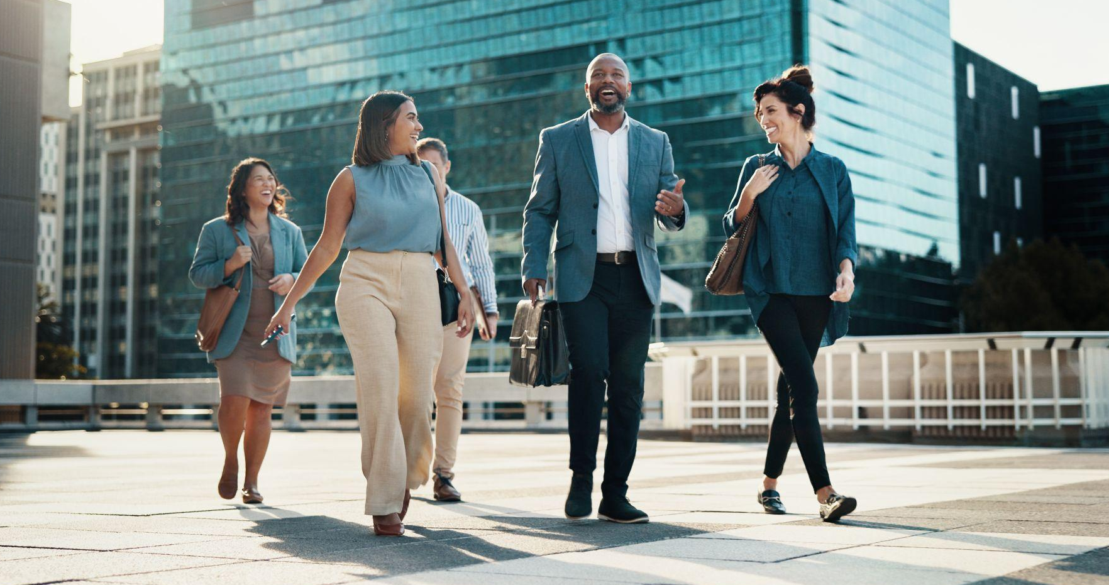
SPRING UMBRELLA CAMPAIGN

Slide 18
SPRING UMBRELLA CAMPAIGN
Research & Insights
Market Research
  2025 State of the Commute Report
  Trends research
  Brain behavior research
Concept Development
Develop new unified creative concepts for Spring 2027 campaign (while still highlighting Ridematch & GRH)
Refine selected concepts for final review & approval

Slide 19
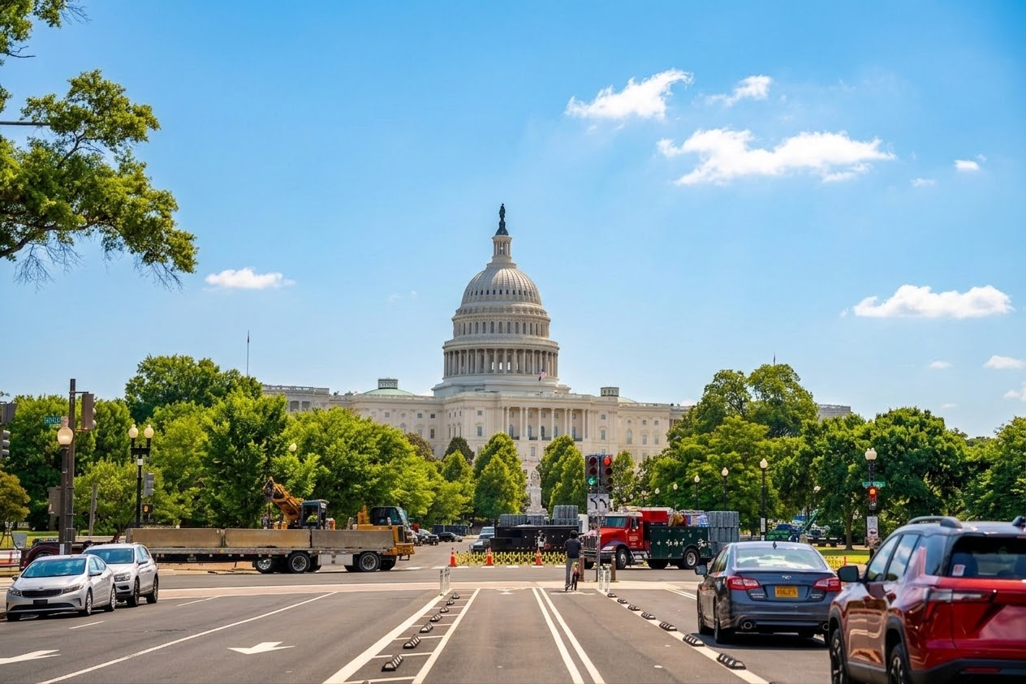
EMPLOYER AWARDS

Slide 20
EMPLOYER AWARDS
Employer Awards 2027 creative concept
Call for nominations materials

Slide 21
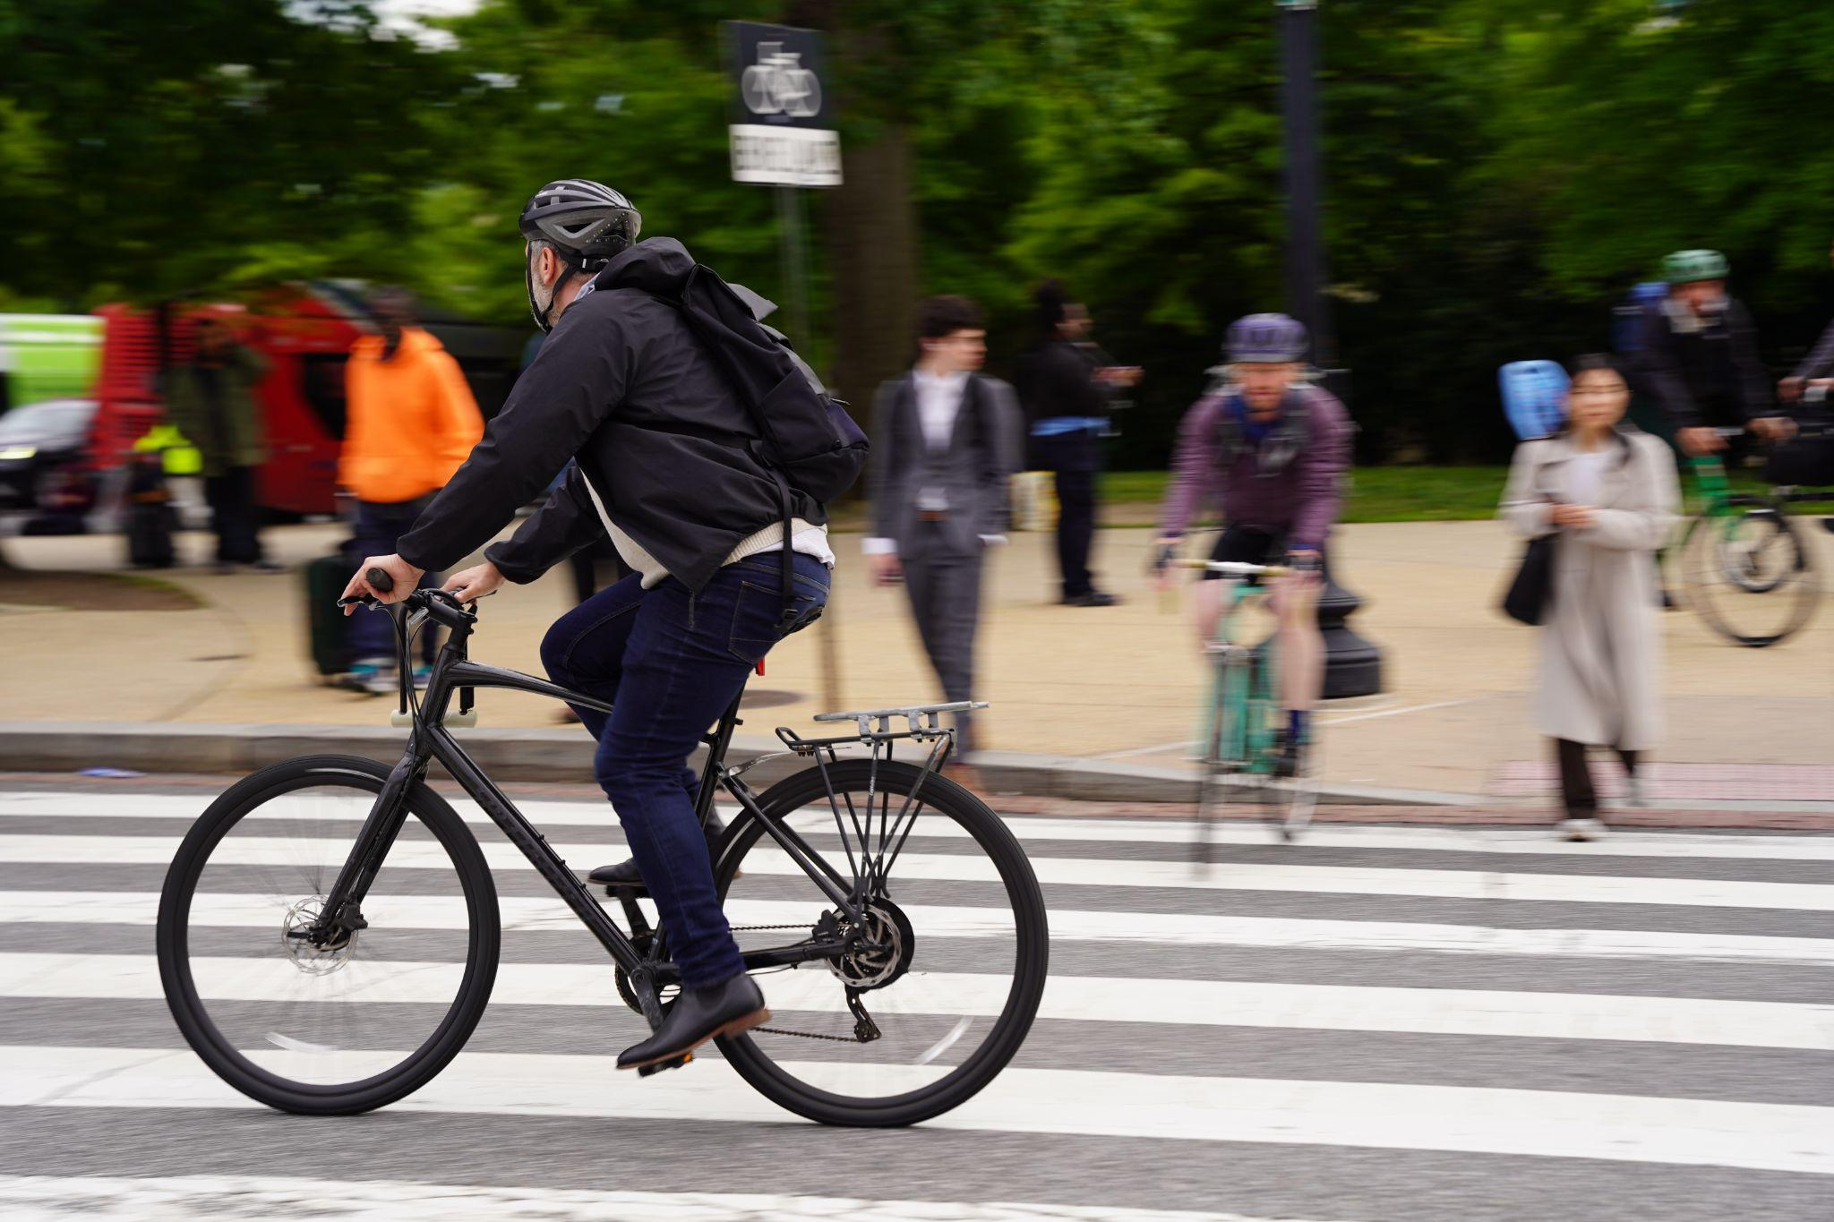
BIKE TO WORK DAY

Slide 22

BIKE TO WORK DAY SPONSOR DRIVE
Solicitation: Oct. 2026 – Jan. 2027
Deadline: Jan. 30, 2027
Goal: $41,000 - cash sponsors only (exception: bike raffle donors)

Slide 23
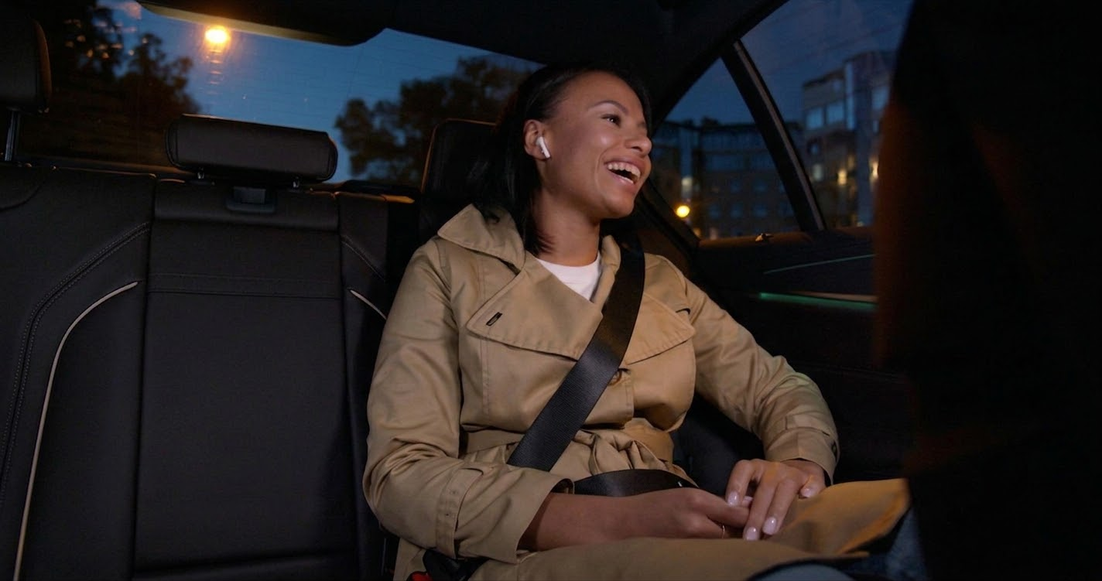
FY26 SPRING CAMPAIGN RESULTS

Slide 24
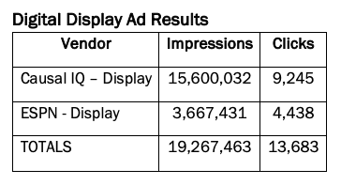
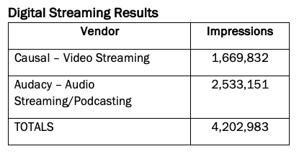
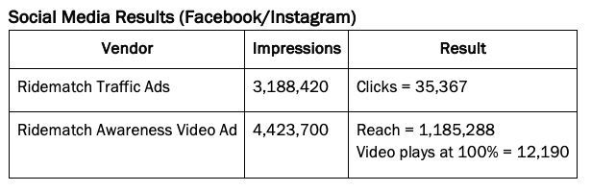
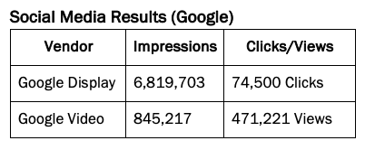
FY26 SPRING RIDEMATCH RESULTS

Slide 25
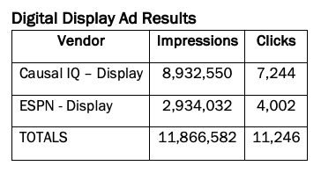
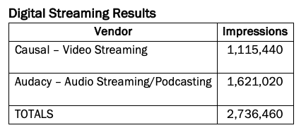
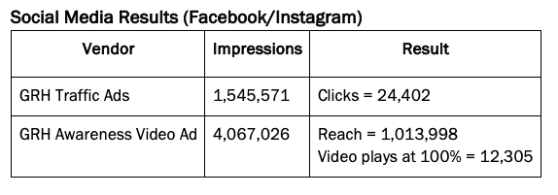
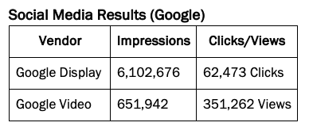
FY26 SPRING GRH RESULTS

Slide 26
THANK YOU

