Slide 1

ENVIRONMENTAL JUSTICE SUBCOMMITTEE AND ACTION PLAN
Kristin Mink, Environmental Justice Subcommittee Co-Chair Robert Christopher, COG Climate, Energy, and Air Program Director Tauhirah Abdul-Matin, AECOM Project Manager MWAQC May 28, 2025
Agenda Item #5
Notes:
Robert: Good afternoon, everyone. Thank you for the opportunity to provide an update on the activities of the Environmental Justice Subcommittee. We are pleased to present the draft Action Plan for your consideration.

Slide 2
Mission of the EJ Subcommittee
Develop an action plan to assist members on how to consider equity when implementing air quality policies, projects, and programs.
The EJ subcommittee will lead the plan development and seek input from MWAQC, ACPAC, TAC and external stakeholders.
Local and state members can voluntarily choose to implement/enforce that which is within their own jurisdictions.
Notes:
Kristin: The mission of the Environmental Justice Subcommittee is to develop an action plan to assist members in considering equity when implementing air quality policies, projects, and programs. The subcommittee will lead the plan development and seek input from MWAQC, ACPAC, TAC, and external stakeholders. Local and state members can voluntarily choose to implement or enforce the plan within their jurisdictions.

Slide 3
EJ Subcommittee Activities to Date
Held monthly meetings, including
  Presentations on active hyper-local monitoring projects
  Public input and community feedback
  development of a complete list and priority of strategies and actions to address air quality in communities historically disfavored or overburdended
The list was informed by public comment provided to the subcommittee and from insights gained from public listening sessions held around the region by AECOM. Key points have included:
  Public Engagement
  Air Monitoring
  Emission Sources
  Air Pollutants
  Community Health Risks
  Action Plan
  Control Measures
  Permits
Notes:
Kristin: To date, the EJ Subcommittee has held monthly meetings, including presentations on active hyper-local monitoring projects, public input, and community feedback. We have developed a complete list and priority of strategies and actions to address air quality in communities historically disfavored or overburdened. This list was informed by public comments and insights gained from public listening sessions held around the region by AECOM. Key points include public engagement, air monitoring, emission sources, air pollutants, community health risks, action plan, control measures, and permits.

Slide 4
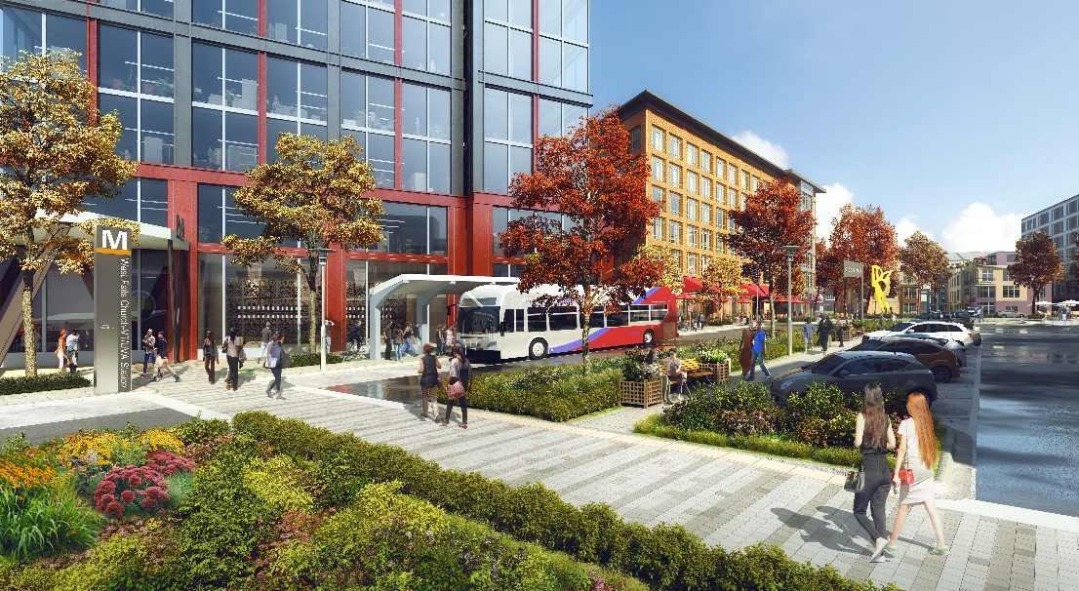
Resource Guide Overview
The Resource Guide for Air Quality Action based on public and stakeholder engagement covers the following:
  Air Quality in the region
  Equity and Environmental Justice
  Strategies to Improve Air Quality
  Recommended Actions
  Call to Action
West Falls Church rendering (WMATA)
Notes:
Kristin: The Resource Guide for Air Quality Action, based on public and stakeholder engagement, covers the following key areas: Air Quality in the Region, Equity and Environmental Justice, Strategies to Improve Air Quality, Recommended Actions, and a Call to Action. Tauhirah with AECOM will walk us through the plan.

Slide 5
Air Quality in the Region
This chapter provides a foundation for the rest of the plan covering:
Key Pollutants
Sources
Monitoring
Regulation Control Methods
Regional Trends
Notes:
Tauhirah: This chapter provides a foundation for the rest of the plan, covering key pollutants, sources, monitoring, regulation control methods, and regional trends.

Slide 6
Equity and Environmental Justice
This chapter highlights the disproportionate impact of air pollution on underserved communities and emphasizes the need for inclusive and equitable policies. Key points include:
Uneven Distribution of Pollution
Health Disparities
Equity-Focused Policies
Community Engagement
Regulatory Integration
Monitoring and Accountability
Notes:
Tauhirah: This chapter highlights the disproportionate impact of air pollution on underserved communities and emphasizes the need for inclusive and equitable policies. Key points include the uneven distribution of pollution, health disparities, equity-focused policies, community engagement, regulatory integration, and monitoring and accountability.

Slide 7
Strategies to Improve Air Quality
Improve Air Quality Monitoring
Foster Stronger Partnerships
Improve Air Quality Regulation
Increase Public Outreach and Education
Reduce Emissions from Stationary Sources
Reduce Vehicle Emissions
Promote Land Use Planning
Notes:
Tauhirah: The strategies to improve air quality include improving air quality monitoring, fostering stronger partnerships, improving air quality regulation, increasing public outreach and education, reducing emissions from stationary sources, reducing vehicle emissions, and promoting land use planning.

Slide 8
Recommended Actions
High Priority Actions:
Advocate for stronger ambient air quality standards
Facilitate knowledge sharing of success stories
Enhance enforcement of fugitive dust and pollution sources
Require additional controls at stationary point sources
Retrofit diesel vehicles and transition fleets to zero-emission vehicles
Promote public transportation and reduce idling of heavy-duty vehicles
Increased air quality monitoring
Notes:
Tauhirah: High priority actions include advocating for stronger ambient air quality standards, facilitating knowledge sharing of success stories, enhancing enforcement of fugitive dust and pollution sources, requiring additional controls at stationary point sources, retrofitting diesel vehicles and transitioning fleets to zero-emission vehicles, promoting public transportation, and reducing idling of heavy-duty vehicles.

Slide 9
Recommended Actions
Medium and Low Priority Actions:
Deploy hyper-local and mobile air quality monitors
Develop new local voluntary bundle measures
Educate the public on data center control measures
Evaluate local land use zoning for pollution sources
Limit highway expansion projects in impacted areas
Increase jurisdictional control and incorporate EJ in SIPs
Reduce vehicle miles traveled for public transportation
Partner with health departments and expand hyper-local monitoring partnerships
Notes:
Tauhirah: Medium and low priority actions include deploying hyper-local and mobile air quality monitors, developing new local voluntary bundle measures, educating the public on data center control measures, evaluating local land use zoning for pollution sources, limiting highway expansion projects in impacted areas, increasing jurisdictional control and incorporating EJ in SIPs, reducing vehicle miles traveled for public transportation, and partnering with health departments and expanding hyper-local monitoring partnerships.

Slide 10
Call to Action
Enhance Air Quality Monitoring: Expand monitoring systems and public outreach efforts.
Implement Targeted Policies: Focus on stationary sources and integrate air quality considerations into land use planning.
Strengthen Regulations: Update and enforce stricter air quality standards.
Foster Regional Partnerships: Collaborate with various stakeholders to pool resources and expertise.
Promote Sustainable Transportation: Invest in public transit, electric vehicle infrastructure, and anti-idling measures.
Raise Public Awareness: Conduct education campaigns to inform communities about air quality issues and mitigation strategies.
Coordinate Efforts: Promote cross-jurisdictional collaboration and advocate for regional investments in sustainable infrastructure.
Notes:
Tauhirah: The Call to Action includes enhancing air quality monitoring, implementing targeted policies, strengthening regulations, fostering regional partnerships, promoting sustainable transportation, raising public awareness, and coordinating efforts to promote cross-jurisdictional collaboration and advocate for regional investments in sustainable infrastructure.

Slide 11
Revision Process
Written feedback accepted from listening sessions, public comment during EJ subcommittee meetings, feedback from COG members and staff.
Renamed to Resource Guide for Air Quality Action noting the voluntary nature of the document.
Added local case studies of successful projects in air quality hot spots
Elevated air quality monitoring to high priority based on feedback
Notes:
Robert: The next steps involve presenting the draft plan to the public in a second round of listening sessions, revising the draft plan based on feedback from the public and the EJ Subcommittee, and finally, approving and publishing the plan.

Slide 12
Questions?
Notes:
Robert: Thank you for your attention. We are now open for any questions you may have.

Slide 13
Presenters Kristin Mink, Environmental Justice Subcommittee Co-Chair Robert Christopher, COG, Director, Climate, Energy, and Air Programs Tauhirah Abdul-Matin, AECOM Project Manager | mwcog.org
777 North Capitol Street NE, Suite 300 Washington, DC 20002
Notes:
Robert: Thank you for your time and feedback.

