Slide 1
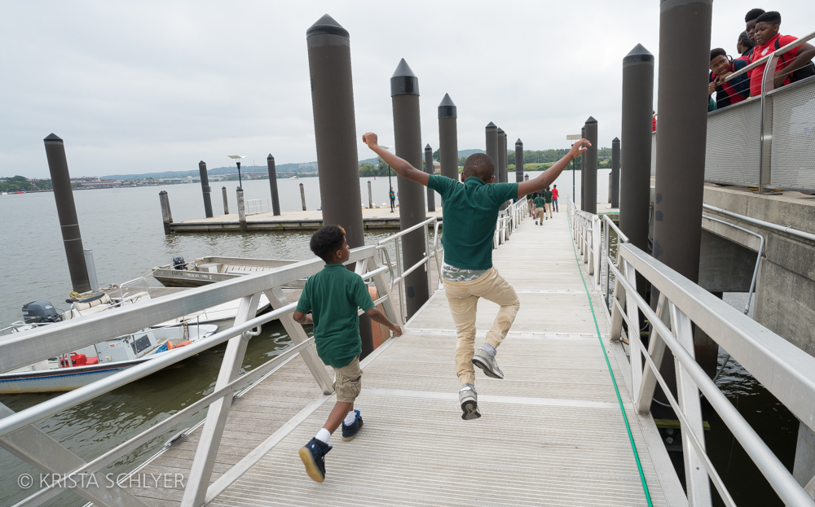


DISTRICT’S DRAFT PHASE III WIP
MWCOG Water Resources Technical Committee May 7, 2019

Slide 2
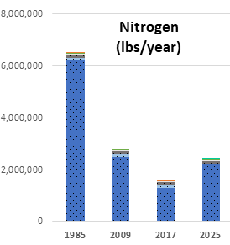
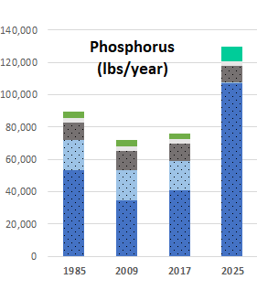
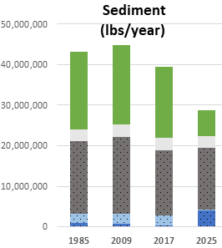
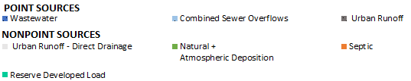

District’s Progress and Planning Goals
Figure ES-1– District Trends and Planning Goals for Nitrogen, Phosphorus and Sediment Pollution

Slide 3
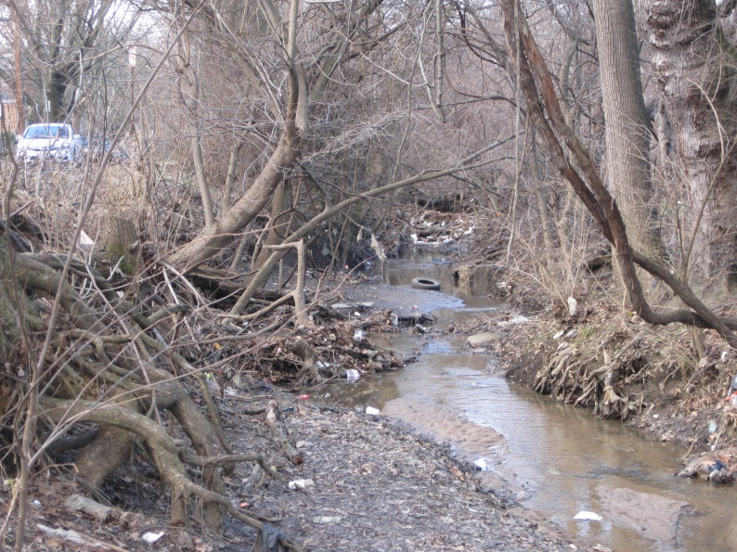
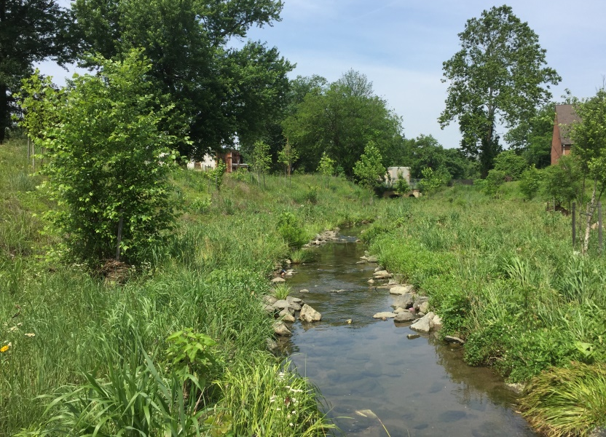
Commitments
Meeting permit requirements and completing planned stream restoration projects will achieve planning goals, including additional reductions to address climate change ​
    Blue Plains Wastewater Permit
    MS4 Permit: 1,038 acres managed over 5 years
    Restore almost 40,000 linear feet of streams
    Identified priority areas for local benefits
    Improve local water quality
    Healthy streams and habitat
    Increase climate resilience
    Maintenance a growing challenge
Nash Run Before
Nash Run After
Photo Credits: DOEE
Photo Credit: Krista

Slide 4
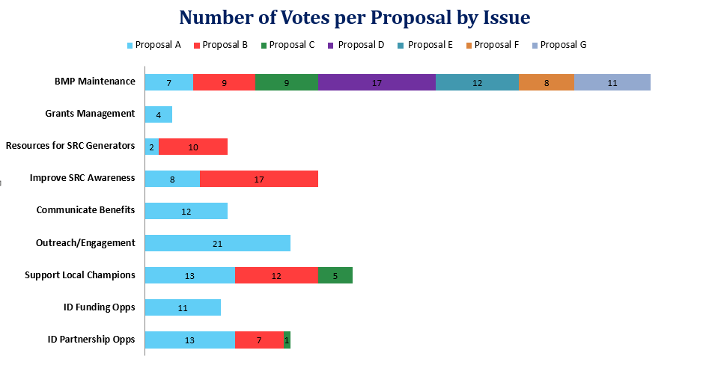
Chesapeake Partner Advisory Group

Slide 5
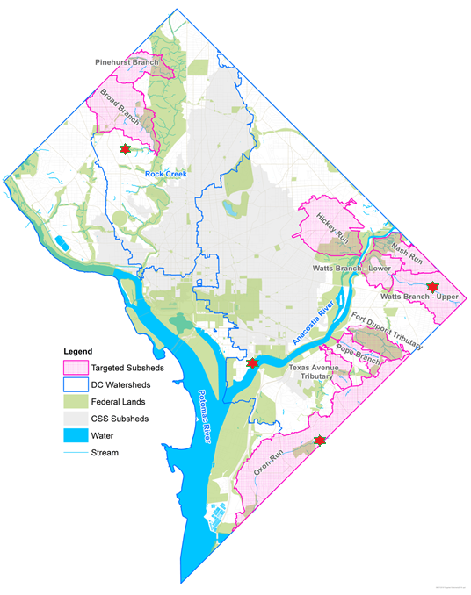
Public Review Process
Piloting approaches for public meetings:
Co-hosting with organizations
Interactive sessions
Working to offer boat tours, childcare,
refreshments at some meetings
Attending existing meetings

Slide 6
Conowingo
Member of Conowingo WIP Steering Committee
Not part of “effective basins,” so don’t anticipate practices to meet Conowingo WIP will be in DC
Working closely with Steering Committee and Chesapeake Bay Program to ensure sound analysis to support Conowingo WIP

Slide 7
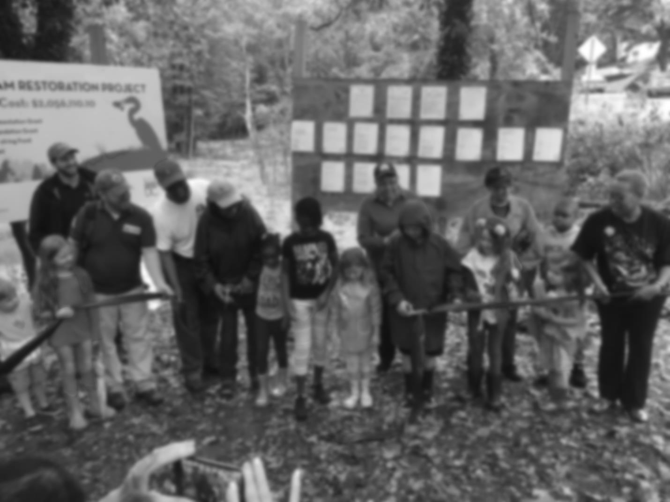

Katherine Antos
Branch Chief
Partnering & Environmental Conservation Branch
Department of Energy & Environment
katherine.antos@dc.gov
(202) 574-7606
https://doee.dc.gov/service/watershed-implementation-plans-chesapeake-bay
chesapeake@dc.gov

