Slide 1
High Cost of Low Bus Speeds
October 2021

Slide 2
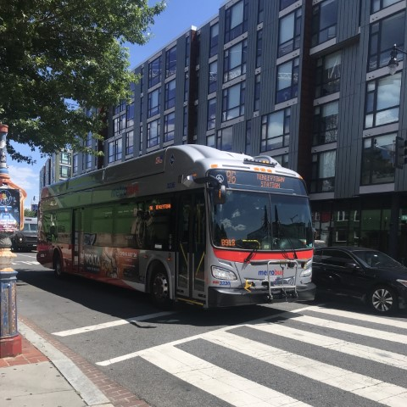
The Cost of Congestion to the Washington Region
Metrobus is slow, and getting slower
  This discourages bus ridership
  Metrobus riders spend 5 million hours delayed by traffic
  Low-income bus riders experience more congestion
Over 12% (about $65m) of the jurisdictions’ annual subsidy to Metrobus pays for buses to sit in traffic
Widespread bus priority (proven to work on H, I, 14th Streets etc.) could:
  Make buses 5-20% faster, improve reliability and the customer experience
  Save 11,000+ tons of CO2 annually, the equivalent of 2,500 cars
  Free up resources equivalent to more than the top 10 busiest corridors in the region
  Reduce regional expenses by nearly double the costs of the September fare and service improvement package: all-day service plan, free bus-rail transfers, lower bus pass prices, and more
Notes:
Voter registration data: https://dcboe.org/CMSPages/GetFile.aspx?guid=10ef0460-5899-4c4c-8e56-f3dd8657498c

Slide 3
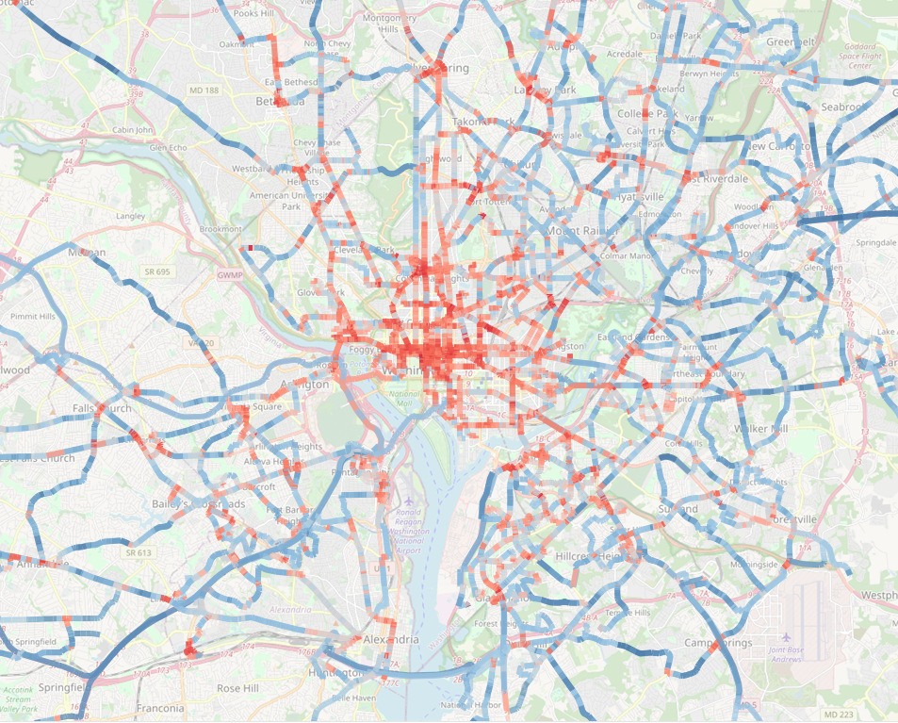

Why Faster Buses are Good for Metro and the Region
Faster buses are better for riders and for Metro
Metro’s buses are slow, and getting slower
Better for riders
  The Bus Transformation Project found bus speeds were 2nd-largest barrier to riding the bus, after frequency¹
  Travel time is a major driver of customer satisfaction²
  Metro research has shown that a 10% increase in speeds is correlated with a 9% increase in ridership³
Better for Metro
  Slower buses cost more to operate
  The Bus Transformation Project found a “1 mph increase in average bus speeds would unlock savings equal to 4% of operating costs”⁴
Average Metrobus speed is under 10 mph, down 10% over the last 10 years⁵
Metrobus trips are about one-third as fast as Metrorail
Median PM Peak Speeds, October 2019
Slowest areas have speeds of 3-5 mph
1 https://bustransformationproject.com/resources/public-survey-results/
2 https://transitcenter.org/publication/whos-on-board-2016/
3 WMATA Short-Term Ridership Forecast Final Report
4 http://bustransformationproject.com/wp-content/uploads/2019/01/20190118-Bus-System-Today_FINAL.pdf slide 172
5. Ibid, slide 179, from NTD data
0 10 mph 50

Slide 4
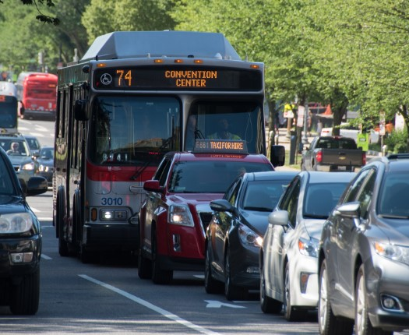
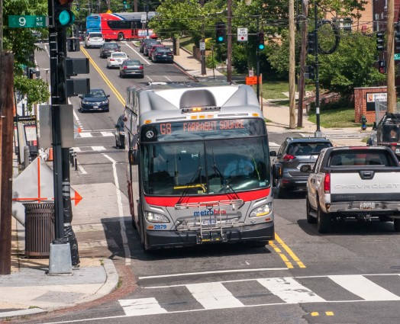
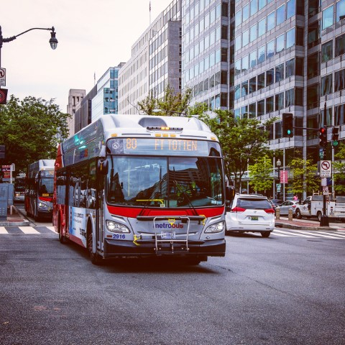
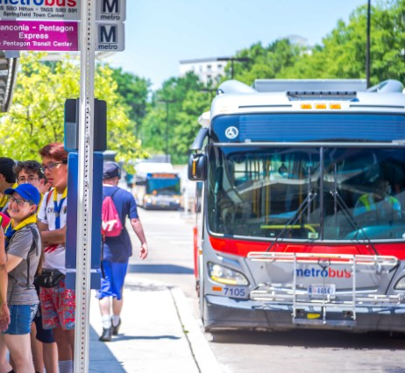
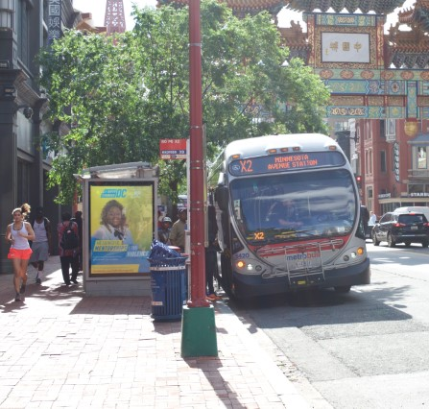
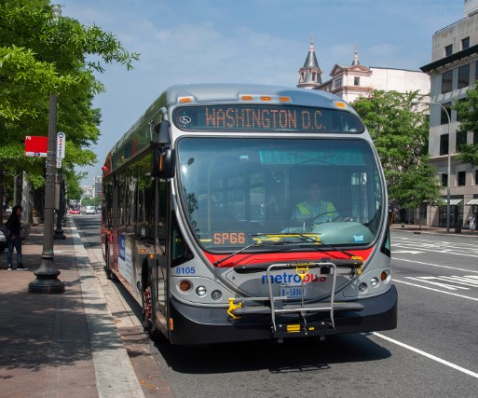
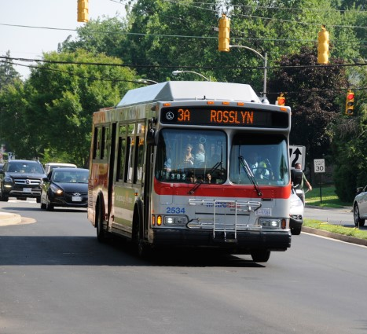





Components of Metrobus’s Costs
Free Flow
Stop Delay:
Deceleration
Stop Delay:
Acceleration
Traffic Congestion
Signal
Delay
Dwell Time
Image Credit: WMATA Photo Archive

Slide 5
Traffic Delay Consumes 17% of Metrobus Resources
Estimated Annual Operating Costs (At Non-Regional Hourly Rate)
 | District of Columbia | Maryland | Virginia | System
Free Flow Time | $132 million | $84 million | $57 million | $273 million
Dwell Time Passenger boarding/alighting | $19 million | $7 million | $4 million | $30 million
Stop Delay Acceleration/ Deceleration | $15 million | $8 million | $4 million | $26 million
Traffic Delay Signals and congestion | $37 million | $17 million | $12 million | $66 million
Total Travel Time | $203 million | $116 million | $77 million | $395 million
Analysis of 2019 data.
The COVID-19 pandemic has temporarily reduced traffic delay, but traffic conditions are rapidly returning to pre-COVID levels in many locations.

Slide 6
57% of Metrobus’s Traffic Delay Occurs in D.C.
District of
Columbia
57%
Maryland
57%
26%
18%
Virginia
Notes:
Highest share of dwell is on major corridors in DC.

Slide 7
Metrobus Riders Spend 5 million hours a year in buses which are stuck in traffic
 | Annual Hours | Annual Value of Time*
Free Flow Time | 18.9 million (67%) | $283 million
Dwell Time | 2.4 million (8%) | $35 million
Stop Delay | 2.0 million (7%) | $30 million
Traffic Delay | 5.0 million (18%) | $75 million
Total Travel Time | 28.2 million | $423 million
Equity Note: Low-Income riders experience more traffic delay
About 62% of passenger time spent delayed by traffic and traffic signals is experienced by low-income passengers, who make up 58% of total ridership
* At DC minimum wage of $15/hour

Slide 8
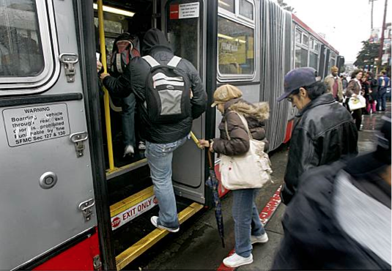
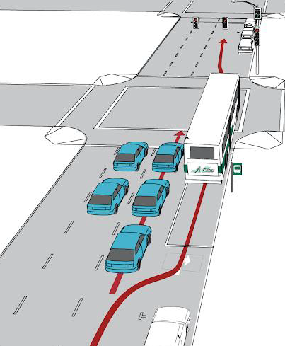
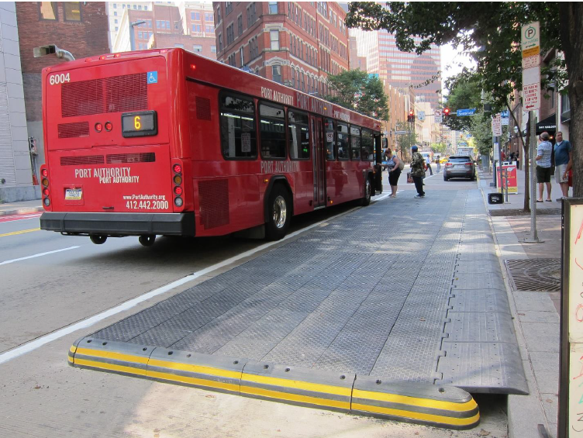
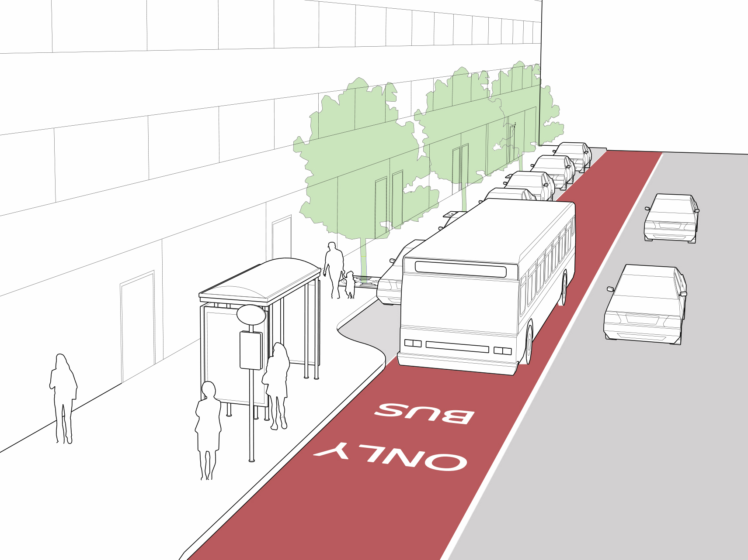
We can speed up buses! Sources of delay guide solutions
To reduce: Consider:
Dwell Time All-Door Boarding
Fare Payment Improvements
Stop Delay Stop Consolidation
Bus Stop Extensions
Traffic Delay Transit Signal Priority
from Signals Queue Jumps
Signal Timing Adjustments
Traffic Delay Dedicated Bus Lanes
from Congestion Violation Detection
$8 million*
$7 million*
$33 million*
For more information, see DDOT’s “Bus Priority Program Toolbox”, November 2020
* Value of potential regional travel time savings

Slide 9
How Could Bus Priority Impact Resource Requirements?
With large enough time savings from bus priority, Metro can run the same service with fewer vehicles
  We need a combination of strategies on a corridor
  Reliability improvements contribute to reduced vehicle needs
Reducing each source of delay by 25-50% could free up:
  Over 200 buses at peak times region-wide
  50-70 buses on weekends
Widespread bus priority could:
  Make buses 5-20% faster, improve reliability and the customer experience
  Save 11,000+ tons of CO2 annually, the equivalent of 2,500 cars
  Bring Metrobus speeds into better alignment with Metrorail
  Free up resources equivalent to more than the top 10 busiest corridors in the region
  Reduce regional expenses by nearly double the costs of the September fare and service improvement package: all-day service plan, free bus-rail transfers, lower bus pass prices, and more
Number of Potential Buses Freed Up by Widespread Bus Priority
Time Period | District of Columbia | Maryland | Virginia | Region
Weekday Peak | 118 | 48 | 45 | 211
Saturday | 37 | 20 | 11 | 67
Sunday | 28 | 13 | 9 | 47
Estimate based on route-level analysis of reduction in vehicle requirement, due to savings in round-trip travel time due to bus priority (see Appendix for details)

Slide 10
Reducing vehicle needs opens up possibilities
Short Run Impacts
Long Run Impacts
Short Run Opportunities
Long Run Opportunities
Additional bus priority
Increase service frequency at the same cost
Increase span of service
Expand the bus network to serve new markets
Grow ridership
Improve access to transit for disadvantaged communities
Reduce fares: low-income fare subsidy, reduce pass prices, etc.
Reinvest
Reduce operating costs
Reduce fleet size
Reduce facility needs
Reduce Costs

Slide 11
Appendix

Slide 12
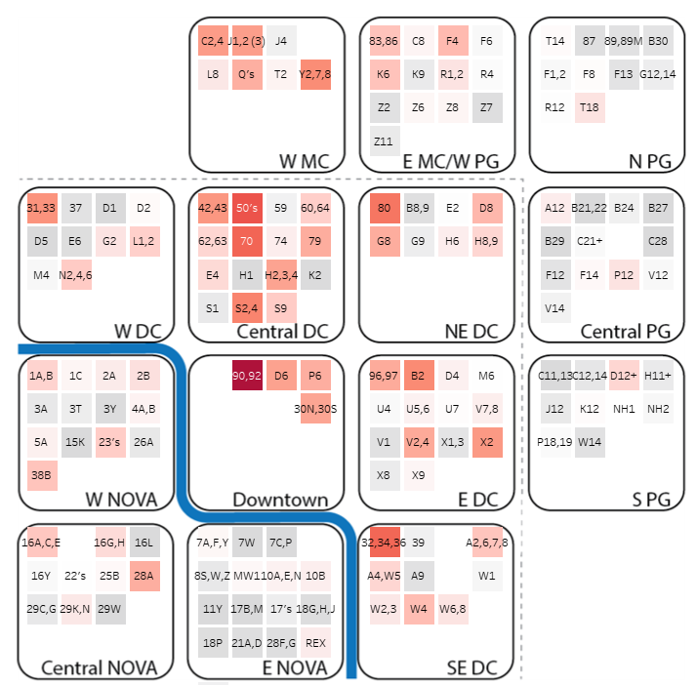

Routes with highest traffic delay are concentrated in downtown DC
Weekday hours of running time from traffic delay
0 135

Slide 13
Congestion is highest in the peak periods

Slide 14
Methodology
Running Time
Free Flow Time
Dwell Time
Stop Delay
Traffic Congestion
Start with the median running time for each route, direction, pattern, time period, and service type (weekday, Saturday, Sunday). Calculate departure from first stop to arrival at last stop.
Find the fastest real-world travel times by taking the minimum of:
10th Percentile running time
Median late night/early morning speed
Median speed early in COVID
Dwell time is recorded by the AVL system. Exclude dwell time at the first and last stops.
The rawnav queue jump study found that stop delay is about 10 seconds per stop. Multiply by the number of stops the bus serves.
Subtract components from median running time; remainder is traffic congestion*
* Traffic congestion includes traffic signal delay in this analysis
Example: Route S2 South, AM Peak
Running Time | Free Flow Time | Dwell Time | Stop Delay | Traffic Congestion
58 minutes (100%) | 38 minutes (65%) | 5 minutes (9%) | 5 minutes (9%) | 10 minutes (17%)
-
-
-
=

Slide 15
Vehicle Savings Example: Route W4 Weekday AM Peak
M
 | Actual | Estimated Optimal
Running Time | 68 min | 57.5 min
Layover | 10 min | 7.5 min
Cycle Time (round trip) | 156 min | 130 min
Headway | 15 min | 15 min
Vehicles | 11 | 9
Estimated 2 vehicles saved!

Slide 16
When can bus priority reduce vehicle requirements?
Shaving a minute or two off a bus trip improves service, but it doesn’t usually have a budget impact.
Removing buses from service (or increasing frequency) requires time savings of a headway or more.
Method: evaluate each route and estimate savings in round-trip travel time from bus priority (see appendix for details)
Results in 5-15% reduction in vehicle requirements at most times of day
Time Period | Weekday | Saturday | Sunday
AM Early | 67​ | 18​ | 13​
AM Peak | 211​ | 33​ | 18​
Midday | 99​ | 67​ | 47​
PM Peak | 199​ | 65​ | 46​
Early Night | 52​ | 49​ | 19​
Late Night | 18​ | 22​ | 8​

Slide 17
Technical Notes
Analysis Period: September 9th – October 23rd, 2019
Overnight running times calculated from 10 p.m. – 6 a.m.
COVID-era running times calculated for April 15th – May 15th, 2020
“Gap” and operator shuttle routes excluded
Assumptions for vehicle savings analysis are that bus priority results in savings of:
  25% of dwell time
  25% of stop delay
  25% of recovery/layover time (improved reliability)
  50% of traffic delay

