Slide 1

Food Security,
Equity, & Livability
COG Region Forward Coalition
July 16, 2021

Slide 2
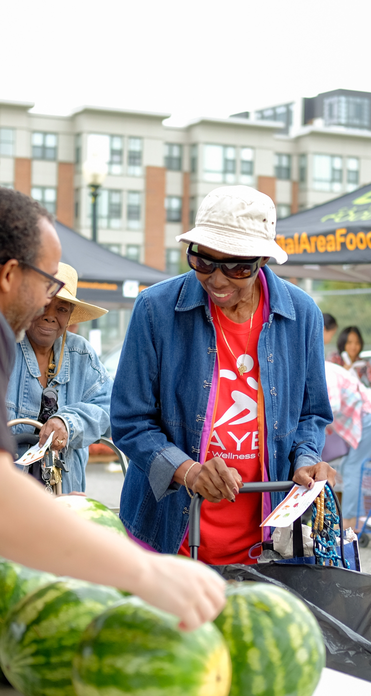
Capital Area Food Bank
The mission of the Capital Area Food Bank is to help our neighbors thrive by creating more equitable access to food and opportunity through community partnerships.
Since 1980 the Capital Area Food Bank has been the anchor of the greater Washington area’s food relief network
Last year we distributed 75 million meals worth of food.

Slide 3




A region characterized by inequity
The pandemic has only exacerbated inequities that previously existed in the region:
While the average household income is $128k, households in the top 20% earn 29 times the income of those in the bottom 20%.
Despite being the #1 most educated metro area in the US, average educational attainment levels in large portions of the region are high school diploma or lower.
Even before the pandemic, highly food insecure neighborhoods in our region had unemployment rates ranging from 11 to 34%.
Average life expectancy can vary by almost 30 years within the District of Columbia. That’s fewer than 10 miles.

Slide 4
Greatest barriers to food security & equity
Source: CAFB Client Survey, 2021

Slide 5
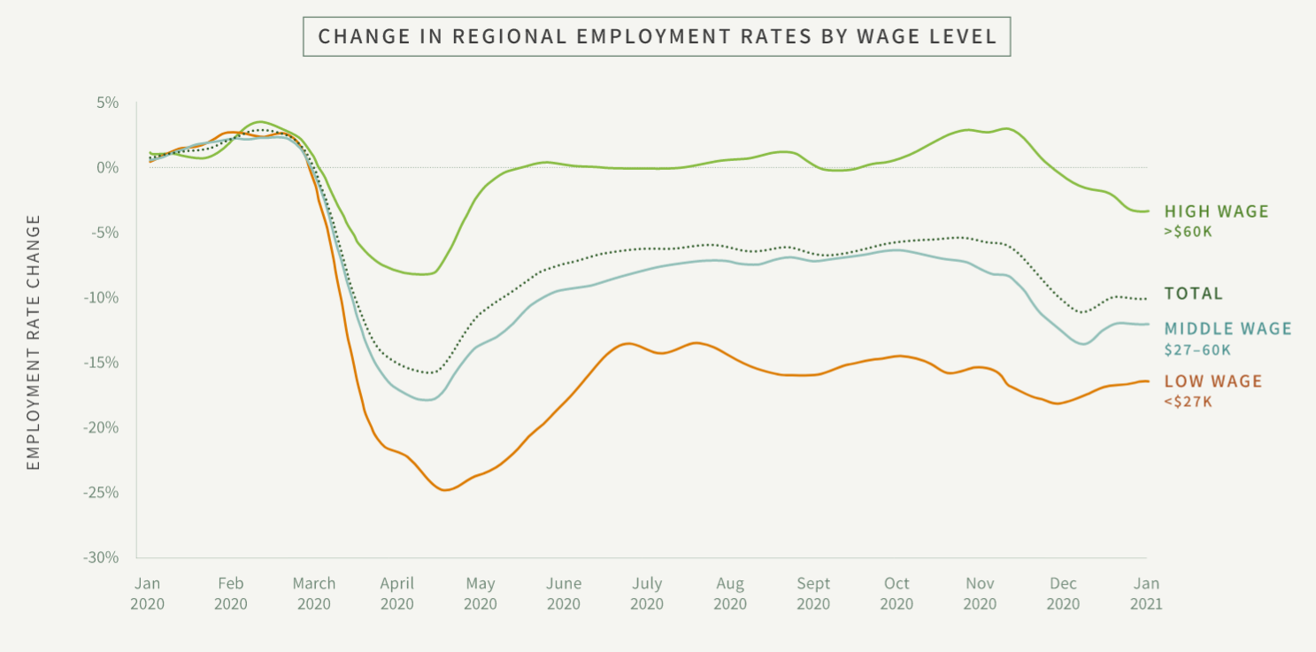
Recovery is not coming quickly for the region’s lowest earners.

Slide 6
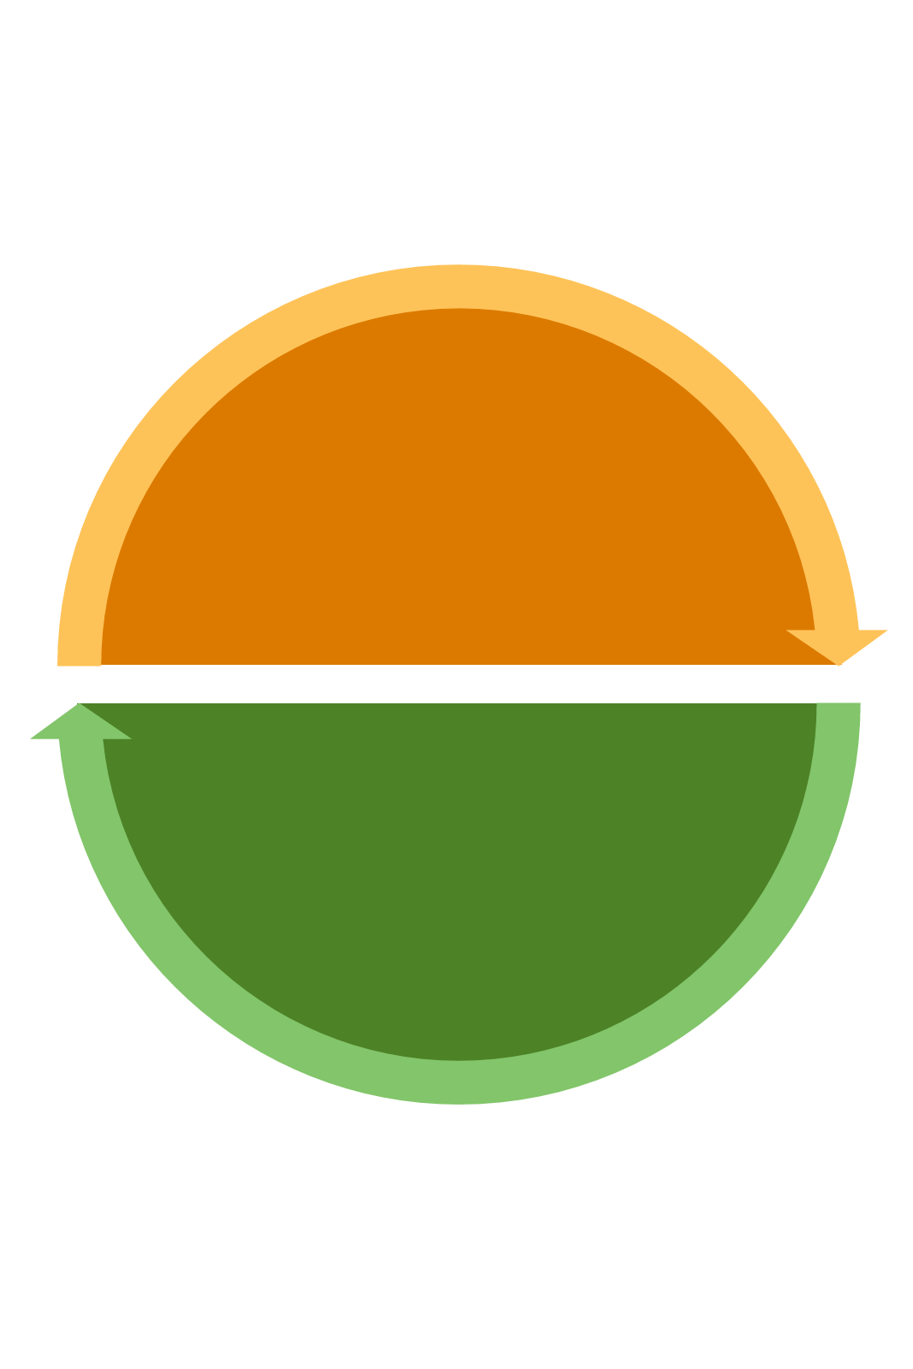
Addressing hunger today and tomorrow
Years before the pandemic, the Capital Area Food Bank had enacted a new strategic plan emphasizing a dual focus on addressing hunger today and seeding innovative approaches that will have a lasting impact on longer term food security for tomorrow.
Key concepts in the plan include client-centered program design and approaches that address the root causes of food insecurity.
Given the deeply rooted inequities that have always existed but were laid bare by the pandemic, these approaches are now more important than ever.
Food to address hunger today
Food for brighter futures tomorrow

Slide 7






Food as a driver of inclusive economic growth
Greater equity and variety in offerings
Growth of lower-middle class population from minimum to
living wage
3
6
Growth in businesses’ locations and offerings to all population segments
2
Integration of food with other services, like education, skill development and health for better outcomes
5
1
4
Increase in consumption of durables and non-durables
Access to and consumption of good, healthy food

Slide 8

Recovery and Rebuilding -- Food+ Pilots
01
02
03
04
Food + Health Care
Food + Workforce Development
Food + Education
Food + Access
Integrating food into health
care settings to promote
disease prevention and management
Using food as an incentive for program attendance and completion
Supporting food insecure college students as they pursue
higher education
Removing transportation barriers to bring nutritious food to every zip code

Slide 9



Every sector has a role in ensuring greater livability and equity.
Identification of gaps & cliffs
Review the landscape of services across sectors in search of discontinuity in coverage (e.g. aging out of programs, unreached populations, etc.)
Utilization assessments
Review rates of utilization of government programs, analyze causes of under-utilization, and address them
Referral services
Screen clients for multiple needs and connect them with a range of service providers who are sharing data with each other
Investment in key stages and sub-segments
Based on gaps, invest in populations that are not receiving enough tailored support with new or modified programs
Cross-sector, multi-year partnerships
Connect service providers from different sectors for long-term partnerships to serve the same population
Integration of service delivery
Co-locate of services in the same place
Blend multiple supports at the same point of service delivery

Slide 10
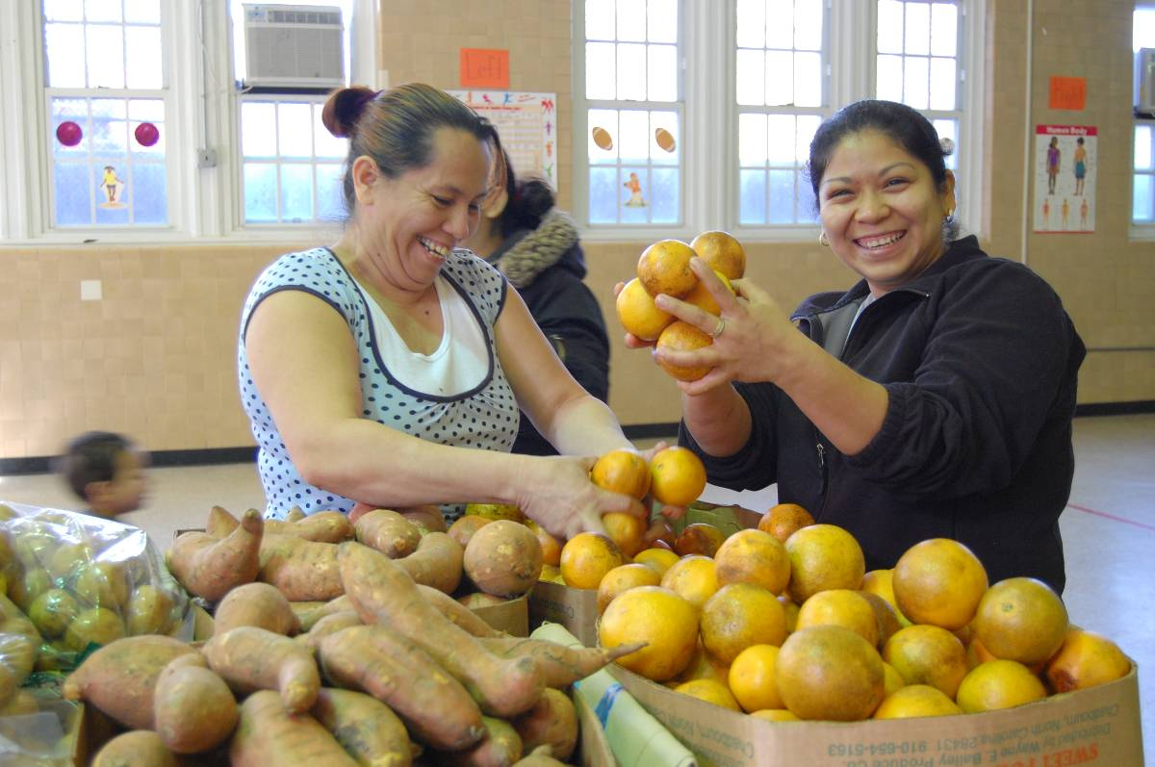

Thank
you

