Slide 1
A Recent Profile of Motor Vehicle Characteristics in METROPOLITAN WASHINGTON
Analysis of 2020 Vehicle Registration Data
Dusan Vuksan TPB Transportation Engineer Jinchul Park TPB Transportation Engineer TPB Technical Committee September 10, 2021
Agenda Item 9

Slide 2
Presentation Purpose – Why Now?
Vehicle registration data, a.k.a. vehicle identification number (VIN) data, provide information about the composition of the current motor vehicle fleet in metropolitan Washington and are used to create key inputs for COG’s mobile emissions model (MOVES)
TPB staff periodically obtains vehicle registration data from departments of motor vehicles through the state air agencies and COG’s Dept. of Environmental Programs (DEP) to ensure that MOVES inputs are current for the purposes of emissions forecasting
Recently obtained 2020 vehicle registration data will be used for:
  Upcoming air quality conformity analysis of the 2022 Update to the Visualize 2045 Long-Range Transportation Plan (ozone-season pollutants),
  Greenhouse gas (GHG) analyses, and
  Upcoming State Implementation Plan (SIP) activities related to the 2015 National Ambient Air Quality Standards (NAAQS) for ozone
Agenda Item 9: Analysis of 2020 Vehicle Registration Data
September 10, 2020

Slide 3
Presentation Outline
Background
  Why are Vehicle Characteristics Important?
  What are Vehicle Registration Data?
  History of Vehicle Registration Data Analysis
  Study Area
Analysis of 2020 Data
  National COVID-19 Pandemic Impacts
  Regional Trends
Key Findings
Next Steps
Agenda Item 9: Analysis of 2020 Vehicle Registration Data
September 10, 2020

Slide 4
Background
Agenda Item 9: Analysis of 2020 Vehicle Registration Data
September 10, 2020

Slide 5
Why are Vehicle Characteristics Important?
The size, composition and age of the vehicle fleet are important determinants of mobile source emissions calculations
The current mobile emissions model (MOVES2014b) requires two key vehicle-related inputs to be specified by jurisdiction, obtained from vehicle registration data:
  The number of vehicles by 13 vehicle classes; and
  The age distribution by vehicle class
Agenda Item 9: Analysis of 2020 Vehicle Registration Data
September 10, 2020

Slide 6
What are Vehicle Registration Data?
A complete inventory of private, public, and commercial registered motor vehicles maintained by departments of motor vehicles (DMVs) at a specific point in time
Data are obtained for specific jurisdictions that comprise the Ozone Nonattainment Area
Registration data can be viewed as a list of Vehicle Identification Numbers (or “VINs”)
Agenda Item 9: Analysis of 2020 Vehicle Registration Data
September 10, 2020

Slide 7
What are Vehicle Identification Numbers (VINs)?
Can be viewed as the “fingerprint” of each vehicle
A standardized 17-character code that indicates the characteristics of each vehicle including manufacturer, model year, engine type, weight, vehicle type, and fuel type
VINs were standardized in 1981 by the National Highway Traffic Safety Administration (NHTSA)
VIN data analysis requires substantial staff effort:
  data cleaning;
  decoding; and
  software and technical analysis.
Agenda Item 9: Analysis of 2020 Vehicle Registration Data
September 10, 2020

Slide 8
History of TPB Staff’s Vehicle Registration Data Analysis
Vehicle registration data have been collected and analyzed since 2008
Previous registration data collections corresponded to:
  July 1, 2008
  July 1, 2011
  July 1, 2014
  December 31, 2016
Current data presented today:
  December 31, 2020 for Maryland and Virginia
  July 1, 2020 for District of Columbia
Agenda Item 9: Analysis of 2020 Vehicle Registration Data
September 10, 2020

Slide 9
History of TPB Staff’s Vehicle Registration Data Analysis (Cont.)
Some of the state air agencies have adopted a year-end data collection cycle as opposed to a July 1 data collection cycle that had been implemented prior to 2016
The analysis of December data may introduce some bias when comparing to prior July data
July 2020 dataset was selected for the District of Columbia (rather than December 2020), because the District Department of Energy and Environment staff noted that the December 2020 dataset was a less representative dataset due to a backlog in processing of vehicle registrations in the District in the second part of 2020 as a result of the COVID-19 restrictions
Agenda Item 9: Analysis of 2020 Vehicle Registration Data
September 10, 2020

Slide 10
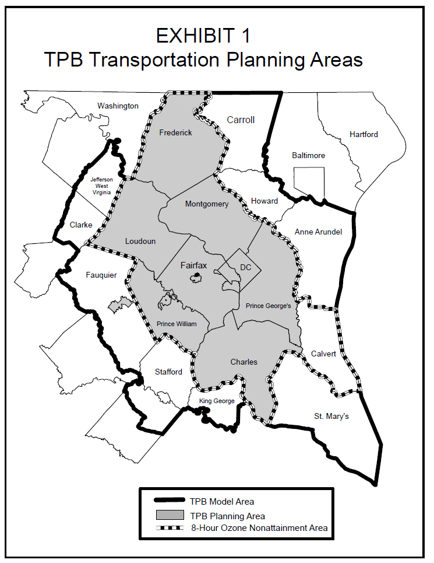
Study Area
VIN data are collected for the Ozone Nonattainment
Area (dashed line on map):
District of Columbia
Maryland:
- Calvert County
- Charles County
- Frederick County
- Montgomery County
- Prince George's County
Virginia:
- Arlington County
- City of Alexandria
- Fairfax County and Cities
- Loudoun County
- Prince William County and Cities
Agenda Item 9: Analysis of 2020 Vehicle Registration Data
September 10, 2020

Slide 11
Analysis of 2020 Data
Agenda Item 9: Analysis of 2020 Vehicle Registration Data
September 10, 2020

Slide 12
COVID-19 Pandemic Impacts (National)
COVID-19 pandemic has impacted vehicle purchasing
National sales estimated to be down by 15% in 2020 relative to 2019*
  Economic uncertainty
  Decrease in vehicle supply – temporary auto factory shutdowns
However, for those who were able to purchase vehicles, the pre-pandemic trend of shifts away from the light duty vehicles to the light duty trucks (SUVs) has continued
* Eisenstein, Paul A. “For the auto industry, 2020 was a horrible year — but it ended better than expected.” NBC News, January 5, 2021. https://www.nbcnews.com/business/autos/auto-industry-2020-was-horrible-year-it-ended-better-expected-n1252892
Agenda Item 9: Analysis of 2020 Vehicle Registration Data
September 10, 2020

Slide 13
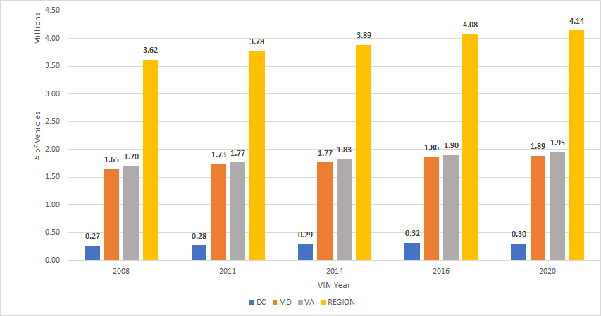
Vehicle Growth over Time by State
* Based on cleaned Total DMV Records
Agenda Item 9: Analysis of 2020 Vehicle Registration Data
September 10, 2020

Slide 14
Historical Changes in Average Vehicle Age
Following a slight decrease in vehicle age noted in the 2016 data, vehicle age increased for all vehicle types in 2020
Average vehicle age for all vehicle types in 2020 is highest among all analysis years
Average Age of the Regional Vehicle Fleet by VIN Year
Year | Light Duty Vehicles* (LDV) | Light Duty Trucks (LDT) | Heavy Duty Vehicles (HDV) | All Vehicle Types
2008 | 8.51 | 7.53 | 9.21 | 8.18
2011 | 9.25 | 8.55 | 10.56 | 9.05
2014 | 9.62 | 9.09 | 11.30 | 9.49
2016 | 9.32 | 8.68 | 11.29 | 9.16
2020 | 10.05 | 8.74 | 11.51 | 9.51
Agenda Item 9: Analysis of 2020 Vehicle Registration Data
September 10, 2020

Slide 15
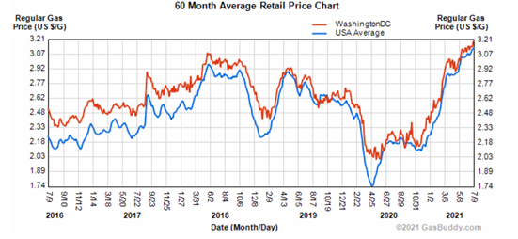
Historical Retail Gas Prices by Year
Could be a factor in vehicle purchase decisions
Washington, D.C. data show higher retail gas price than the national average
Decrease of average gas prices during the height of the stay-at-home orders designed to stop the spread of COVID-19 appears on the chart
Source: https://www.gasbuddy.com/charts
Agenda Item 9: Analysis of 2020 Vehicle Registration Data
September 10, 2020

Slide 16
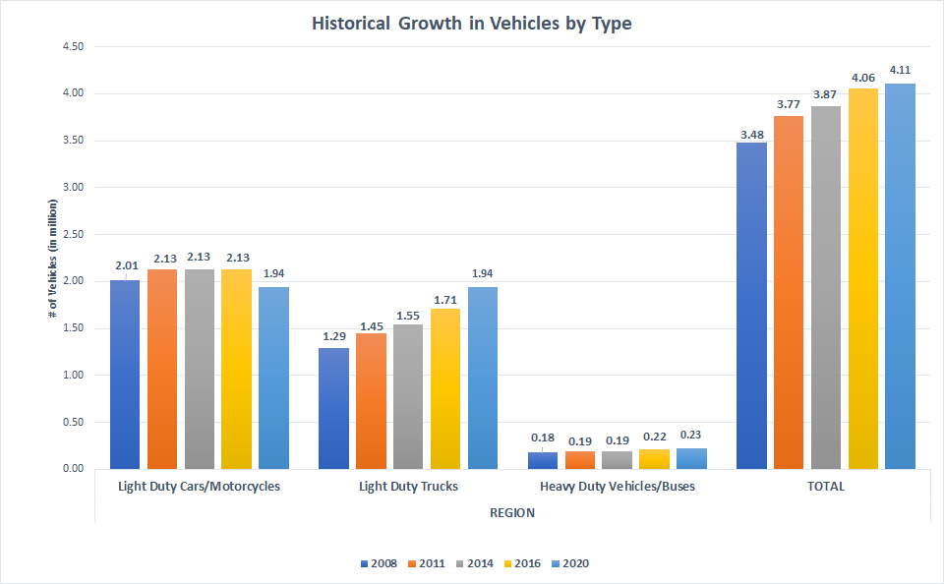
Historical Growth in Vehicles by Type
Agenda Item 9: Analysis of 2020 Vehicle Registration Data
September 10, 2020

Slide 17
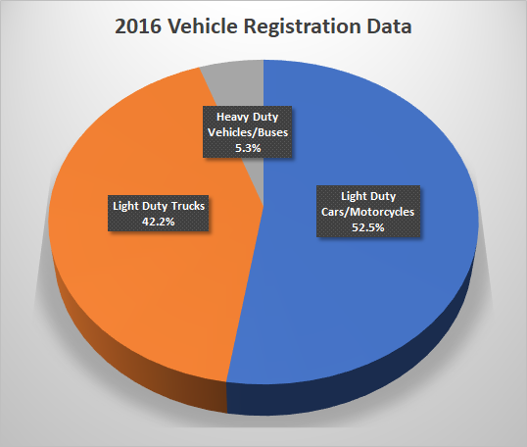
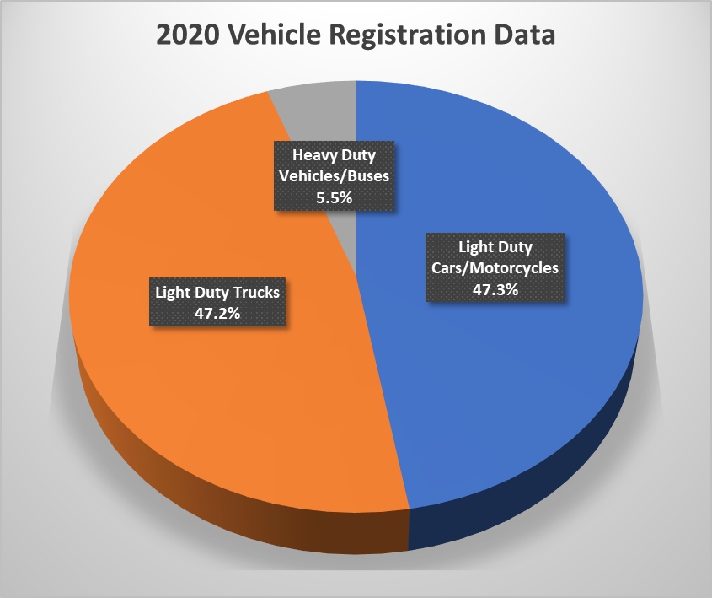
Changes in Regional Vehicle Composition: 2016 vs. 2020 Vehicle Registration Data
Between 2016 and 2020:
Share of light duty trucks (including SUVs) increased by 5.0%
Share of heavy duty vehicles increased by 0.2%
Share of light duty cars decreased by 5.2%
Agenda Item 9: Analysis of 2020 Vehicle Registration Data
September 10, 2020

Slide 18
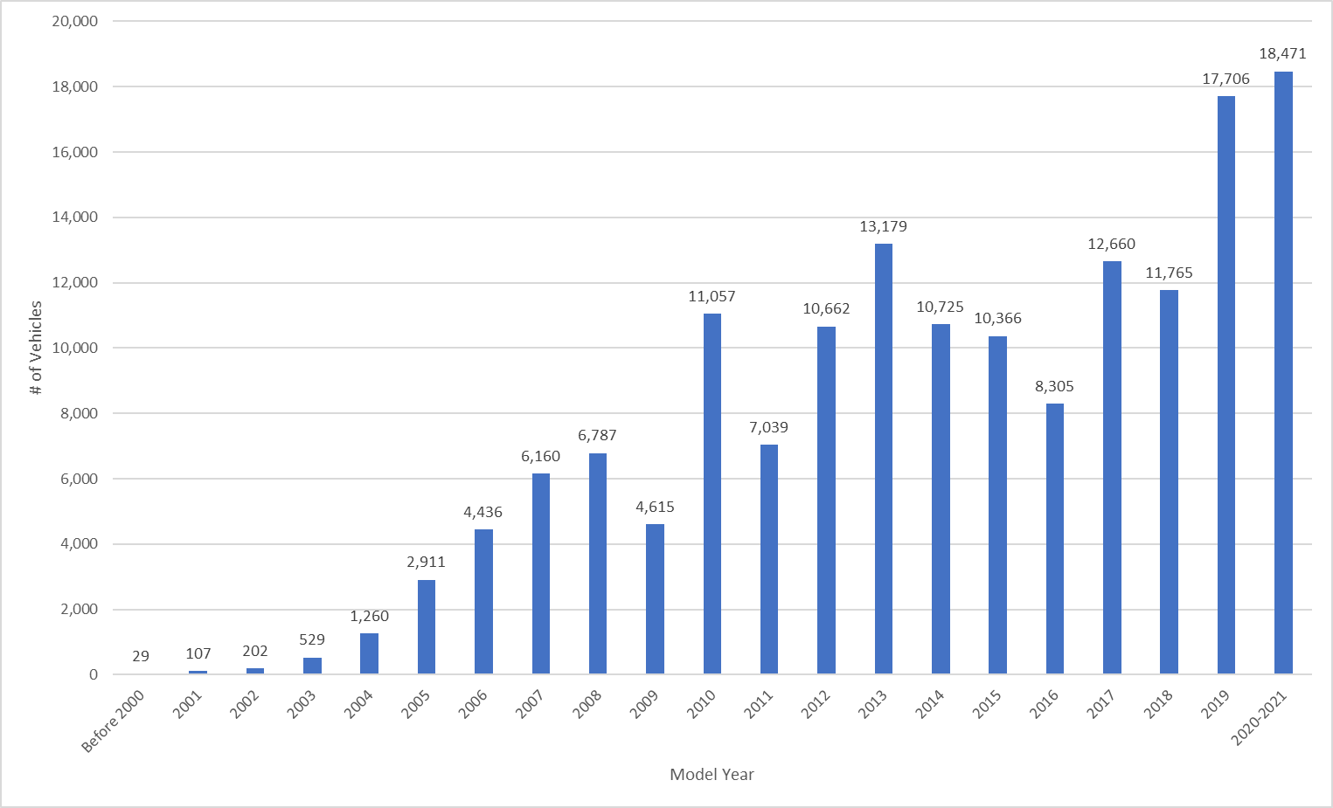
Current Distribution of Hybrid Vehicles by Model Year
Hybrid vehicles include hybrid electric and plug-in hybrid vehicles
Regional total = 159k hybrid vehicles, 3.9% out of all vehicles
Number of registered hybrid vehicles in the fleet increased by 32.0% between 2016 and 2020 data
Agenda Item 9: Analysis of 2020 Vehicle Registration Data
September 10, 2020

Slide 19
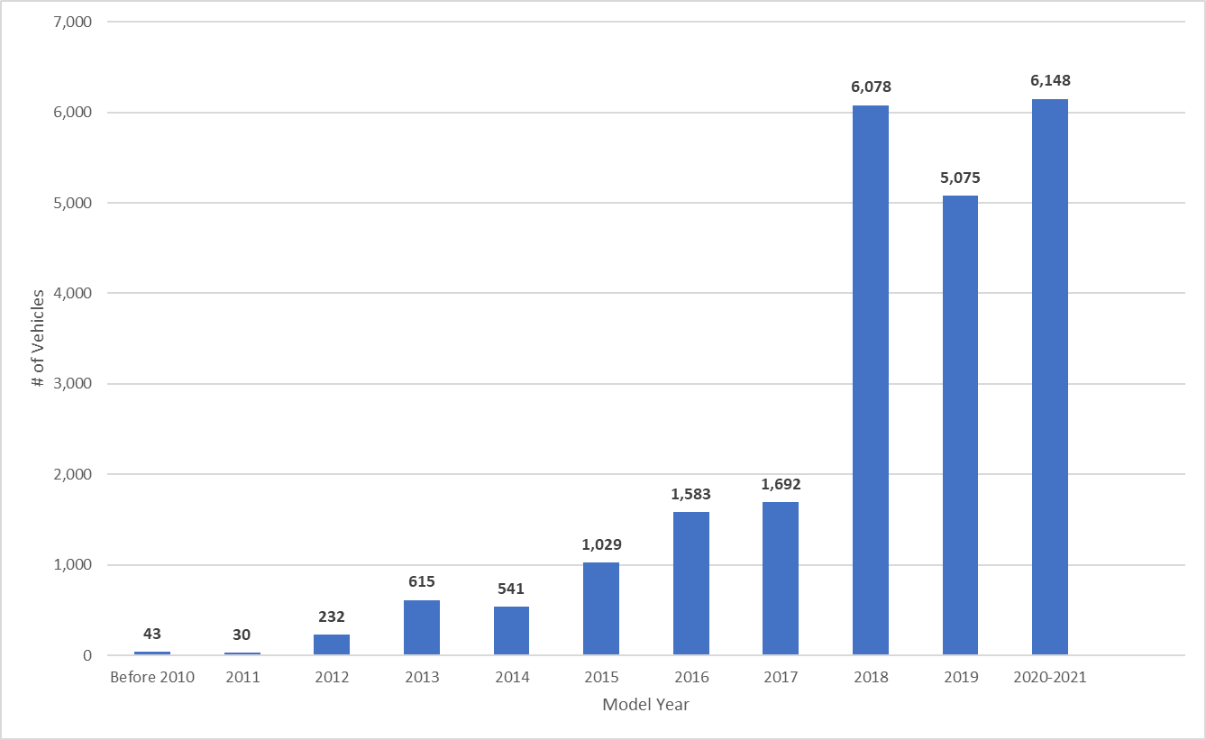
Current Distribution of Battery Electric Vehicles (BEVs) by Model Year
Regional total = 23k electric vehicles (BEVs), 0.6% out of all vehicles
Number of registered BEVs in the fleet increased by 452.9% between 2016 and 2020 data
Agenda Item 9: Analysis of 2020 Vehicle Registration Data
September 10, 2020

Slide 20
Key Findings
COVID-19 pandemic has impacted vehicle purchases both nationally and regionally
In recent years, growth in the number of total vehicles has slowed down, with total number of registered vehicles increasing from 4.08M in 2016 to 4.14M in 2020
The vehicle composition is changing between 2016 and 2020:
  The share of LD trucks (SUVs) increased by 5.0%
  The share of LD cars decreased by 5.2%
  The share of HDV/buses increased by 0.2%
Agenda Item 9: Analysis of 2020 Vehicle Registration Data
September 10, 2020

Slide 21
Key Findings (Cont.)
Average age of the vehicle fleet has increased from 9.16 years in 2016 to 9.51 in 2020
Hybrid vehicles account for 3.9% of the vehicle fleet
Electric vehicles account for 0.6% of the vehicle fleet, but the size of EV fleet has increased at a fast rate over time
While the growth in electric and hybrid vehicles is encouraging, an older vehicle fleet and a shift toward light duty trucks and away from light duty cars could lead to negative impacts on emissions (in 2020, for the first time in our region, number of LD cars ≈ number of LD trucks)
Agenda Item 9: Analysis of 2020 Vehicle Registration Data
September 10, 2020

Slide 22
Next Steps
Assemble vehicle population, vehicle composition and vehicle age distribution inputs to the MOVES model based on the 2020 dataset
Apply in:
  Air quality conformity analysis of the constrained element of the 2022 Update to Visualize 2045
  GHG Analysis of the 2022 Update to Visualize 2045
  2015 National Ambient Air Quality Standards Ozone SIP
Agenda Item 9: Analysis of 2020 Vehicle Registration Data
September 10, 2020

Slide 23
Appreciation
The state air agencies and DEP staff for granting access to the 2020 vehicle registration data
Daniel Son for data cleaning, VIN decoding and conducting detailed analysis of the data
Agenda Item 9: Analysis of 2020 Vehicle Registration Data
September 10, 2020

Slide 24
Jinchul Park TPB Transportation Engineer (202) 962-3320 jpark@mwcog.org Dusan Vuksan TPB Transportation Engineer (202) 962-3279 dvuksan@mwcog.org | mwcog.org/tpb
Metropolitan Washington Council of Governments 777 North Capitol Street NE, Suite 300 Washington, DC 20002

