Slide 1
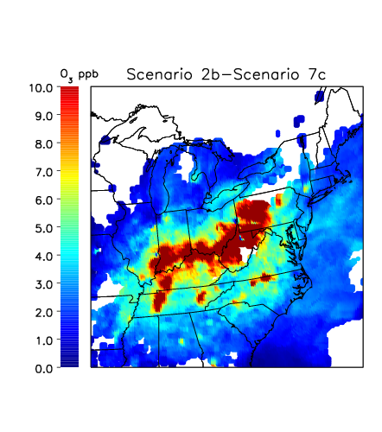
Status of Collaborative Solution to the Ozone Transport Problem
and
Preliminary Attainment Modeling Results
Tad Aburn, Air Director, MDE
MWAQC-Technical Advisory Committee Meeting – February 10, 2015

Slide 2


Topics
Background
Why is Maryland Pushing so Hard for “Good Neighbor” Partnerships?
Technical Analyses to Date
  Maryland’s Modeling and Analysis of EGU Emissions Data
Timing and Future Efforts
Discussion

Slide 3

Background – Collaboration
On August 6, 2013- Approximately 30 Air Directors participated in a call to begin a technical collaboration on ozone transport in the East
  Preliminary analysis was conducted that indicated that a collaborative solution for the 75 ppb ozone standard may be possible
  Additional calls held in 2013 and 2014
In April 2014, preliminary discussions between Commissioners began
As a result of these discussions, the “State Collaborative on Ozone Transport” (SCOOT ) was established
  First meeting of SCOOT was on November 20, 2014
  Action plan in several areas agreed upon

Slide 4

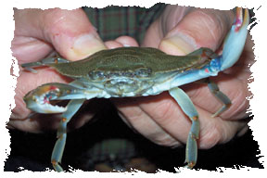
Why Is MD Pushing so Hard?
Only state East of the Mississippi designated as a “Moderate” nonattainment area by EPA
Baltimore is the only nonattainment area in the East required to submit an “Attainment” SIP in 2015
  This SIP must be supported by photochemical modeling and an “Attainment Demonstration”
We believe we have enough modeling and technical analysis completed to have a clear picture of what Maryland needs in it’s plan to bring the State into attainment
  This analysis also shows that most other areas in the East should also come close to attaining the 75 ppb standard

Slide 5
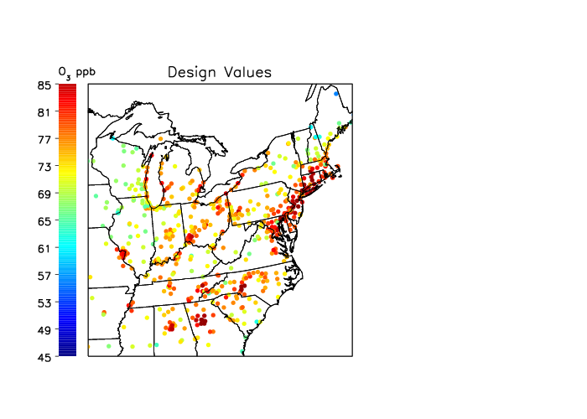
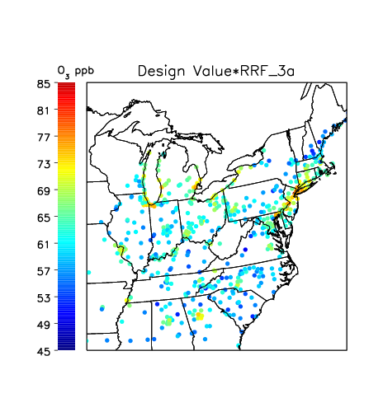
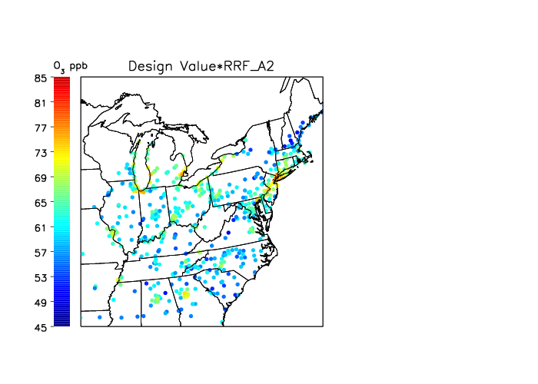

Building the Maryland Plan
The 2007 or 2011 Base
Add regional controls across the East (OTB/OTW, Tier 3, regional EGU controls)
Add the “OTR” controls along I-95 corridor
Add new controls just in MD

Slide 6


Modeling the Maryland Plan
Maryland has conducted preliminary modeling of the Plan and believes it will allow MD to come very close to meeting the 75 ppb ozone standard
  Started with the OTC CMAQ 2007 platform – 2018 future year
    1 month sensitivity runs and full ozone season runs now completed
  Have evolved to the 2011 platform and now running both CMAQ and CAMX
    Focus still on 2018 as the future year
  There is still a significant amount of work that needs to get done to improve the 2011 platform … but we have learned a lot

Slide 7


What We’ve Learned
The 2011 Platform is giving us results consistent with the 2007 Platform
We will make significant progress because of existing control programs
We appear to be close to having a plan to meet the 75 ppb standard
Running EGU controls optimally during bad ozone periods is important
Additional reductions in Maryland and in “close-by” states are important

Slide 8
Modeling the MD Plan in 2018 - 2007 Platform
About 1 ppb from OTC initiatives
About a 12 ppb reduction from the older OTB/OTW measures
About 1 ppb from Tier 3
About 1 ppb from upwind power plants
About 1 ppb from MD efforts

Slide 9
Other Areas – 2007 Platform
… Before and After the MD Plan
County | Design Value 2007 | After Maryland Plan 2018
Harford, MD | 90.7 | 74.7
Prince Georges, MD | 85.3 | 65.1
Fairfield, CT | 88.7 | 70.8
New Castle, DE | 81.3 | 66.3
Bucks, PA | 90.7 | 76.8
Suffolk, NY | 88.0 | 71.0
Camden, NJ | 87.5 | 74.2
Fairfax, VA | 85.3 | 66.9
Franklin, OH | 84.7 | 69.7
Fulton County, GA | 90.3 | 73.7
Wayne, MI | 81.3 | 74.5
Sheboygan, WI | 83.3 | 70.8
Mecklenberg Co, NC | 87.0 | 67.6
Knoxville, TN | 80.7 | 70.7
Jefferson County, KY | 80.0 | 67.0
Lake County, IN | 77.5 | 77.4
Cook County, IL | 77.0 | 75.0
9

Slide 10
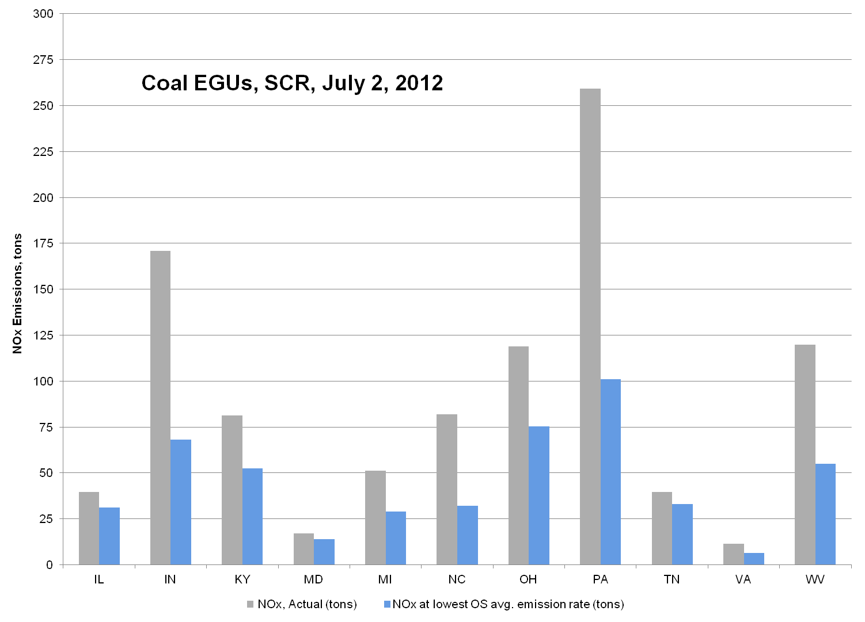
EGU Control Technology Optimization
…Maryland has conducted significant analyses looking at how certain EGUs appear to be running controls less efficiently than they have in the past
Average daily reductions that could have been achieved on this day … about 490 tons per day
Total reductions that could have been achieved during the 10 day episode … about 4740 tons
Maryland just distributed a third update to this data analysis package.

Slide 11
We Modeled Lost Ozone Benefit
Again – 2007 Platform
Most Difficult Monitors | Increased Ozone in 2018 – 2 EGU Optimization Scenarios
County | Using worst rate CAMD Data (Scenario 3B) | Using actual 2011/2012 Data (Scenario 3C)
Harford, MD | 1.2 | 0.5
Prince Georges, MD | 1 | 0.5
Fairfield, CT | 0.3 | 0.1
New Castle, DE | 0.8 | 0.4
Bucks, PA | 0.6 | 0.4
Suffolk, NY | 0.4 | 0.2
Camden, NJ | 0.5 | 0.3
Fairfax, VA | 1 | 0.5
Franklin, OH | 1.7 | 1
Fulton County, GA | 0.3 | 0.2
Wayne, MI | 0.5 | 0.2
Sheboygan, WI | 0.1 | 0.1
Mecklenberg Co, NC | 1.8 | 1.2
Knoxville, TN | 0.7 | 0.5
Jefferson County, KY | 2 | 1.5
Lake County, IN | 0.2 | 0.1
Cook County, IL | 0.2 | 0.1
11

Slide 12
Also Looked at Optimization and Designations?
… 2007 Platform - EPA has proposed a new ozone standard - 60 to 70 ppb range
Projected to be Clean in 2018 … Potentially at Risk |  | Increased Ozone in 2018 – 2 EGU Optimization Scenarios
County | 2018 – Controls Running Well (Scenario 3A) | Using worst rate CAMD Data (Scenario 3B) | Using actual 2011/2012 Data (Scenario 3C)
Blair, PA | 58.7 | 64 | 62.7
Armstrong, PA | 66.4 | 70.7 | 68.8
Washington, OH | 60.1 | 68.9 | 66.2
Warren, OH | 68.8 | 72.1 | 70.9
Kanawa, WV | 64.5 | 67.8 | 66.3
Monogolia, WV | 61.4 | 64.4 | 63.1
Oldham, KY | 67.2 | 70.2 | 69.1
Boone, KY | 57.5 | 64.7 | 61.6
Campbell, KY | 61.6 | 64.3 | 63.3
Greene, IN | 61.8 | 67.3 | 65.2
Vanderburgh, IN | 62.3 | 65.8 | 64.7
Person, NC | 60.2 | 71.7 | 63.6
Garrett, MD | 58.7 | 62.6 | 61.1
Greater than 70 ppb
65 to 70 ppb
12
60 to 65 ppb

Slide 13


Moving On to the 2011 Platform
Transitioned to the 2011 platform starting in the summer of 2014
Have completed many sensitivity runs focused now on July, 2011
  DISCOVER–AQ (2011) data sets extremely valuable for comparison
Initial EGU emissions from IPM, soon to have ERTAC based inputs
Meteorology is WRF 2011
Using both CMAQ and CAMX models.

Slide 14


Sensitivity Tests – 2011 Platform
Enhanced Future Base Case (3A or ATT-1)
  OTB/OTW , Tier 3, Optimized EGU Controls
Additional analyses of EGU Control Technology Optimization (3B and 3C)
Maryland Attainment Plan
  Same as 3A or ATT-1 but with “inside Maryland” controls included in the modeling and new OTC controls included, but based upon rough estimates from earlier modeling (ATT-4)

Slide 15
Maryland Monitors - 2011 Platform - CMAQ
County | DV 2011 (ppb) | 2018 Baseline (ppb) | 3A (ATT-1) (ppb) | 3B (ppb) | 3C (ppb) | ATT-4 (ppb)
Anne Arundel | 83.0 | 70.2 | 69.1 | 71.1 | 70.3 | 68.7
Baltimore | 79.0 | 68.4 | 67.0 | 69.5 | 68.7 | 66.7
Baltimore | 80.7 | 70.4 | 69.4 | 71.2 | 70.5 | 69.1
Calvert | 79.7 | 68.5 | 67.5 | 69.9 | 68.7 | 66.7
Carroll | 76.3 | 67.2 | 65.6 | 69.0 | 67.9 | 65.3
Cecil | 83.0 | 70.5 | 69.0 | 71.8 | 70.8 | 68.8
Charles | 79.0 | 67.3 | 66.1 | 69.5 | 67.6 | 64.6
Frederick | 76.3 | 66.9 | 65.3 | 68.9 | 67.7 | 64.8
Garrett | 72.0 | 60.8 | 59.4 | 62.8 | 61.3 | 59.4
Harford | 90.0 | 77.3 | 75.7 | 78.3 | 77.3 | 75.4
Harford | 79.3 | 67.1 | 65.8 | 68.1 | 67.2 | 65.6
Kent | 78.7 | 66.8 | 65.4 | 67.9 | 67.0 | 65.2
Montgomery | 76.3 | 66.9 | 65.3 | 68.9 | 67.7 | 64.8
Prince George's | 79.0 | 66.7 | 65.8 | 67.7 | 67.0 | 65.5
Prince George's | 82.3 | 69.6 | 68.6 | 70.6 | 69.8 | 68.1
Washington | 72.7 | 63.3 | 61.9 | 65.4 | 64.4 | 61.9
2018 Base … OTB/OTW with Tier 3
3A or ATT-1 … OTB/OTW, Tier 3 and Optimized EGU Controls
3B and 3C … Worst case and best case without EGU optimization
ATT-4 … OTB/OTW, Tier 3, Optimized EGU Controls and new MD controls

Slide 16
Modeling the MD Plan in 2018 - 2011 Platform
About 1 ppb from Tier 3 †
Less than 1 ppb from MD initiatives
About a 12 ppb reduction from the older OTB/OTW measures
We expect about 1 ppb from OTC efforts†
About 2 ppb from upwind power plants
† This value is based on a very rough estimate from earlier modeling work.

Slide 17
Other Difficult Monitors - 2011 Platform - CMAQ
County, State | DV 2011 (ppb) | 2018 Baseline (ppb) | 3A (ATT-1) (ppb) | 3B (ppb) | 3C (ppb) | ATT-4 (ppb)
Bayonne, NJ | 77.0 | 70.3 | 69.5 | 70.8 | 70.3 | 69.4
Babylon, NY | 83.3 | 80.6 | 80.1 | 80.8 | 80.6 | 80.1
Greenwich Point Park, CT | 80.3 | 78.1 | 77.7 | 78.3 | 78.1 | 77.7
Sherwood Island Connector, CT | 83.7 | 77.2 | 76.8 | 77.4 | 77.2 | 76.7
White Plains, NY | 75.3 | 76.7 | 76.1 | 77.2 | 76.8 | 76.0
Edgewood, MD | 90.0 | 77.3 | 75.7 | 78.3 | 77.3 | 75.4
Sheboygan Kohler Andre, WI | 84.3 | 75.6 | 75.4 | 75.9 | 75.7 | 75.4
Hammonasset State Park, CT | 85.7 | 75.4 | 75.1 | 75.6 | 75.4 | 75.1
Susan Wagner HS, NY | 81.3 | 75.4 | 74.9 | 75.8 | 75.5 | 74.9
Pfizer Lab Site, NY | 74.0 | 75.6 | 74.9 | 76.0 | 75.6 | 74.8
Shreveport / Airport, LA | 77.3 | 74.1 | 74.0 | 74.1 | 74.1 | 74.1
2018 Base … OTB/OTW with Tier 3
3A or ATT-1 … OTB/OTW, Tier 3 and Optimized EGU Controls
3B and 3C … Worst case and best case without EGU optimization
ATT-4 … OTB/OTW, Tier 3, Optimized EGU Controls and new MD controls

Slide 18

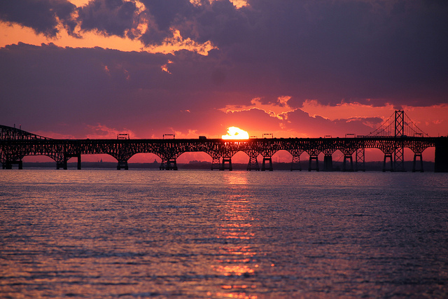
CAMX Modeling – 2011 Platform
Maryland is now working to have both CMAQ and CAMX working in harmony … using the 2011 platform
Still have a ways to go, but preliminary work is both promising and interesting
Have also begun to use CAMX/OSAT to look at contribution by meteorological regime and time of day

Slide 19
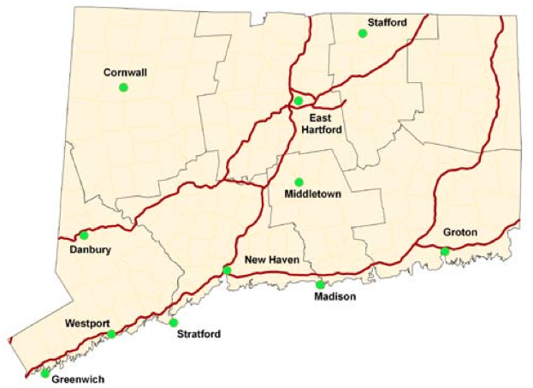

Preliminary 2018 CAMX Analyses
Our preliminary CAMX work with the 2011 platform is still evolving but also very interesting. Appears that CAMX is “less optimistic” than CMAQ. CAMX modeling of MD Plan available soon.
LADCO’s CAMx simulation @ Edgewood:
2018 DV (IPM): 81.5 ppb
2018 DV (ERTAC): 82.7 ppb
What’s different between LADCO and U. of Maryland?
Model domain … Time period … Boundary condition
19
Preliminary analyses – contact Dan Goldberg, UMD prior to use

Slide 20
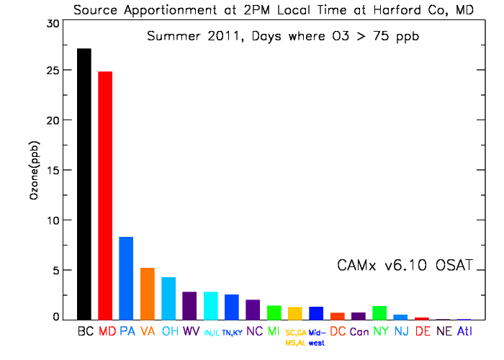
2011 - Traditional OSAT – Harford, MD
Average contribution driven by Boundary Conditions, MD and close by states
20
Preliminary analyses – contact Dan Goldberg, UMD prior to use

Slide 21
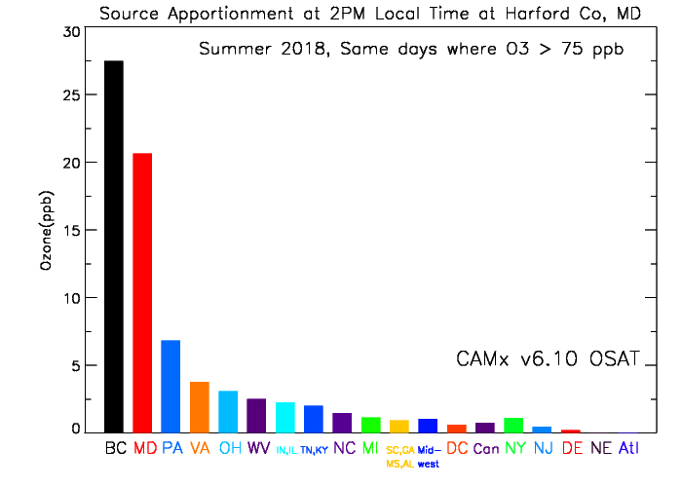
2018 - Traditional OSAT – Harford, MD
Average contribution driven even more by Boundary Conditions. MD and close by states still show larger contribution
21
Preliminary analyses – contact Dan Goldberg, UMD prior to use

Slide 22
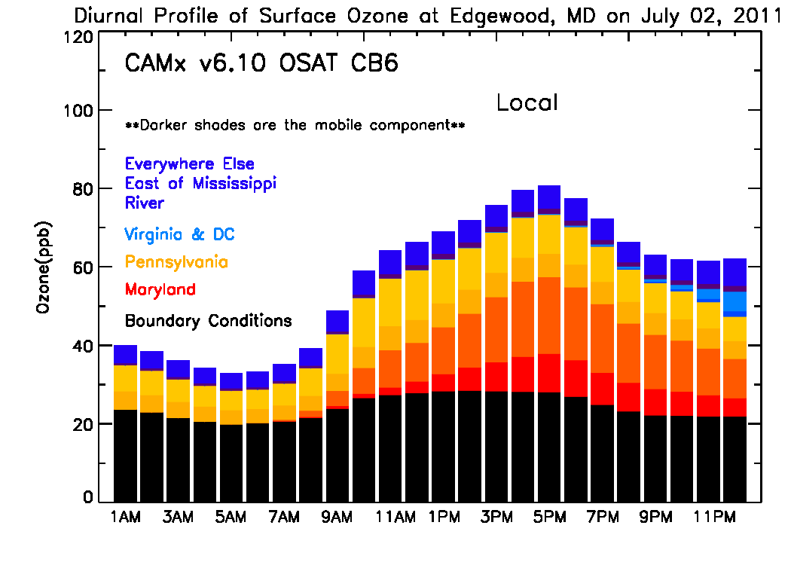
Contribution by Transport Pattern - Local
Contribution – Edgewood MD – July 2, 2011
Contribution dominated by boundary conditions, Maryland and Pennsylvania. Contribution from other areas is smaller.

Slide 23
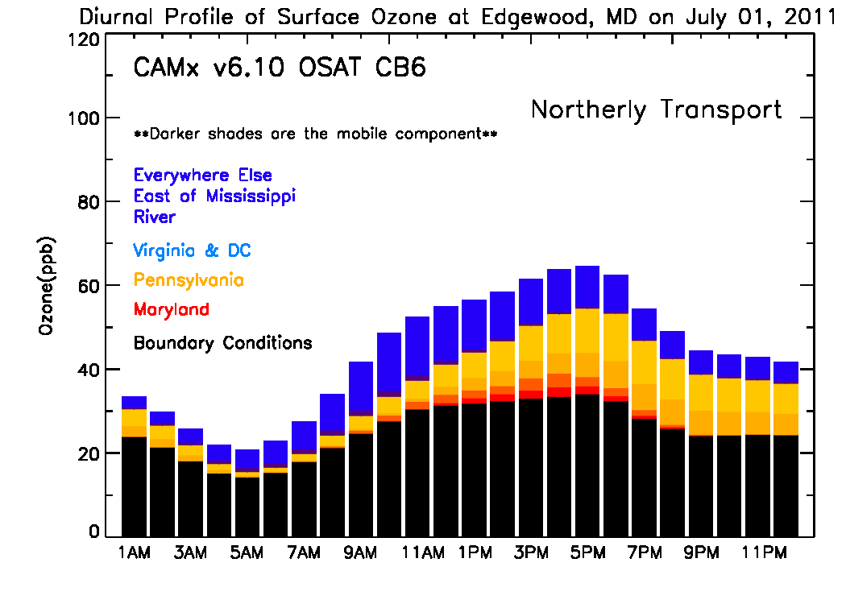
Transport from North and West
Contribution – Edgewood MD – July 1, 2011
Contribution dominated by boundary conditions, Pennsylvania and other upwind areas. Contribution from MD and VA is minimal

Slide 24
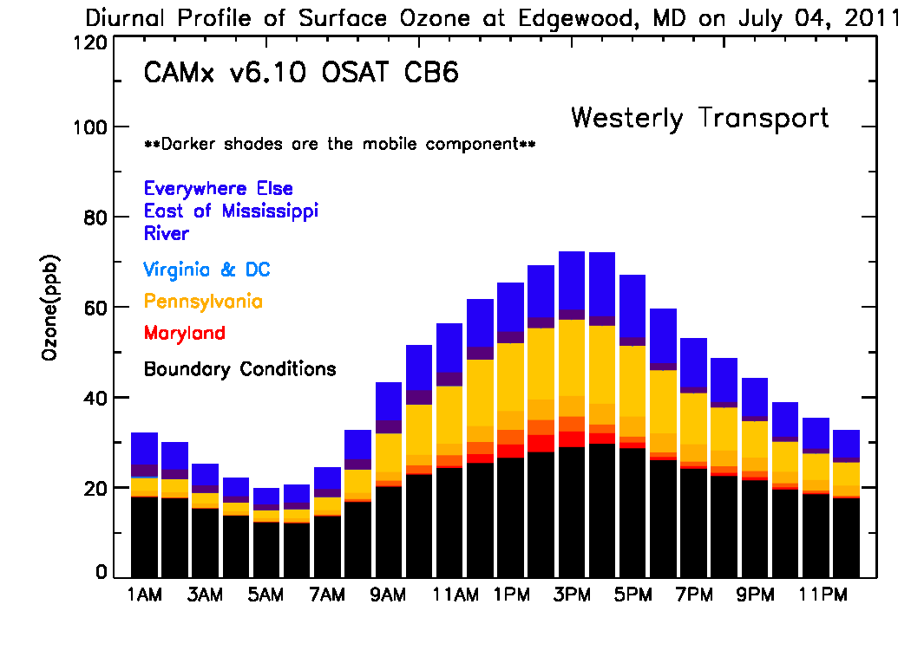
Transport from the West
Contribution – Edgewood MD – July 4, 2011
Contribution dominated by boundary conditions, Pennsylvania and other areas. MD and VA contribution is smaller.

Slide 25
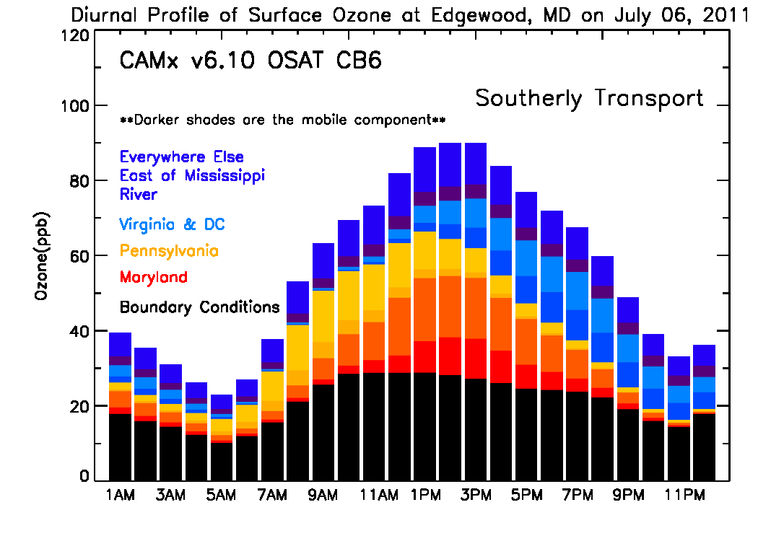
Transport from the South
Contribution – Edgewood MD – July 6, 2011
Contribution dominated by boundary conditions, Maryland, VA and PA. Contribution from other areas is smaller.

Slide 26
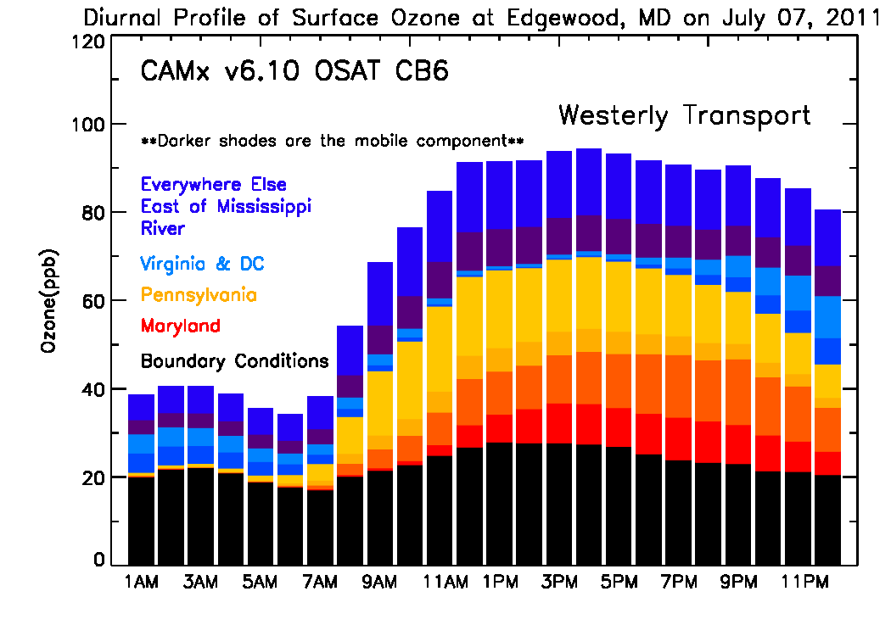
Westerly with a Little Southerly Flow
… and maybe a nocturnal low level jet ?
Contribution – Edgewood MD – July 7, 2011
Contribution spread between boundary conditions, MD, PA and other areas. Note interesting VA contribution at night during a westerly flow event.

Slide 27

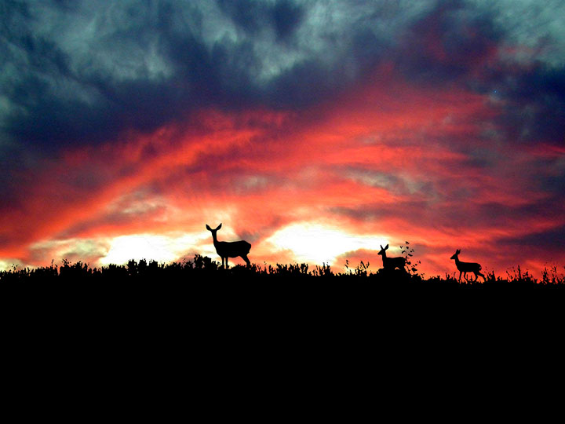
Next Steps With MD Modeling
Continue to refine 2011 Platform
  CMAQ and CAMX
Continue to work through inter-regional modeling process
Upcoming enhancements
  Updated ERTAC results soon
  EPA V2 inventories ASAP
  Mobile emissions with MOVES14
  Moving to new Megan or new BEIS
  Continuing to test how new aloft chemistry and issues with mobile source NOx impact model results

Slide 28
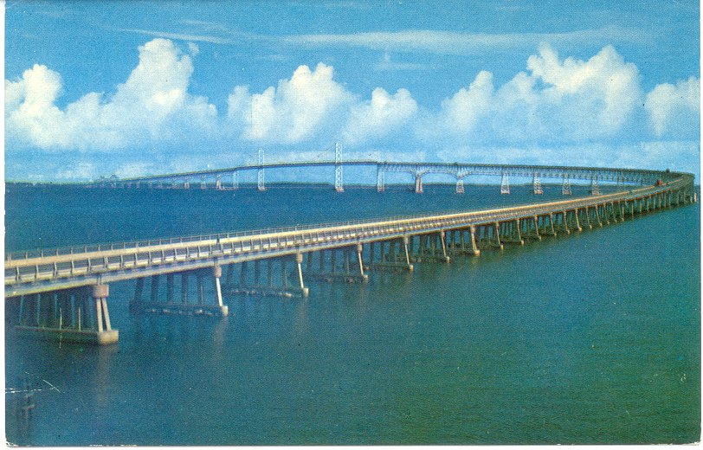
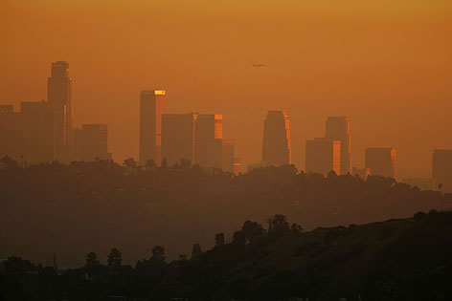
Maryland’s Push
… Can we work together to submit complementary SIPs?
  The SCOOT process has started
  The current modeling tells us we are very close to meeting the 75 ppb ozone standard
In 2015 … areas like Baltimore owe Attainment SIPs and modeling
All states owe “Good Neighbor” SIPs
  They were actually due in 2011
Maryland is pushing …very hard … on “A package of complementary Attainment and Good Neighbor SIPs” to be finalized in 2015
  Maryland believes the key issue needed in Good Neighbor SIPs is to optimize the effectiveness of controls at EGUs that have already installed SCR or SNCR controls
  The SCOOT process will help with this

Slide 29
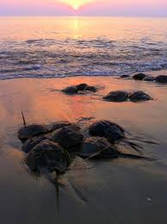

Timing
Maryland Straw Proposal
  2014 to Spring/Summer 2015
    Technical collaboration and stakeholder discussions continue
  Summer 2014 to Spring/Summer 2015
    SCOOT - Commissioner level discussions
  Mid-2015
    Technical work to support “Complementary Package of SIPs” approaches near “SIP Quality” status
  Spring/Summer/Fall 2015
    States submit SIPs

Slide 30

Thanks
The real work is done by Mike Woodman, Dave Krask, Jen Hains, Joel Dreessen, Emily Bull, Kathy Wehnes, Carolyn Jones and Roger Thunell at MDE and Tim Canty, Dan Goldberg, Hao He, Xinrong Ren, Dale Allen, Ross Salawitch, Russ Dickerson, Tim Vinciguerra, Dan Anderson, Samantha Carpenter, Linda Hembeck and Sheryl Ehrman at UMCP. Thanks to support/input from MARAMA, OTC, NH, NYDEC, NJDEP, ME, VADEQ, LADCO, MOG and EPA.

