Slide 1
Denver’s NZE Plan
New Buildings & Homes
February 18, 2021

Slide 2
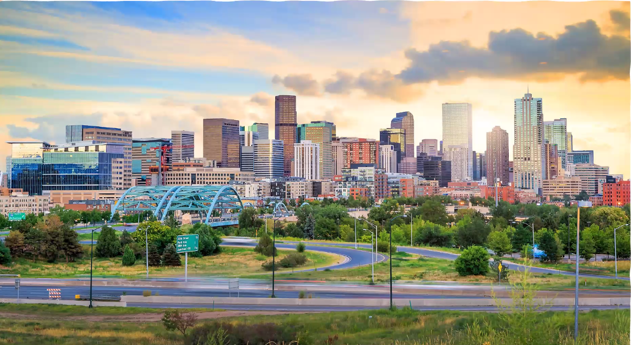
Overview
      COVID & equity
      Climate Goals
        Net Zero
      Next steps

Slide 3
Community, Goals, & Update

Slide 4
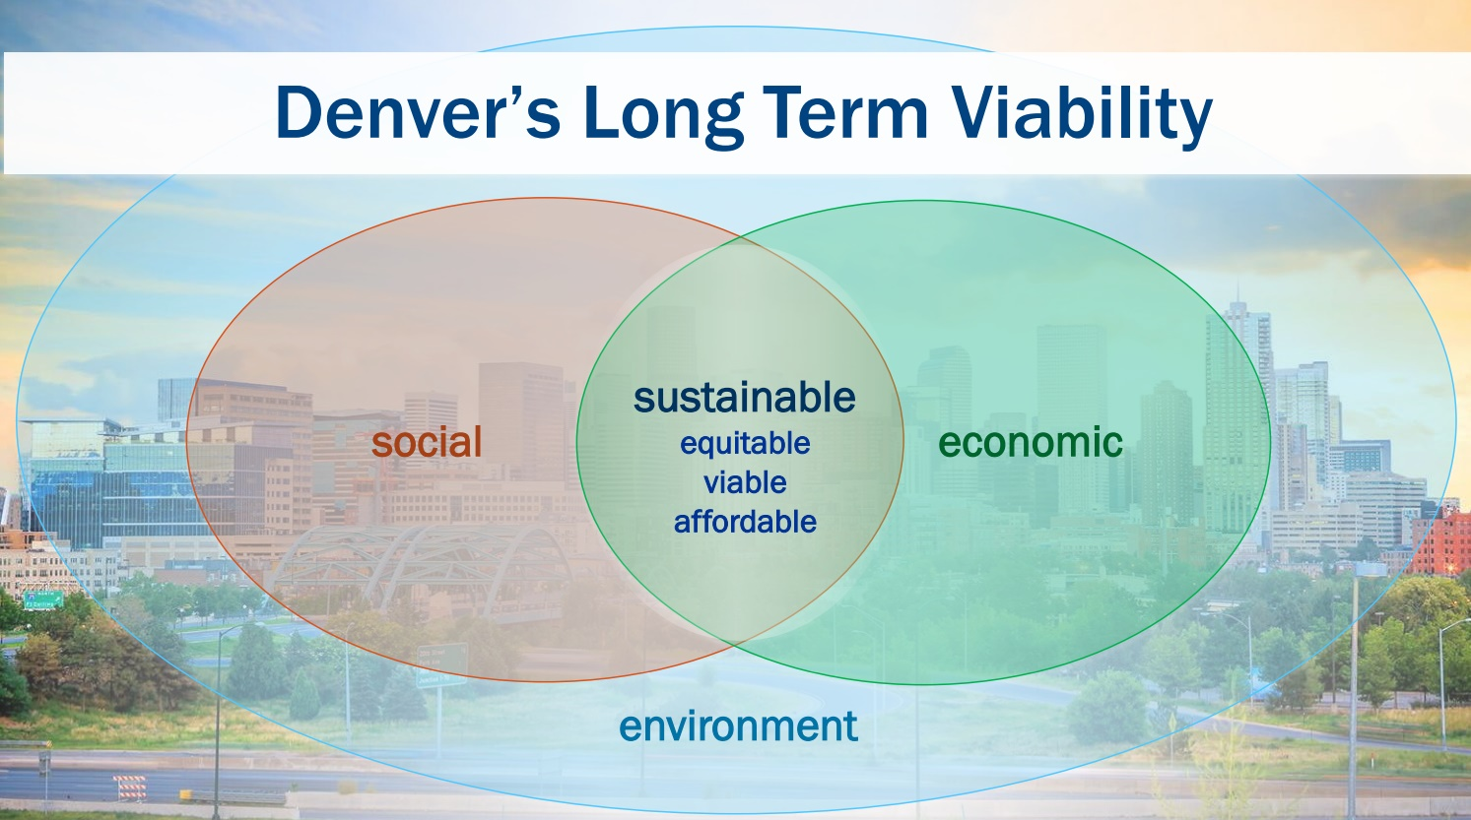
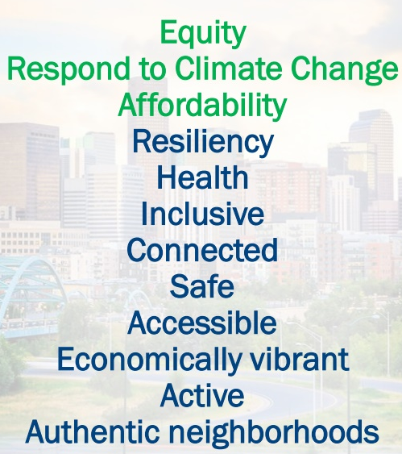
Denver’s Community & Equity
Notes:
2020: equity, affordability, health

Slide 5
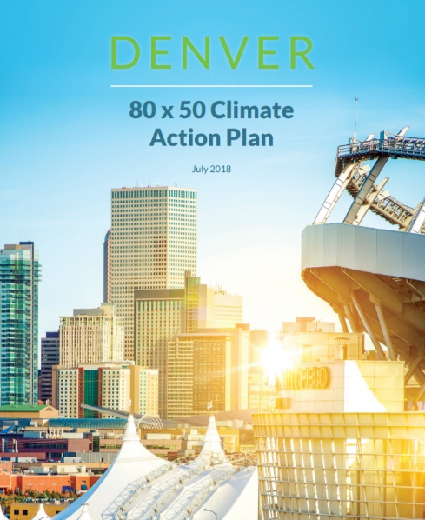
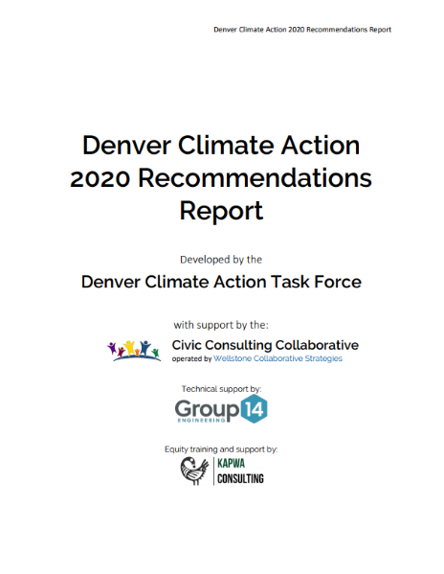
Denver’s Climate Goals: 80% by 2050
Climate Goals:
Climate Recommendations:
Notes:
NZE New Buildings & Homes by 2030

Slide 6




Homes and Buildings Account for
64% of Denver’s GHG Emissions
15% GHG
49% GHG
Notes:
Denver’s 2019 BASIC GHG Emissions

Slide 7
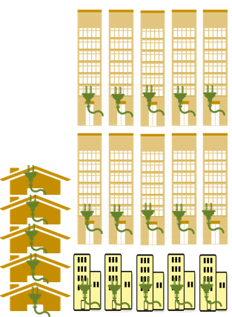
Goal: NZE New Construction by 2030
The IPCC tells us we must have net zero new construction in 2020.
By 2050, ~40% of our building stock will be “new” construction

Slide 8
Defining Net Zero

Slide 9
Denver Net Zero Definition
A new building or home that is highly energy-efficient and fully powered from on-site and/or off-site renewable energy.
  1. Highly Energy Efficient
  2. All-Electric
  3. Powered by Renewable Energy and Electricity
  4. Providers of Demand Flexibility for the Grid
Notes:
4 Foundations of NZE within the implementation plan
Highly Energy Efficient
Highly energy-efficient buildings on site
Target Energy Use Intensity (EUI) for commercial buildings. Target Energy Rating Index (ERI) for homes.
Buildings will have to perform as designed where practical for that building type.
Energy efficiency is the step that makes everything more cost-effective.
All Electric
Reduce greenhouse gas emissions through all-electric equipment in buildings.
No more natural gas in our new buildings and homes.
Powered by Renewable Energy & Electricity
On-site or off-site renewables focused on additional production.
REC’s (renewable attributes) need to be retired by the customer or the utility and not sold.
By 2050 the grid will be 100% renewable. Buildings are part of that equation.
Providers of Demand Flexibility for the Grid
Energy storage, grid integration, and flexibility to respond to grid signals.

Slide 10
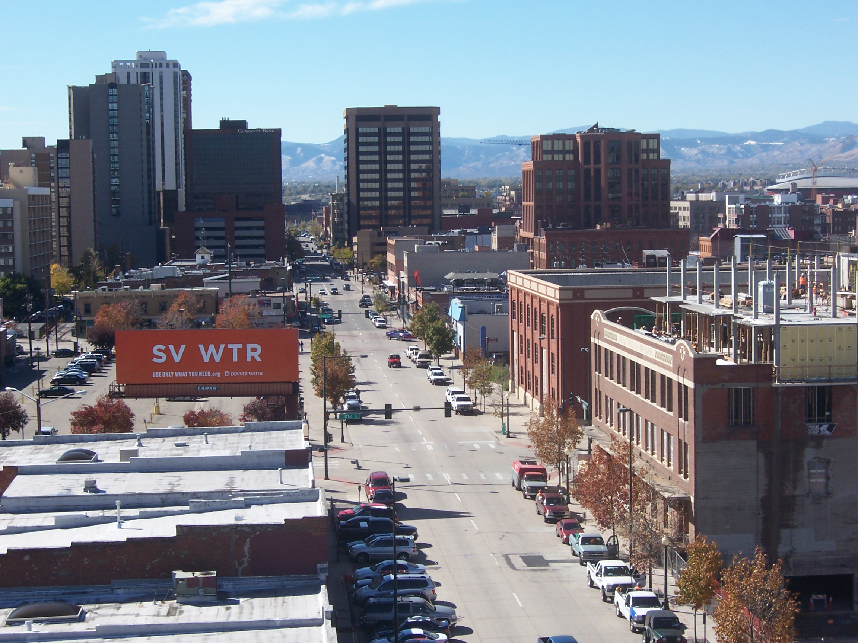
Guiding Principles
Incentives to equitably support construction
Achieve NZE as a whole community
Different solutions based on type
Stakeholders will help us
Notes:
Need incentives to equitably support construction & Denver
As a whole community of buildings, we want to achieve this goal. We will not achieve it in every individual building.
There will be different solutions for different buildings: our goal is to write an implementation plan that requires a fair and consistent level of effort across building types, sectors, and neighborhoods.
Stakeholders will help us figure out this path.

Slide 11
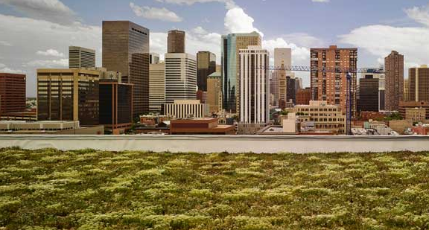
Accounting in Denver
Community goal: net zero emissions
Energy is the metric
Denver’s priority is to add renewable capacity

Slide 12
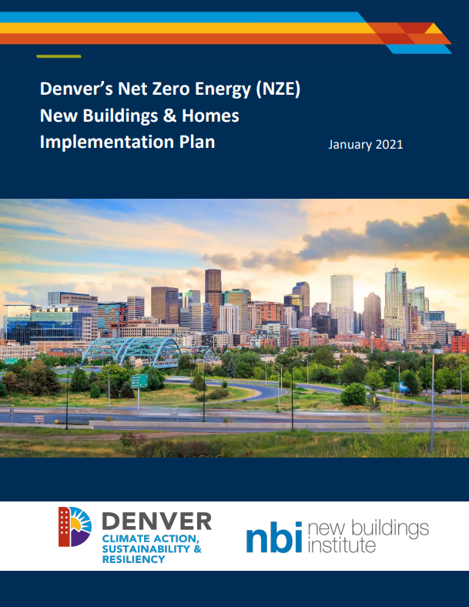
Supports for NZE
Denver Support:
Resources
Staff
Community Support:
Marketing and Outreach
Training and Education
Financing
Advocacy
Education
Programs

Slide 13
What’s in Denver’s NZE Plan?

Slide 14
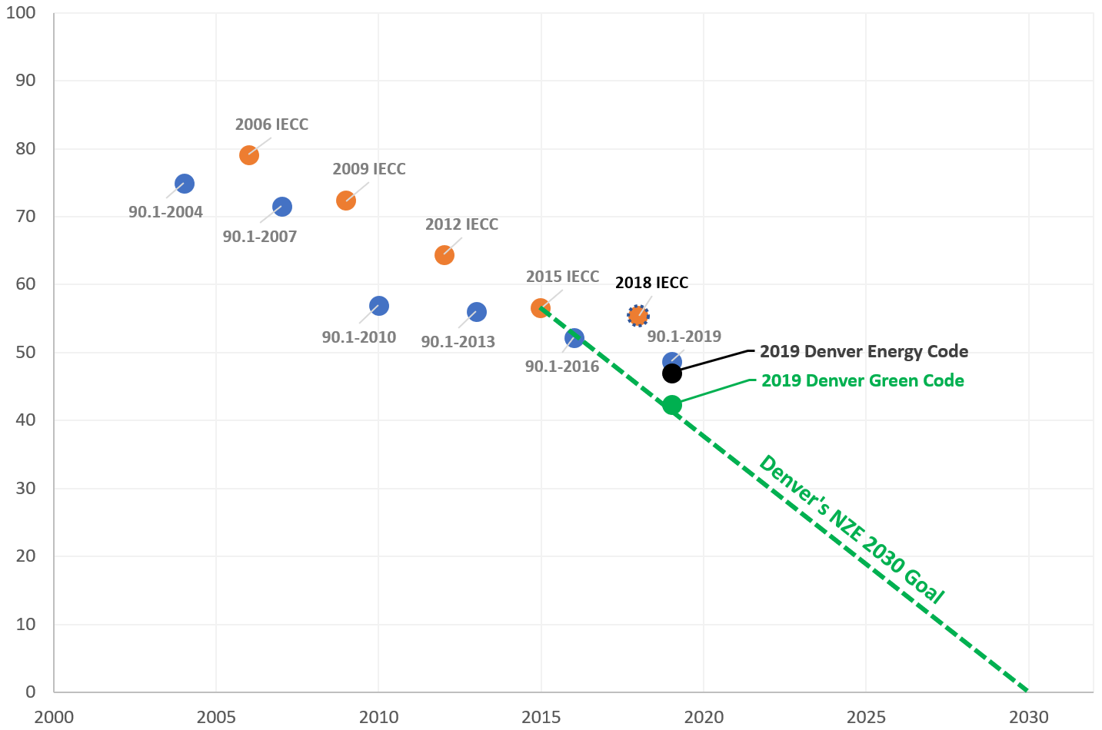
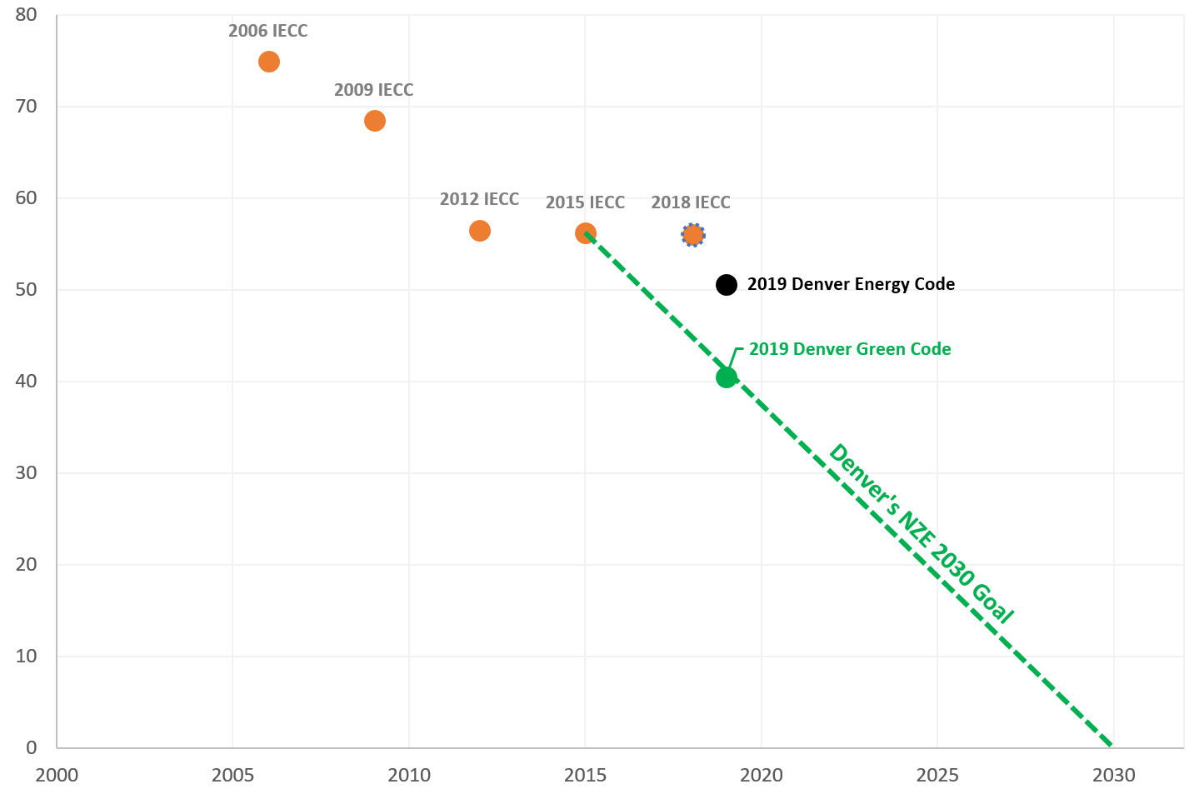
Denver’s Path to NZE by 2030
Path to NZE – Commercial & Multifamily
Path to NZE – Residential
Energy Use
Energy Use
Year
Year

Slide 15
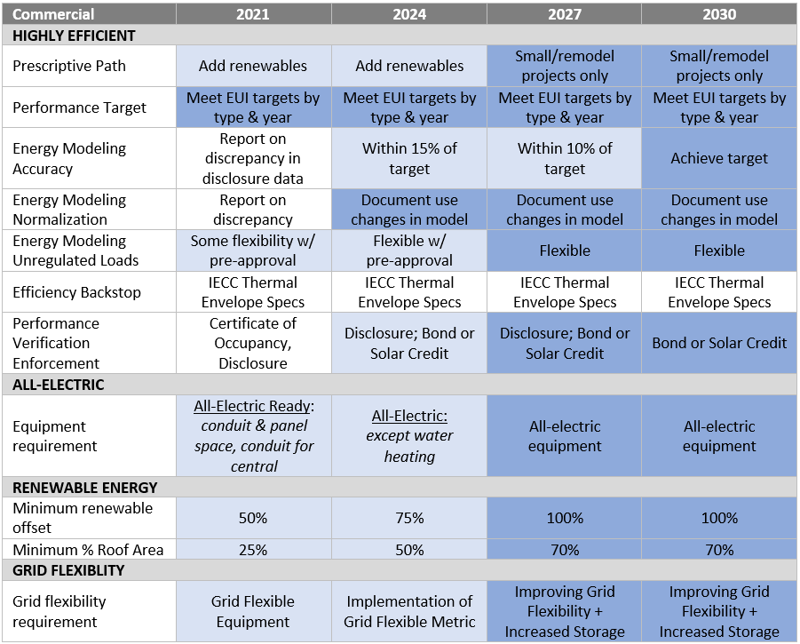
Denver’s Commercial Code Timeline

Slide 16
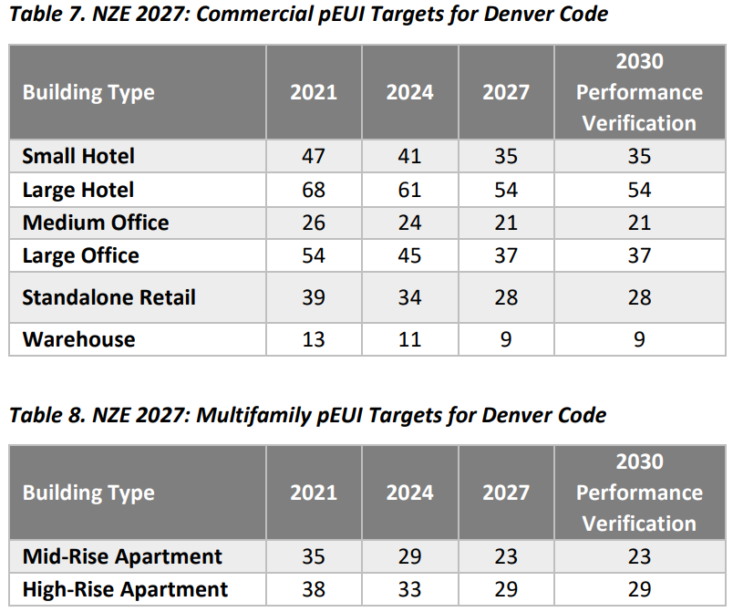
Denver’s Commercial & Multifamily Energy Targets
Notes:
NBI suggested net zero performance targets by building type
2019 Denver Codes – Wanted code adoption to include the easy things and first steps for the community
Meeting 80x50 goal of NZE by 2035
Stakeholders: are these reasonable targets?

Slide 17
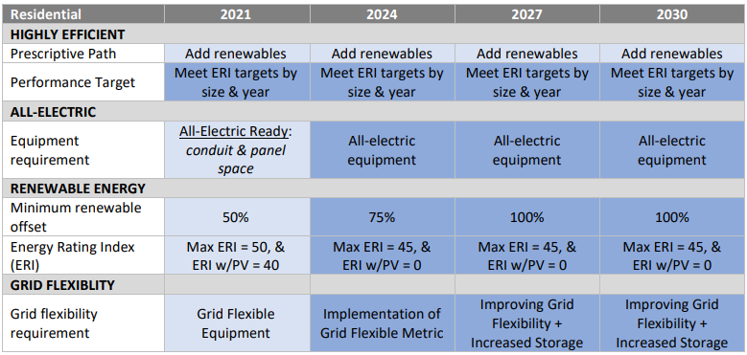
Denver’s Residential Code Timeline

Slide 18
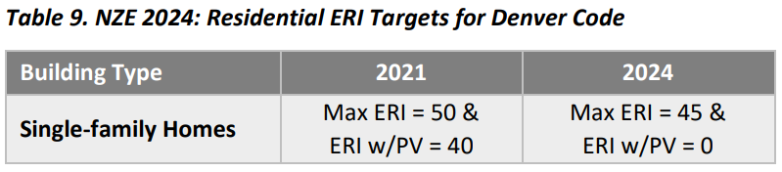
Denver’s Residential Code Energy Targets
Notes:
NBI suggested net zero performance targets by building type
2019 Denver Codes – Wanted code adoption to include the easy things and first steps for the community
Meeting 80x50 goal of NZE by 2035
Stakeholders: are these reasonable targets?

Slide 19
Next Steps

Slide 20
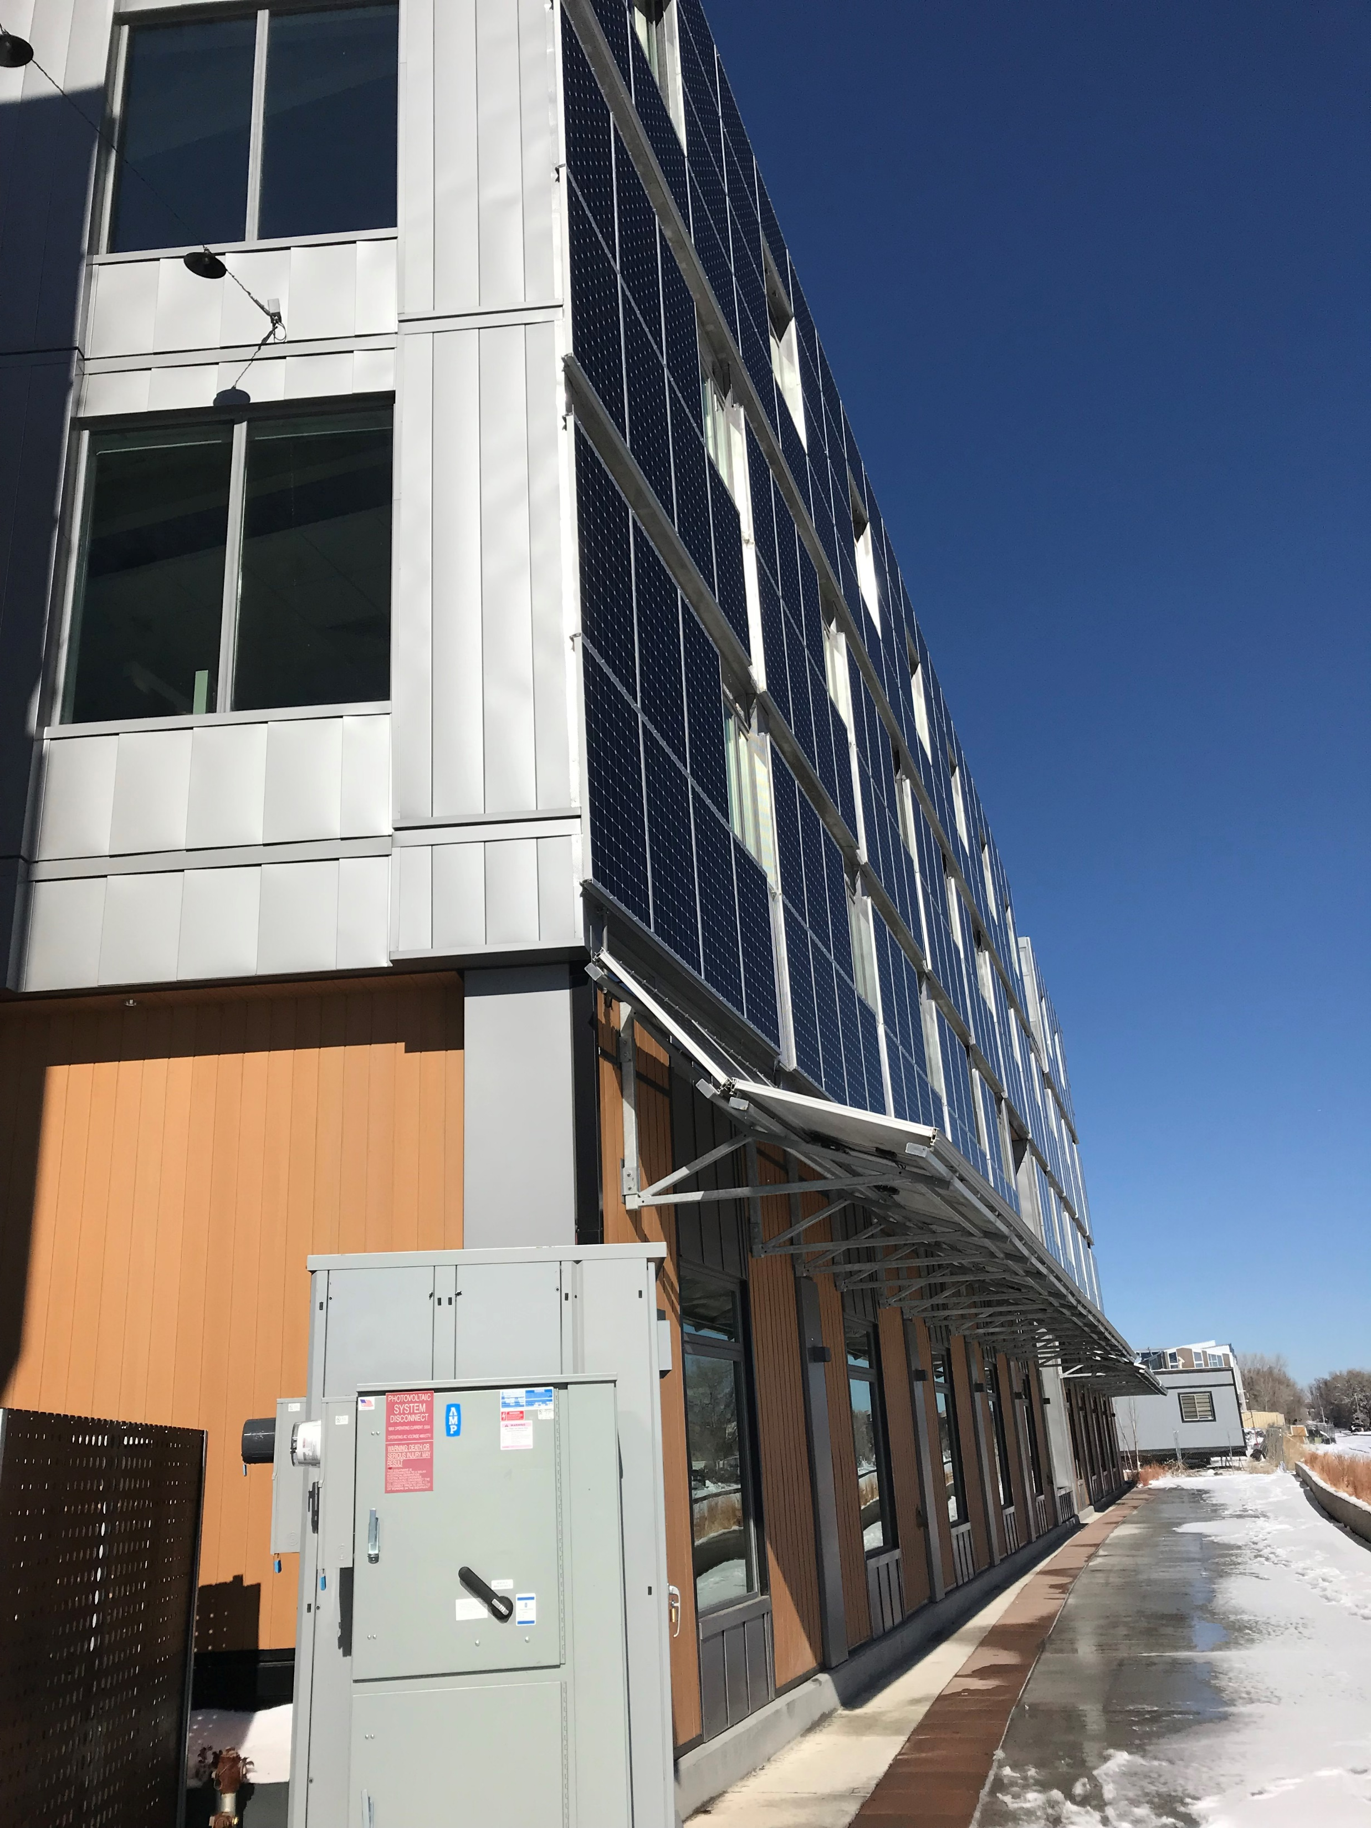
Next Steps & Future Input for Codes
2021 Code Adoption Process
  1st Quarter of 2021
  Input & Feedback
Preliminary 2021 Code Meetings
  Energy efficiency
  Sustainability
Code Adoption Process

Slide 21
Thank You!
Amber Wood,
Denver Energy Program Admin

