Slide 1

Chesapeake Bay Program
Modeling Developments
April 28, 2015
Karl Berger
Dept. of Environmental Programs
Metropolitan Washington Council of Governments

Slide 2
Presentation Overview
Model Development Schedule/Role in Mid-Point Assessment
Watershed Model Schedule
Watershed Model Issues
Local government/COG role
  Potential consultant help

Slide 3
Disclaimer
Data slides in this presentation derived from preliminary CBP Modeling Workgroup output that WILL change

Slide 4
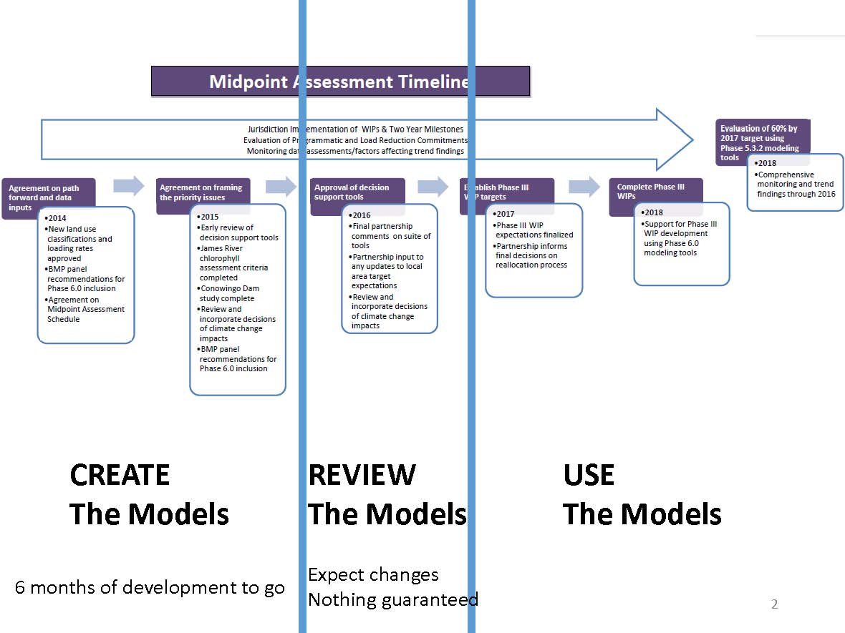

Slide 5
Watershed Model Development 2015
April – Preliminary decision on global targets for land use in July P6 prototype I. Land use categories are finalized
June - Local land use data completed. Review by local jurisdictions from June 15 through July 30, to be finalized in September and used in September prototype
July Quarterly –Review of Phase 6 Prototype 1
September - Agricultural land use from Ag Census is finalized
October Quarterly – Review of Phase 6 Prototype 2
December - Phase 6 draft model will be completed by Dec 20 and prepared for the January quarterly review

Slide 6
Watershed Model Issues
New Land Use
New Target Load Methodology
New Model Processing Techniques

Slide 7
New Phase 6 Land Use
Revised set of land uses
Revised process for generating data
  No longer just Bay-wide land use and land cover data; incorporating localized data sets and localized review
Bay Program paying for new land cover data analysis to fill in gaps
  High-resolution Land Cover Data derived from existing 1 meter leaf-on aerial imagery, leaf-off aerial imagery (where available), and LiDAR-derived digital surface models
    Produced by Chesapeake Conservancy, University of Vermont or VARGIS RFP – Contractor yet to be selected

Slide 8
Proposed Phase 6 Developed Land Uses
Developed
Impervious
Pervious
Construction
Extractive
Roads
Other
(e.g. Buildings, parking lots, etc.)
Open space
Turf
Tree canopy
Level I
Level II
Move to Natural category
Move to its own category
Level III
Stream corridor loading framework still in development

Slide 9
P6 Land Use Development Schedule
Apr 2015 Complete regional land use dataset using nationally available data (P6 Land Use Database v1)
Jun 15, 2015 Complete integration of local land use data (P6LU_v2)
Jun-Jul 2015 State and local jurisdictions review land use data (six weeks)
Aug 2015 CBP responds to comments on P6LU_v2 data
Sep 1, 2015 Submit P6LU_v2 to CBP Modeling Team
Sep’15 -Jun’16 Incorporate additional local data and high-res land cover into P6 Land Use Database v3.
Jan –Jul 2016 Rolling jurisdictional review of P6LU_v3 and CBPO response to comments.
Aug 2016 Finalization of P6 land use database v3 (1985 –2014)
Sep 1, 2016 Submit final database to CBP Modeling Team

Slide 10
Target Load Methodology
Land segment lb/A = target + Σ ((lseg input rate–median input for CBWS) * sensitivity)
Plan to set global target via Bay-specific model results rather than some sort of average literature values
Issue is which model to use
  Sparrow
  CEAP
  CBP WSM Phase 5.3
or whether to average results

Slide 11
Global Targets
Targets are for each nutrient and major land use, category (forest, ag and urban) in lbs/acre
Set relative relationship between ag, urban and forest loading
Represent long-term average loading, not specific to any one year
  annual variation in loads determined by hydrology and nutrient inputs, which varies geographically
Does not include effect of BMPs

Slide 12
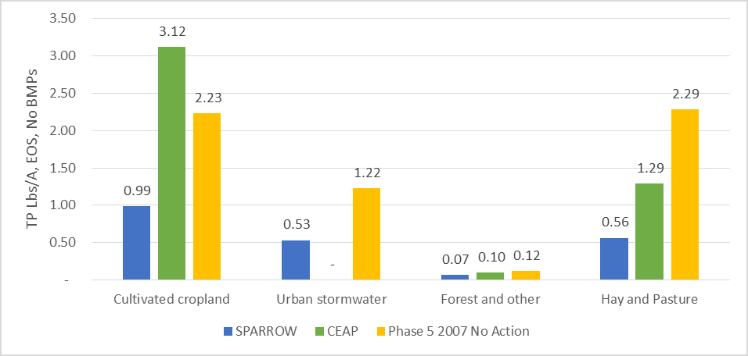
Potential Global Target Values for TP
DRAFT

Slide 13
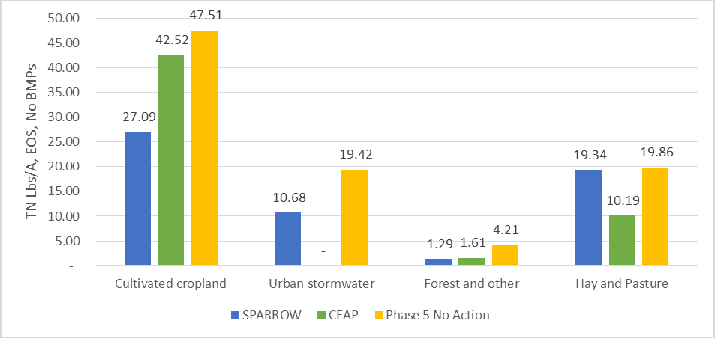
Potential Global Target Values for TN
DRAFT

Slide 14
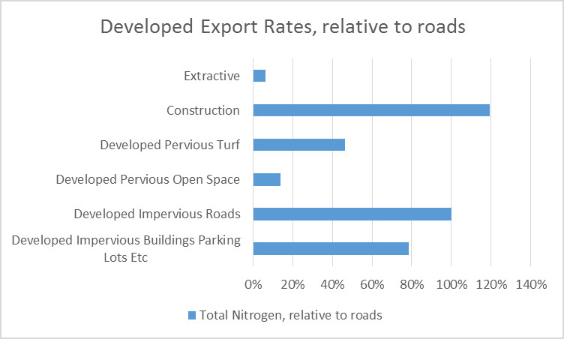
Targets within Developed Sector
DRAFT

Slide 15
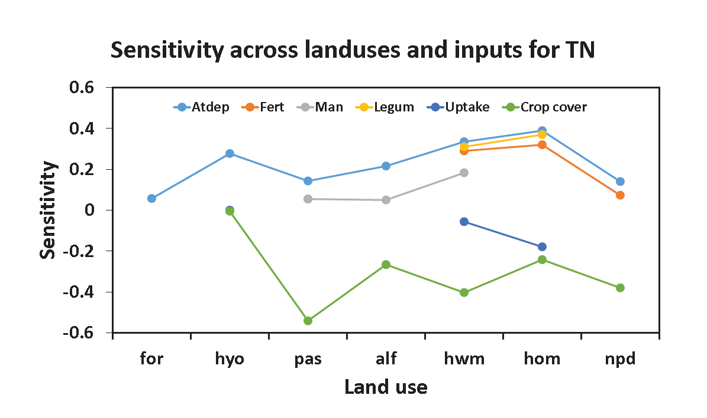
Preliminary Sensitivity Data
Derived from WSM Phase 5.3.2 data
DRAFT
Pervious urban shows same sensitivities as pasture

Slide 16
New Model Processing Techniques
Goal is to make model results more transparent
  No longer using Ag Chem submodel; now using P-Qual submodel
  Substitute explainable parameters for “regional factors”
  More explainable land-to-river and stream-to-river factors
Incorporate lag time into nutrient input – nutrient output relationship

Slide 17
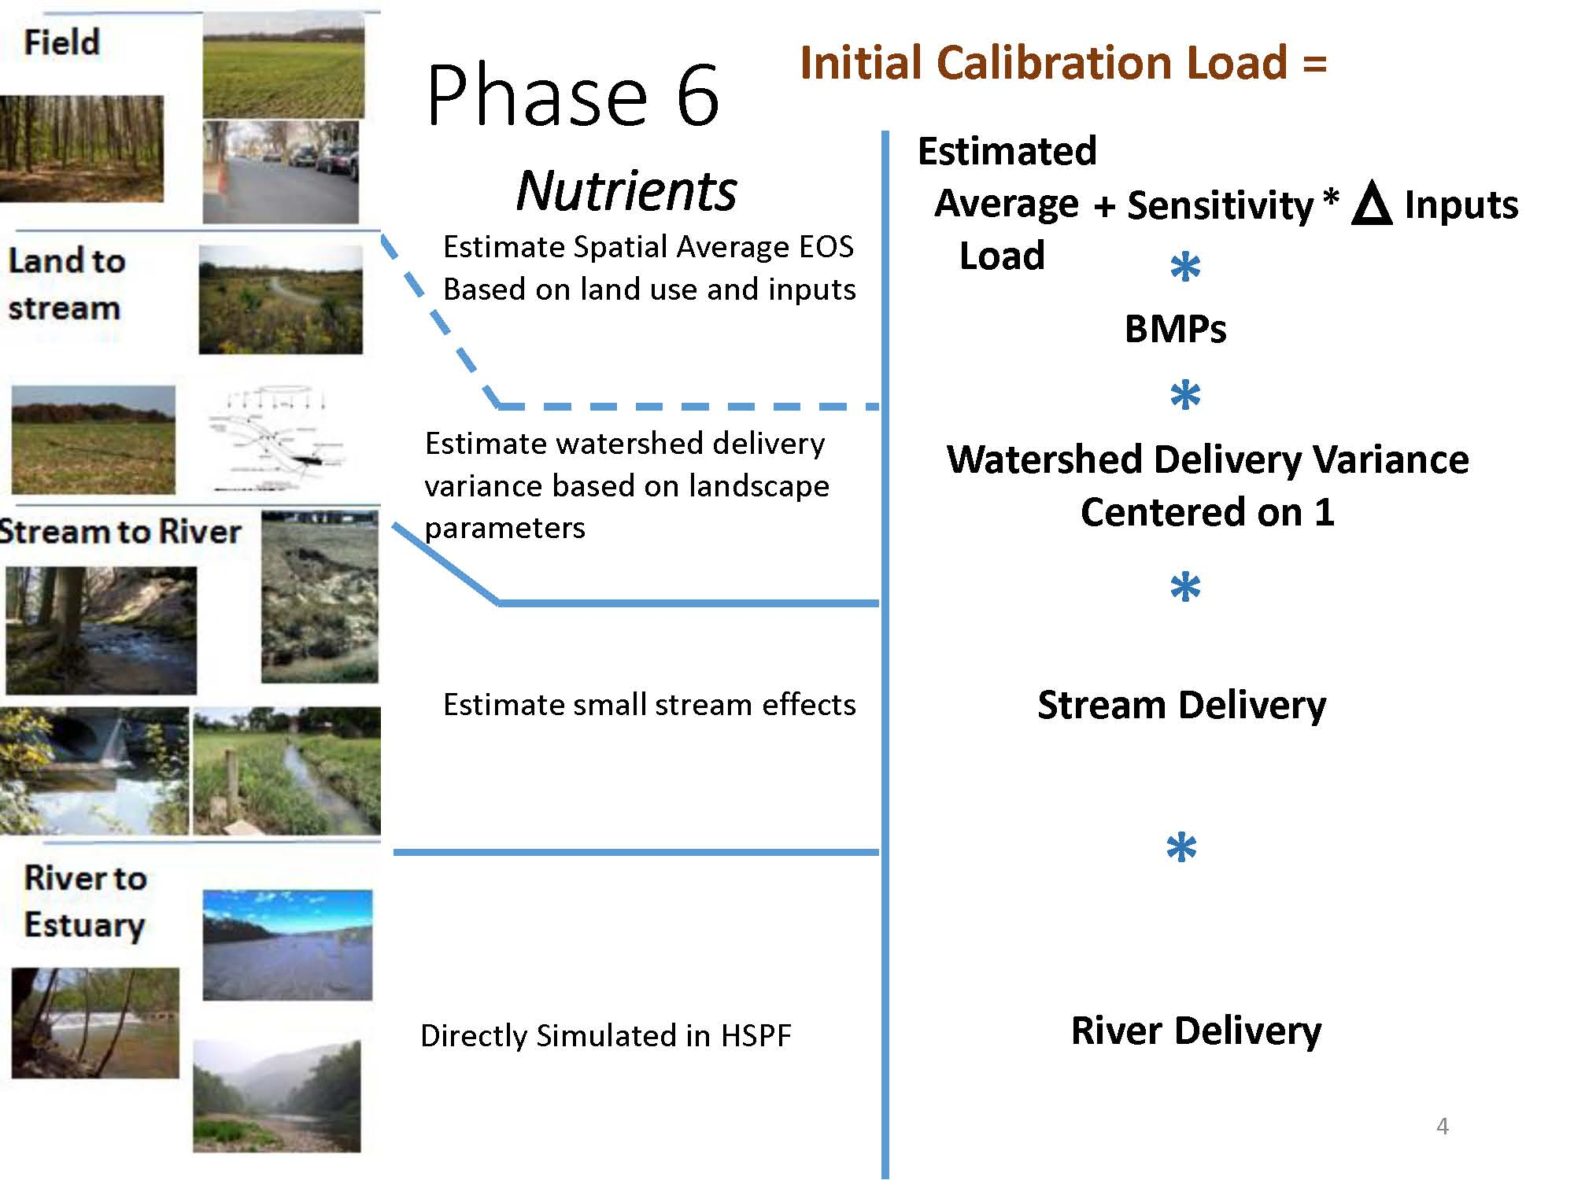

Slide 18
Other WSM Issues
Revised Conowingo dynamics
Revised BMP efficiencies
Climate change impacts
Potential need for new hydrodynamic calibration
Refinement to shallow water simulation
Development of a Stream Source Ratio (SSR) that quantifies the relative load attributed to instream sources (e.g. bed & bank erosion, resuspension)

Slide 19
Local Government/COG Role
Watershed model development entering final decision stage
  Lot of reliance on WSM 5.3.2 results
Local government tracking resources are fairly minimal
Need for consultant help with target loads and sensitivities, other issues - ?
In depth model workshop – September ?

Slide 20
Extra Slides

Slide 23
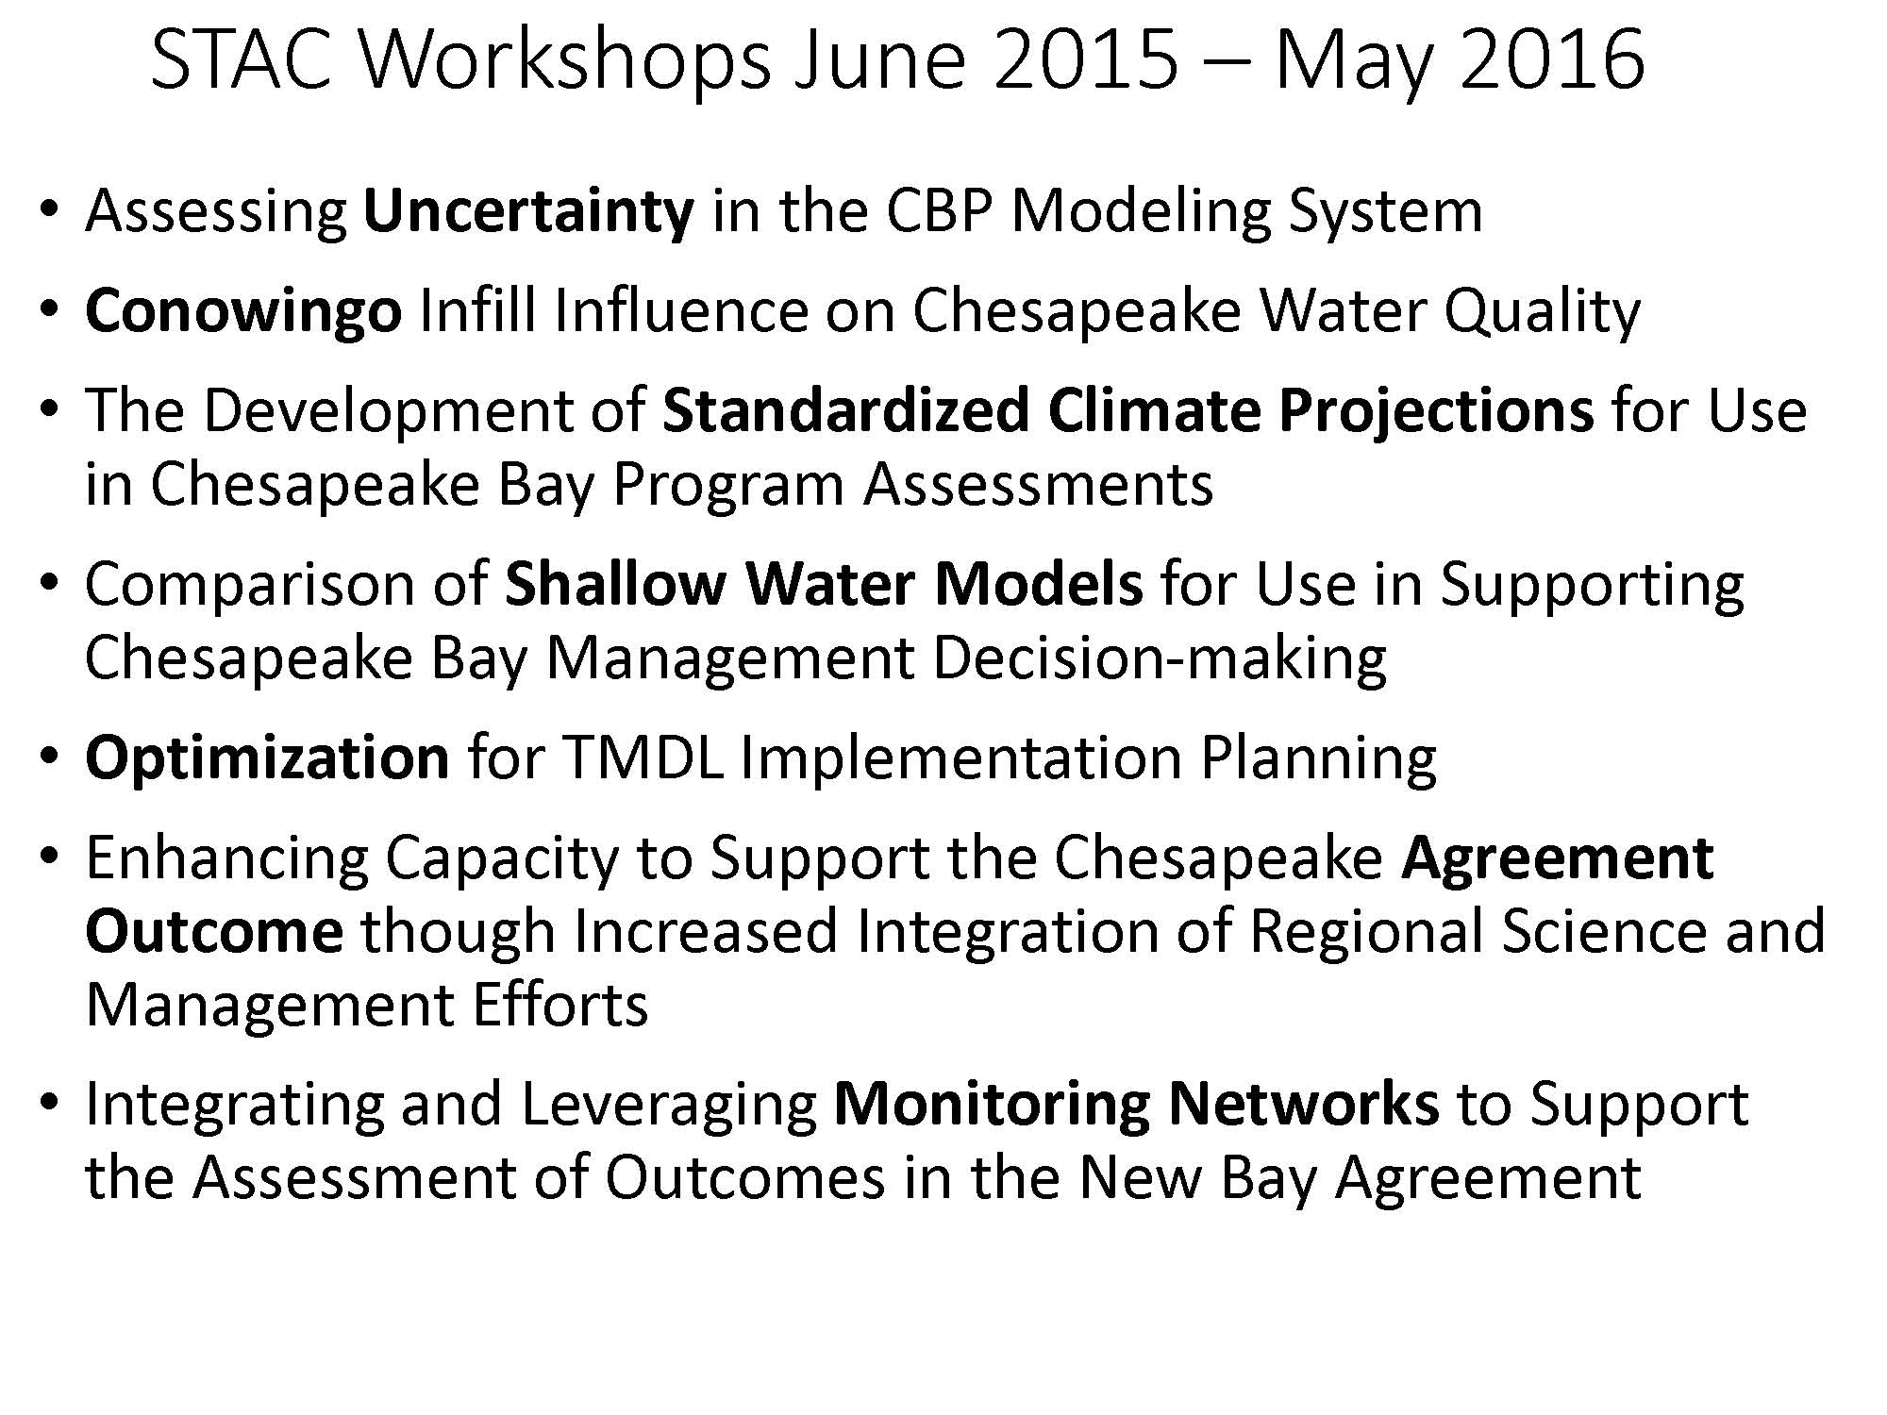

Slide 24


