Slide 1
the National Capital Trail Initiative
Of the TPB’s 2018 Long-Range Transportation Plan Visualize 2045
Michael Farrell Transportation Planner Bicycle and Pedestrian Subcommittee Item #4 September 17, 2019

Slide 2
2018 Long-Range Plan
UNFUNDED
ELEMENT
ASPIRATIONAL
ELEMENT
CONSTRAINED ELEMENT

Slide 3
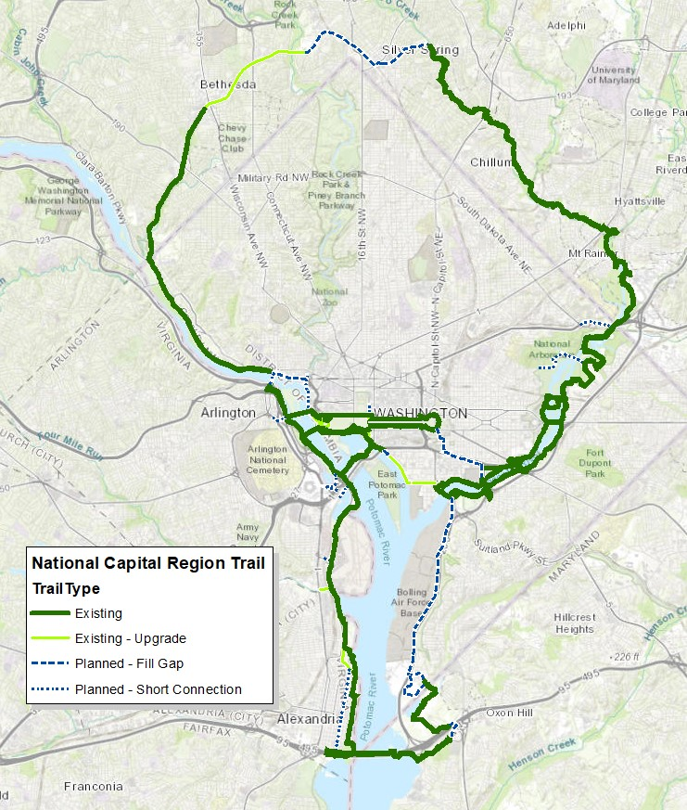
National Capital Trail
60 total miles total
21 miles unconstructed
3 miles need upgrading

Slide 4
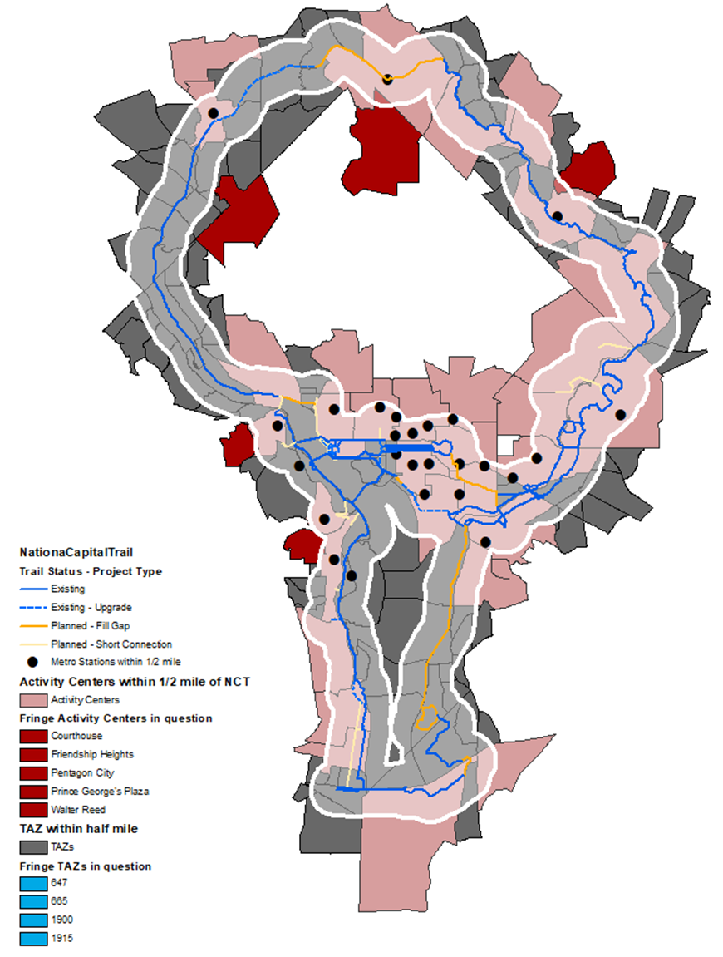
People and Jobs Served
Within 1/2 mile of the National Capital Trail:
36 Activity Centers
26 Metro Station
817,983 jobs
498,161 people
 | Activity Centers | Metro Stations | Employment | Population
1/2-mile Buffer | 36 | 26 | 817983 | 498161
2-mile Buffer | 57 | 58 | 1254344 | 1365260

Slide 5
TPB calls for Expansion
In Fall 2018, TPB Bicycle and Pedestrian Subcommittee recommended that the National Capital Trail be expanded to cover the entire TPB footprint
Capital Trails Coalition urged the TPB to incorporate its newly adopted Capital Trails Network into Visualize 2045
In December 2018, TPB adopted Resolution TPB R20-2019, which directed TPB staff to:
“Expand the TPB-endorsed National Capital Trail to provide connectivity to other major trails in the region thereby creating a regional trail network that extends into all TPB member jurisdictions, by building on previous work done by TPB and others, and to report on progress by end of June 2019…”

Slide 6

Building on Previous Work
TPB staff participated in four years of planning and consensus-building with the Capital Trails Coalition
REI-funded 1.5 full time equivalent staff, housed at Washington Area Bicyclist Association and at Rails to Trails
Vision: A continuous network of “all-ages, all-abilities” long distance multi-use trails, covering the entire region, connecting people to jobs, transit, and nature.

Slide 7
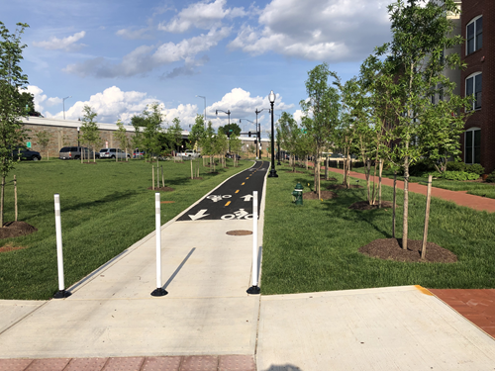
Selection Criteria
Long-distance, regional trail network
  Many local trails will not be included
Accessible for “All Ages and Abilities”
Off-Street Multi-Use Paths:
  10’+ wide for new construction.
  8’ minimum for existing facilities
  Narrower in short segments if design constrains
  Paved, or firm surface such as crushed limestone
On-street:
  Protected from moving traffic (i.e. parked cars, curb, flexposts)
  Short unprotected connections where necessary
Designed for non-motorized use
Connectivity
  Directly connected to the regional network
  Suitable for both transportation and recreation
Existing or Planned Facilities are acceptable
  Planned facilities must be in an approved plan
Virginia Avenue SE

Slide 8
Progress to Date
Coordination/Planning
  B/P Subcommittee
    Endorsed Capital Trails Coalition Network – March 19
    Endorsed Criteria for Network Inclusion – May 21
  Site Visits
    Capital Trails Coalition – March 8
    Frederick County/City – April 30
    Prince William/Manassas/Manassas Park – May 2
    Loudoun – May 13
    Charles – Met at COG, June 7
Data Gathering/Mapping
    GIS data gathered from all the major jurisdictions
    Draft map created

Slide 9
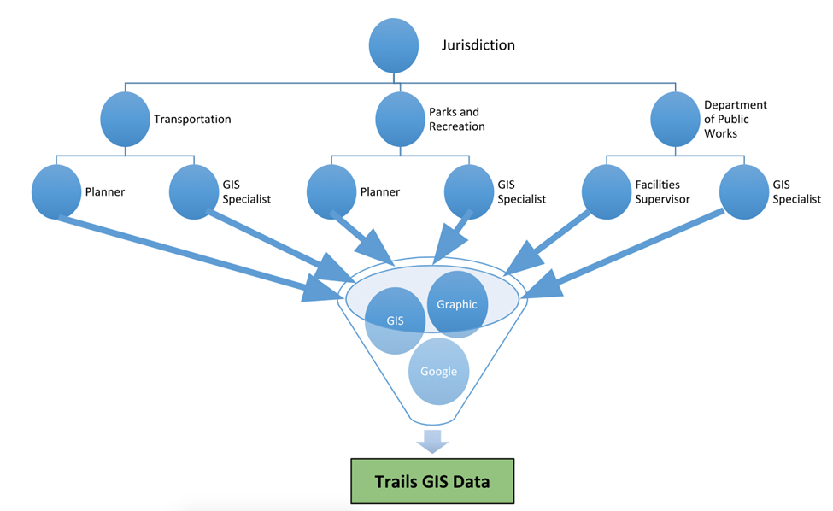
Data Gathering
Source: Capital Trails Coalition

Slide 10
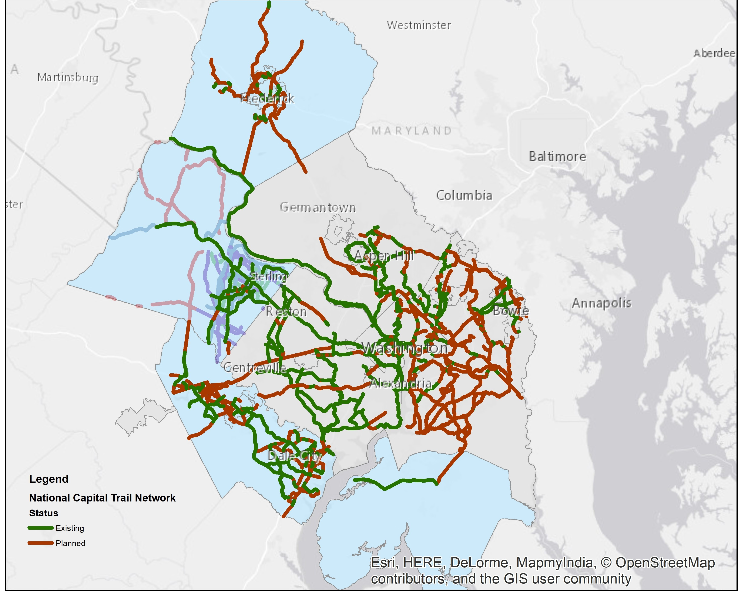
Draft Map

Slide 11
Schedule/Next Steps
  Apply the Selection Criteria to produce a draft Network – August-September
  Report Progress to TPB - October
  Vet Draft Network – September-October
  TPB Adopts Final Network – Late 2019
  Follow-on Effort: Update of the regional Bicycle and Pedestrian Plan

Slide 12
Michael Farrell Transportation Planner (202) 962-3760 mfarrell@mwcog.org | mwcog.org/tpb
Metropolitan Washington Council of Governments 777 North Capitol Street NE, Suite 300 Washington, DC 20002

