Slide 1
FARM Ad-HOC Committee
Near-Term Priorities Discussion
Mary Cheh, FARM Chair Councilmember, District of Columbia December 11, 2020
Agenda Item 6

Slide 2
Committee Charge
From Certified Resolution R37-2020:
The Board endorses the establishment of a Food and Agriculture Regional Member (FARM) Ad-Hoc Committee for a period of one year from its commencement (with necessary extension as approved by the COG Board), which would be charged with:
1) Making policy recommendations for member jurisdictions to support a more resilient, connected food and farm economy in metropolitan Washington;
2) Recommending how to provide long-term direction and collaboration through a regional food and agriculture committee representing diverse entities across metropolitan Washington;
3) Furthering the goals identified in the What Our Region Grows report to the benefit of member jurisdictions; and
4) Assisting COG in continuing its COVID-19 food security collaboration.
Agenda Item 6: COG FARM Ad Hoc Committee Meeting
December 11, 2020

Slide 3
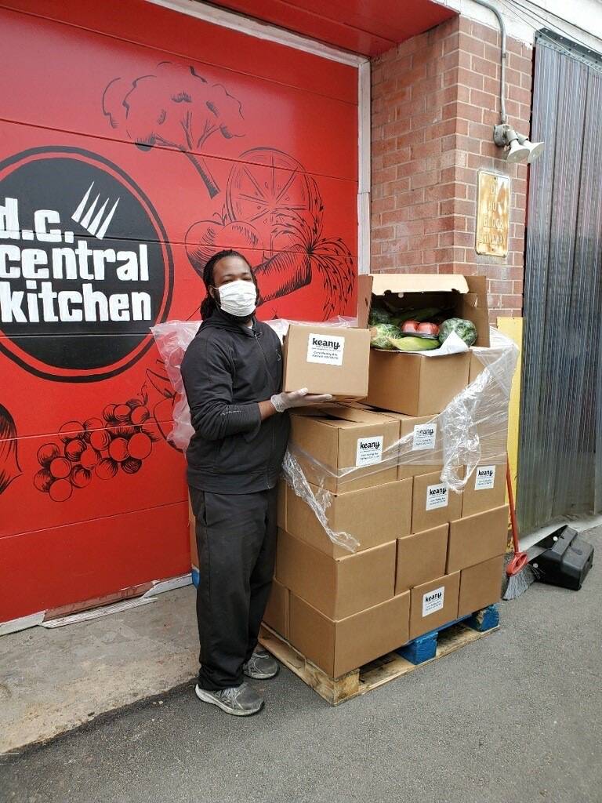
Near-Term Priorities Discussion
Building on conversation from our first meeting
Interested in your ideas, understanding what you want to work on
Goal: Confirm several priorities to work on together
Receiving food for distribution at DC Central Kitchen in May. (DC Central Kitchen Flickr)

Slide 4
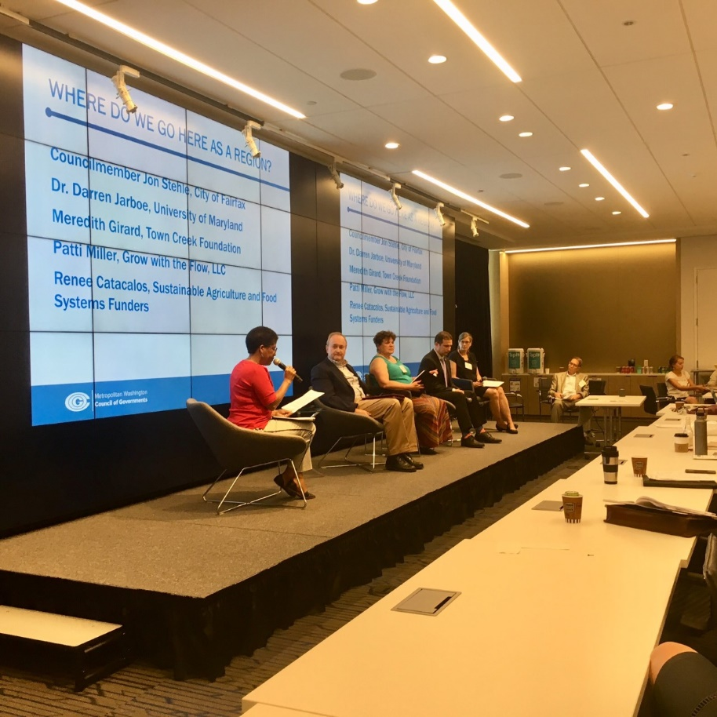
Reporting Back, Looking Ahead
What we heard at our first meeting
Existing and available information resources
Aligning Regional Food Systems Program with FARM priorities
Panelists at the June 2019 Supply Chain Studies Summit (Lindsay Smith/COG)
Agenda Item 6: COG FARM Ad Hoc Committee Meeting
December 11, 2020

Slide 5
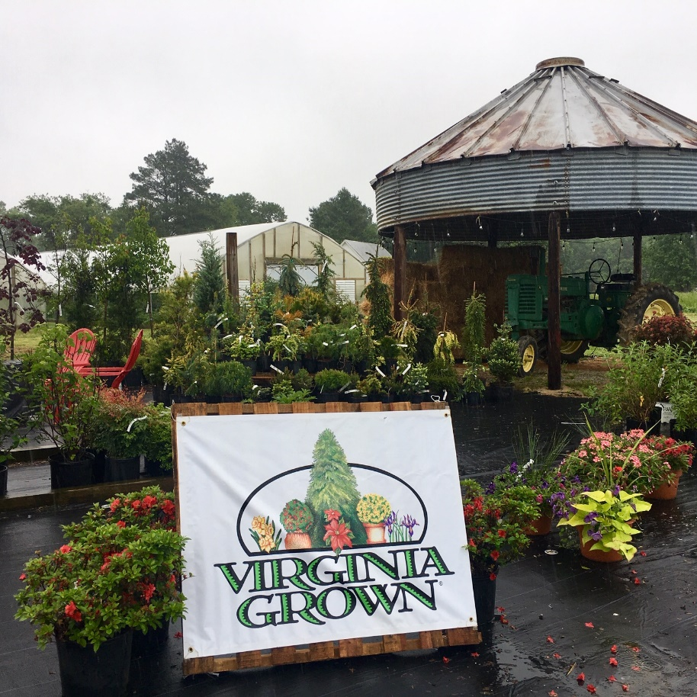
Near-Term Priorities: Questions
As we look at possible areas of focus in Food Security, Agriculture, and Food Procurement and Purchasing:
Do you want to work on these proposed topics?
Can you provide more detail/depth on them?
Are there additional topics that should be included?
There will be time to talk about other major issues.
Produce farm and nursery in the Northern Neck that participates in the Virginia Grown program (Lindsay Smith/COG)

Slide 6


Food Security
Maximize participation in federal nutrition programs; share best practices for implementation and outreach
Advocate regionally for federal relief and recovery funding
Reduce barriers to food access at farmers markets
Several new studies call for maximizing enrollment in federal programs like the Supplemental Nutrition Assistance Program (SNAP).
Agenda Item 6: COG FARM Ad Hoc Committee Meeting
December 11, 2020

Slide 7
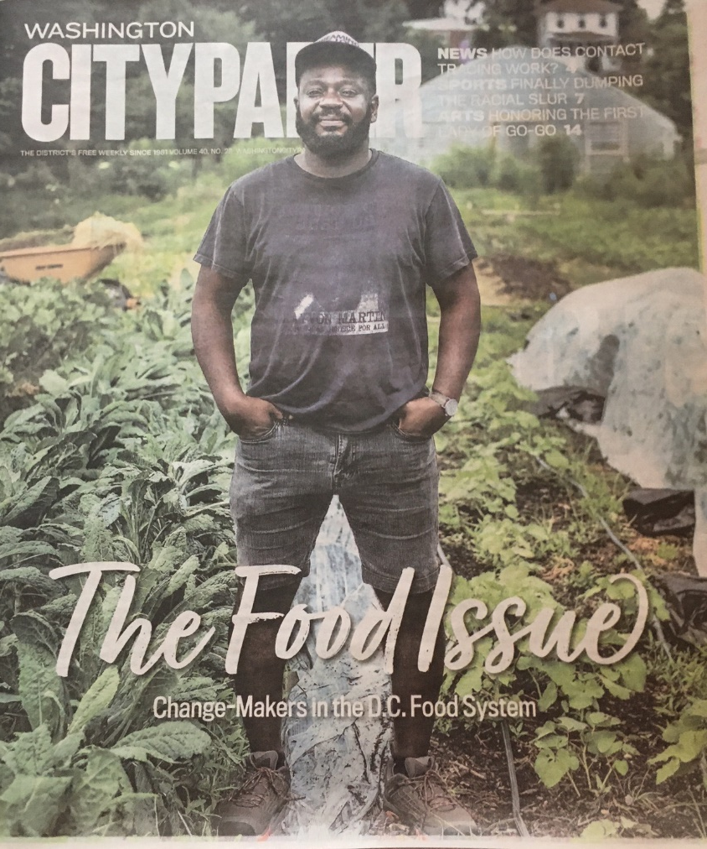
Agriculture
Increase opportunities for BIPOC farmers; address barriers to land ownership
Identify and address barriers to processing and distribution of local products
Help small farmers access capital, infrastructure, and markets to grow their enterprises (individually or cooperatively)
Increase gardening opportunities (e.g., community gardens, school gardens, backyard chickens)
  Dreaming Out Loud’s Executive Director, Chris Bradshaw on the cover of this summer’s Washington City Paper: The Food Issue. Darrow Montgomery/Washington City Paper

Slide 8
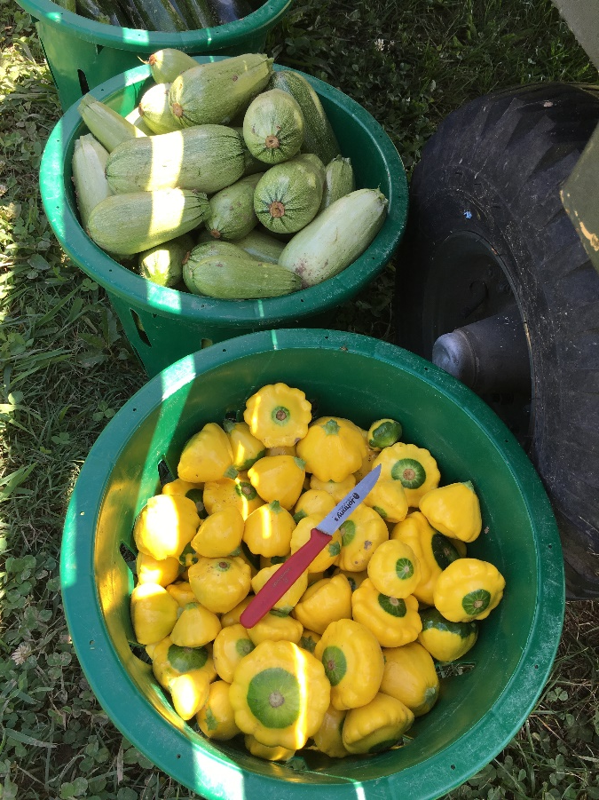
Food Procurement and Purchasing
Support local farmers and BIPOC farmers through targeted institutional and government procurement
Explore and share procurement standards for sustainability, health, equity, local purchasing
Summer produce grown at University of Maryland’s Terp Farm in Upper Marlboro, MD is used by UMD’s Dining Services to achieve sustainability goals for procurement (Lindsay Smith/COG)

Slide 9
Data
Develop listing for the COG region on direct markets (farmers markets, farm stands, CSAs, food access programs)
Develop regional food assistance GIS layer in NCR GDX
Organize compendium of food access/food security programs and resources across the region

Slide 10
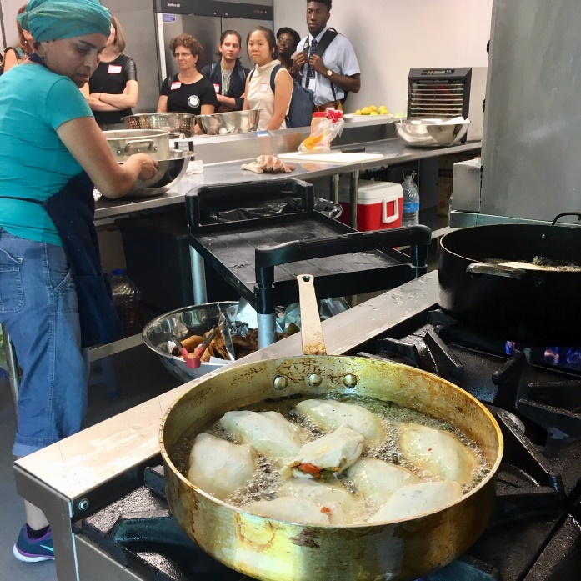
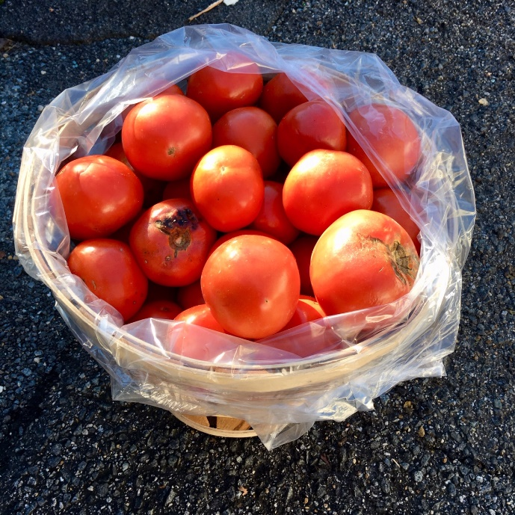
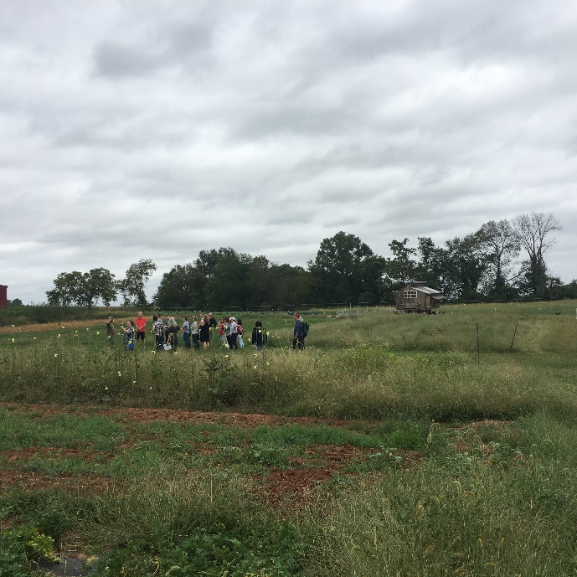
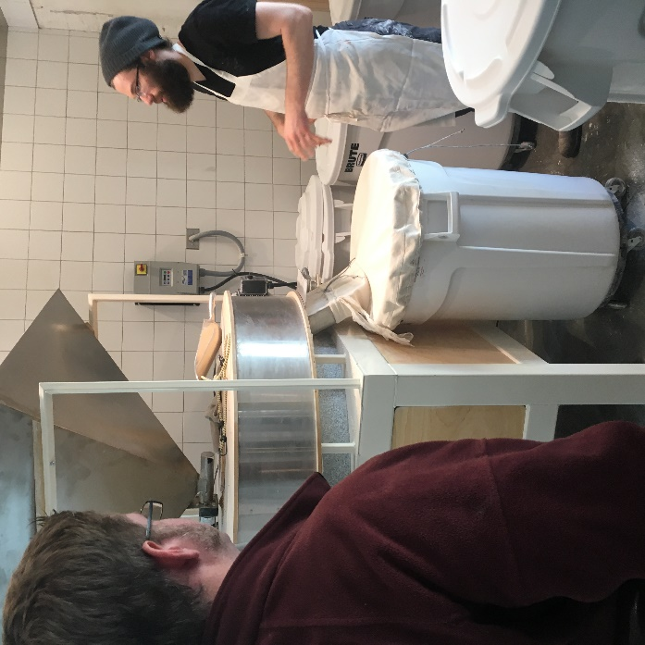
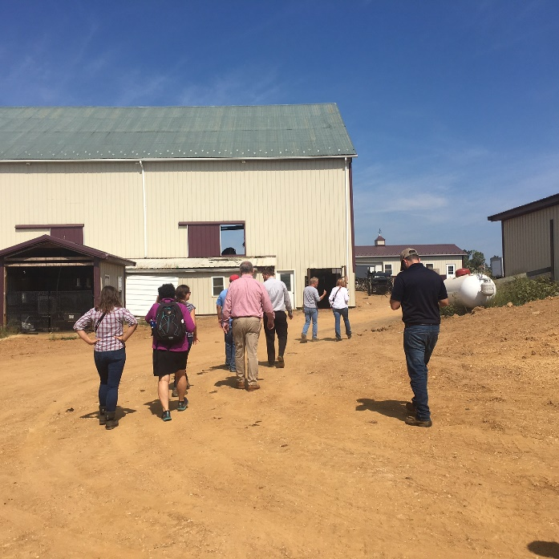
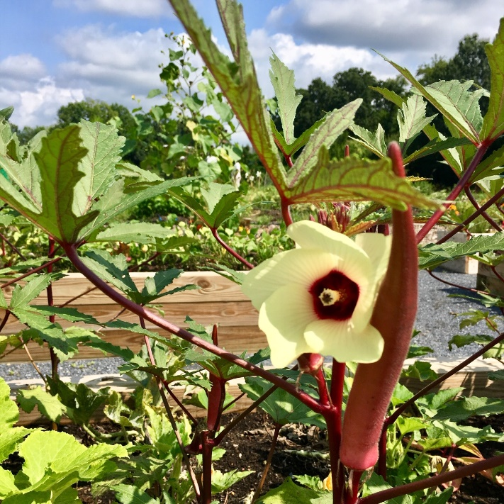
Other Major Issues?
Agenda Item 6: COG FARM Ad Hoc Committee Meeting
December 11, 2020
Pre-pandemic images from urban and rural regional farms and food enterprises (Lindsay Smith/COG)

Slide 11
More Information Mary Cheh, FARM Chair Councilmember, District of Columbia mcheh@dccouncil.us Rachel Clark, Legislative Counsel Office of Councilmember Mary Cheh rclark@dccouncil.us Lindsay Smith Regional Food Systems Value Chain Coordinator (202) 962-3307 lsmith@mwcog.org | mwcog.org
777 North Capitol Street NE, Suite 300 Washington, DC 20002

