Slide 1


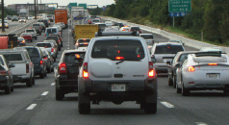
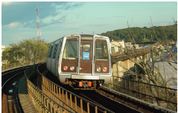
Item 10
Adopted: July 18, 2012
Performance Analysis
December 19, 2012
(updated from November 28, 2012)
Presentation to the
National Capital Region Transportation Planning Board (NCR-TPB)

Slide 2
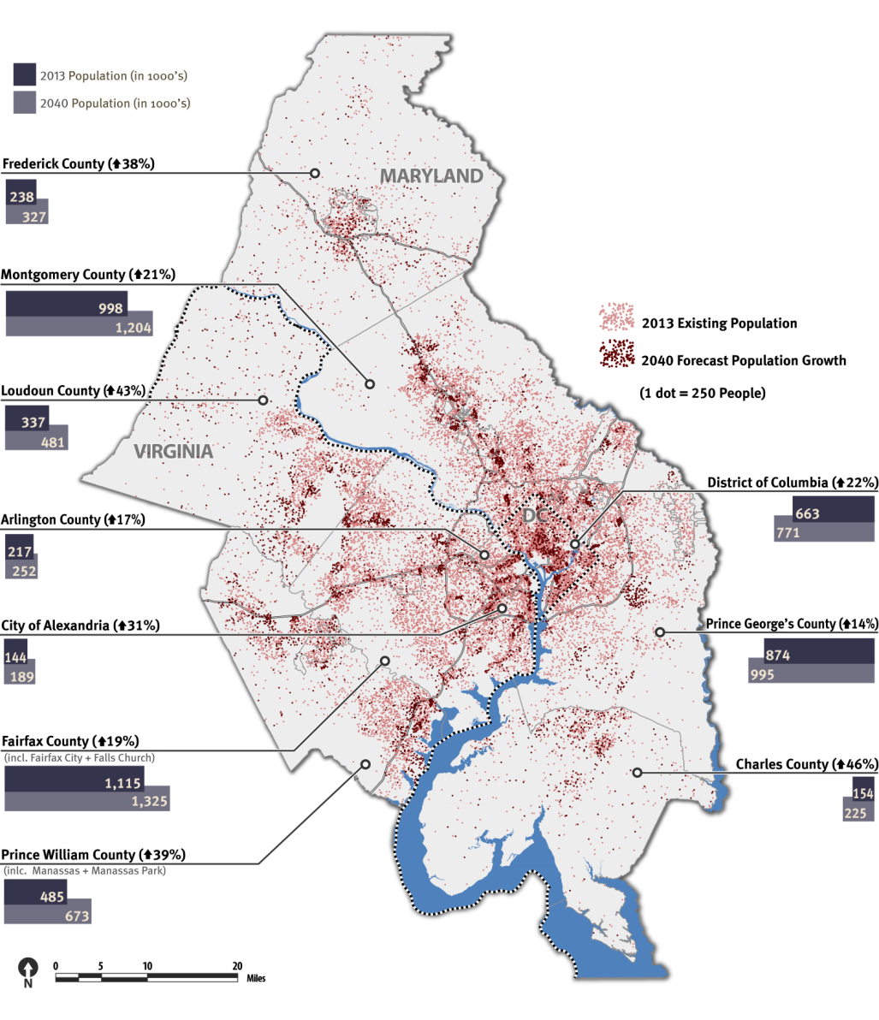
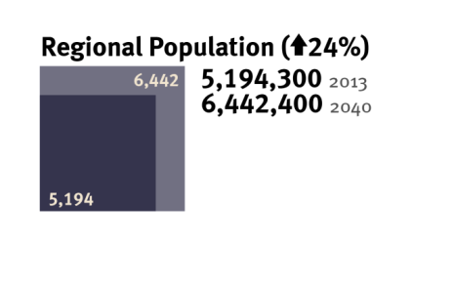
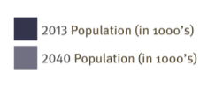
Population Growth
2013 - 2040
2040 Population Distribution
By 2040 the region’s population will grow by 24% to almost 6.5 million people.
The population of the outer jurisdictions is expected to grow at a faster rate than the inner jurisdictions.
The inner jurisdictions will retain the majority of the region’s population in 2040.

Slide 3
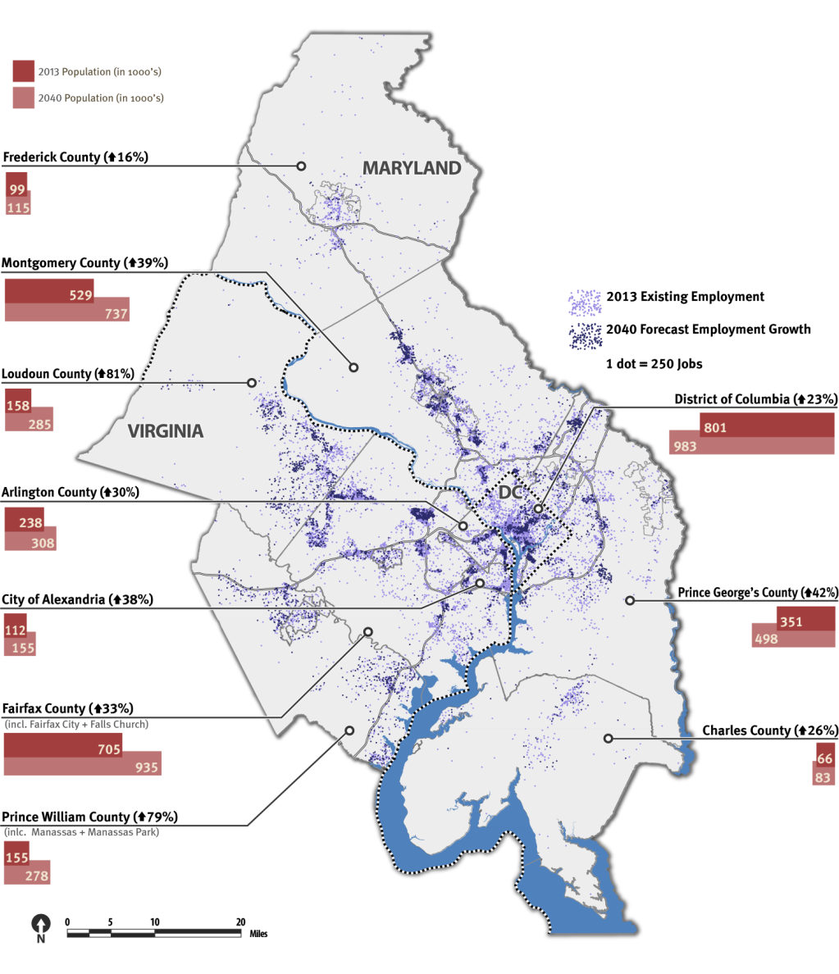
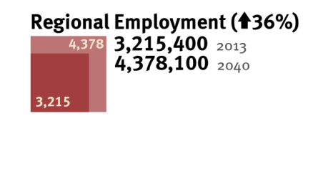
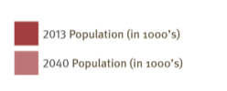
Employment Growth
2013 - 2040
2040 Employment Distribution
By 2040 the region’s employment will grow by 36%.
Employment is expected to grow fastest in the outer jurisdictions of Virginia, but the highest concentration of jobs will be in the District of Columbia, Fairfax County, VA, and Montgomery County, MD in 2040.
In 2040 population will be slightly more dispersed than it is today, and jobs will continue to concentrate toward the western side of the region.

Slide 4
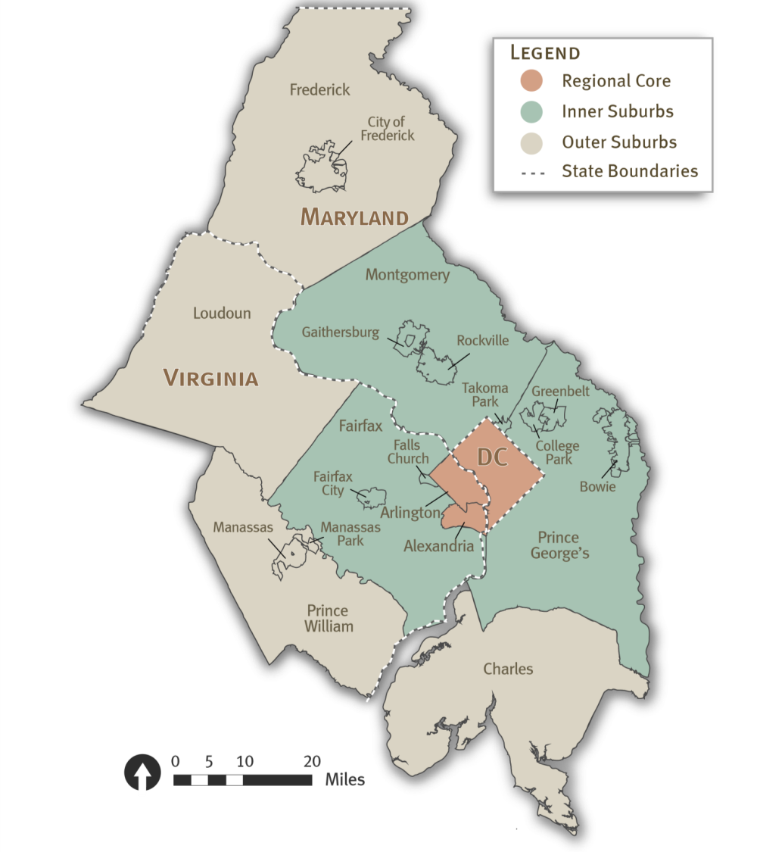
The TPB Planning Area
Regional Core, Inner, and Outer Suburbs

Slide 5
Households, Population, and Employment in 1990 and 2010
As estimated by Round 4.1 (1991) and Round 8.1 (2012) Cooperative Forecasts
 |  | Households |  |  | Population |  |  | Employment
Jurisdiction: |  | 1990¹ | 2010² | Percent Growth | 1990¹ | 2010² | Percent Growth | 1990¹ | 2010² | Percent Growth
District of Columbia |  | 259.3 | 266.7 | 3% | 628.3 | 601.7 | - 4% | 718.2 | 783.5 | 9%
Arlington Co., VA |  | 81.4 | 98.1 | 20% | 167.0 | 207.6 | 24% | 214.6 | 223.3 | 4%
City of Alexandria, VA |  | 56.0 | 68.1 | 22% | 111.1 | 140.0 | 26% | 97.1 | 106.0 | 9%
Montgomery Co., MD |  | 280.0 | 361.0 | 29% | 710.0 | 971.6 | 37% | 455.0 | 510.1 | 12%
Prince George's Co., MD |  | 262.9 | 304.0 | 16% | 718.4 | 863.4 | 20% | 311.8 | 342.6 | 10%
Fairfax Co., VA |  | 316.3 | 399.5 | 26% | 825.8 | 1,091.5 | 32% | 412.4 | 680.0 | 65%
Loudoun Co., VA |  | 30.7 | 104.6 | 241% | 89.8 | 312.3 | 248% | 33.8 | 143.7 | 325%
Prince William Co., VA |  | 88.9 | 147.8 | 66% | 277.0 | 454.1 | 64% | 75.5 | 143.6 | 90%
Frederick Co., MD |  | 53.0 | 84.8 | 60% | 149.1 | 233.4 | 57% | 54.0 | 98.7 | 83%
Charles Co., MD |  | 34.0 | 51.0 | 50% | 103.8 | 144.6 | 39% | 34.2 | 62.2 | 82%
Total |  | 1,462.5 | 1,885.6 | 29% | 3,780.3 | 5,020.2 | 33% | 2,406.6 | 3,093.7 | 29%
1990 estimates come from the Round 4.1 Cooperative Forecast – 1991
(2) 2010 estimates come from the Round 8.1 Cooperative Forecast – 2012

Slide 6
Households, Population, and Employment in 2010
Comparison of estimates from Round 4.1 (1991) and Round 8.1 (2012) Cooperative Forecasts
 |  | Households |  |  | Population |  |  | Employment
Jurisdiction: |  | Round 4.1 2010 | Round 8.1 2010 | Ratio (8.1:4.1) | Round 4.1 2010 | Round 8.1 2010 | Ratio (8.1:4.1) | Round 4.1 2010 | Round 8.1 2010 | Ratio (8.1:4.1)
District of Columbia |  | 264.8 | 266.7 | 1.01 | 627.7 | 601.7 | 0.96 | 886.0 | 783.5 | 0.88
Arlington Co., VA |  | 95.9 | 98.1 | 1.02 | 178.8 | 207.6 | 1.16 | 263.6 | 223.3 | 0.85
City of Alexandria, VA |  | 72.0 | 68.1 | 0.95 | 135.0 | 140.0 | 1.04 | 145.2 | 106.0 | 0.73
Montgomery Co., MD |  | 371.0 | 361.0 | 0.97 | 820.0 | 971.6 | 1.18 | 670.0 | 510.1 | 0.76
Prince George's Co., MD |  | 337.0 | 304.0 | 0.90 | 840.9 | 863.4 | 1.03 | 473.0 | 342.6 | 0.72
Fairfax Co., VA |  | 448.2 | 399.5 | 0.89 | 1,028.4 | 1,091.5 | 1.06 | 625.4 | 680.0 | 1.09
Loudoun Co., VA |  | 77.4 | 104.6 | 1.35 | 210.9 | 312.3 | 1.48 | 98.3 | 143.7 | 1.46
Prince William Co., VA |  | 142.7 | 147.8 | 1.04 | 390.2 | 454.1 | 1.16 | 142.9 | 143.6 | 1.00
Frederick Co., MD |  | 92.5 | 84.8 | 0.92 | 243.6 | 233.4 | 0.96 | 117.5 | 98.7 | 0.84
Charles Co., MD |  | 58.5 | 51.0 | 0.87 | 161.5 | 144.6 | 0.90 | 43.0 | 62.2 | 1.45
Total |  | 1,960.0 | 1,885.6 | 0.96 | 4,637.0 | 5,020.2 | 1.08 | 3,464.9 | 3,093.7 | 0.89

Slide 7
Major CLRP and Non-CLRP Projects Completed by 2010
Major projects in 1991 CLRP and Completed by 2010
The Green line to Greenbelt and Branch Ave. in MD, and from U Street to Ft. Totten in DC.
The Red line to Glenmont in MD
The Blue line to Franconia /Springfield in VA, and to Largo in MD
The Fairfax County Parkway, construct
I-66 widen to 6 lanes from Fairfax City to Manassas
I-270 spurs widen to 6 lanes in MD
Dulles Toll Road widen to 6 lanes in VA
VA 28 widen to 8 lanes in VA
Projects not in the 1991 CLRP but built by 2010
The Woodrow Wilson Bridge reconstruction (study only)
I-95/395/495 interchange reconstruction (study only)
Dulles Greenway construct 4 lanes in VA (study only)
I-95 interchange at Arena Drive in MD
New York Ave Metro Station in DC

Slide 8
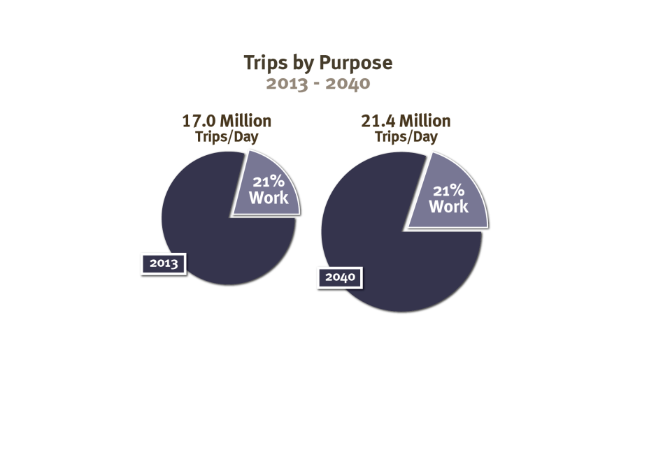
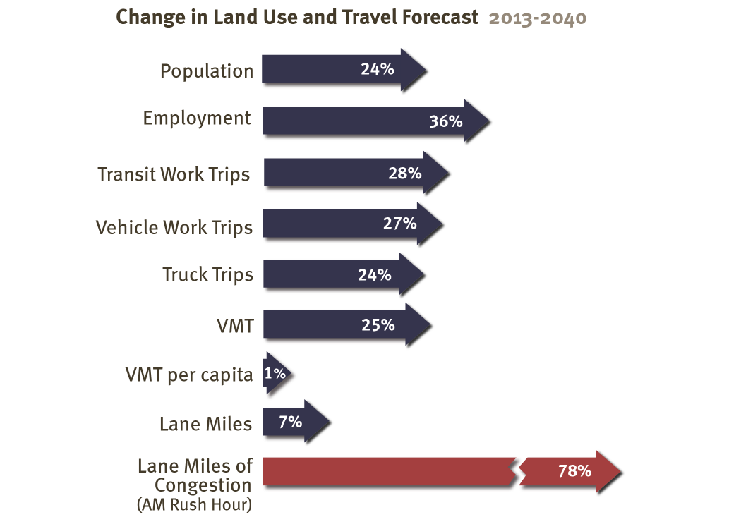
Travel Demand 2013 - 2040
In 2040 the total number of trips taken will increase by 4.4 million, or 26%.
Commute trips will continue to account for only 21% of all trips taken in the region.

Slide 9
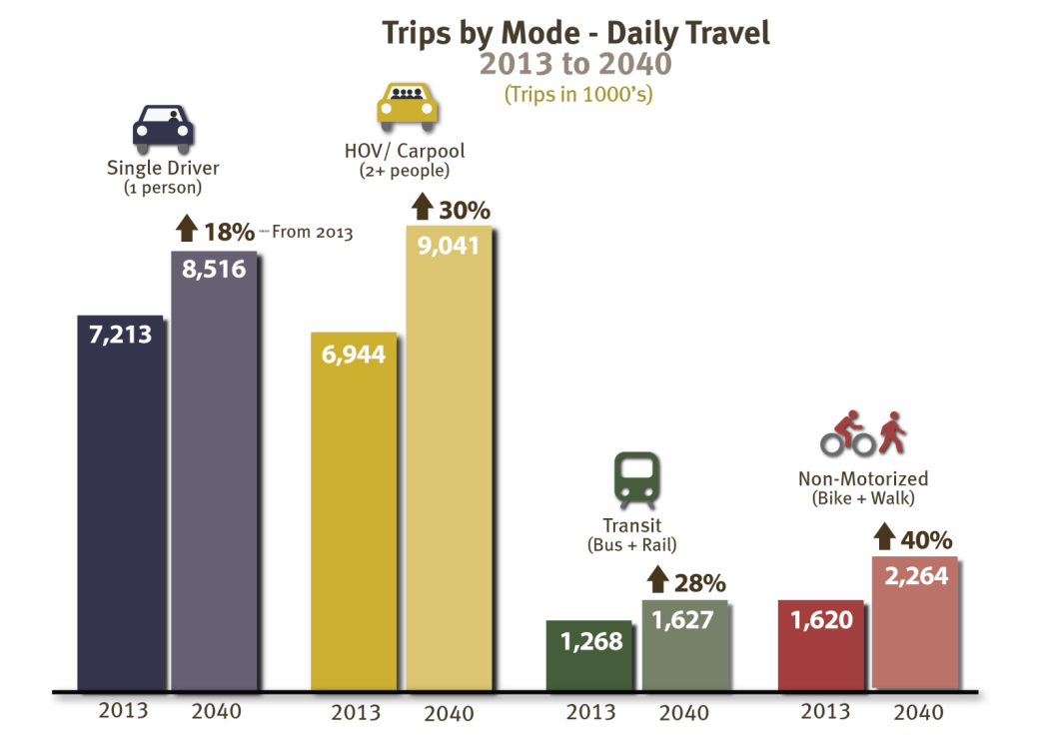
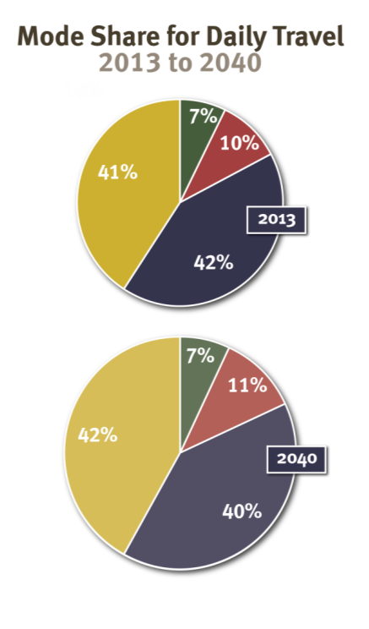
Daily Travel by Mode and Mode Share
2013 - 2040

Slide 10
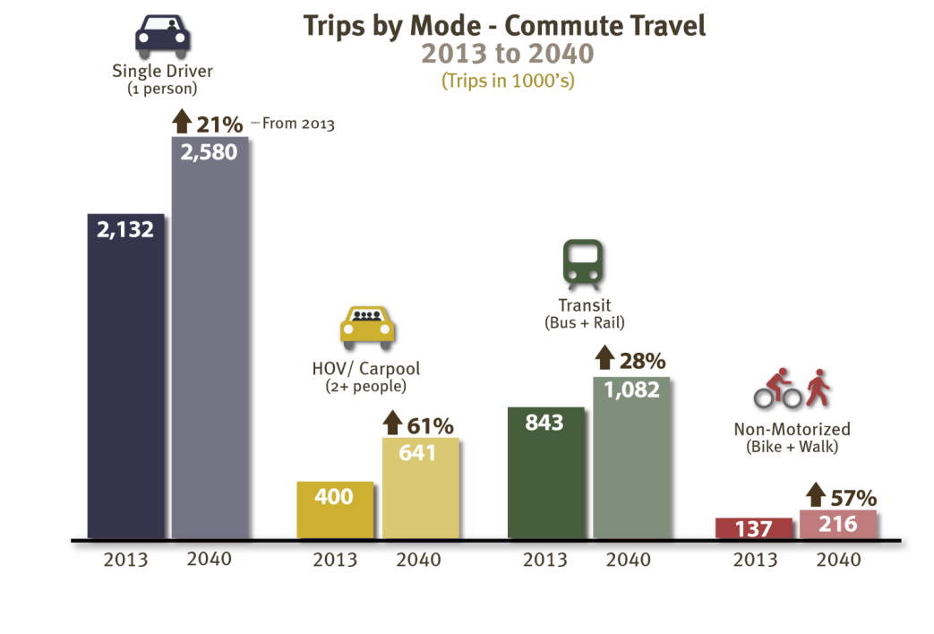
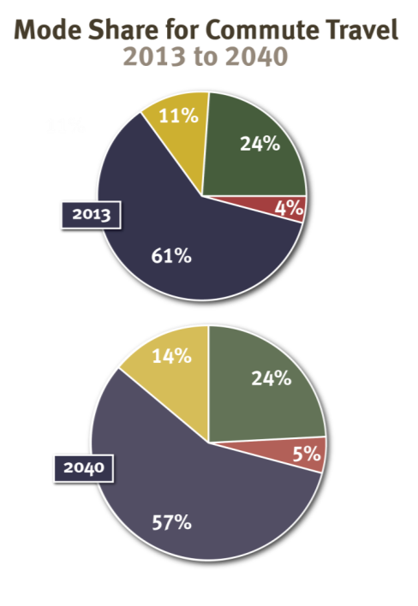
Commute Travel by Mode and Mode Share
2013 - 2040

Slide 11
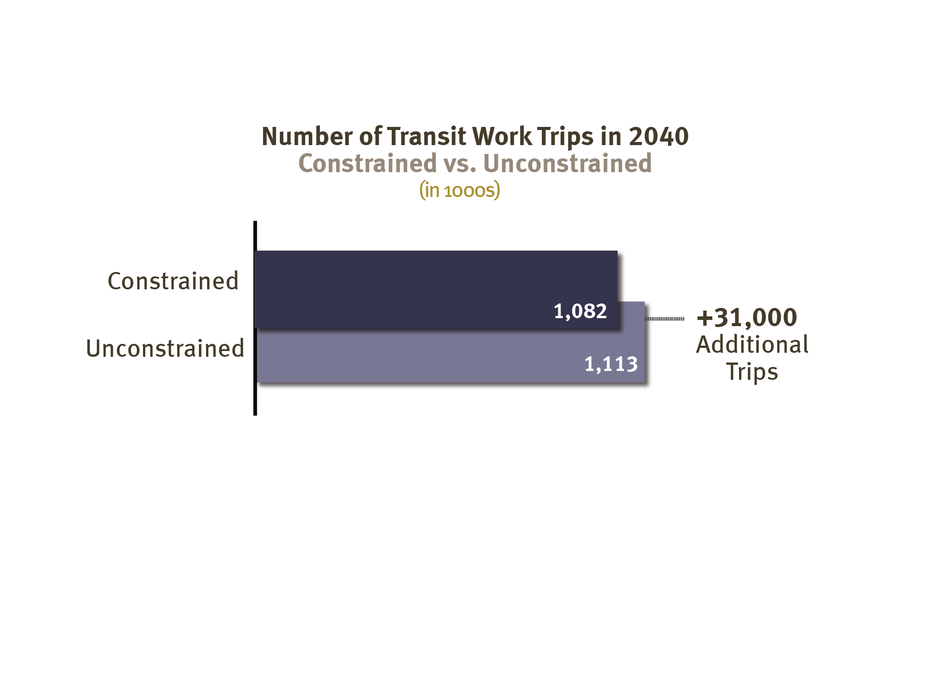
Unconstrained Transit
2013 - 2040
To address the lack of identified funding for WMATA’s future rehabilitation and maintenance needs beyond 2020, transit ridership to or through the core area was constrained to 2020 levels.
When this constraint on transit trips is lifted, there is an increase of 31,000 transit work trips in 2040. This brings the commute mode share for transit up to 24.5% from 24.0%.

Slide 12

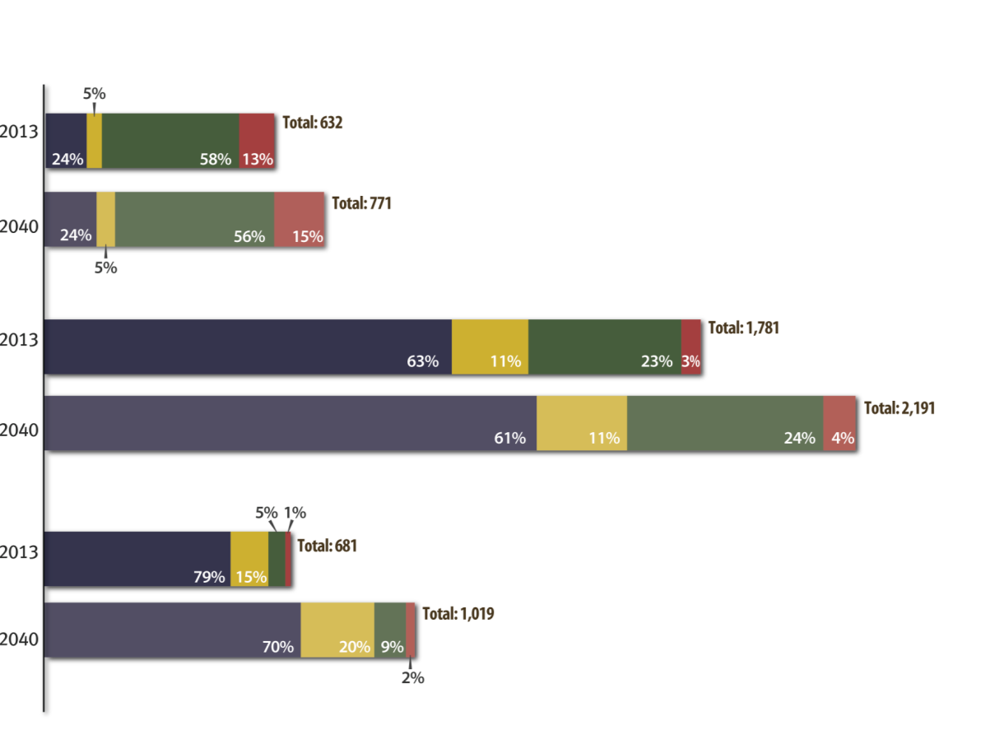

Commute Travel by Mode and Mode Share
For the Regional Core, Inner, and Outer Suburbs
(Total Trips in 1000’s)

Slide 13
Commute Mode Share 2010/2011
In Selected Neighborhoods
 |  | Drive Alone (SOV) | Carpool (HOV) | Transit | Walk | Bike | Other
Core | Logan Circle, DC | 21% | 4% | 28% | 33% | 10.6% | 2%
 | Crystal City, VA | 22% | 4% | 53% | 19% | 0.7% | 2%
Inner | Largo, MD | 70% | 11% | 13% | 3% | 2.8% | --
 | Reston, VA | 70% | 17% | 8% | 3% | 0.7% | 2%
Outer | Woodbridge, VA | 76% | 13% | 8% | 1% | 0.3% | 2%
 | Frederick, MD | 78% | 12% | 4% | 4% | 1.5% | --
Source: 2010/2011 Geographically Focused Household
Surveys reported to the TPB on May 16, 2012

Slide 14
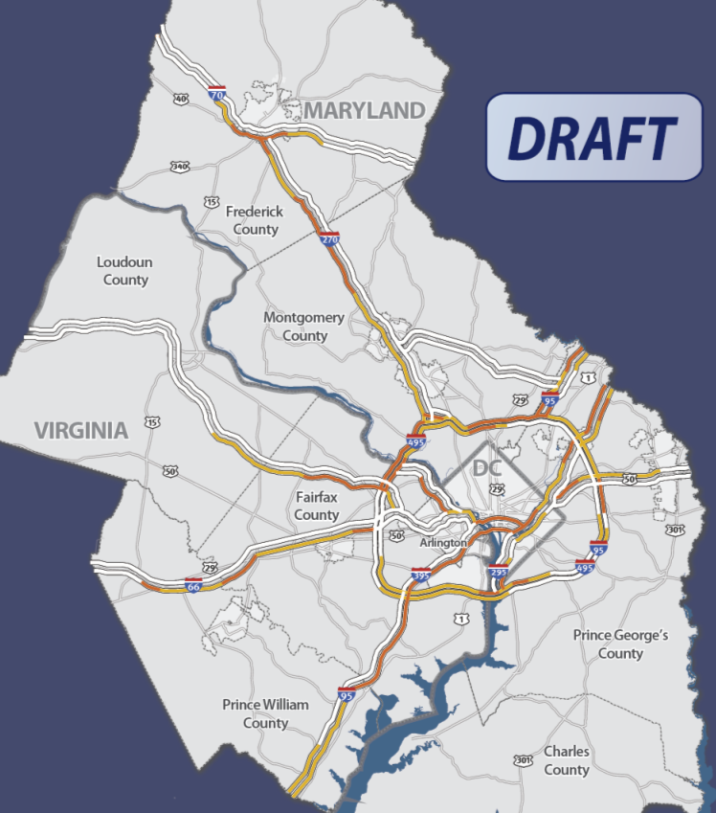
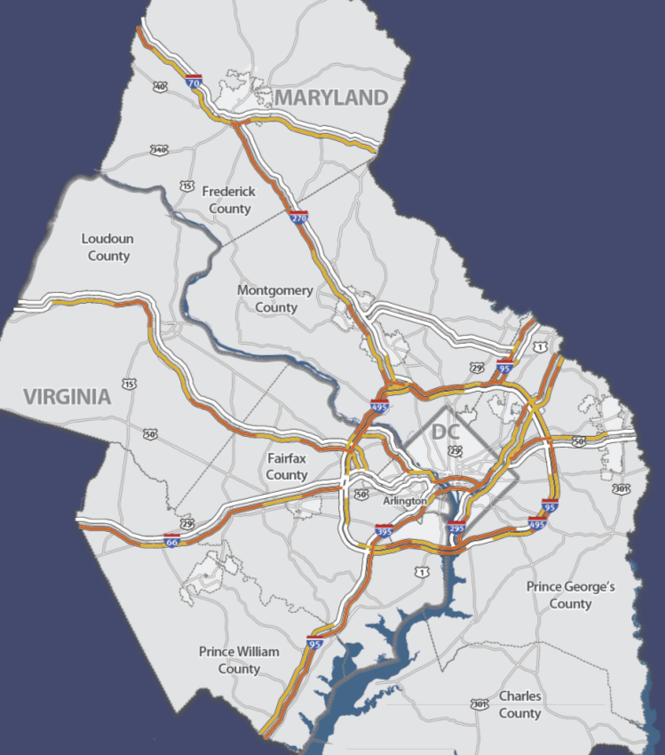
Highway Congestion 2013 - 2040
AM Rush Highway Congestion, 2013
AM Rush Highway Congestion, 2040
NOTE: I-95 and I-495 in VA illustrates only non-priced lanes. Priced lanes will have free flow traffic.

Slide 15
Highway Congestion 2013 - 2040
AM congestion is expected to increase throughout most of the region in 2040, particularly in the following outer jurisdiction locations:
    I-95 North in Prince William County
    I-70 East in Frederick County
    I-270 South in Frederick and Montgomery Counties
    I-66 East in Prince Williams and Fairfax Counties
    The Dulles Toll Rd. Eastbound in Loudoun and Fairfax Counties
Congestion will also increase inside the Capital Beltway along I-395 North, I-295/MD-295 North, and the George Washington Memorial Parkway; however I-66 is expected to be uncongested due to planned HOV-3 restrictions.
While the Capital Beltway is expected to be more congested in most locations, congestion along the inner and outer loops in Fairfax County will be somewhat reduced due to the Express Toll Lanes.

Slide 16
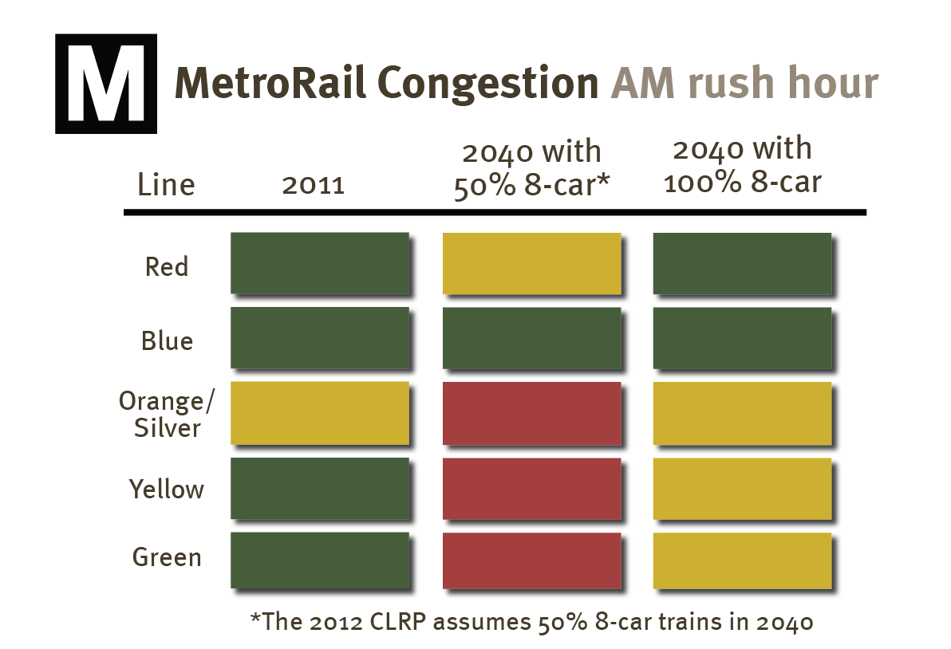
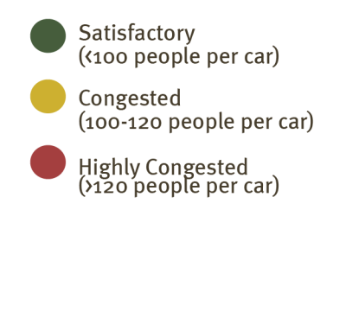
Transit Congestion 2013 - 2040
The Metrorail system will likely reach capacity on trips to and through the regional core, due to lack of funding for capacity enhancements.
Without additional railcars beyond those currently funded, all lines entering the core will become congested by 2040.

Slide 17
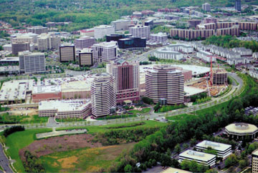
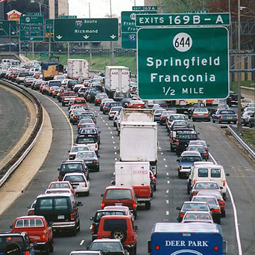
Accessibility to Jobs
What is Job Accessibility?
Accessibility
+
=
[Number of Jobs Within 45 Minute Commute]
Location of Jobs
Travel Time
(by auto or transit)
Jobs are considered to be accessible if they are within a 45 minute commute range.

Slide 18
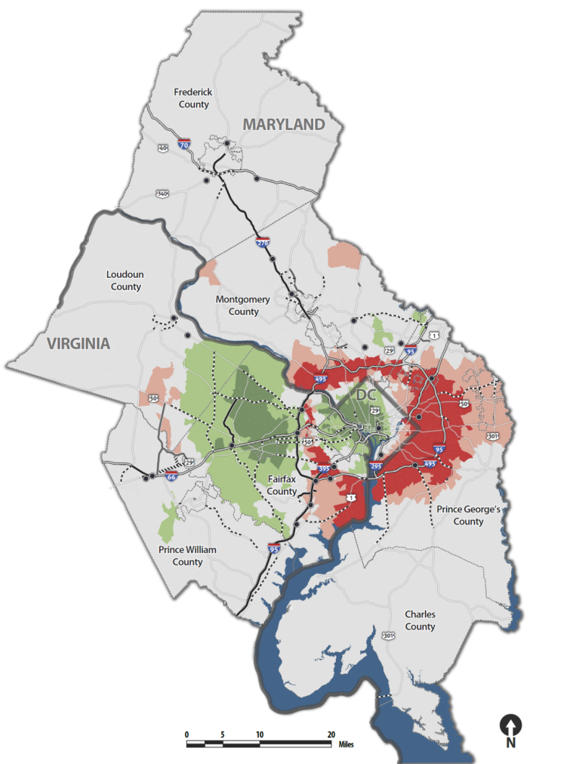
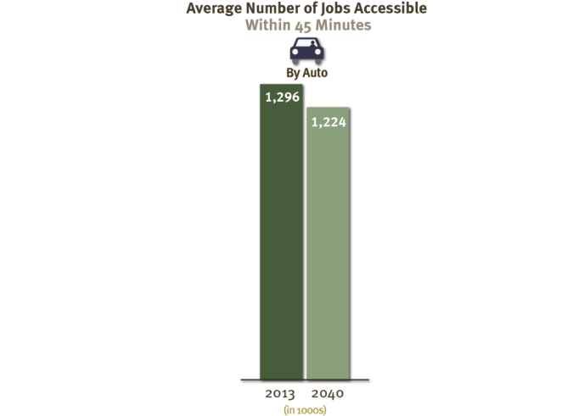
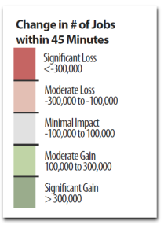
Accessibility to Jobs by Auto
2013 - 2040
The average number of jobs accessible within a 45 minute automobile commute is expected to go down slightly.
The greatest reductions in job accessibility are expected to be on the eastern side of the region, due to increases in congestion system-wide and a higher concentration of future jobs on the west side.

Slide 19
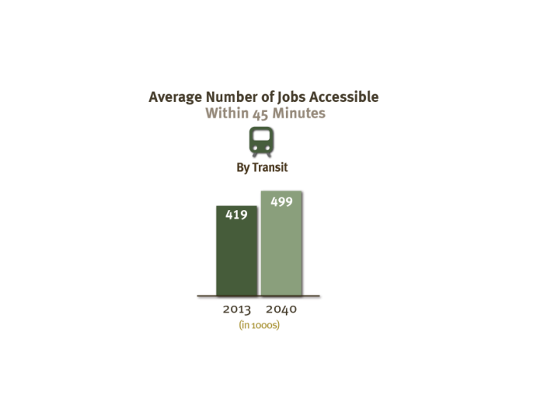
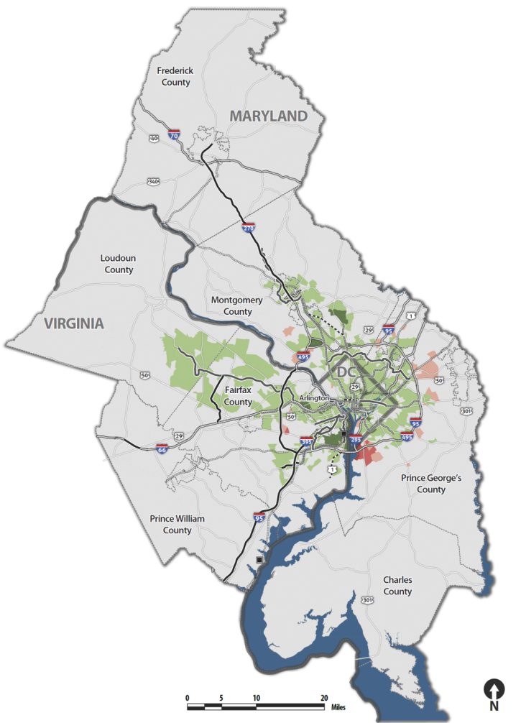
Accessibility to Jobs by Transit
2013 - 2040
Average accessibility by transit is forecast to increase, but will remain significantly lower than by automobile.

Slide 20
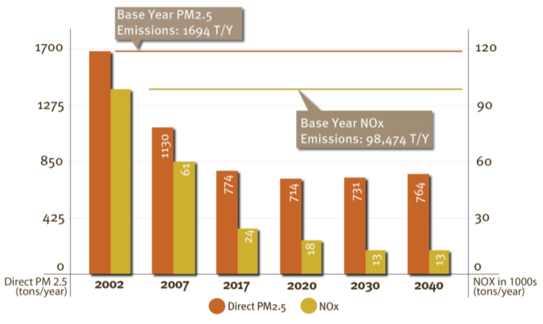
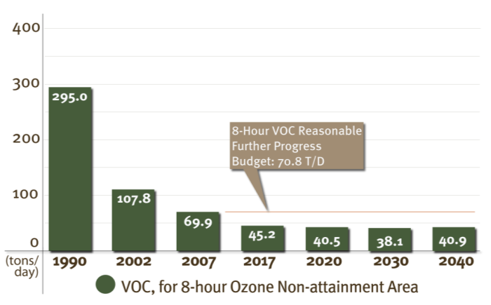
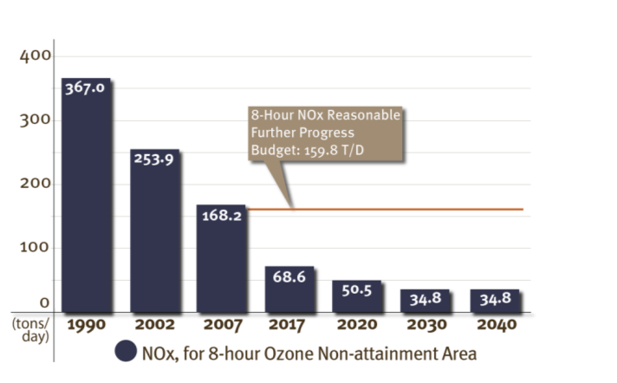
Air Quality
2013 - 2040
PM2.5 Direct and
Precursor NOx emissions
The CLRP shows substantial reductions in all three main pollutants through 2020, with a very small uptick between 2030 and 2040.
Estimated emissions are well within the approved budget for each pollutant through 2040.
Mobile Source VOC Emissions
Mobile Source NOx Emissions

Slide 21
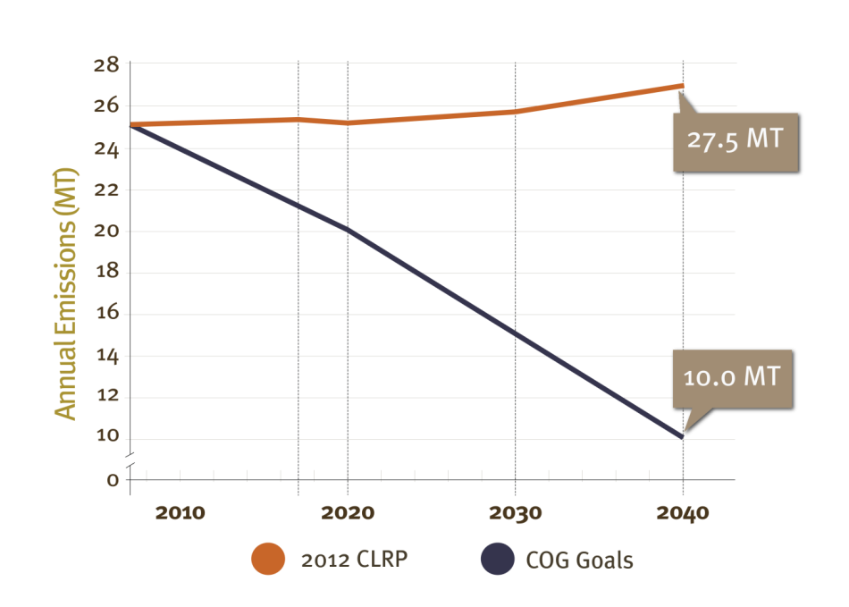
Air Quality – Carbon Dioxide (CO₂)
2013 - 2040
Carbon Dioxide (CO₂) Emissions
The regional target for carbon dioxide emissions is far from being met: emissions are projected to increase between 2010 and 2040.
However, when new federal fuel economy standards are included, it is expected that CO2 emissions estimates will decrease over time.

Slide 22
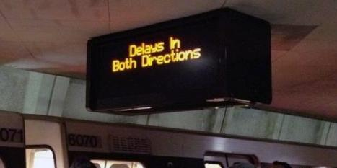
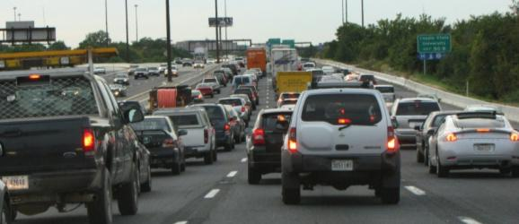
Regional Challenges Highlighted by the 2012 CLRP
Metrorail Repair Needs: Funding to address deferred Metrorail maintenance needs is committed only through 2020.
Roadway Congestion: The region’s roadways will remain among the most congested in the nation, limiting travel options for people and goods.

Slide 23
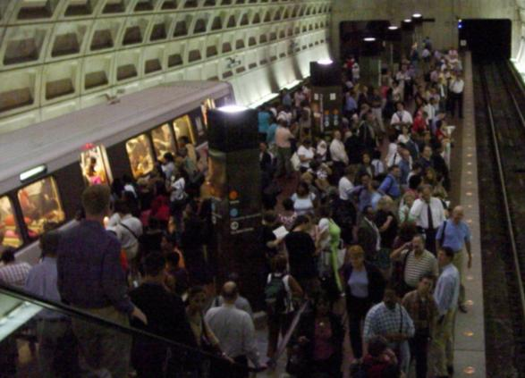
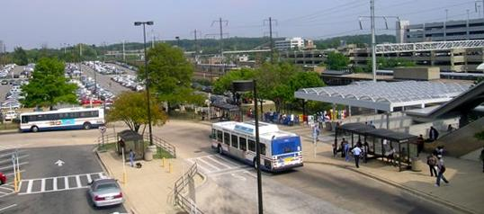
Regional Challenges Highlighted by the 2012 CLRP
Transit Congestion: The Metrorail system will experience increasingly severe crowding problems, and lack the capacity to support forecasted population and employment growth.
Housing & Job Location: Most housing and many of the region’s jobs will continue to be located far outside of activity centers in locations with limited travel options.

Slide 24
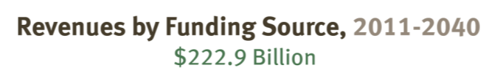
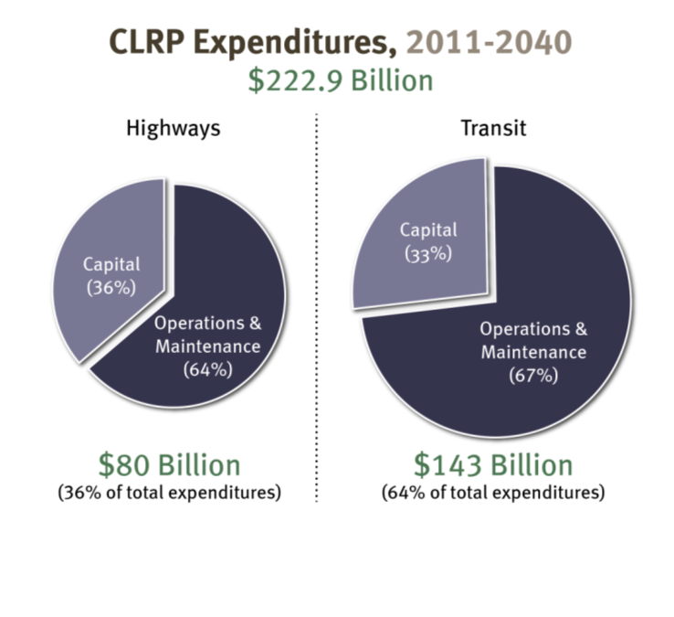
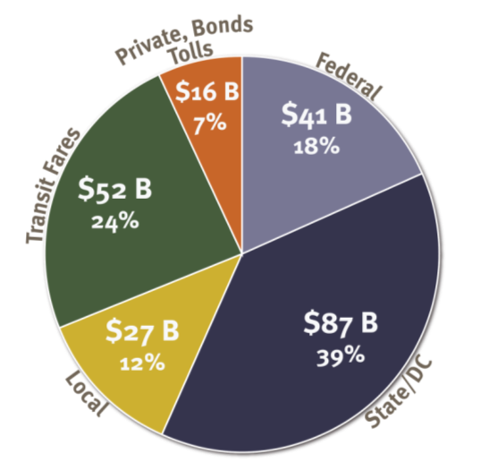
CLRP Funding and Expenditures

Slide 25
Addressing the Challenges Highlighted by the 2012 CLRP
Obtain additional funding for both transit and roadways
  Transit:
    Funding for Metrorail maintenance and rehabilitation needs beyond 2020
    Funding to expand Metrorail capacity through 8-car trains and other measures
  Roadways:
    Sufficient funding to support both road and bridge maintenance requirements and the capacity improvements needed to accommodate a growing region
Improve coordination of transportation and land-use
  Take advantage of the many untapped opportunities for mixed-use development near existing rail stations
  Concentrate more of the region’s housing and employment growth in activity centers and other areas with good transportation options
  Address the imbalance between the east and west sides of the region

