Slide 1
EPA Proposal to Revise the National Ambient Air Quality Standard for Ozone
MWAQC
January 27, 2010

Slide 2
EPA Proposal
On January 6, 2010 EPA proposed to revise the 2008 8-Hour Ozone Standard
Existing 2008 8-Hour Ozone Standard = 0.075 parts per million (ppm)
Proposed revised 8-Hour Ozone Standard = Anywhere between 0.060 - 0.070 parts per million (ppm)
EPA is also proposing to update the Air Quality Index (AQI) for ozone.

Slide 3
Reasons for Revision of Standard
EPA’s proposal to revise the 2008 ozone standard is based on following key scientific evidence:
Evidence from clinical studies showing adverse respiratory effects in healthy adults at 0.060 ppm;
Evidence from clinical and epidemiological studies indicating that people with asthma are likely to experience larger and more serious effects than healthy people;
Epidemiological evidence indicating associations for a wide range of serious health effects and hospital admissions and premature mortality, that extend below the current standard level of 0.075 ppm; and
Estimates from the risk and exposure assessment indicating that important improvements in public health could be achieved by a standard more stringent than 0.075 ppm.

Slide 4
Comments on Proposal
Proposed revised ozone standard published in Federal Register on January 19, 2010
Comment period ends: March 22, 2010
3 Public hearings:
  Arlington – Feb 2, 2010
  (Hyatt Regency Crystal City @ Reagan National Airport, Washington Room (located on the Ballroom Level), 2799 Jefferson Davis Highway, Arlington, Virginia 22202)
  Houston – Feb 2, 2010
  Sacramento – Feb 4, 2010

Slide 5
Proposed Implementation Schedule
Milestone | 2008 Ozone Standard | 2010 Ozone Standard
Signature—Final Rule | March 12, 2008 | August 31, 2010
State Designation Recommendations to EPA | No later than March 12, 2009 | January 2011
Final Designations | No later than March 12, 2010* | Effective no later than August 2011
Attainment Demonstration SIPs Due | 2013* | December 2013
Attainment Dates | 2013-2030 (depends on severity of problem) | 2014-2031 (depends on severity of problem)

Slide 6
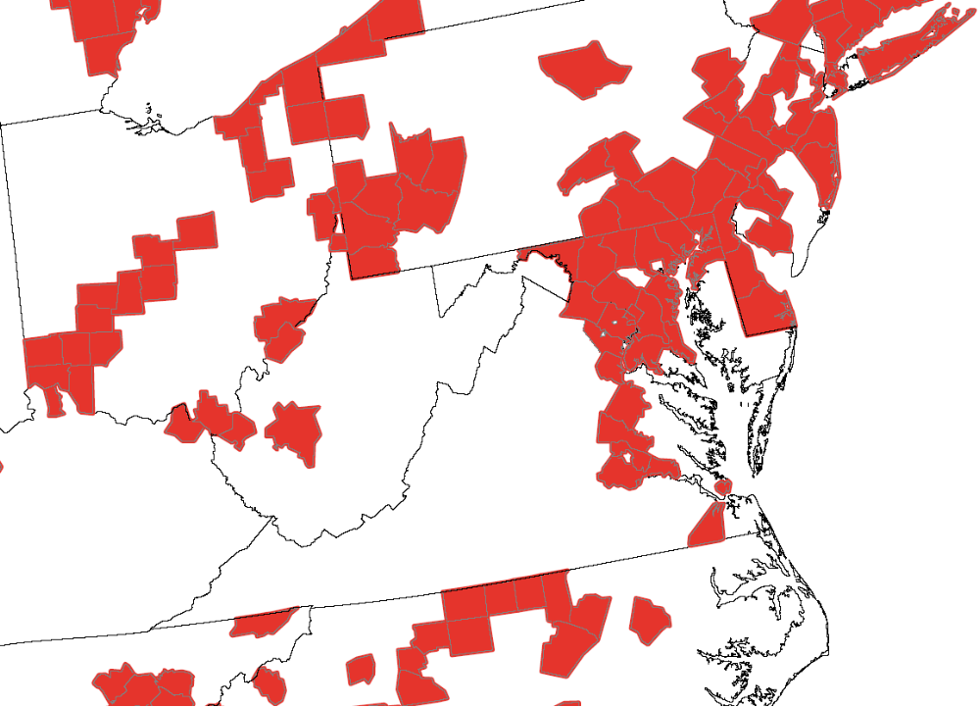
Counties Violating 2008 Ozone Standard
(0.075 ppm)
DC-MD-VA Counties
Washington, DC
Maryland
Montgomery, Prince George’s,
Charles, Calvert, Fredrick, Ann Arundel, Washington, Carroll, Baltimore, Hartford, Cecil, Kent
Virginia
Arlington, Fairfax, Alexandria city, Loudoun, Prince William, Stafford, Caroline, Hanover, Henrico, Chesterfield, Charles city, Hampton city, Suffolk city
Nonattainment Area for 1997
Ozone Standard (0.08 ppm)
* This analysis is based on 2006-08 data. Nonattainment designation for 2010 ozone standard is likely based on 2008-10 data.

Slide 7
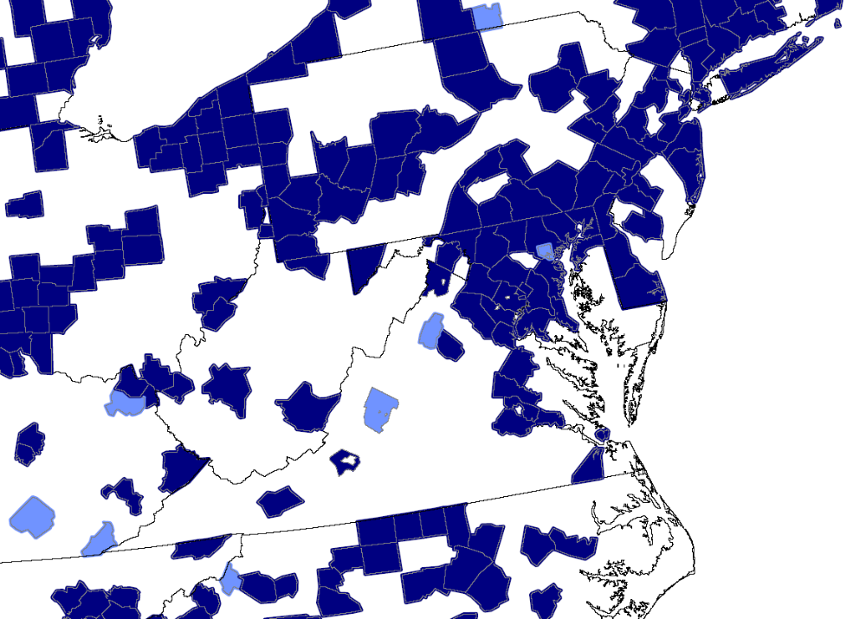

Counties Violating Proposed 2010 Ozone Standard
(0.060 – 0.070 ppm)
Additional DC-MD-VA Counties
Maryland
Garrett, Baltimore city
Virginia
Berkeley, Fredrick, Madison, Roanoke, Wythe, Page, Rockbridge
Counties violating 0.070 ppm standard
Counties violating 0.065 ppm standard
Counties violating 0.060 ppm standard
* This analysis based on 2006-08 data. Nonattainment designation is likely based on 2008-10 data.

Slide 8
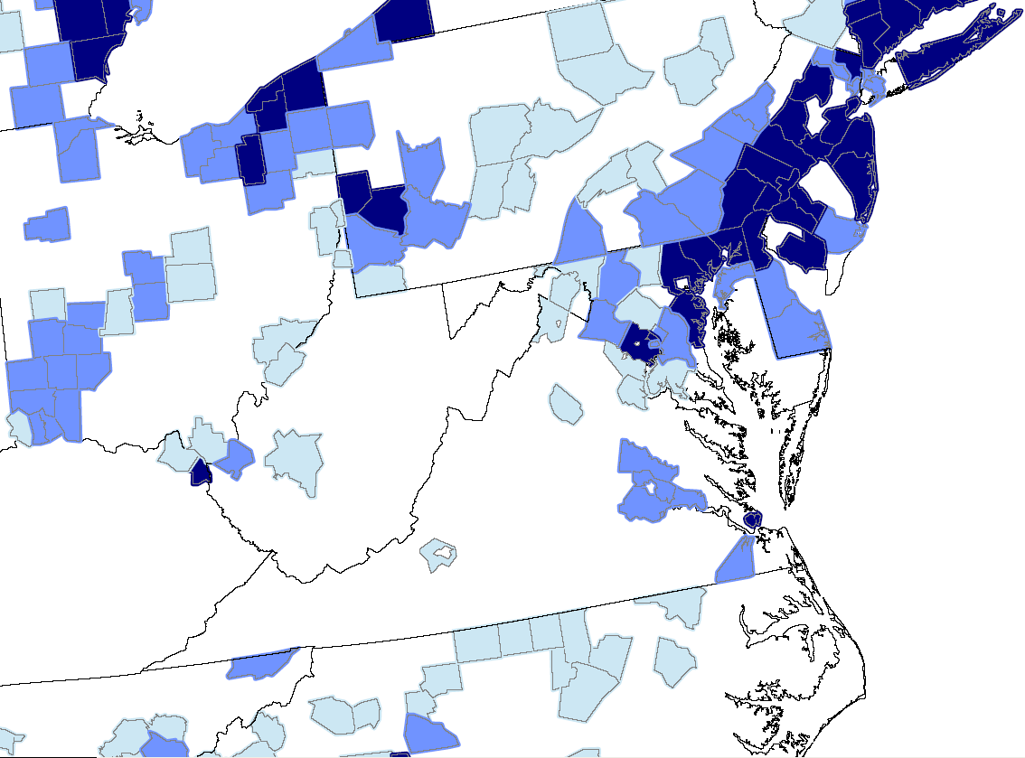
Counties Projected to Violate Proposed 2010 Ozone Standard in 2020
(0.060 – 0.070 ppm)
DC-MD-VA Counties
Washington, DC
Maryland
Montgomery, Charles, Prince George’s, Fredrick, Kent , Ann Arundel, Baltimore, Hartford, Cecil, Washington, Carroll, Berkeley
Virginia
Arlington, Fairfax, Alexandria city, Stafford, Loudoun, Prince William, Hanover, Henrico, Chesterfield, Charles city, Suffolk city, Hampton city, Madison, Roanoke, Fredrick
Counties violating 0.070 ppm standard
Counties violating 0.065 ppm standard
Counties violating 0.060 ppm standard
Notes:
Controls: CAIR, CAMR, CAVR, Nonroad diesel rule, Tier 2 rule, Heavy-duty diesel rule, Proposed locomotive, marine vessels, small spark-ignition engine rules, State mobile & stationary source controls for existing PM 2.5 & ozone standards.

