Slide 1
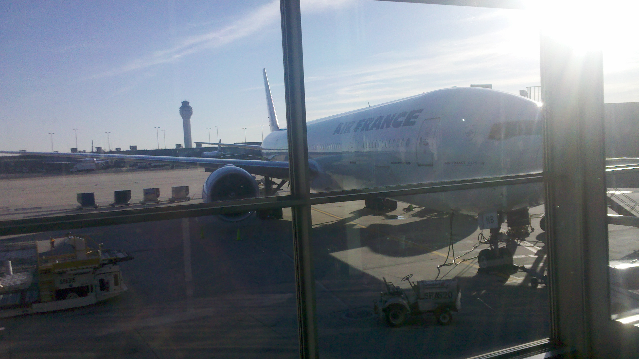
Transportation and Air Traveler Characteristics Findings from the 2011 Washington-Baltimore Regional Air Passenger Survey
Transportation Planning Board
December 19, 2012
Rich Roisman
DTP Staff

Slide 2
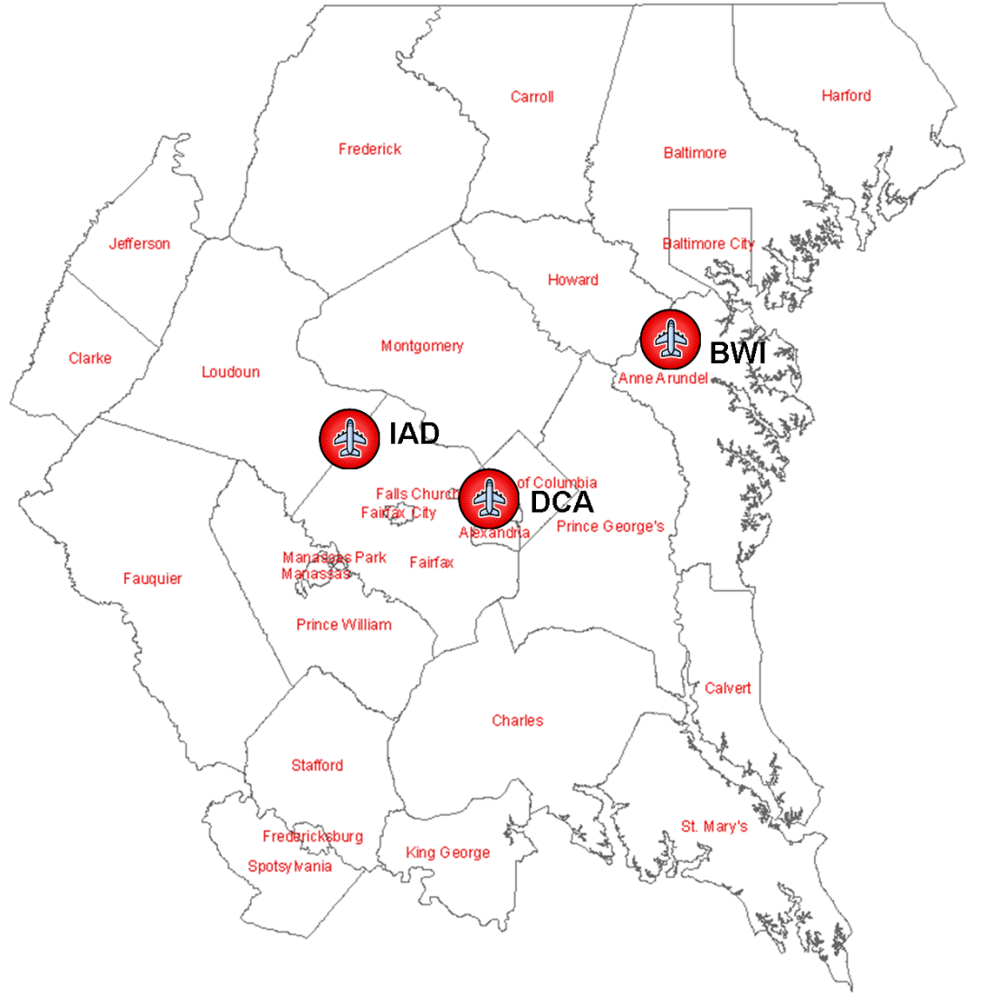
Regional Air Passenger Survey Overview
Current data to support planning for airport facilities and services
Survey every two years at region’s three commercial airports
Random sample of domestic and international flights during two-week survey period in late October / early November
Passengers surveyed at departure gates while waiting to board flights
Approximately 40% of surveyed passengers completed and returned a survey questionnaire
1

Slide 3
Regional Air Passenger Enplanements Trend (2000 – 2011)
2

Slide 4
More than 32 million air passengers boarded flights at the region’s commercial airports in 2011
3
Notes:
For 2011, all three of the airports rank in the top 30 nationally for enplanements

Slide 5
Locally Originating vs. Connecting Passengers
Connecting passengers account for:
35% of IAD enplanements
22% of BWI enplanements
12% of DCA enplanements
4
Notes:
Local originations access the airport using the regional surface transportation network

Slide 6
Trip Origins of Locally Originating
Air Passengers
Originating at a private residence:
67% for BWI and IAD
50% for DCA
Originating at a hotel or motel:
21% for BWI
26% for IAD
33% for DCA
Originating at a place of business:
10% at BWI
8% at IAD
14% at DCA
Regional
5

Slide 7
Air Passenger Mode of Travel to Airport
Mode of Access in 2011
Usage of private and rental cars:
78% at BWI
68% at IAD
43% at DCA
Use of taxis:
6% at BWI
17% at IAD
31% at DCA
Use of rail service:
16% at DCA by Metrorail (among highest in the nation)
2% at BWI by MARC/AMTRAK service
6
Notes:
DCA most preferred airport by travelers because of its convenient access to most of the region’s commercial centers and visitor destinations

Slide 8
Air Passenger Trip Purposes
Compared to 2009:
Business travel up to 44% from 38%
Government-related business up from 18% to 20%
Non-government related business up from 20% to 24%
Vacation trips down from 24% to 21%
School trips down from 5% to 3%
Trip Purpose in 2011
7

Slide 9
Factors Influencing Airport Choice by Trip Purpose
 | Business | Non-Business | All
Closest airport | 62% | 55% | 58%
Better public ground transportation | 2% | 2% | 2%
Better access roads and parking | 2% | 3% | 2%
More convenient flight times | 7% | 6% | 7%
Only airport with direct flight | 7% | 6% | 7%
Less expensive airfare | 9% | 19% | 14%
Frequent flyer with specific airline | 3% | 3% | 3%
Only airport serving market | 2% | 2% | 2%
Other | 5% | 4% | 4%
8

Slide 10
Factors Influencing Airport Choice for Business Travelers – by Airport
 | BWI | DCA | IAD | All
Closest airport | 60% | 74% | 47% | 62%
Better public ground transportation | 0% | 5% | 0% | 2%
Better access roads and parking | 3% | 1% | 2% | 2%
More convenient flight times | 6% | 7% | 9% | 7%
Only airport with direct flight | 4% | 3% | 15% | 7%
Less expensive airfare | 18% | 3% | 8% | 9%
Frequent flyer with specific airline | 3% | 2% | 6% | 3%
Only airport serving market | 2% | 1% | 5% | 2%
Other | 4% | 4% | 7% | 5%
9
Notes:
The three points they make are:
DCA is highly preferred by business travelers for its accessibility and good public ground transportation
Less expensive airfares attract significant numbers of both business and non-business air travelers to BWI -- Southwest Airlines has 57% market share
The number of markets served and the wide availability of direct flights to these markets are important airline service attributes influencing air passengers to choose IAD for their travel to and from our region.
US Airways market share at DCA (9/2012) is 43%

Slide 11
Factors Influencing Airport Choice for
Non-Business Travelers – by Airport
 | BWI | DCA | IAD | All
Closest airport | 57% | 63% | 47% | 55%
Better public ground transportation | 1% | 5% | 0% | 2%
Better access roads and parking | 3% | 2% | 3% | 3%
More convenient flight times | 5% | 6% | 7% | 6%
Only airport with direct flight | 4% | 4% | 12% | 6%
Less expensive airfare | 24% | 14% | 16% | 19%
Frequent flyer with specific airline | 2% | 2% | 5% | 3%
Only airport serving market | 2% | 1% | 4% | 2%
Other | 3% | 3% | 6% | 4%
10

Slide 12
FAA Forecast Increase in
Regional Air Passengers
32.2 Million
Air Passengers
69.0 Million
Air Passengers
Source: FAA Terminal Area Forecasts, 2011
11
Notes:
There is also significant growth in air cargo movements forecast for BWI and Dulles; more than 200% increase in tonnage to 2040 and more than 500% increase in value of freight over same time period, according to USDOT.

Slide 13
Issues for the Future
By 2040, air passenger travel at the region’s three major airports is forecast to more than double, with most of the growth projected to occur at BWI and IAD
Significant air cargo growth forecast at BWI and IAD by USDOT
Continued growth in domestic and international air travel, especially business travel, and air cargo, is vitally important to the region’s economy
Improving ground access connections to BWI and IAD will be very important to the region’s future economic growth and prosperity
12
Notes:
Business travelers assign very high priority to convenient and quick, reliable ground access between the airport and their local destination in the region
Currently, DCA is the airport most preferred by travelers because of its convenient access to most of the region’s commercial centers and visitor destinations
Recent MWAA / Loudoun County initiative to double air cargo volume at Dulles over the next ten years; Dulles access to and from the north, south, and west identified as major issue
Update to Air Cargo Element of regional air system plan beginning second half of next year
Projects like the Wilson Bridge, Intercounty Connector (MD 200), 495 Express Lanes, and the Silver Line have improved or will improve access to the region’s airports.

