Slide 1

The 2012 Financially Constrained Long-Range Transportation Plan (CLRP) and the
FY 2013-2018 Transportation Improvement Program (TIP)
Item # 10
Transportation Planning Board – June 20, 2012

Slide 2
2012 CLRP & FY 2013-2018 TIP
Progress of the 2012 CLRP
and FY 2013-2018 TIP
Description of significant
changes and additions
Financial analysis of the
FY 2013-2018 TIP
Schedule for approval
of the CLRP and TIP

Slide 3
Progress of the CLRP & TIP
October 2011 – Call for Projects
January 12 – February 11 – Public comment period on projects submissions
February 15 – TPB approved project submissions for inclusion in Air Quality Conformity Analysis
Since February – air quality analysis and development of the FY 2013-2018 TIP
June 14 - Draft CLRP, FY 2013-2018 TIP and Conformity Assessment released for 30-day public comment period

Slide 4
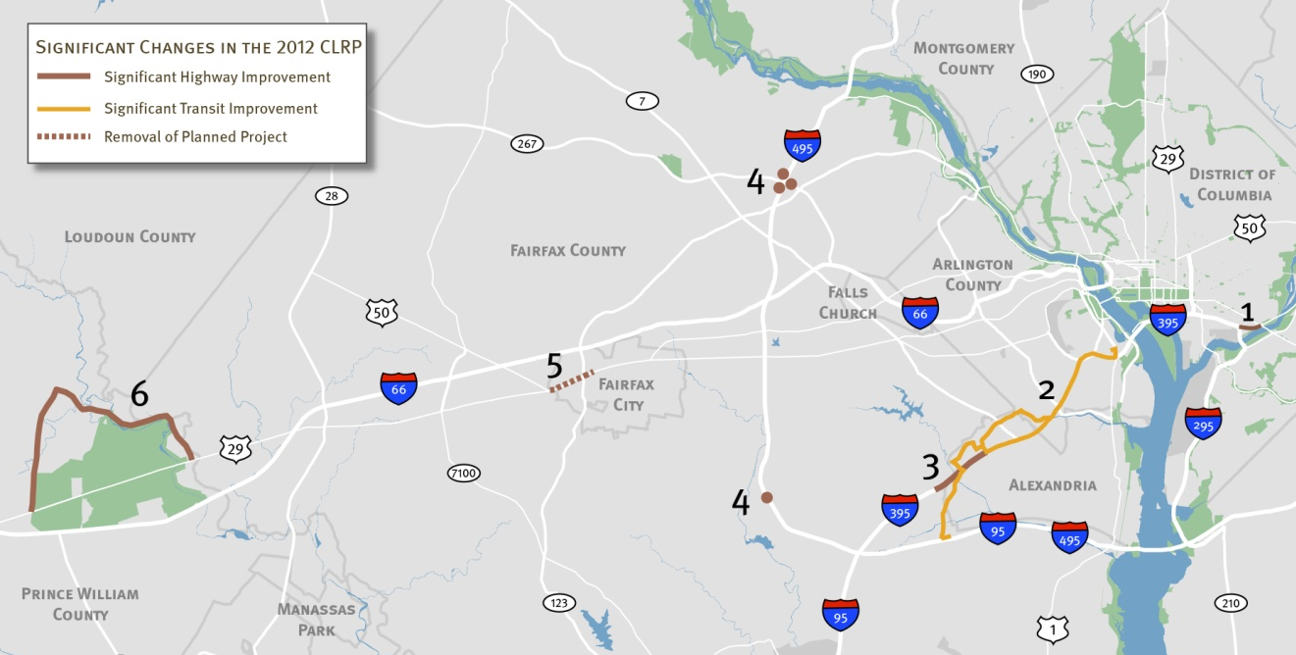
Significant Additions and
Changes to the 2012 CLRP
Create Southeast Boulevard from
11th Street Bridge to Barney Circle
Bus Rapid Transit from Van Dorn Metro Station to Pentagon Metro Station
I-395 Auxiliary Lane, northbound from Duke Street to Seminary Road
Date Change on I-495 HOT Lanes Interchanges (2030 2013)
Remove Widening of US 29 from US 50 to Eaton Place in the City of Fairfax
Construct Manassas National Battlefield Park Bypass

Slide 5
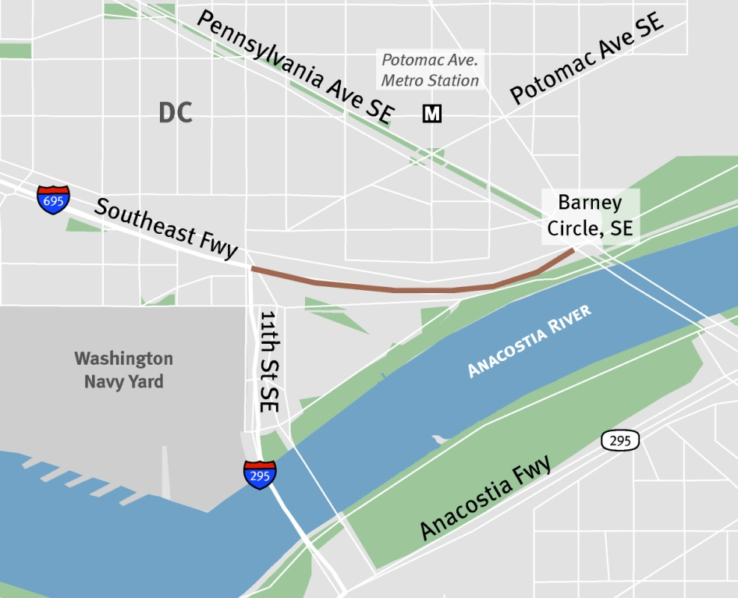
1. Create Southeast Boulevard from
11th Street Bridge to Barney Circle
Once the 11th Street SE Bridge fully connects I-695 (Southeast Freeway) and I-295 in both directions, the segment between 11th Street SE and Barney Circle/ Pennsylvania Avenue will become obsolete. This project proposes to convert that segment of the Southeast Freeway to an urban boulevard, connected to Barney Circle, with an at-grade intersection.
Complete: 2015
Length: 0.5 mile
Cost: $80 million
Funding: Federal, Local and Private

Slide 6
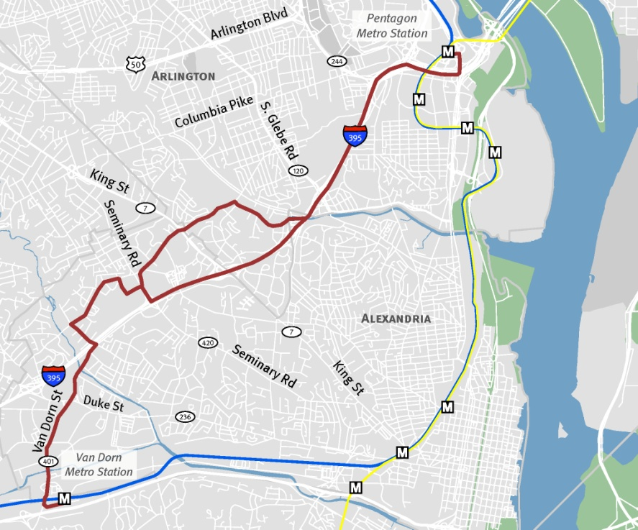
2. Bus Rapid Transit from Van Dorn
Metro Station to Pentagon Metro Station
This project will construct and operate a Bus Rapid Transit (BRT) service that will connect the Van Dorn Metro Station to the Pentagon Metro Station via the Mark Center. The line will split into two spurs at the Mark Center. The BRT spur will continue north on Beauregard Street, serving the Northern Virginia Community College at Braddock Road, turn east on S. Arlington Mill Drive to serve the Shirlington Transit Center, then continue on I-395 to the Pentagon. A separate rapid bus spur will travel on the I-395 HOV lanes from the Mark Center directly to the Pentagon.
The BRT alignment will operate in dedicated lanes where possible, and may include additional elements such as pre-board payment, transit signal priority, improved bus shelters/stops, and branded vehicles. The rapid bus alignment will contain some of the same features as BRT but will operate in shared lanes. Buses will run every 7.5 minutes during peak periods.
Complete: 2016
Length: 6.5 miles
Cost: $100 million
Funding: Federal, Local and Private

Slide 7
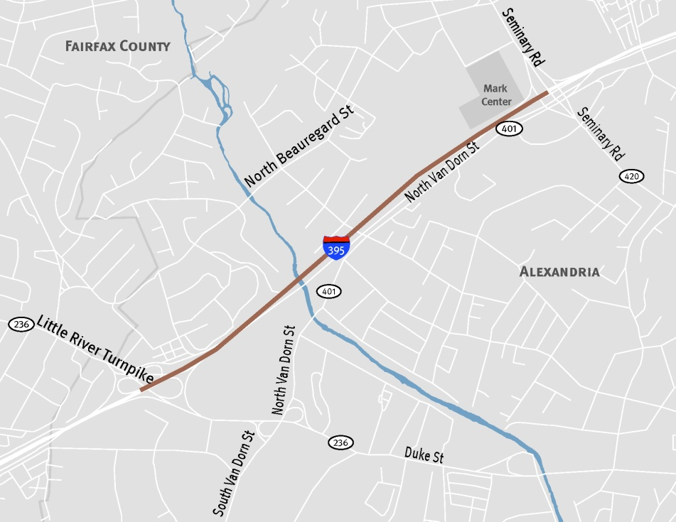
3. I-395 Auxiliary Lane, Northbound from Duke Street to Seminary Road
This project will construct an auxiliary lane on northbound I-395 connecting the Duke Street on ramp to the off ramp at Seminary Road.
Complete: 2015
Length: 1 mile
Cost: $20 million
Funding: Federal and State

Slide 8
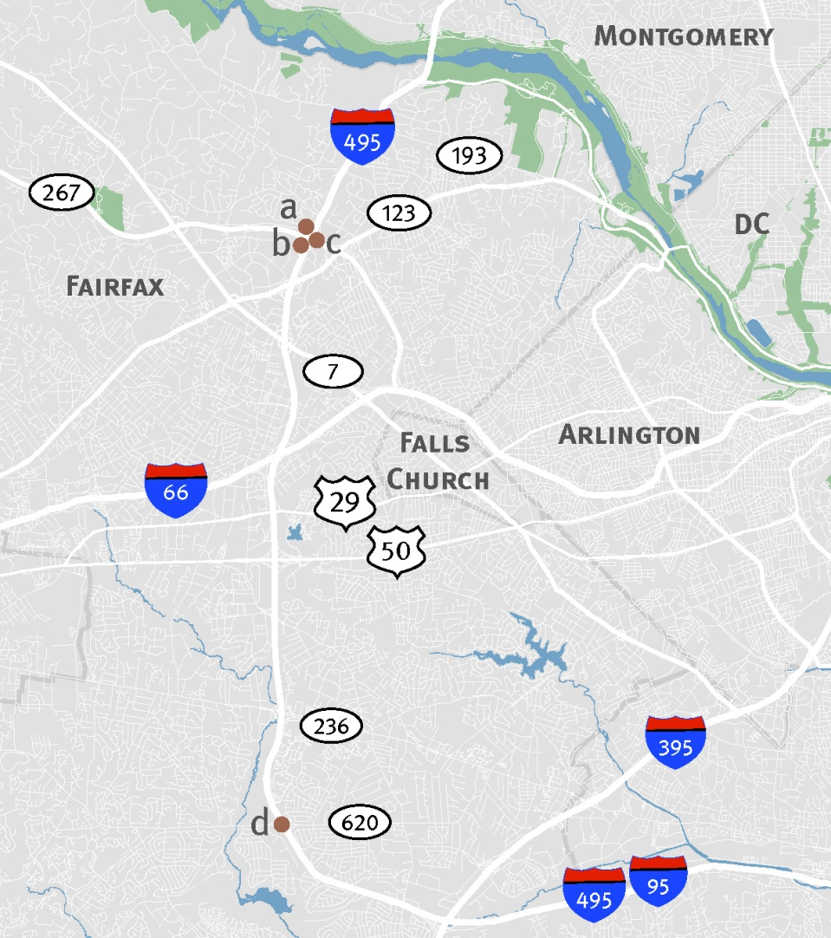
4. Date Change on
I-495 HOT Lanes Interchanges
The 2011 CLRP includes the widening of the Capital Beltway to include a system of HOT lanes from the American Legion Bridge to the Backlick Road Underpass. As part of the larger I-495 HOT lanes project, VDOT is proposing to advance the completion dates of four interchanges from 2030 to 2013:
a & b: Two interchanges at VA-267,
Dulles Toll Rd
c: One interchange at Dulles Airport Access Highway
d: One interchange at VA-620 (Braddock Rd)

Slide 9
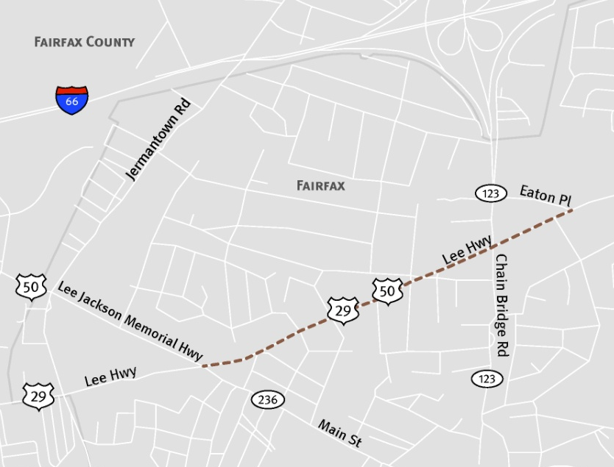
5. Remove Widening of US 29 from US 50 to Eaton Place
The 2011 CLRP includes the widening of US 29, Lee Highway from four to six lanes in the City of Fairfax between US 50 and Eaton Place. VDOT proposes to remove this project from the CLRP.
Complete: 2013, 2040
Cost: $30.2 million

Slide 10
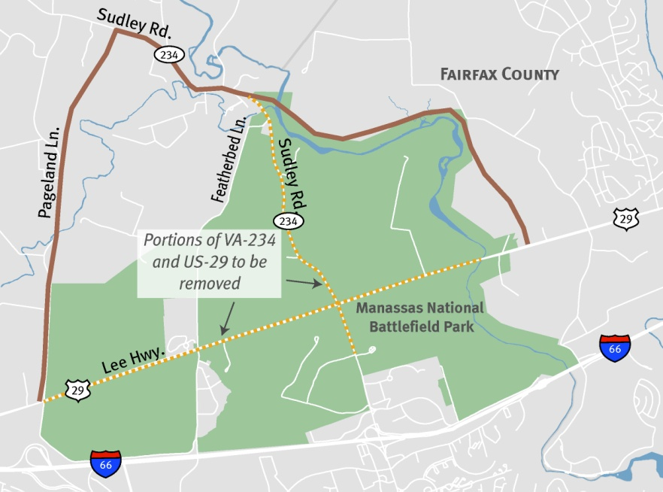
6. Construct the Manassas
National Battlefield Bypass
This project will construct a four lane bypass for US 29 to the north of the Manassas National Battlefield Park.
Two segments of the project are already included in the plan:
a portion of the Tri-County Parkway (improvements to Pageland Lane),
and widening of VA 234, Sudley Road.
The remaining portion will construct a new four lane facility from Sudley Road to east of the intersection of US 29 and Paddington Lane. Once the Bypass is complete, about four miles of US 29 and three miles of Sudley Road located inside the Park will be closed.
Complete: 2035
Length: 9 miles
Cost: $305 million
Funding: Federal, State and Local

Slide 11
FY 2013-2018 TIP
Six-year capital programming by state
DOTs, local agencies, WMATA and the TPB
355 projects
$15.77 billion
Interstate, Primary, Secondary, Bridge, Transit, Bike/Ped, Enhancements, ITS, CMAQ, TERMs, Maintenance
Formally updated every two years
Amended as necessary
Searchable database at mwcog.org/clrp

Slide 12
Comparison of Recent TIPs
Billions of $

Slide 13
FY 2013-2018 TIP by Source
6
7
1
5
4
2
3
$15.77 Billion

Slide 14
FY 2013-2018 TIP by Project Type
1
7
2
3
6
4
5
$15.77 Billion

Slide 15
Schedule for the 2012 CLRP
June 14 Public comment period began www.mwcog.org/tpbpubliccomment
July 14 Public comment period closes
July 18 TPB reviews comments and responses and is presented with the Draft CLRP, TIP and Conformity Assessment for adoption

